Slide 1
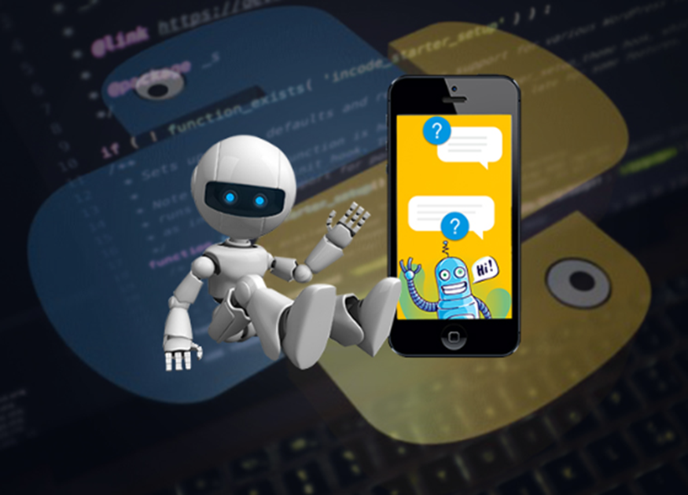
Multi-User Group Chat GUI Application

Slide 2

Represented By:
Suraya Ahlam

Slide 3
Introduction:
Chat Application provides communication between two parties i.e. sender and receiver.
The sender is someone who initiates and send a message to other known as receiver; receiver at other end, receives the message.
The main reason for the development of the chat application was the growth it provided for the marketing and purchase channels.

Slide 4
History:
In the early 1980s, Quantum Link or Q-Link was introduced by Commodore.
2000’s Skype and Yahoo chat room.
late 2000s Blackberry Messenger

Slide 5
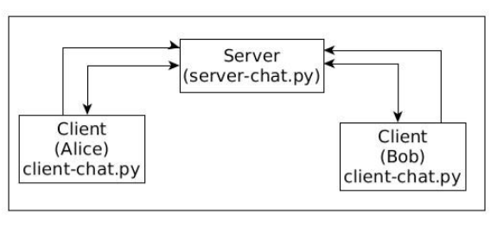
Workflow:

Slide 6
Modules:
Socket
Threading
Pyqt5
Client_ui
Connect_ui

Slide 7
Server.py
Server class
Connect to client
Receive message
Send message

Slide 8
Client.py
Client class
btn_connect_clicked()
show_message()
connect()
Send message
ReceiveThread()
receive_message()

Slide 9
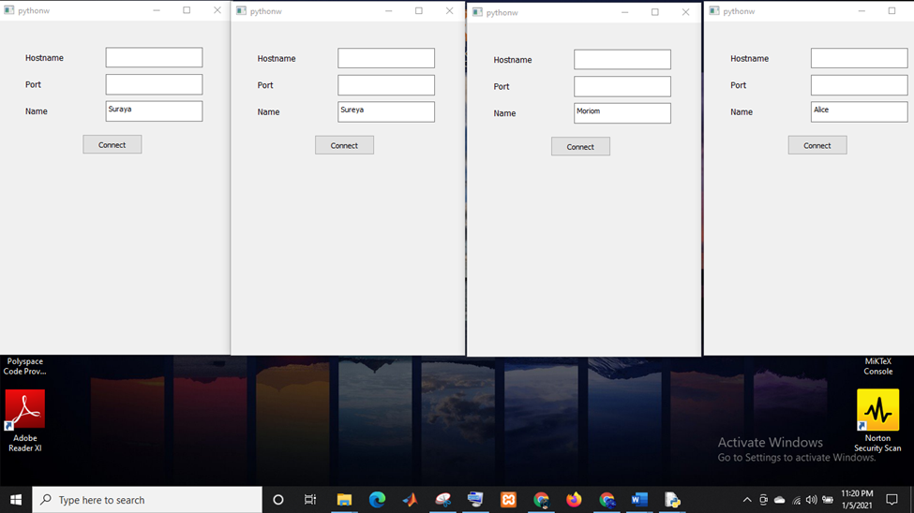

Slide 10
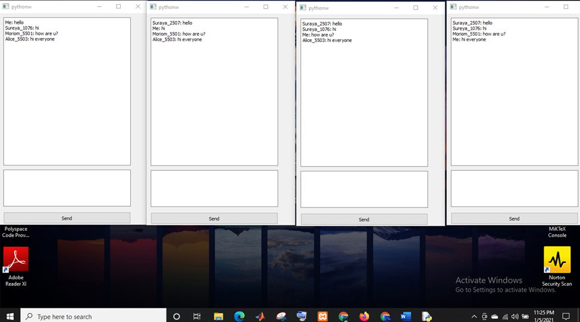

Slide 11
Limitations:
There are some limitations in our application. First it is not nicely designed. And we can only send text messages. No emojis or files or pictures or videos.

Slide 12
Future Work:
File transfer
Voice chat
Video chat

