Slide 1
Enhancing WordPress Blogs with Amazon Polly: A Text-to-Speech Plugin

Slide 2
INTRODUCTION
Amazon Polly is a cutting-edge text-to-speech service offered by Amazon Web Services (AWS). Launched in late 2016, it boasts a variety of voices and supports multiple languages.
Today, we're exploring the innovative intersection of Amazon Polly and WordPress.
Our focus is on introducing a groundbreaking WordPress plugin designed to bring audio versions to your blog posts.
Imagine extending the reach of your content beyond written words.
This plugin leverages Amazon Polly's capabilities to seamlessly convert text-based blog posts into immersive audio experiences.

Slide 3
Problem Statement
The project aims to address the need for enhanced accessibility and audience engagement on WordPress blogs by introducing a text-to-speech plugin leveraging Amazon Polly.
Many online content consumers face challenges in accessing written content, and traditional methods of engagement may not be inclusive for all audiences.
The existing gap in providing audio alternatives to written blog posts on WordPress platforms restricts the reach and impact of content creators.
The project seeks to bridge this gap by offering a seamless solution that integrates Amazon Polly's advanced text-to-speech capabilities with WordPress, providing users with high-quality audio versions of their written content.

Slide 4
Proposed Method
The plugin seamlessly integrates with WordPress, making it easy for users to install and configure.
The plugin utilizes Amazon Polly's text-to-speech capabilities to convert written content into audio files.
Users can easily configure the plugin settings within the WordPress Dashboard.
This includes specifying AWS credentials, choosing voices, setting sample rates, configuring player positions, and defining default options for new posts.
The solution provides flexibility in storing generated audio files.
Users can choose to store files alongside WordPress content or in Amazon S3, with optional support for content distribution through Amazon CloudFront.

Slide 5
Requirements
WordPress
Amazon Polly
Amazon s3
Cloud front
Lightsail

Slide 6
WordPress:
WordPress is a popular open-source content management system (CMS) that allows users to create and manage websites, including blogs. It provides a user-friendly interface for content creation and supports various plugins and themes to enhance functionality and design.
Amazon Polly:
Amazon Polly is a cloud service offered by Amazon Web Services (AWS) that converts text into lifelike speech. It provides a variety of voices and language options, allowing developers to integrate text-to-speech capabilities into their applications, services, or, as in this case, WordPress blogs.
Amazon S3 (Simple Storage Service):
Amazon S3 is a scalable and secure object storage service provided by AWS. It allows users to store and retrieve any amount of data from anywhere on the web. In the context of the blog post, Amazon S3 is used to store the generated audio files (in MP3 format) alongside the WordPress content.

Slide 7
CloudFront:
Amazon CloudFront is a content delivery network (CDN) service provided by AWS. It accelerates the delivery of content (such as images, videos, and audio) to users by caching the content at edge locations around the world. In the context of the blog post, CloudFront is used to distribute the audio files, ensuring faster and more efficient delivery to users.
Lightsail:
Amazon Lightsail is a simplified and easy-to-use cloud service that enables users to launch and manage virtual private servers (VPS) with pre-configured application stacks. In the blog post, Lightsail is mentioned as a platform for hosting the WordPress blog. It simplifies the process of setting up and managing servers, making it accessible to users without extensive technical expertise.

Slide 8
Procedure
Prepare WordPress Environment:
If don't have a WordPress-powered blog, set it up on your server or using a service like Amazon Lightsail.
Launch a Lightsail instance with the WordPress 4.8.1 blueprint.
Obtain AWS Credentials:
Access your login credentials through the WordPress Dashboard.
Go to the IAM Console to create a new policy that allows the plugin to access specific S3 and Polly functions.
Create an IAM user for programmatic access and attach the policy.
Install the Amazon Polly Plugin:
Download the Amazon Polly plugin ZIP file from the WordPress Plugins site.
In the WordPress Dashboard, go to Plugins > Add New > Upload Plugin, and select the ZIP file.
Install the plugin and activate it.

Slide 9
Procedure
Configure the Plugin:
In the WordPress Dashboard, go to Settings > Polly.
Enter your AWS Access Key ID and Secret Access Key.
Adjust General settings for sample rate, voice, player position, default settings for new posts, and autoplay options.
Configure Cloud Storage settings for storing audio in S3 and using CloudFront for distribution.
Set Amazon Pollycast parameters for iTunes in the generated RSS feed. Save the changes.
Create a New Blog Post:
Write a new blog post or edit an existing one.
Enable and customize the plugin for each post using the Polly settings.
Generate and Publish Audio:
Click on the "Publish" button.
The plugin breaks the text into sentence boundaries, calls the Polly SynthesizeSpeech API for each block, and accumulates the resulting audio in an MP3 file.
The published blog post references the audio file using the <audio> tag.Create a New Blog Post

Slide 10
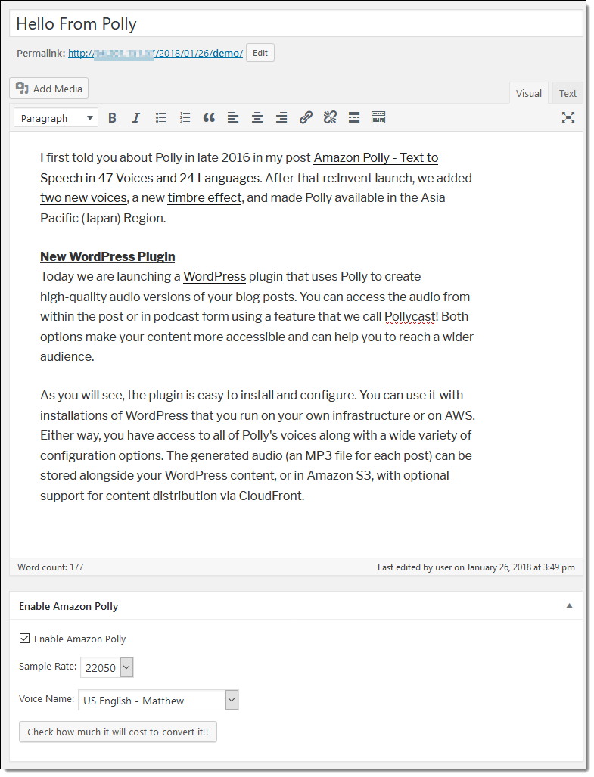
Result

Slide 11
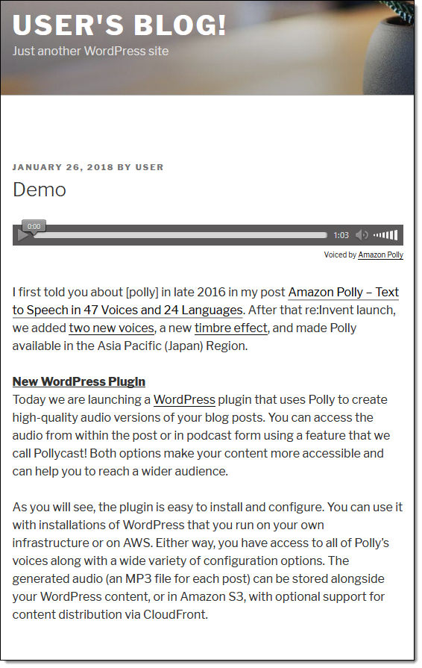
Result

Slide 12
Thank you

