Slide 1
Superstore Sales Dashboard
BY- Surbhi SINGH

Slide 2
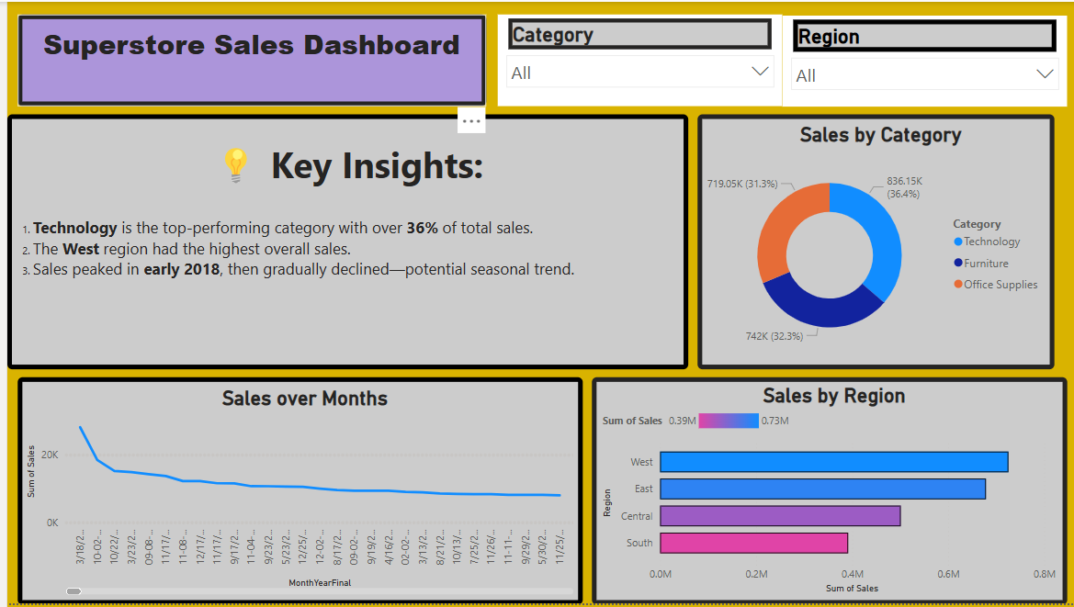

Slide 3
📊 Sales Dashboard – Insights:
Technology is the highest revenue-generating category, contributing significantly to overall sales.
The West region leads in total sales, indicating strong market performance in that area.
Sales show a noticeable peak in December, suggesting seasonal spikes during year-end.
The South region consistently reports the lowest sales and could benefit from targeted marketing strategies.

Slide 4
Thank you for viewing my Sales Dashboard!
I hope this presentation provided clear insights into the sales performance across regions, categories, and time.
Looking forward to your feedback!

