Slide 1
Presentation on Online Help Desk
Submitted By: Submitted To(Mentor):
Shrayansha Mathur (12ESKCS749) Ms Priyanka Sharma
Surbhi Chauhan (12ESKCS755) (Lecturer , Dept. Of
Computer Science)

Slide 2
Table of Contents:
Introduction
Types of Users
Technologies Used
Interfaces
Advantages
Limitations

Slide 3
Introduction
Our project is aimed at developing an Online Help Desk (OHD) for the facilities in the campus.
This is an Intranet based application that can be accessed throughout the campus.
This system can be used to automate the workflow of service requests for the various facilities in the campus.
This is one integrated system that covers different kinds of facilities like class-rooms, labs, hostels, mess, canteen, gymnasium, computer center, faculty club etc.

Slide 4
Registered users (students, faculty, lab assistants and others) will be able to log in a request for service for any of the supported facilities. These requests will be sent to the concerned people, who are also valid users of the system, to get them resolved.
There are features like email notifications/reminders, addition of a new facility to the system, report generators etc in this system. This project is to be made on the platform of JAVA SE,JAVA EE and Database. The database we are going to use is MYSQL database.
This project is quite beneficial in connecting people of different fields in the campus and solving their queries. Thus our aim is to develop such a system which can resolve problems associated with varied sections in the campus.

Slide 5
Type of Users In System:
Admin
Facility Consultant
Request Manager
Other( Students, Faculties, Staff etc.)

Slide 6
Role Of Users:
Admin:
Add new Services
View all accounts and update usertype of users.
View all complaints list and generate report accordingly.

Slide 7
Role of Users:
Facility Consultant:
Login to the system through the first page of the application.
Change the password after logging into the system and view profile.
Create a new complaint by specifying the facility along with a brief description of the request.
See the list of complaint (both open and closed) created by him/her over the past.

Slide 8
See the status of the requests created by him/her.
See the complaints that are assigned to him/her by the Request-Manager and update the status of requests (after working on them).

Slide 9
Role of Users:
Request Manager:
View all complaints created by respective users.
According to subject of the complaint, forward complaint to the consultant of appropriate department.
View all the mails send by users.
Send mail to the Facility consultant regarding pending request.

Slide 10
Role Of Users:
Other Users
Login to the system through the first page of the application
Change the password after logging into the system and view profile.
Create a new complaint by specifying the facility, the severity of the request along with a brief description of the request.
See the list of complaint (both open and closed) created by him/her over the past.
See the status of the requests created by him/her.

Slide 11
Technologies Used:
MySQL Database
MySQL is an open source back end database system. Database system is the main application to store data. Database system is mainly used for processing information. A good database system can efficiently and quickly process the data rather than data.
SQL is structured query language and it is the easy database language to store data. Also SQL language can update and access the data. In the website, people get a variety of information through the SQL language.

Slide 12
Technologies Used
JSP(Java Server Pages):
Java Server Pages (JSP) is a server-side programming technology that enables the creation of dynamic, platform-independent method for building Web-based applications. JSP have access to the entire family of Java APIs, including the JDBC API to access enterprise databases .

Slide 13
Technologies Used:
HTML:
Hypertext Markup Language, a standardized system for tagging text files to achieve font, colour, graphic, and hyperlink effects on World Wide Web pages.
CSS:
Cascading Style Sheets (CSS) is a style sheet language used for describing the look and formatting of a document written in a markup language.
JavaScript:
JavaScript is an object-oriented computer programming language commonly used to create interactive effects within web browsers.

Slide 14
Interfaces:
Home Page:
It is the main page from where user can have a complete look of online help desk i.e. how it works, what are the main services provided by OHD etc.

Slide 15
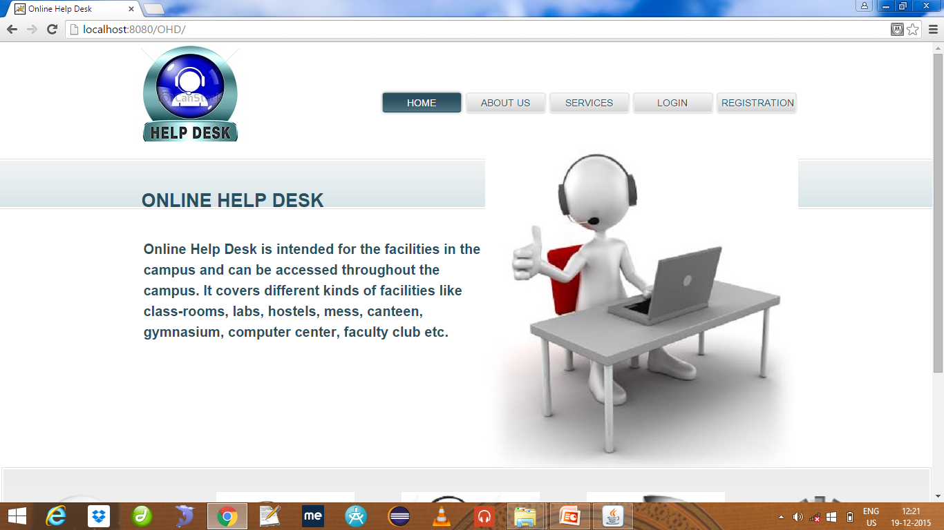

Slide 16
Interfaces:
Registration Page:
If someone wants to use the services provided by the OHD then he will have to register himself first.

Slide 17
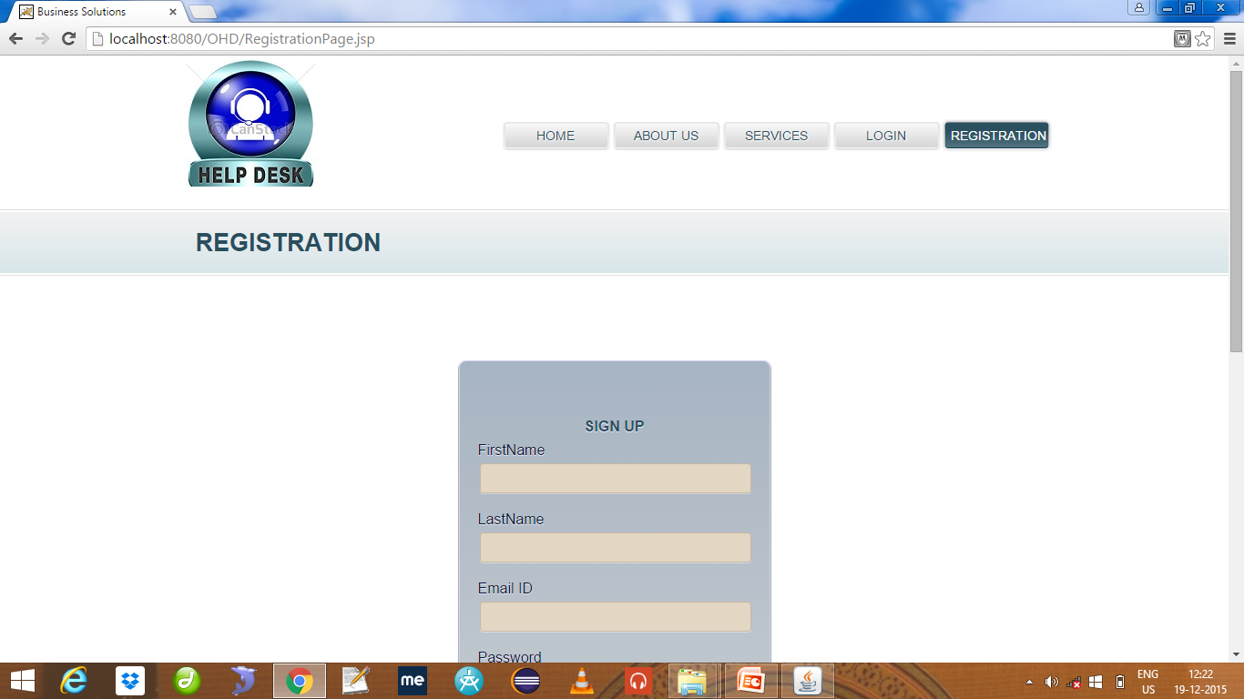

Slide 18
Interfaces:
Login Page:
After registration the user will have to login in order to continue and will be directed to their respective pages.

Slide 19
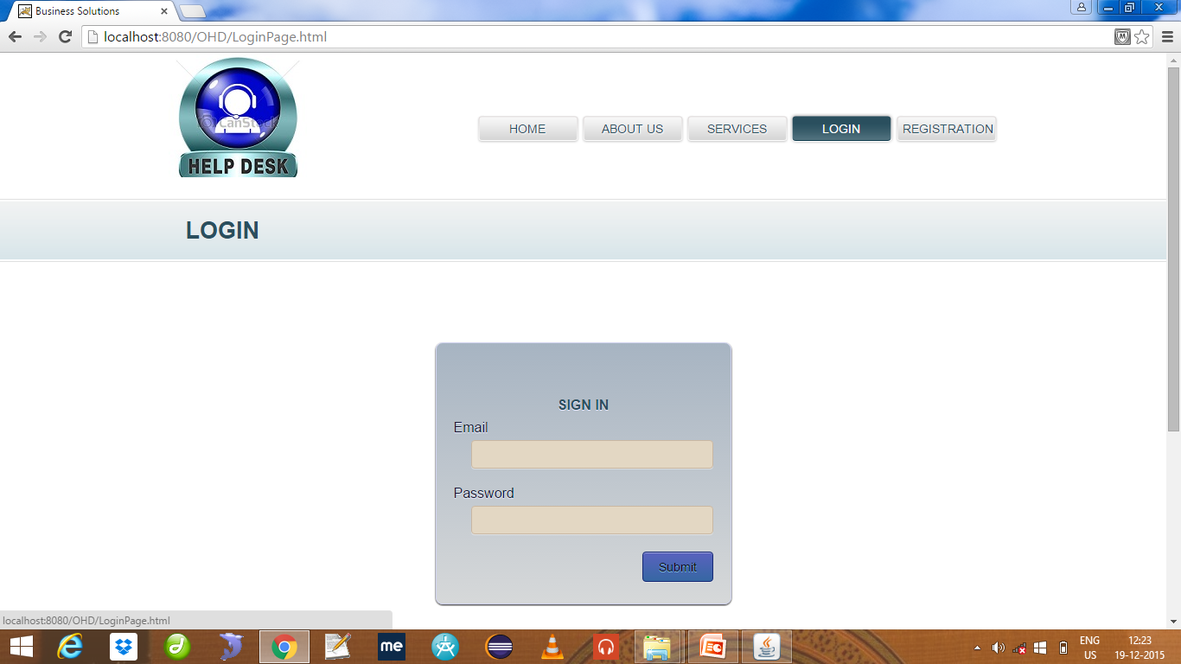

Slide 20
Interfaces:
Welcome Page User/Consultant:
From here one can create a complaint, view the solutions and view all complaints created by him . He can also update his profile.
A user can also take benefit of other services provided by OHD according to the type of user.

Slide 21
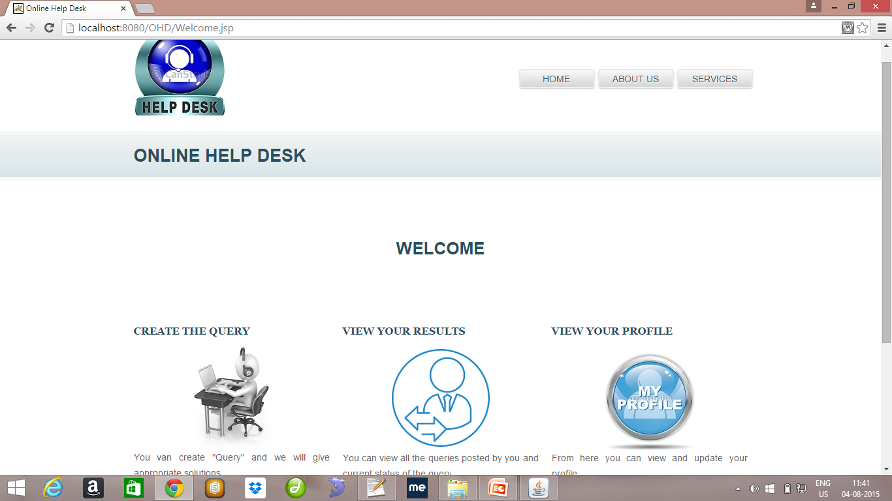

Slide 22
Interfaces:
Welcome Page for Request Manager:
The request manager can view all complaints and can forward them to respective consultants according to the department of the complaint.
He can also send mail to the consultants and can view all the mails send by users.

Slide 23
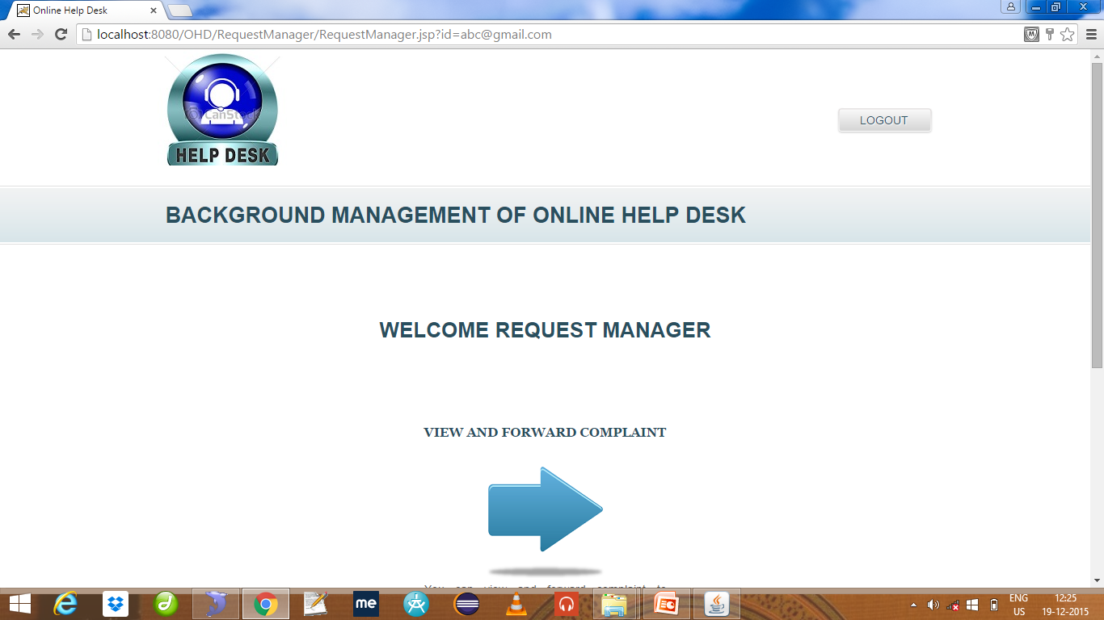

Slide 24
Interfaces:
Welcome Page for Admin:
He can view account details of all users and can change usertype accordingly.
He can view all the complaints by the users and accordingly can generate report.
He can also add new services.

Slide 25
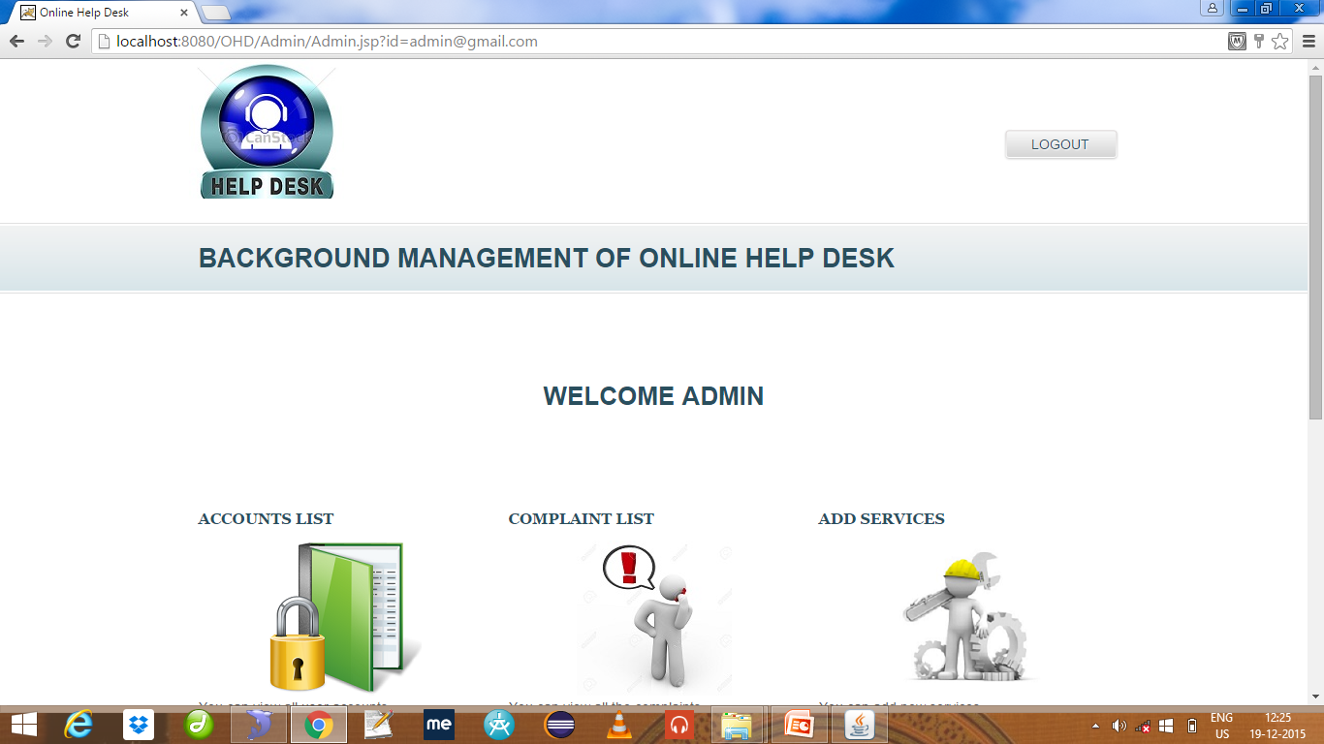

Slide 26
Benefits of Online Help Desk:
User can create complaints whenever he have any issue in any sector in college.
User can track complaint by analyzing status of the complaint i.e. complaint is in progress or whether closed.
He can send an email if complaint is pending for a long time.

Slide 27
Limitations of Online Help Desk:
Since it is intranet based application so cannot be accessed outside the campus.
If user is not satisfied with the solution provided by the consultant then he cannot raise any objection regarding the solution.

Slide 28
References:
w3schools.com, HTML Example,[WWW-document] http://www.w3schools.com/html/
ADOBE DREAMWEAVER CS5, What is Dreamweaver, [WWW-document] http://www.adobe.com/products/dreamweaver/whatisdreamweaver/
Mysql,What is Mysql ,[WWW-document]http://dev.mysql.com/doc/refman/5.0/en/what-is-mysql.html>
w3schools.com, CSS Example,[WWW-document] http://www.w3schools.com/css/
w3schools.com,JSPExample,[WWW-document] http://www.w3schools.com/JSP/

Slide 29
Thank You!!

