Slide 1

Title: Exploring Hybrid Models and GAN-Based Approaches for Automated Detection of Machine-Generated Text
PRESENTED BY
SURBHI SHARMA
Under Supervision Of
Dr. Jon Rusert

Slide 2

Introduction
Increasing Prevalence of Machine-Generated Text:
Deep learning fuels widespread machine-generated text online.
Pervades digital platforms, from news articles to chatbots.
Blurs lines between human and AI content, raising authenticity concerns.

Slide 3
Challenges Posed by Fake Content Dissemination
Proliferation of Machine-Generated Text:
Challenge: The widespread dissemination of machine-generated text.
Consequence: Increased spread of fake content across online platforms.
Types of Machine-Generated Fake Content:
Fake news articles.
Fraudulent reviews.
Deceptive social media posts.
Impact on Users and Narratives:
Deception: Machine-generated content can deceive users.
Propagation: False narratives can spread rapidly.
Inadequacy of Traditional Methods:
Struggle: Traditional content moderation and fact-checking methods struggle.
Reasons: Unable to cope with volume and sophistication of machine-generated fake content.
Need for Advanced Detection Techniques:
Requirement: More advanced detection techniques are necessary.
Purpose: To address the challenges posed by machine-generated fake content effectively.

Slide 4
Need for Effective Detection Methods
Urgent Need for Effective Detection Methods:
Challenges posed by fake content dissemination emphasize the need for prompt action.
Effective detection methods are required to identify and mitigate the impact of machine-generated text.
Role of Advanced Technologies:
Automated detection systems leverage advanced technologies such as:
Natural language processing (NLP).
Machine learning.
Deep learning.
These technologies enable the development of robust detection methods.
Crucial Role in Identifying Suspicious Content:
Automated detection systems play a crucial role in:
Identifying suspicious content.
Flagging it for further review.
Enhancing Resilience of Online Platforms:
Robust detection methods enhance the resilience of online platforms.
They help in:
Preventing the spread of fake content.
Preserving the integrity of digital communication channels.

Slide 5
Literature Review And Background
Authorship Attribution in NLP:
Traditionally, authorship attribution in NLP aimed to:
Identify the true human author of a text.
Analyze stylistic features and linguistic patterns unique to each author.
With the emergence of neural text generation techniques, the focus has expanded to:
Include texts authored by machines or a combination of humans and machines.
This shift poses challenges:
In distinguishing between human and machine-generated content.
Necessitating the development of new methodologies and models.

Slide 6


Transfer Learning and Pre-trained Language Models
Utilize transfer learning technique.
Address text classification challenges.
Leverage pre-trained language models like RoBERTa.
Fine-tune models for specific downstream tasks.
Achieve significant improvements in accuracy and performance.
Example: Authorship attribution.

Slide 7
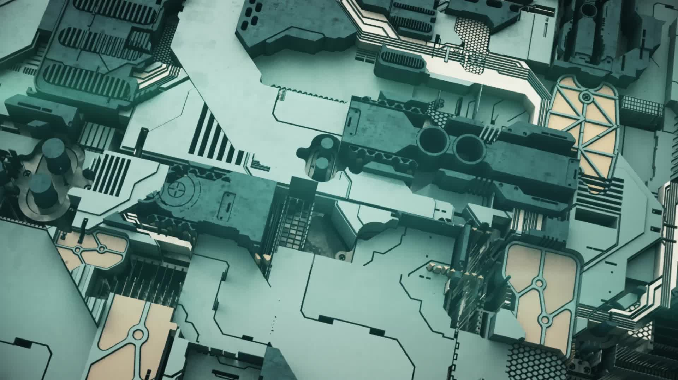
Transformer Architecture
The Transformer architecture, introduced by Vaswani et al., has become a cornerstone in NLP for its ability to capture long-range dependencies in sequences without relying on recurrent or convolutional layers.
Components like the self-attention mechanism, multi-head attention, and positional encoding enable Transformers to generate contextually rich representations of text, facilitating various NLP tasks.

Slide 8

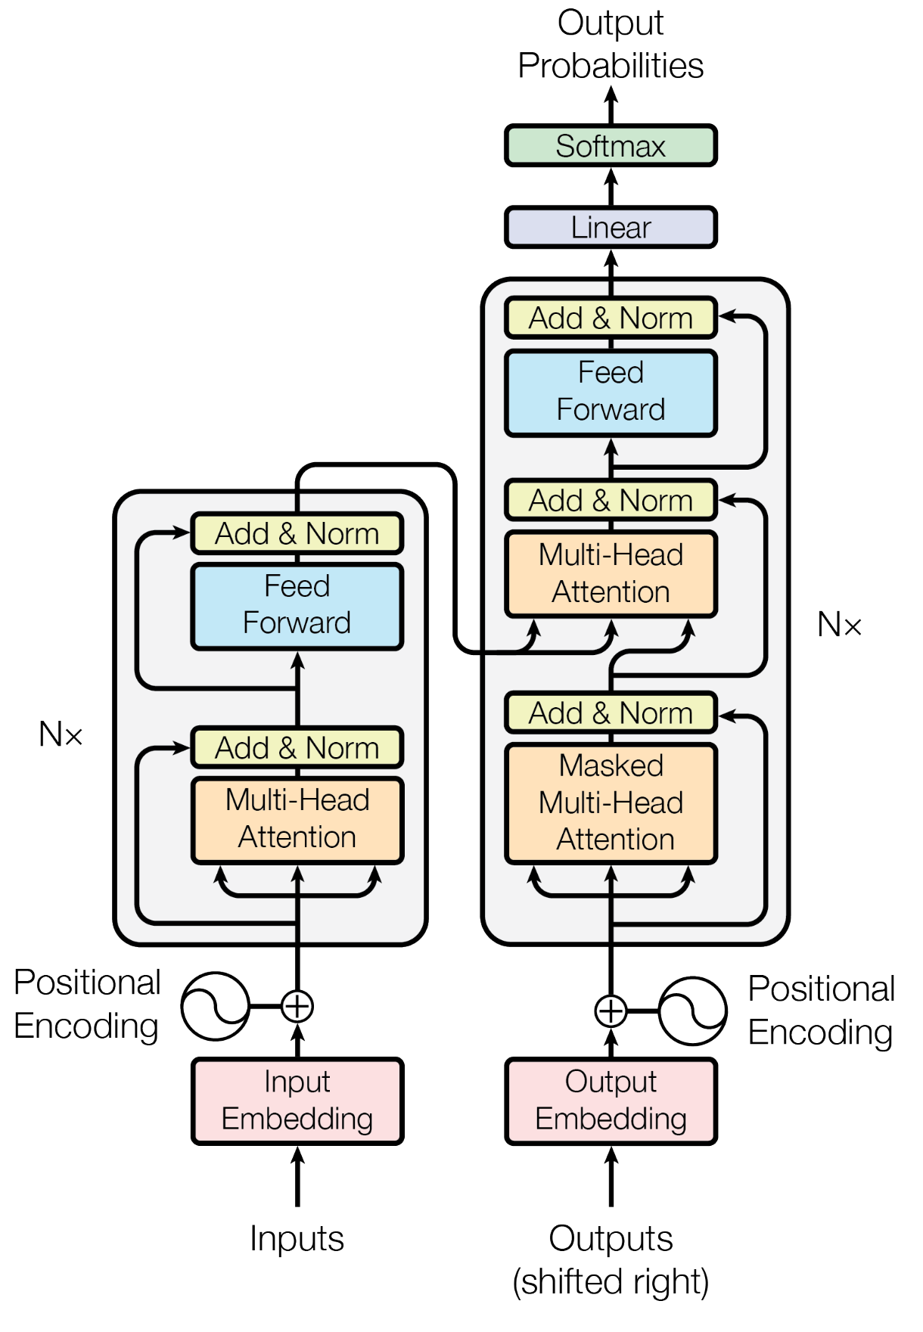
Transformer Architecture(Vaswani et al.)

Slide 9
GAN-BERT Integration
GAN-Bert integrates the generative capabilities of GANs with the discriminative power of BERT for tasks such as text generation and machine-generated content detection.
The model utilizes a discriminator to classify examples and a generator to produce fake examples, enabling the detection of authorship obfuscation and forgery.
GAN-Bert holds promise in applications such as text generation, paraphrasing, and detecting machine-generated content by leveraging both generative and discriminative models.

Slide 10

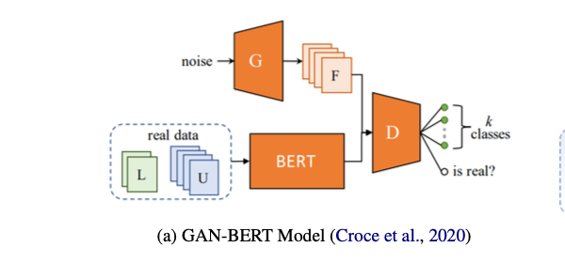
GAN-BERT Architecture(D. Croce et al.)

Slide 11
Dataset Used (Binary Classification)
Dataset (Monolingual(English)) | No. Of Samples | Proportion of (0/1)
Training Dataset | 119757 | 63,351/56,406
Development Dataset | 5000 | 2500/2500
Testing Dataset | 34272 | 16272/18000
Dataset Used: Subtask A of Task-8 in the SemEval challenge.
Label 1: (Machine Generated Text)
Label 0 : ( Human written. Text)
Columns : model, text, sources.

Slide 12
Experiments
Methodology:
Addressed Subtask A in SemEval challenge's monolingual track, involving binary classification of human vs. machine-generated text (ChatGPT).
Developed a Stylometric classifier to extract stylistic attributes such as text length and word count for Logistic Regression training.
Integrated hybrid features, including character n-grams, into the model.
Adopted a hybrid strategy by combining output probabilities from RoBERTa, Stylometric classifier, and hybrid features classifier for Logistic Regression classification.

Slide 13
Stylometric classifier:
Captures lexical stylometric features and trains a Logistic Regression model using extracted features. (word count, avg length, frequency of short words etc. )
Hybrid feature classifier:
Utilizes character n-grams (2-3) to capture syntactic and semantic patterns for predictions and then trained on a Logistic Regression model.

Slide 14
Ensemble classifier:
Concatenation of RoBERTa representations, Stylometric features, and Hybrid features.
Utilization of logistic regression for classification.
Synergy between diverse feature sets enhances classification accuracy.

Slide 15
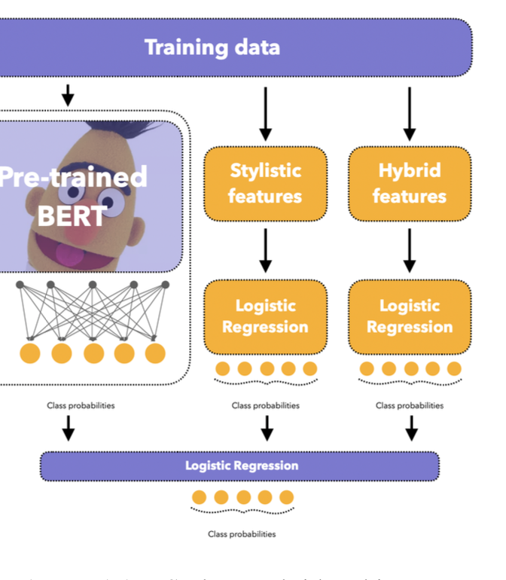
Ensemble Architecture(M. Fabien et al.)

Slide 16
Results And Discussions
Different classifiers were evaluated on the test dataset, showcasing varying performance.
The Ensemble Classifier (RoBERTa + Style + Hybrid) : highest accuracy of 73%, outperforming other classifiers.
Incorporating RoBERTa-based representations along with Stylometric and hybrid features significantly improved classification accuracy.
The Ensemble Classifier's superior performance attributed to RoBERTa's ability to capture rich contextual information from text.

Slide 17
Classic Models Results on DEV Data
Classifier | Accuracy | F1 Score | Precision | Recall | ROC AUC SCORE
Logistic Regression(LR) | 56 | 42 | 62 | 31 | 0.58
Naïve Bayes(NB) | 52 | 46 | 52 | 42 | 0.56
Support Vector Machine(SVM) | 59 | 43 | 70 | 31 | 0.62
Random Forest(RF) | 60 | 45 | 72 | 32 | 0.71
Xgboost | 58 | 44 | 72 | 32 | 0.63

Slide 18
Classic Models Results on Test Data
CLASSIFIER | ACCURACY | F1 SCORE | PRECISION | RECALL | ROC-AUC SCORE
Logistic Regression (LR) | 72.90 | 76 | 70.0 | 82.40 | 0. 82
Naïve Bayes(NB) | 84.20 | 82 | 97.10 | 72.10 | 0.93
Support Vector Machine (SVM) | 77.40 | 79 | 76.71 | 81.90 | 0.84
Random Forest (RF) | 85.70 | 85 | 89.0 | 83.10 | 0.92
Xgboost | 78 | 80 | 88 | 83.0 | 0.87

Slide 19
Accuracy Results on the Test/Dev Dataset
Classifier | Accuracy (%) | F1 SCORE | PRECISION | RECALL | ROC-AUC SCORE
Stylometric classifier | 49/40 | 44/03 | 46/03 | 47/08 | 0.46/.40
Hybrid Features Classifier | 58/49 | 57/36 | 61/38 | 61/49 | 0.65/0.52
RoBERTa + Style | 73/83 | 72/83 | 72/83 | 72/83 | 0.75/0.86
Ensemble Classifier (RoBERTa + Style + Hy- brid) | 73/83 | 72/83 | 72/83 | 72/83 | 0.75/0.86

Slide 20
Accuracy Of GAN-RoBERTa on the Test Dataset
Scenario | Accuracy (%)
Labeled & Unlabeled data(1 epoch) | 73.6
Trained on entire Labeled data(1 epoch) | 70

Slide 21
ML Models vs. Transformer
ML models show strengths in accuracy on test data but may struggle with generalization.
Transformer models like RoBERTa exhibit consistent performance across both test and dev data, indicating better generalization capabilities.
Transformers excel in capturing complex linguistic patterns and contextual information, making them suitable for various real-world text classification tasks.

Slide 22
Accuracy Results:
GAN-RoBERTa achieved an accuracy of 73.6% when trained on labeled and unlabeled data for one epoch.
Accuracy decreased slightly to 70% when trained exclusively on labeled data.
Potential Overfitting:
Training solely on labeled data may have led to overfitting, resulting in decreased accuracy.
Overfitting could be a contributing factor to the decrease in accuracy observed in the second scenario.
Effectiveness of GAN-RoBERTa:
Despite variations in performance under different training scenarios, GAN-RoBERTa remains effective.
It demonstrates proficiency in generating realistic text and accurately classifying it.
Implications for Application:
Variations in performance highlight the importance of considering different training strategies.
Understanding how training data composition affects model performance is crucial for real-world applications.

Slide 23
CONCLUSION AND FUTURE WORK
Future Exploration:
Investigate novel features or representations for capturing unique text characteristics.
Explore linguistic, stylistic, or structural aspects to enhance detection.
Enhancing Robustness:
Develop techniques to combat adversarial attacks.
Mitigate impact of deceptive examples on detection systems.

Slide 24
Augmentation Opportunities:
Integrate fine-tuned RoBERTa model into GAN-RoBERTa framework

Slide 25

References
A. Vaswani et al., “Attention is all you need,” Advances in neural information processing systems, vol. 30, 2017.
D. Croce, G. Castellucci, and R. Basili, “Gan-bert: Generative adversarial learning for robust text classification with a bunch of labeled examples,” in Proceedings of the 58th annual meeting of the association for computational linguistics, 2020, pp. 2114– 2119.
M. Fabien, E. Villatoro-Tello, P. Motlicek, and S. Parida, “Bertaa: Bert fine-tuning for authorship attribution,” in Proceedings of the 17th International Conference on Natural Language Processing (ICON), 2020, pp. 127–137.

Slide 26

THANK YOU Dr. Jonathan Rusert Dr. Zesheng Chen
Dr. Mohammedreza Hajiarbabi

