Slide 1

Atliq Hardwares
Consumer Goods
Ad-hoc Insights
Presented by: Surbhi Khorasiya

Slide 2
Agenda:
Context/ Introduction
Company’s Background (their market and products)
Visualization and Insights

Slide 3
CONTEXT / INTRODUCTION
Company:
Atliq Hardwares is one of the leading computer hardware producers in India as well as across the globe.
Background:
The management noticed that they do not get enough insights of the company to make quick and smart data-informed decisions. They want to use data to make better choices.

Slide 4
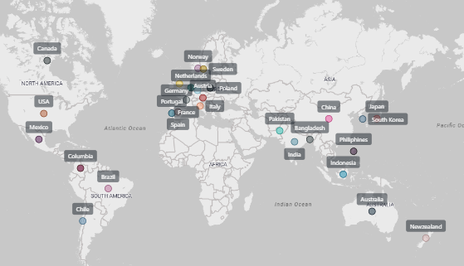
ATLIQ’S MARKET

Slide 5
ATLIQ’S PRODUCT LINES
PC
Desktop
Business Laptop
Personal Laptop
Notebook
Gaming Laptop
Business Laptop
Personal Laptop
P&A
Peripherals
Graphics Card
Accessories
Batteries
Motherboard
Internal HDD
Processors
Keyboard
Mouse
N&S
Networking
Wi Fi Extender
Storage
External SSD
USB Flash Drives

Slide 6
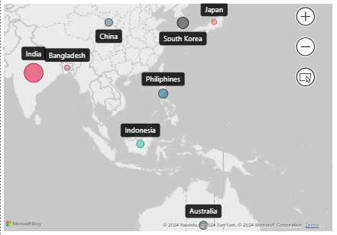
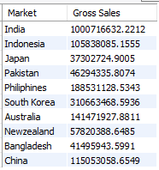

IN WHICH COUNTRY DOES ATLIQ HARDWARES HAVE THE GREATEST MARKET IN APAC REGION?
India Is A Leading Market
In Terms Of Gross Sales
In APAC Region
Output:
SQL Code:

Slide 7
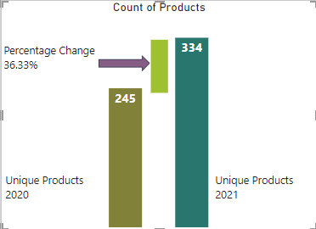
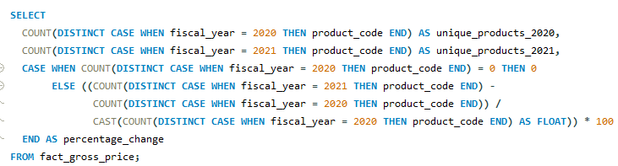

CHANGE IN NUMBER OF UNIQUE PRODUCTS.
It reveals a positive trend in the number of unique products from 2020 to 2021(a growth of 36.33%).
If the company continues to strategically expand its product offerings by researching current trends and consumer needs, it is likely to experience continued growth in the upcoming years.
SQL Code:
Output:

Slide 8
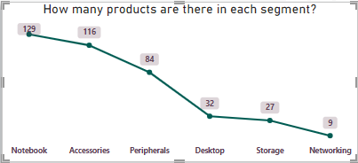
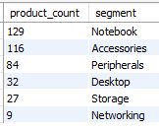

UNIQUE PRODUCTS COUNTS FOR EACH SEGMENT
The Notebook segment stands out for its extensive range of products.
Output:
SQL Code:

Slide 9
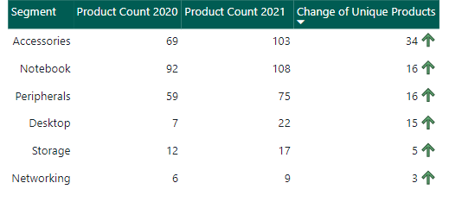
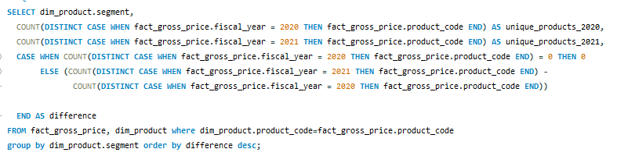
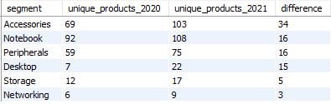
UNIQUE PRODUCT DIFFERENCE PER SEGMENT FROM 2020 TO 2021
In 2021, the Accessories segment saw the biggest jump in product sales relative to other segments.
SQL Code:
Output:

Slide 10
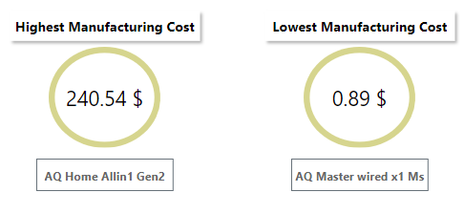
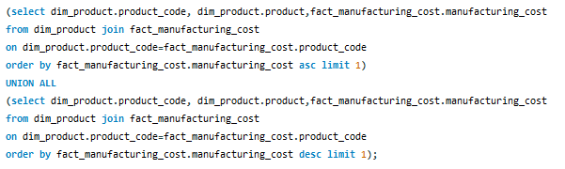

Products having the highest and lowest manufacturing costs
SQL Code:
Output:

Slide 11
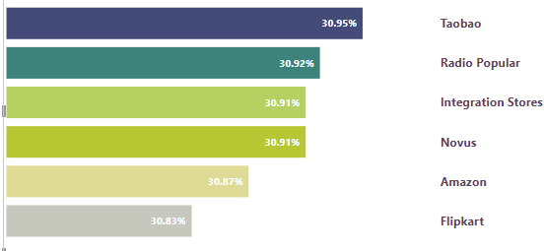

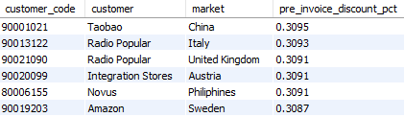
TOP 5 CUSTOMERS WITH HIGHEST PRE-INVOICE DISCOUNT PERCENTAGE
Taobao offers the highest overall discount, but other companies are still within a few percentage points. This suggests that price may be an important factor for these companies, and that customers who shop around can find good deals.
SQL Code:
Output:

Slide 12
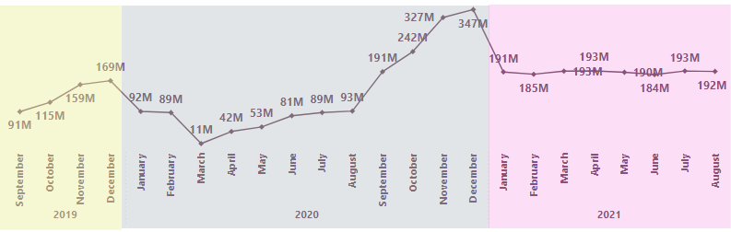
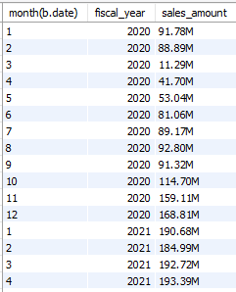

GROSS SALES MONTHLY
Offering More Hardware Products Can Boost Sales During The Summer Months. Overall The Sales Have Been Increased After Pandemic.
Output:
SQL Code:

Slide 13
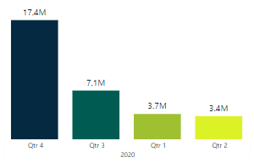


HOW MANY QUANTITIES WERE SOLD DURING THE QUARTERS OF 2020
For Year 2020, Q2 Was With The Least Products Sold. In Summer The Computer Hardware Demand Decreases And Atliq Hardware Can Come Up With Some New Products.
SQL Code:
Output:

Slide 14
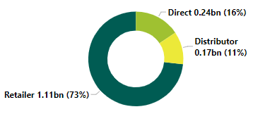
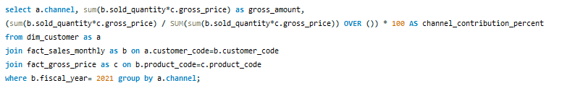

GROSS SALES AND CONTRIBUTION PERCENTAGES BY CHANNELS
Retailers are the dominant channel. This suggests that a strong retail presence is important
SQL Code:
Output:

Slide 15
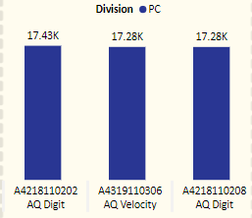
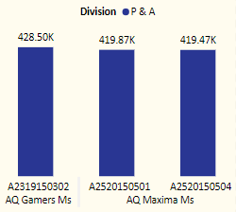
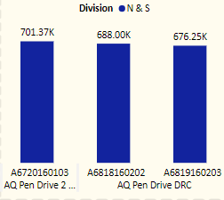
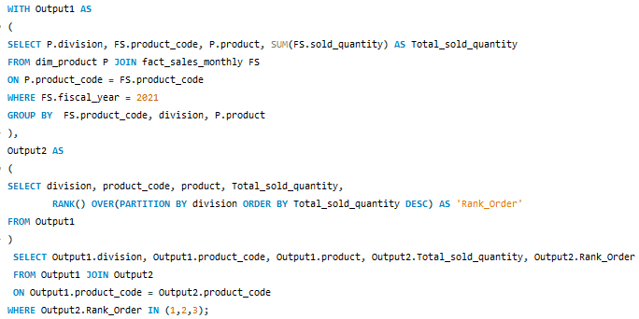
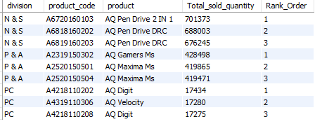
TOP 3 HIGHEST-SELLING PRODUCTS BY DIVISION FOR FY 2021
SQL Code:
Output:

Slide 16
THANK YOU!

