Slide 1
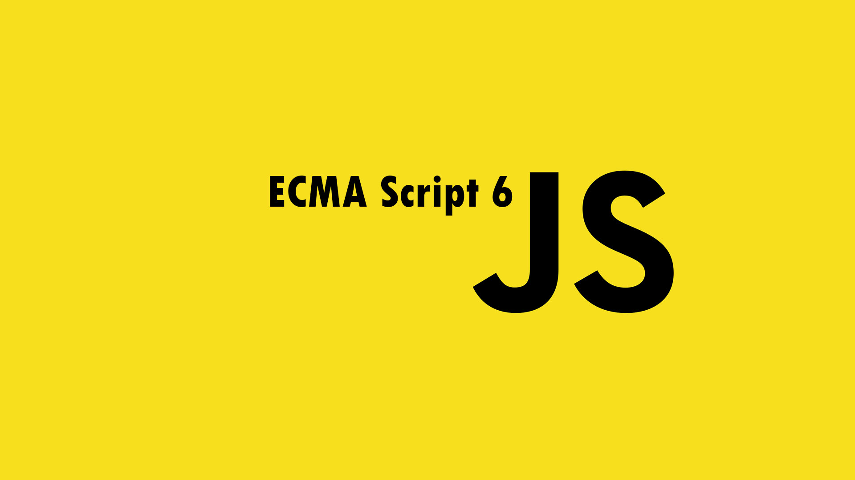

Slide 2
About the Program
Published on June 17, 2015
Formally "ECMA Script 2015"
6 years! from ES5

Slide 3
Why ES6 ?
Modern syntax fixing pitfalls
Better support for large applications
No (or few) breaking changes

Slide 4
Browser Support…
Modern browsers and io.js (node.js) support half of ES6 features.
Safari 9 (WebKit) will support many ES6 features soon.
Except for IE11…
Check http://www.caniuse.com

Slide 5
Libraries to bridge the support now…
BabelJs : https://babeljs.io/
Traceur: https://github.com/google/traceur-compiler

Slide 6
What’s new in ES6 ?
Block Scope (let/const) Destructuring Default Params Rest Params Spread Operator Arrow Function ( Fat Arrow Function) Iterator Generator | Template Strings Array Methods Extended Object Promise Classes Modules Proxy Set and Map

Slide 7
Block Scope in ES6
VAR Globally Available in the function which it is declared Hoisted Names can be declared many times | LET / CONST Only available in the block in which it is declared Not Hoisted Names can only be declared once per block

Slide 8
Block Scope in ES6

Slide 9
Generics in ES6
Generics are templates that allow the same function to work with different data types.
Good when we create reusable code that preserve the data type that go in and out of them.
You can use data type markers to denote a data type and refer those markers to represent the same data type in side a function / program
function getType<T>(value:T):string{
return typeof (value);
};
getType(“hello there”) ; // says string
getType(true) ;// says boolean

Slide 10
Block Scope in ES6
VAR Globally Available in the function which it is declared Hoisted Names can be declared many times | LET / CONST Only available in the block in which it is declared Not Hoisted Names can only be declared once per block

Slide 11
Block Scope in ES6

Slide 12
Generics in ES6
Generics are templates that allow the same function to work with different data types.
Good when we create reusable code that preserve the data type that go in and out of them.
You can use data type markers to denote a data type and refer those markers to represent the same data type in side a function / program
function getType<T>(value:T):string{
return typeof (value);
};
getType(“hello there”) ; // says string
getType(true) ;// says boolean

Slide 13
Thank you
please forward your comments and feedback
vijay.shivu@gmail.com

Slide 14

About me
Vijay Shivakumar
Designer | Developer | Trainer
Training on web and Adobe products from past 10+ years

