Slide 1
Restaurant Searcher
Combining API data pulled from Google Maps and Zomato to give users ability to search restaurant near any location.
It also provides links to restaurant websites that have further details about menu, timings etc.
it provides restaurant ratings that helps user in picking restaurant of their choice.
It provides average cost and Cuisine details to users that helps users for their restaurant choice.
It is responsive and works on all devices.

Slide 2
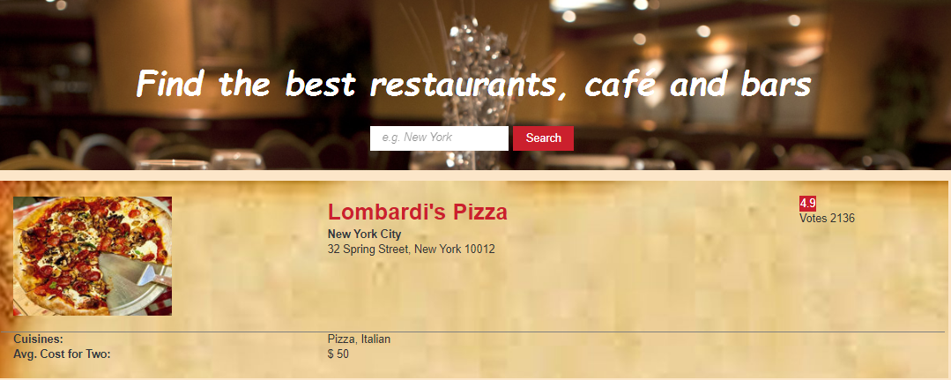

Slide 3
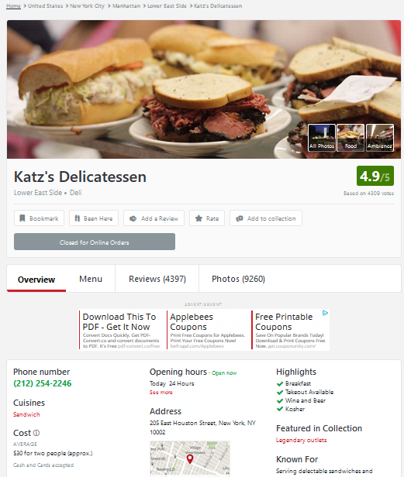

Slide 4
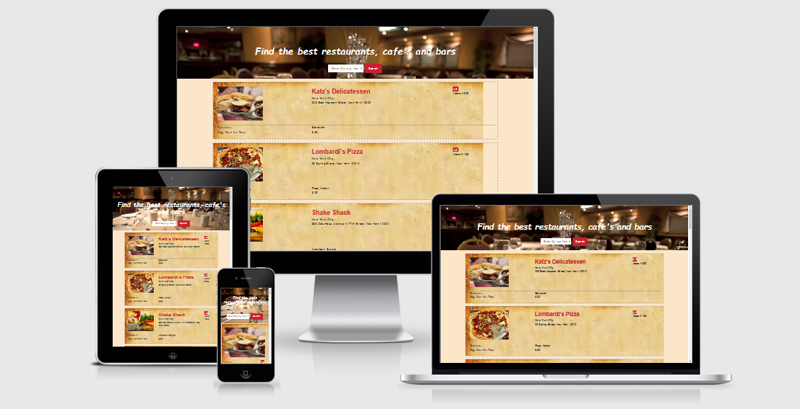

Slide 5
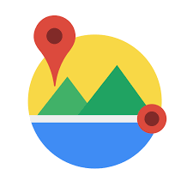


Tech Stack and Public API

