Slide 1
NYC Bike Features
This app allows user to find and manage a bike rides.
It provides real time information about available bikes and docking stations in NYC leveraging information from public API.
It has further features to select appropriate stations as well as pictorial view leveraging Google location API.
it also helps user to manage his rides by posting his rides and allowing with features to post, modify or delete his rides.
it also provides information to user about rules of road and how to ride bike and safety rules.
it also gives user information about various places of interest for bike ride as well as for tourism purposes.
it has signup/sign in features and allows users to login as guest by default.
This app is responsive and works on various devices.

Slide 2
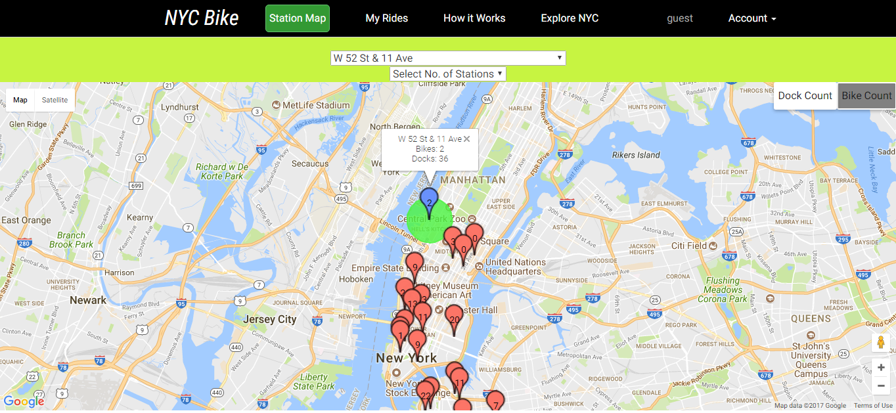

Slide 3
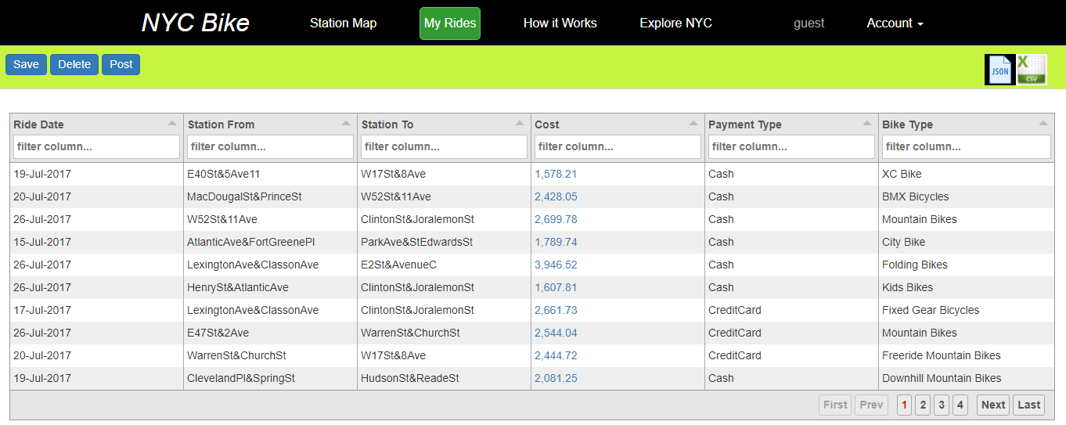

Slide 4
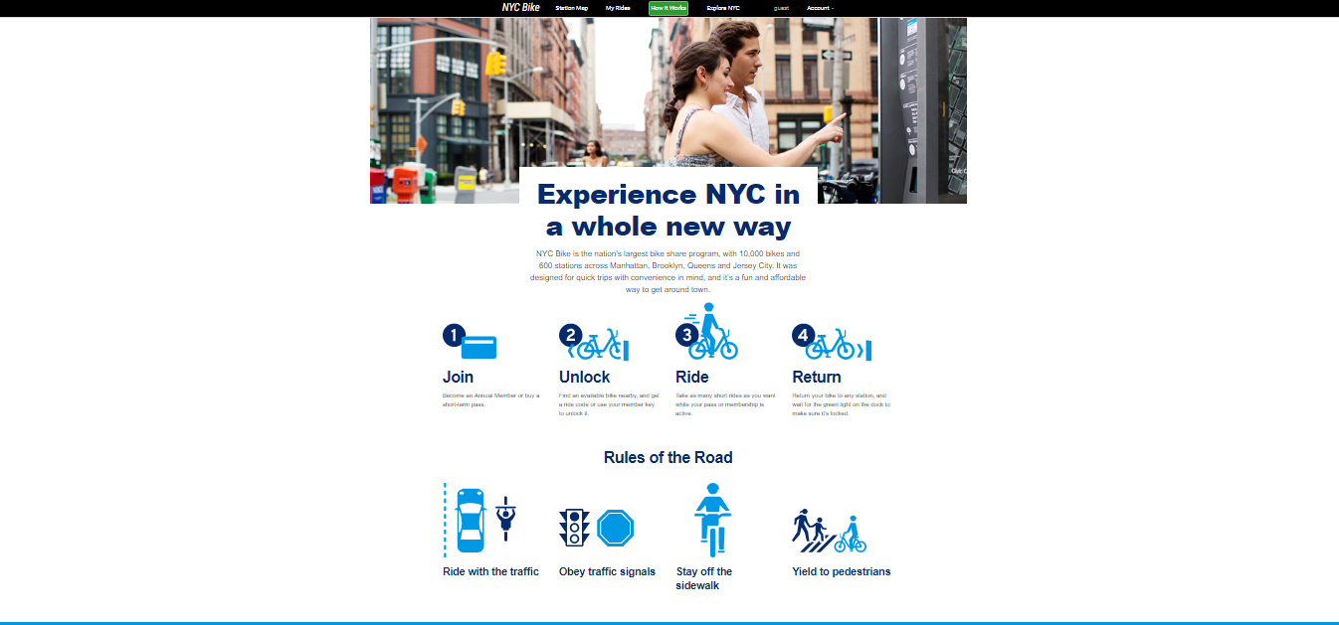

Slide 5
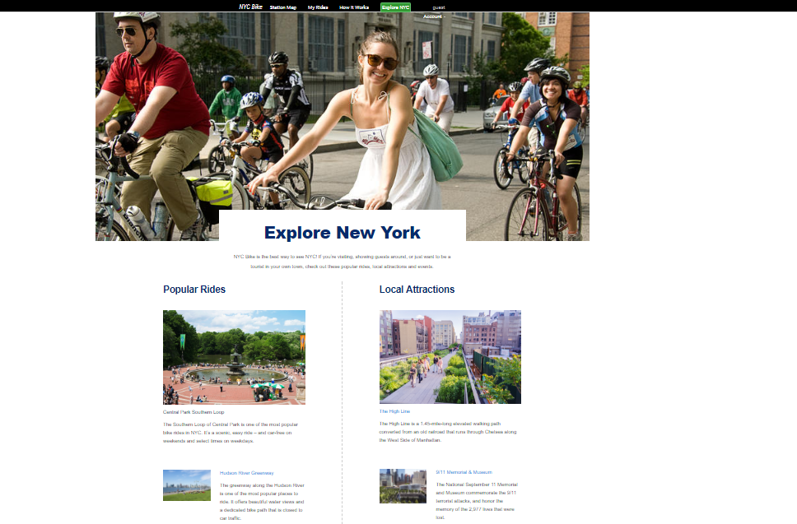

Slide 6
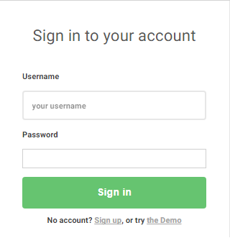
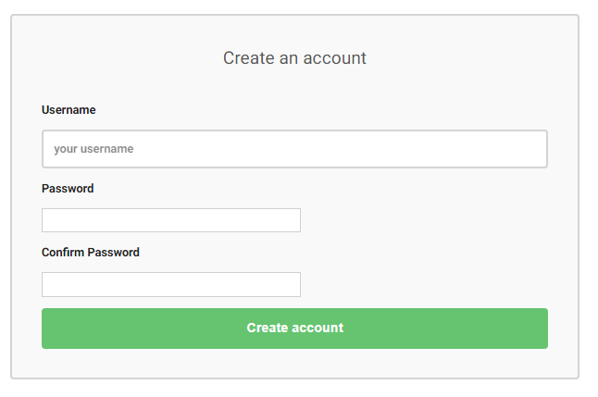

Slide 7
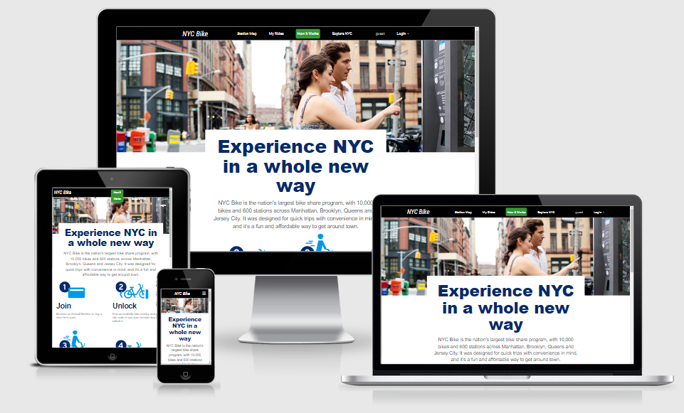

Slide 8

Tech Stack

