Slide 1
Contact App
My Contacts App enables users to easily store and find contact information, such as names, addresses and telephone numbers.
Add your contact
Edit your contact
Remove your contact
Get your contact
Download your contact

Slide 2


Slide 3
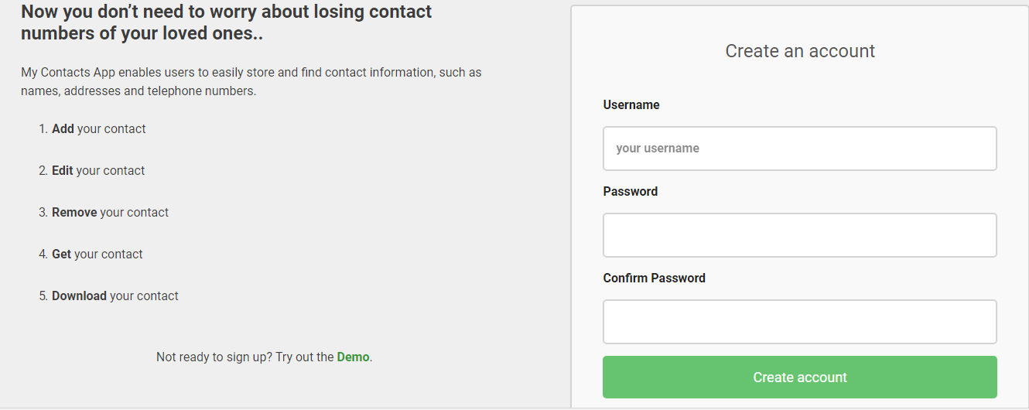

Slide 4
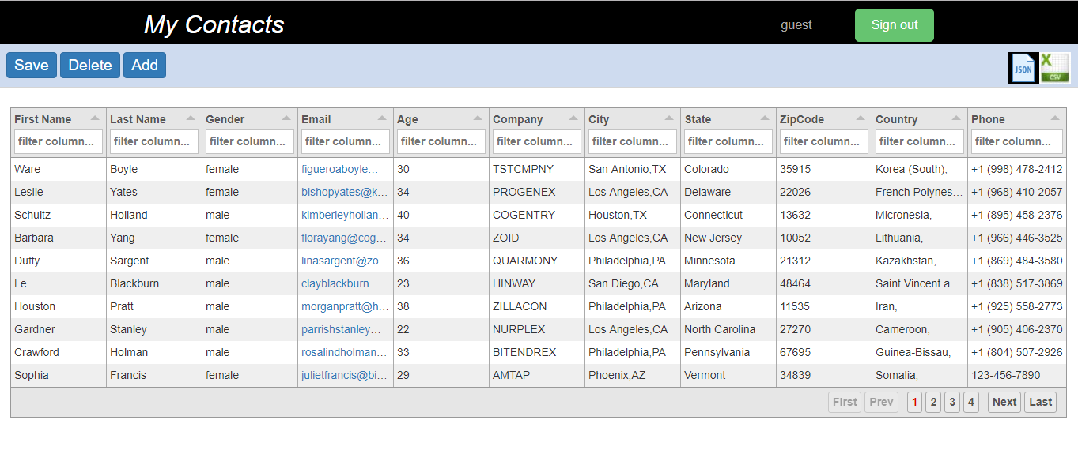

Slide 5
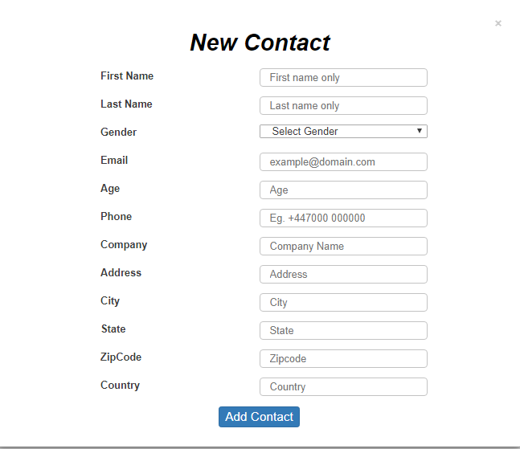

Slide 6
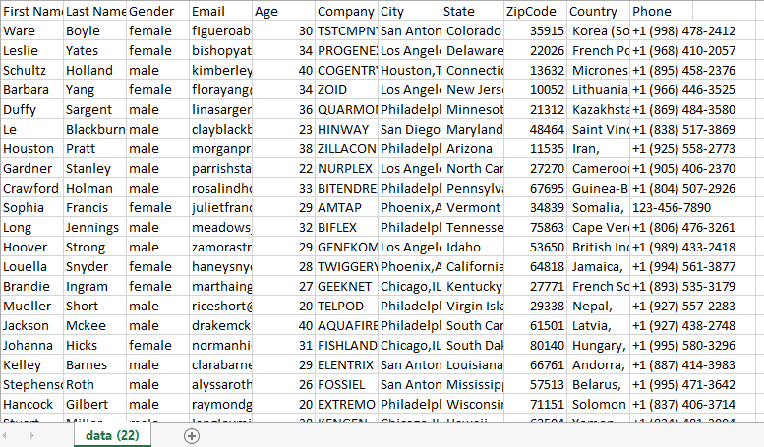

Slide 7
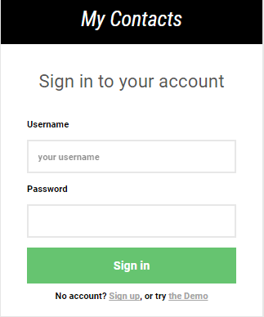

Slide 8
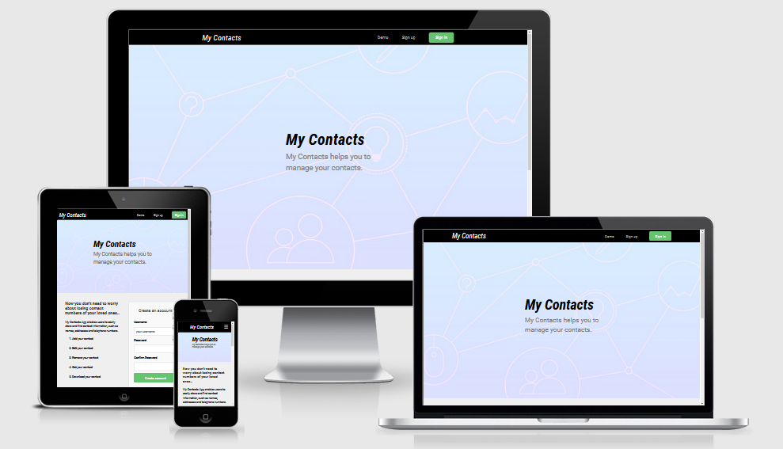

Slide 9


