Slide 1

IILM UNIVERSITY, GREATER NOIDA
School of Computer Science and Engineering
DATA ENGINEERING VIRTUAL INTERNSHIP
AICTE – EduSkills National Internship Program | Curriculum by AWS Academy
STUDENT NAME
ENROLLMENT NUMBER
PROGRAM & SEMESTER
Surbhi Sagar
2410031002
B.Tech CSE, 5th Semester
ORGANIZATION
EduSkills (AICTE National Internship Program)

Slide 2
AT A GLANCE
Internship Snapshot
8
40
2026
O
Weeks Duration
Training Hours
Internship Period
Final Grade
June – August 2026
AWS Academy
June – August
Outstanding
◈
DOMAIN
◉
MODE
✓
RECOGNITION
Data Engineering
Virtual Internship
AICTE + AWS Academy
Data pipelines, processing and cloud workflows
Structured online learning experience
Internship certificate and training badge
A structured eight-week experience focused on building a foundation in modern data engineering.
2

Slide 3
PROGRAM ECOSYSTEM
Who Powered the Internship?
01
AICTE
02
EduSkills
03
National Internship
04
AWS Academy
→
→
→
Technical education framework
Virtual internship platform
Industry–academia bridge
Cloud & data curriculum
THE LEARNING CHAIN
AICTE enables the program → EduSkills delivers the internship → AWS Academy provides the Data Engineering curriculum
A
Academic Framework
E
Internship Delivery
A
Technical Curriculum
AICTE supports technical education and accreditation.
EduSkills connects students with structured virtual internships.
AWS Academy provides the Data Engineering training.
3

Slide 4
LEARNING JOURNEY
8-Week Internship Structure
Conceptual learning journey — organized for presentation; exact weekly curriculum is maintained by the training provider.
01
→
02
→
03
→
04
Weeks 1–2
Weeks 3–4
Weeks 5–6
Weeks 7–8
FOUNDATION
CORE DATA
CLOUD & PRACTICE
INTEGRATION
Data engineering basics Cloud fundamentals
Ingestion • ETL / ELT Data processing
AWS-oriented learning Pipeline thinking
Quality • governance Completion
4

Slide 5
CORE CONCEPT
Understanding Data Engineering
1
→
2
→
3
→
4
→
5
SOURCE
INGEST
STORE
PROCESS
DELIVER
Data origins
Collect & move
Organize & retain
Clean & transform
Analytics / applications
•
ETL / ELT
•
DATA QUALITY
Prepare raw data for analysis.
Accuracy, completeness and consistency.
•
PIPELINES
•
CLOUD WORKFLOWS
Automate repeatable data movement.
Scale processing with cloud platforms.
5

Slide 6
TECHNICAL VIEW
From Raw Data to Insights
END-TO-END DATA PIPELINE
WHY THIS MATTERS
1
SOURCE
Files • APIs • Databases
AUTOMATION
1
INGEST
Capture and move data
Repeatable workflows reduce manual effort.
2
3
STORE
Centralize raw data
2
SCALABILITY
Cloud pipelines can grow with data volume.
4
TRANSFORM
Clean and reshape
5
VALIDATE
Check data quality
3
RELIABILITY
Validation and monitoring improve trust.
6
ANALYZE
Serve useful outputs
6

Slide 7
CLOUD PERSPECTIVE
AWS & Data Engineering
AWS Academy is identified on the certificate as the curriculum provider for the Data Engineering internship.
CLOUD DATA WORKFLOW
LEARNING AREAS
1
Cloud Fundamentals
DATA SOURCES
Files • databases • APIs
Understanding cloud-based computing concepts.
↓
2
Data Services
DATA SERVICES
Cloud-based storage & processing
Exposure to cloud approaches for data solutions.
↓
DATA PROCESSING
Transform • prepare • validate
3
Scalable Processing
↓
Thinking about data workflows at scale.
DATA OUTPUTS
Analytics • applications
4
Hands-on Learning
Applying concepts in a cloud environment.
7

Slide 8
OUTCOMES
Skills & Learning Outcomes
01
DATA PIPELINES
02
ETL / ELT
03
DATA PROCESSING
Understand how data moves through stages.
Prepare and transform raw data.
Work with structured processing workflows.
04
CLOUD COMPUTING
05
DATA QUALITY
06
PROBLEM SOLVING
Build awareness of cloud data architecture.
Focus on accuracy and consistency.
Approach workflow challenges systematically.
LEARN
APPLY
BUILD
✓
Concepts
✓
Practice
✓
Confidence
8

Slide 9
ARCHITECTURE
Data Engineering Workflow
COLLECT
DATA SOURCES
Files | APIs | Databases
↓
INGESTION LAYER
Collect | Move | Capture
↓
STORAGE LAYER
Organize | Retain | Access
↓
PROCESSING LAYER
Clean | Transform | Validate
↓
OUTPUT LAYER
Analytics | Applications | Insights
DELIVER
A simple architecture view: data is collected, stored, processed and validated before it becomes useful to analytics or applications.
9

Slide 10
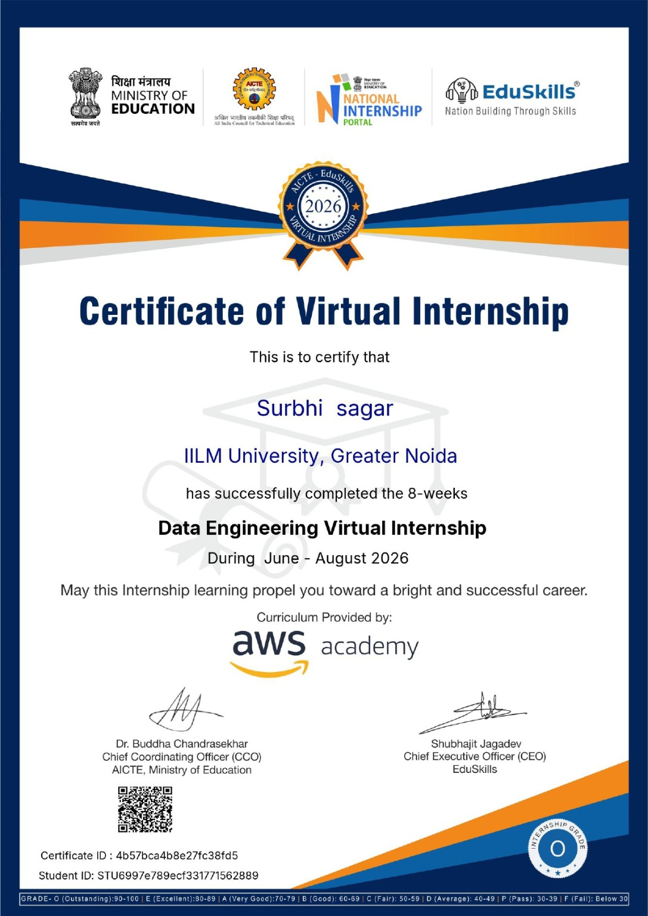
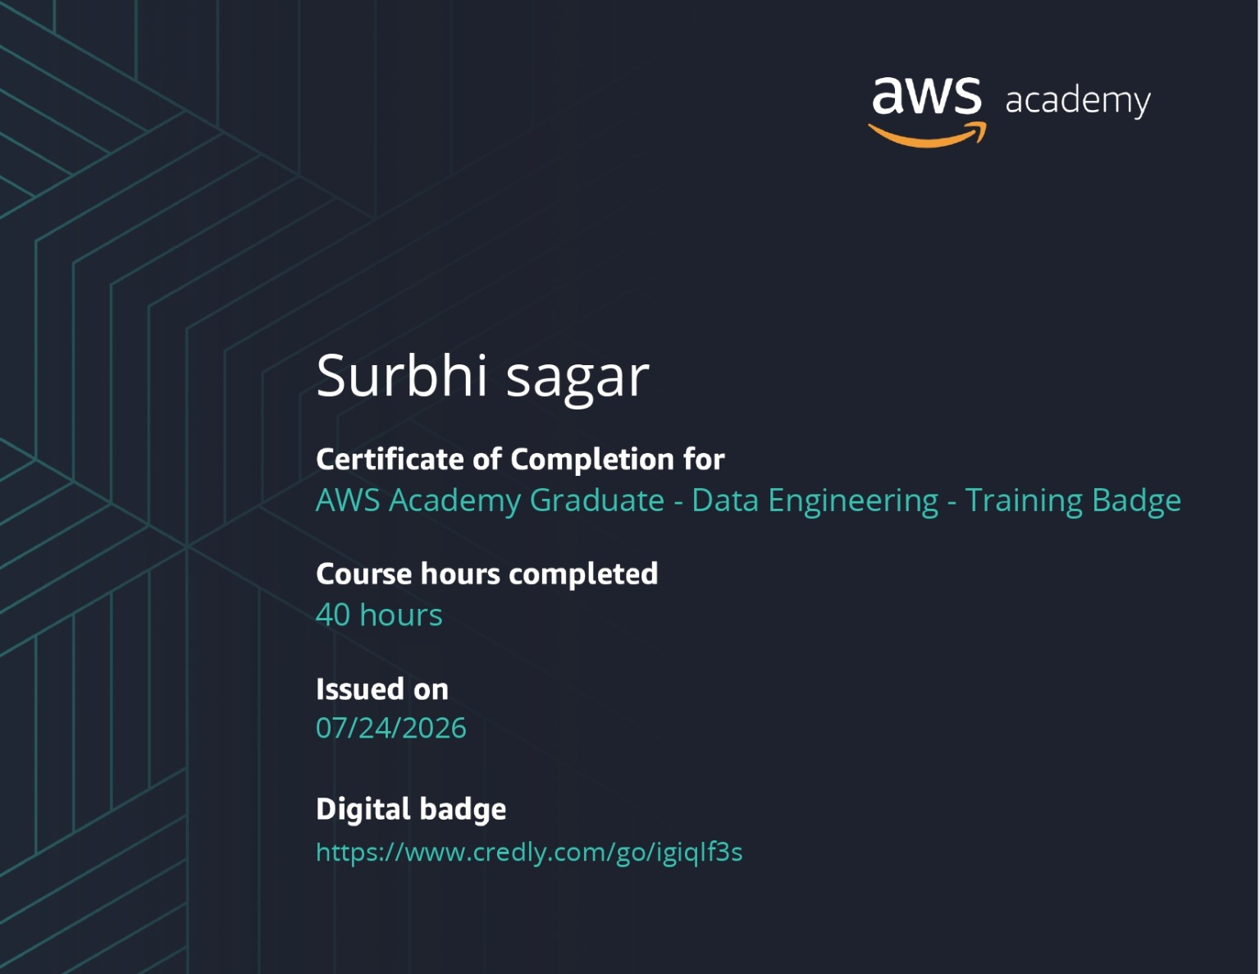
RECOGNITION
Certificates & Credentials
AICTE – EduSkills Virtual Internship
AWS Academy Training Badge
8
WEEKS
40
HOURS
O
OUTSTANDING
10

Slide 11
REFLECTION
Key Takeaways & Future Path
What this internship adds to my learning journey
1
→
2
→
3
→
4
INTERNSHIP
FOUNDATION
CLOUD
NEXT STEP
8-week structured experience
Data engineering concepts
AWS-oriented exposure
Further projects & learning
FUTURE FOCUS
1
Data Engineering
2
Cloud Computing
3
Analytics
Build more end-to-end pipeline projects.
Deepen AWS and cloud architecture knowledge.
Connect reliable data with useful insights.
11

Slide 12
THANK YOU
Data Engineering Virtual Internship
Surbhi Sagar • 2410031002
B.Tech CSE, 5th Semester • IILM University, Greater Noida
12

