Slide 1


Teach Back
Topic - AWS Step Function
Presented By - Surbhi Nayak

Slide 2
Agenda
Introduction
Demo
Challenges
Summary

Slide 3
Introduction

Slide 4
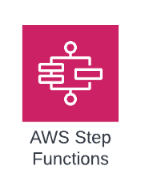
Coordinate components of distributed applications and microservices by using visual workflows.
Enable you to step through the functions of your application
Automatically triggers and tracks each step
Provide simple error caching and logging if step fails

Slide 5
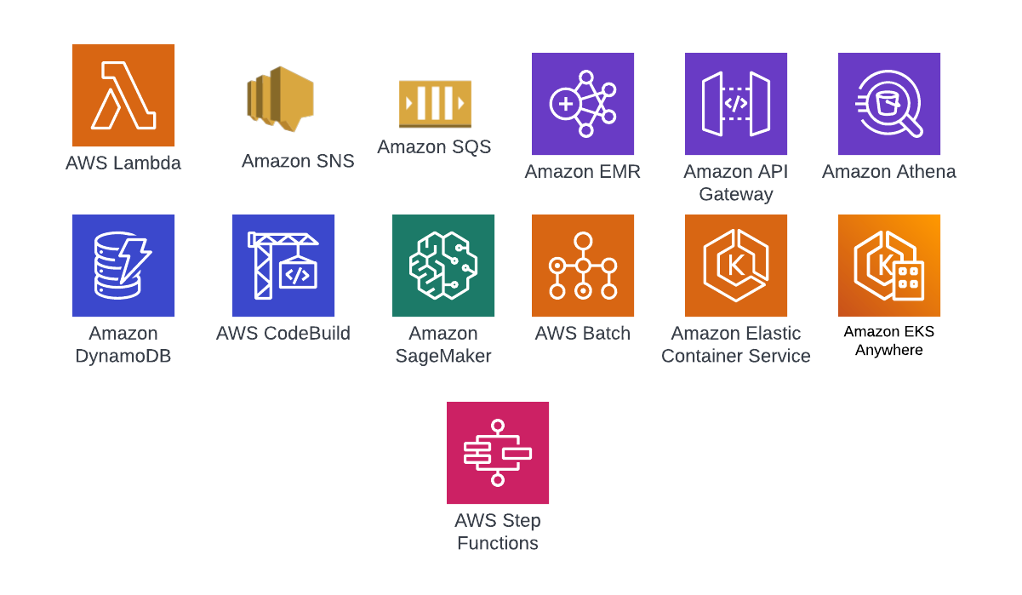
Supported services from Step Function:
Note: For unsupported services you need to call a third-party API or another cloud provider service, you need to use AWS Lambda.

Slide 6
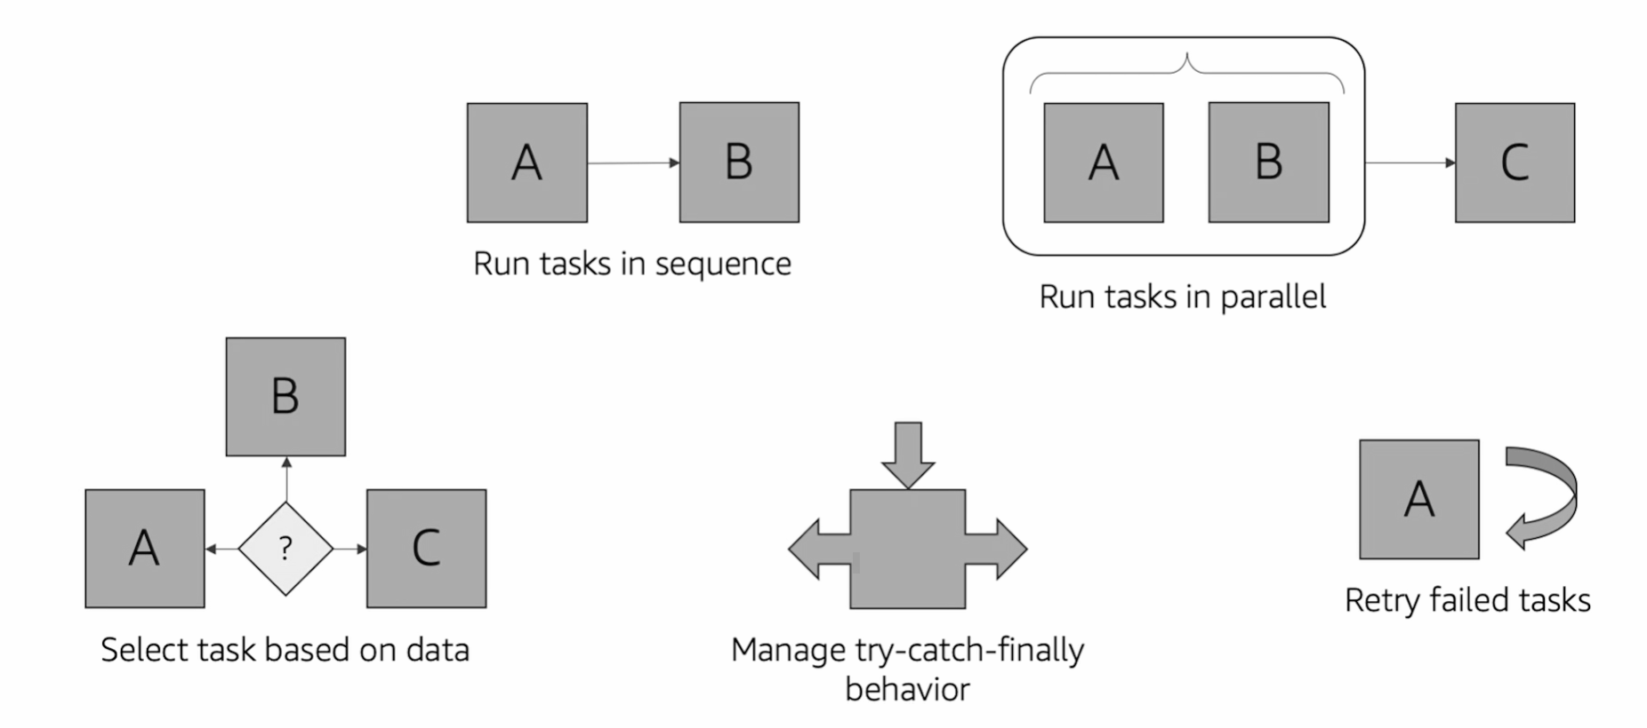
Workflow Coordination:

Slide 7
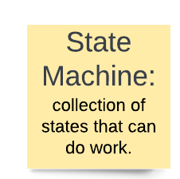
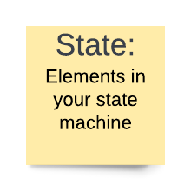
Concepts of AWS Step Functions
States Types:
Task - Do some work in your state machine
Choice - Make a choice between branches of state machines to run
Fail state or Succeed - Stop an running state machine with a failure or success
Pass - Pass its input to its output or inject some fixed data
Wait - Provide a delay for a certain amount of time or until a specified time and date
Parallel - Begin parallel branches to run in your state machine
Map - Dynamically iterate steps

Slide 8
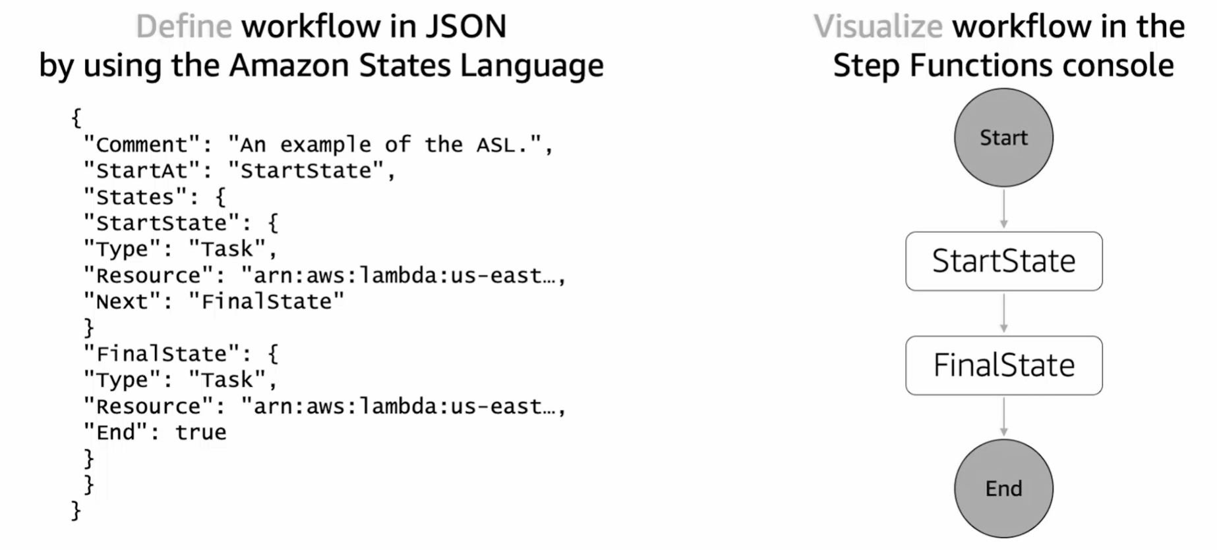
State Language:

Slide 9
Demo

Slide 10
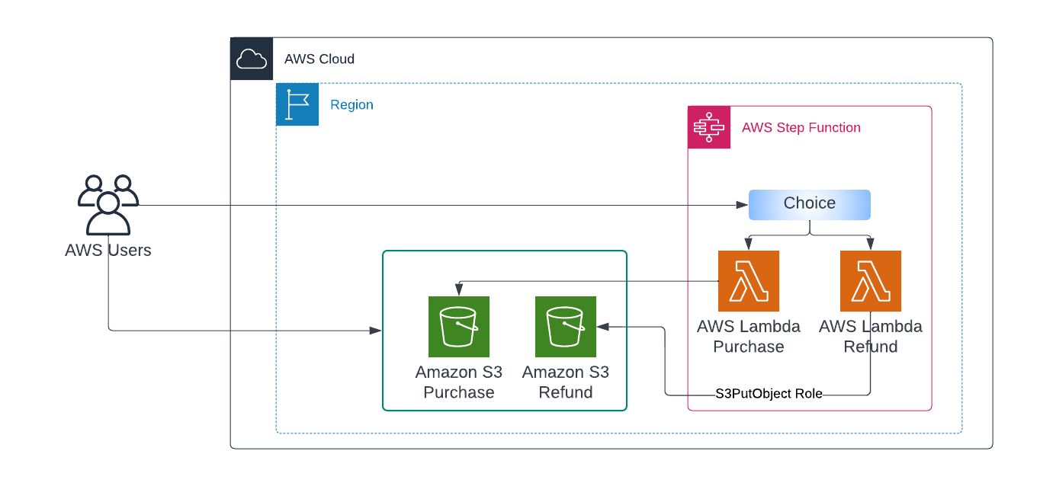
Use Case Flow in AWS

Slide 11
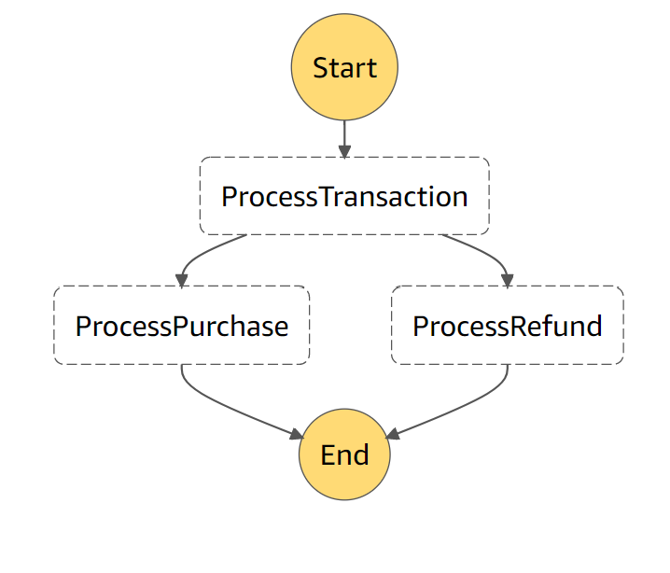
Working with Step Functions with Boto3
State Machine
ProcessTransaction – is the Choice state that uses the TransactionType input value to choose the next step (process purchase or process refund)
ProcessPurchase – is the Task implemented by the Lambda function
ProcessRefund – is the Task implemented by the Lambda function

Slide 12
Challenges

Slide 13
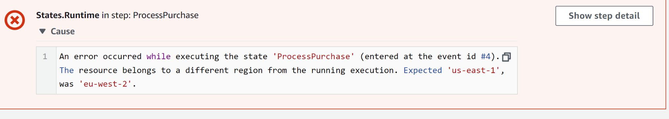
Challenge - While development I have faced the multi region error
Solution - My step function and Lambda function both were in different region. Then I created the lambda function in same region as Step function.

Slide 14
Summary

Slide 15
AWS Step Functions is a web service that enables you to coordinate components of distributed applications and microservices by using visual workflows
AWS Step Functions enables you to create and automate your own state machines within the AWS environment
AWS Step Functions manages the logic of your application for you, and it implements basic primitives, such as sequential or parallel branches, and timeouts
You define state machines by using the Amazon States Language

Slide 16
References:
https://hands-on.cloud/how-to-start-using-aws-step-functions/
https://hands-on.cloud/working-with-step-functions-in-python-using-boto3/#:~:text=Step%20Functions%20workflows%20manage%20failures%2C%20retries%2C%20parallelization%2C%20service,library%20%28Python%20SDK%20for%20AWS%29.%20Table%20of%20contents
https://youtu.be/vXiZO1c5Sk0

