Slide 1
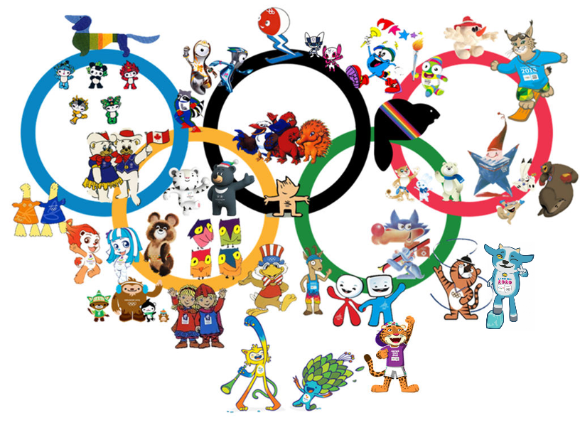
Summer Olympics Data Analysis (1960-2016)

Slide 2
Question-1
How Olympians have changed over the years in terms of BMI parameters?

Slide 3
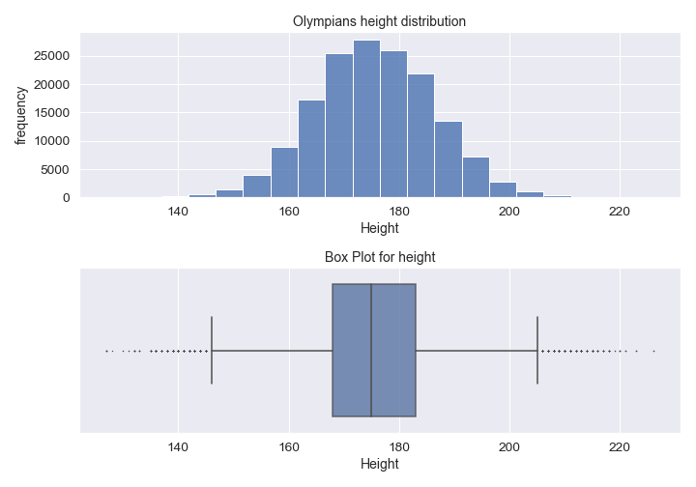

Slide 4
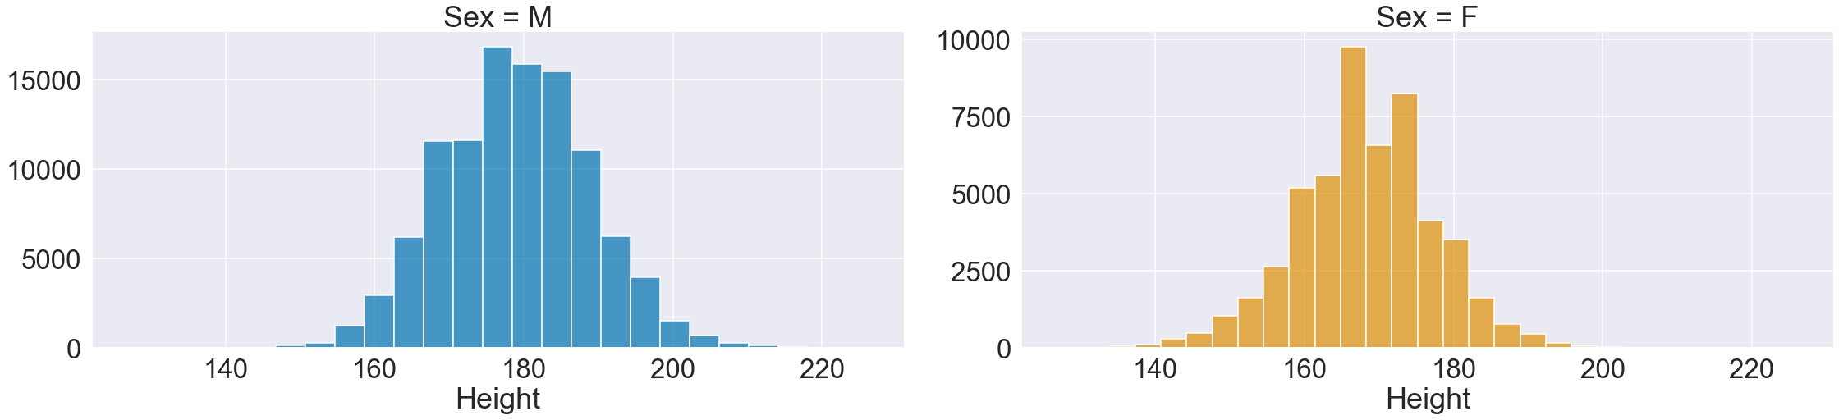
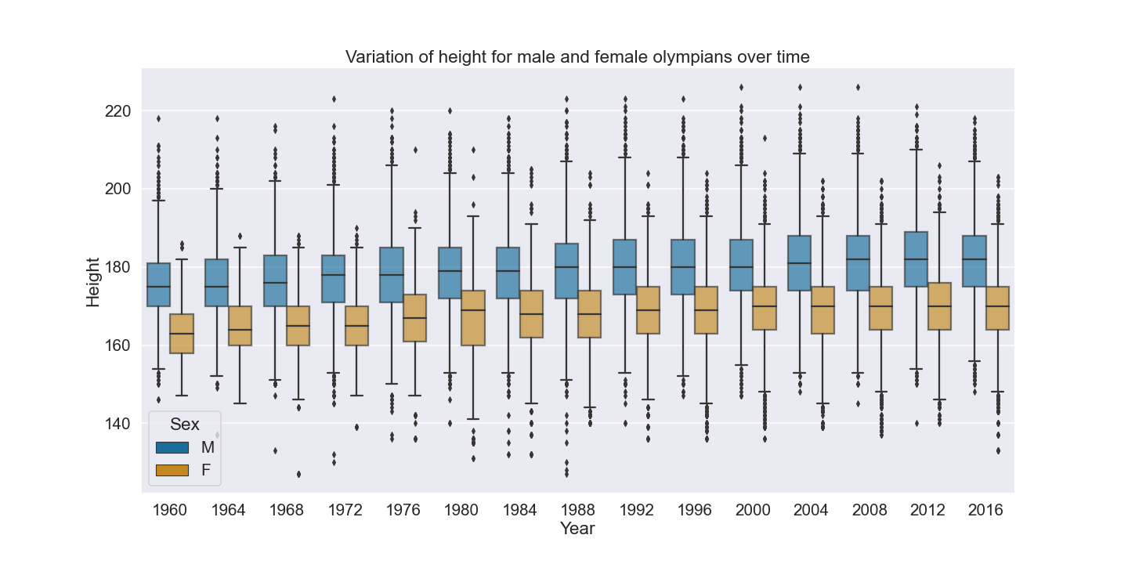

Slide 5
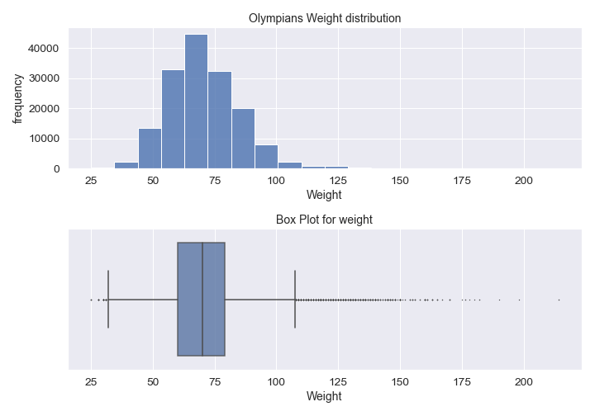

Slide 6
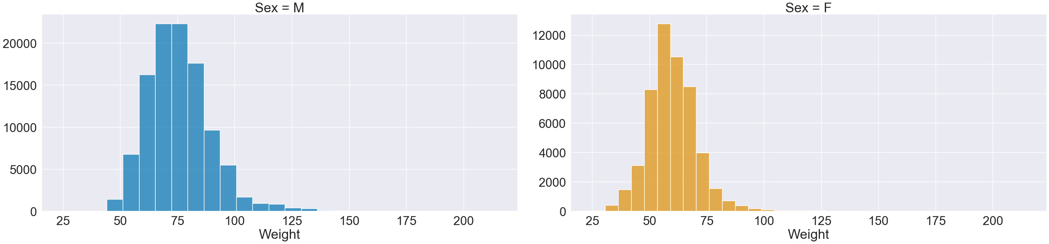
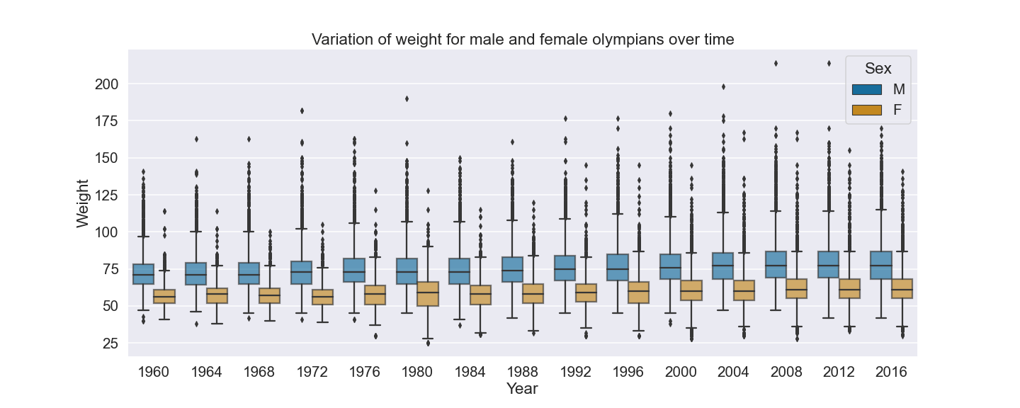

Slide 7
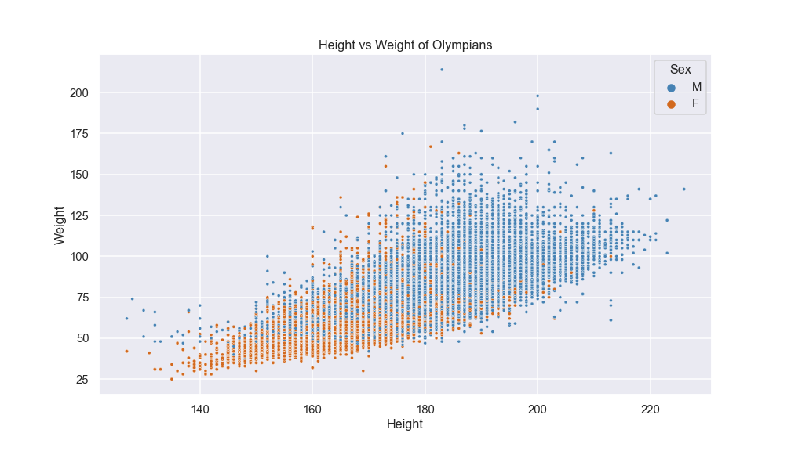

Slide 8
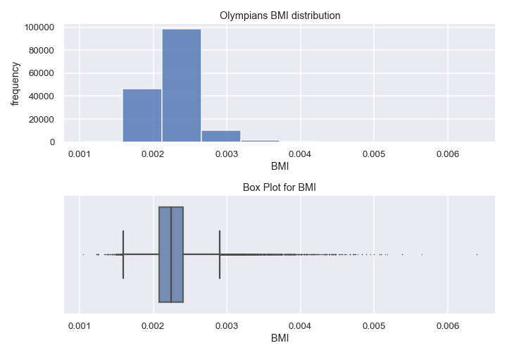

Slide 9
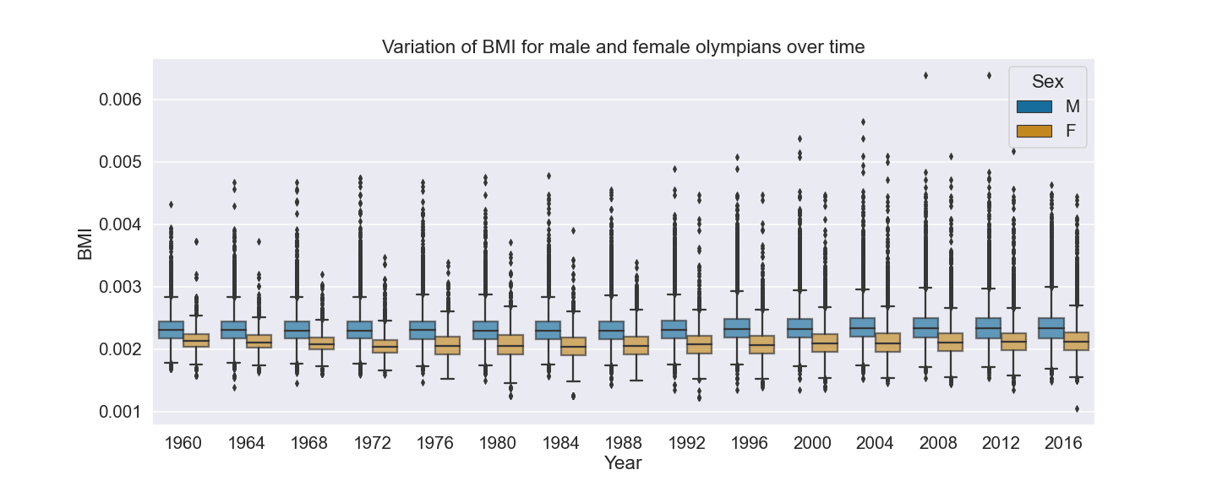

Slide 10
Question-2
How has the gender wise participation trend changed over the years?

Slide 11
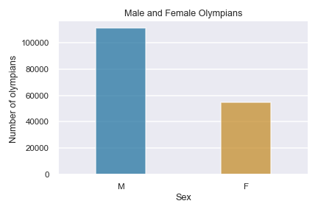
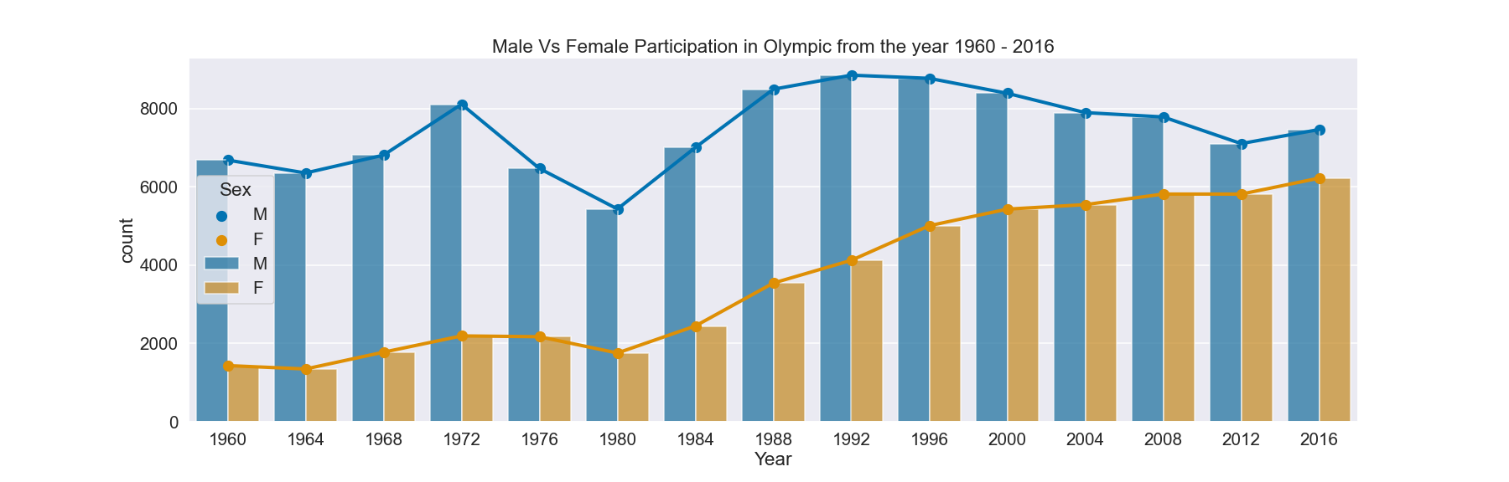

Slide 12
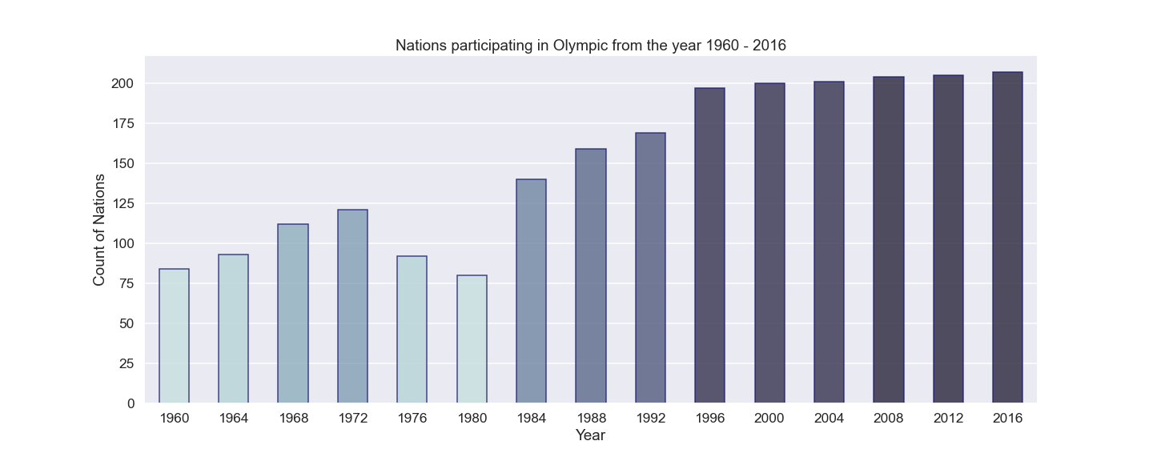

Slide 13
Question-3
How does the economy of a country affected their performance & participation factor?

Slide 14
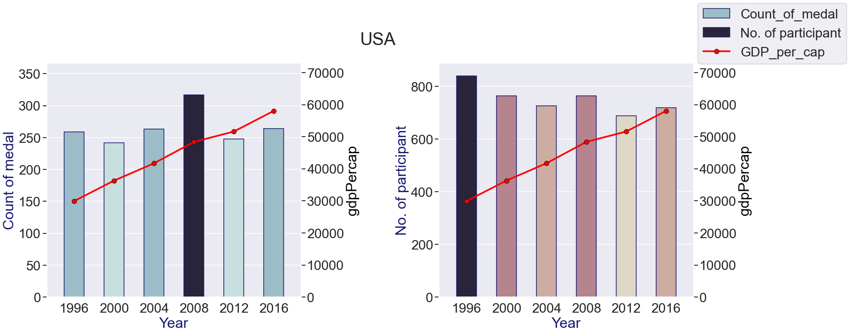
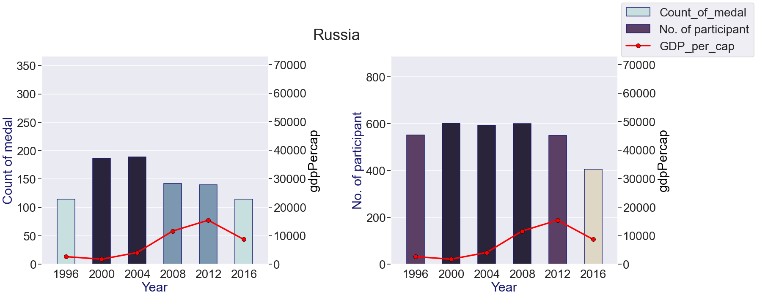

Slide 15
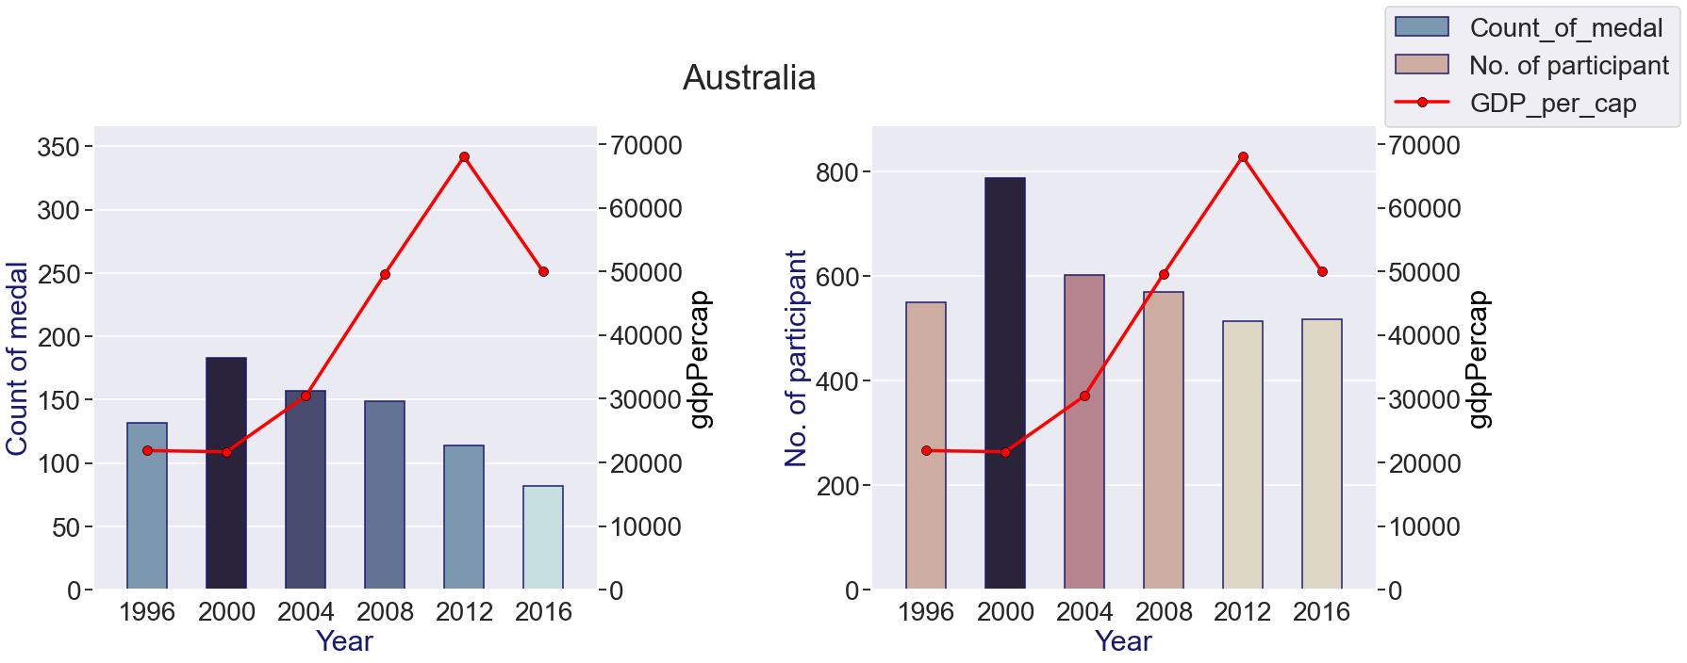
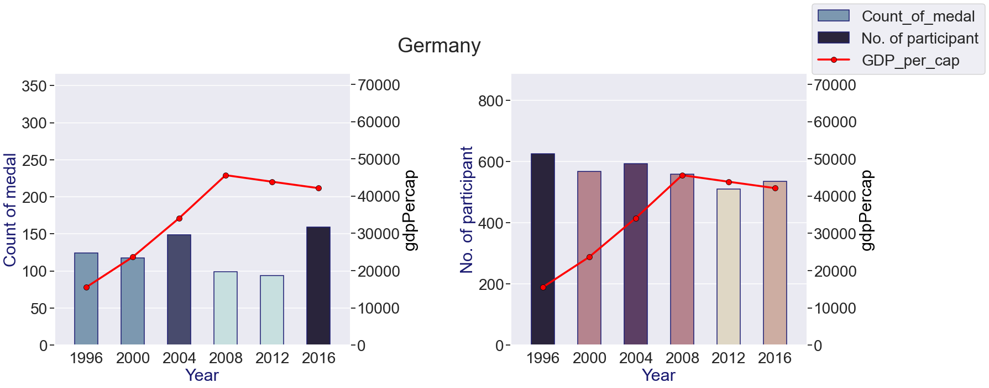

Slide 16
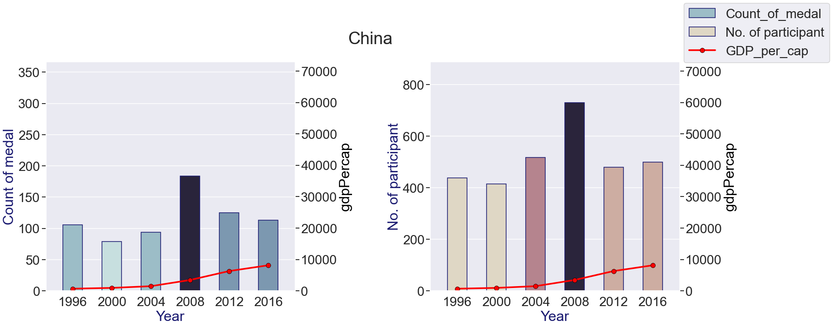

Slide 17
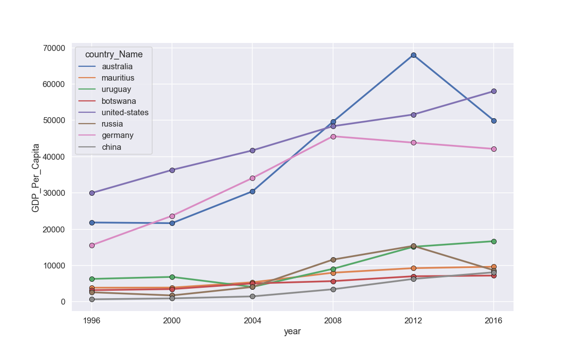

Slide 18
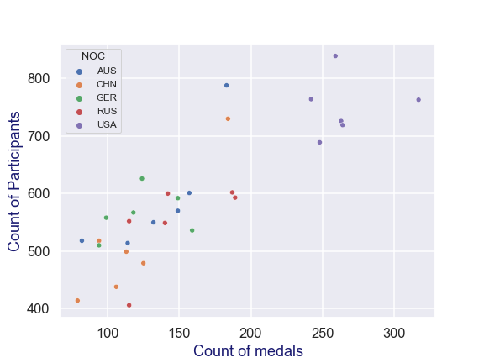
Correlation Value : 0.8453

Slide 19
Conclusion
The number of men that have participated in the Olympics games is higher than women participants however the participation of female athletes reached its highest point during the most recent Olympiad compared to male participants. Since 65 countries boycotted the 1980 Olympics, the participation of both women and male athletes decreased. On the other hand, height, weight and BMI have increased gradually over the history of the games. However, these plots could be hiding important variation since different body types are favored in different events. To explore this possibility, it would be better to dive deeper into the data and consider trends in size separately for different events. GDP per capita plays an important role in winning medal for each country. Also, we can conclude that a greater number of participants from country earns more medal.

