Slide 1
Name – Surbhi Salvi Sant Shiromani ravidas Global Skills Park Group Members(Surbhi salvi, tapas Pawar, Uprendra)

Slide 2
My Project : Blood Bank Management
(ASP.NET Web Forms with Master Page)

Slide 3
Purpose of Project
Manages details of donors, acceptors and blood stock.
Tracks availability of different blood groups in real-time.
Provides a platform for donors, acceptors, and admin.
Helps hospitals and patients during emergency needs.
Generates reports for decision-making.

Slide 4
🩸 Patients Who Need Blood
Blood is required in the following medical cases:
Heavy blood loss (accidents, surgery, delivery)
anemia, thalassemia, sickle cell anemia
Cancer and chemotherapy patients
Liver and kidney failure patients
Major surgeries (heart, bone, transplant)

Slide 5
Advantages/Benefits is:
Quick access to required blood group information.
Saves time in emergency situations.
Reduces human errors in record keeping.
Ensures transparency in blood donation and supply.
Easy communication between donors, patients, and admin.
Provides secure and reliable digital records.
Generates useful reports for better planning.

Slide 6
Output screens

Slide 7
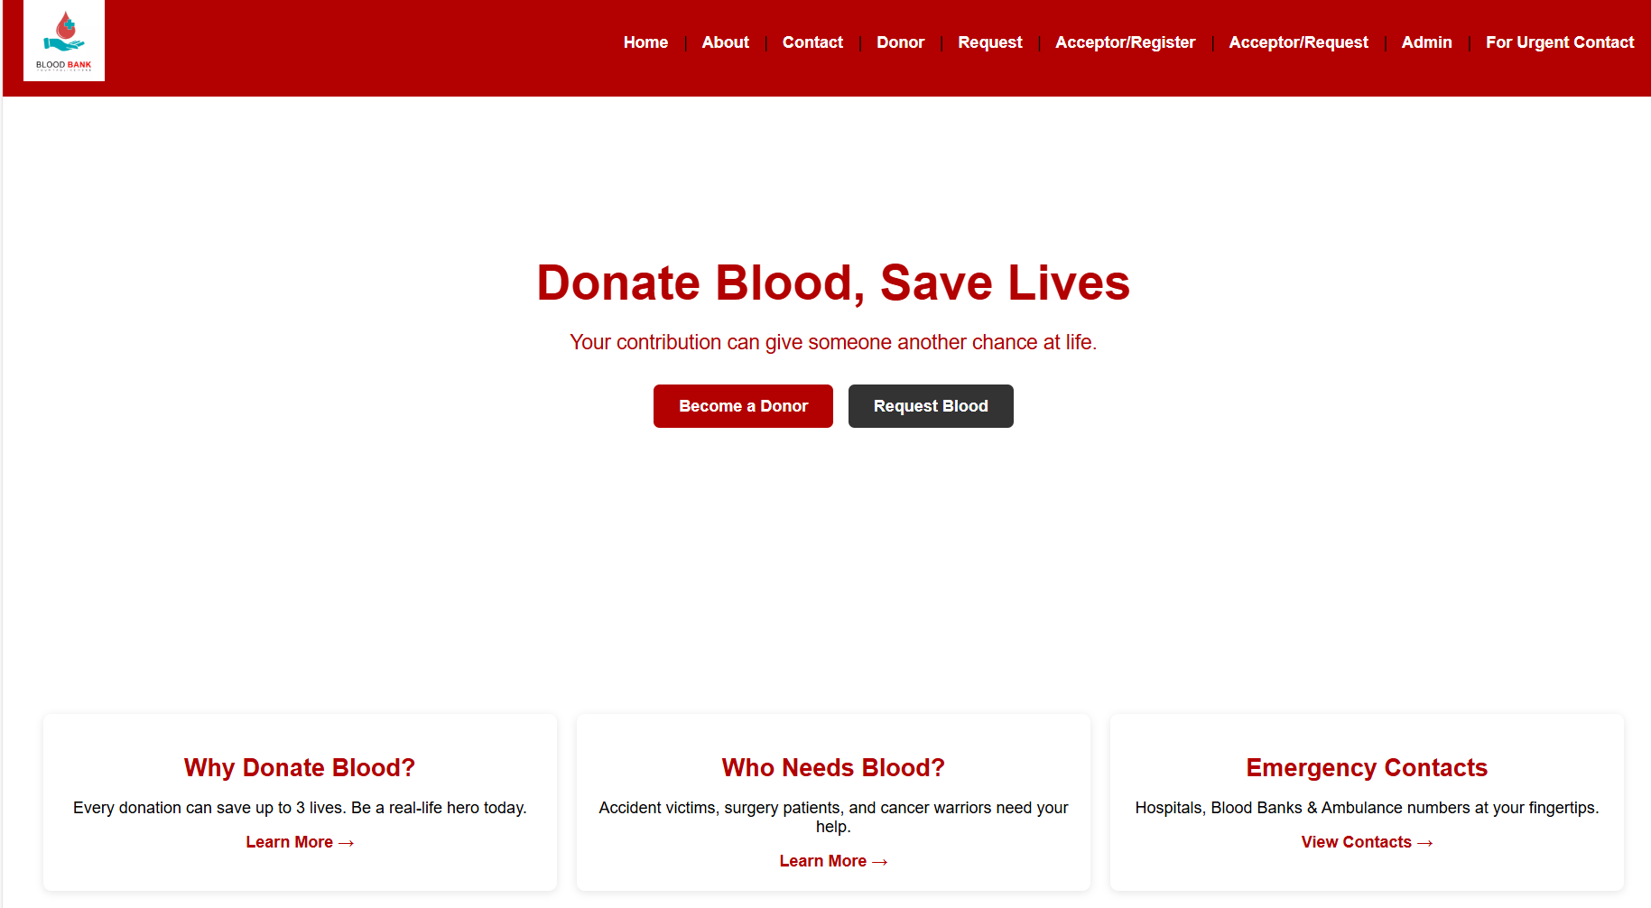
My Home Page Screen is:

Slide 8
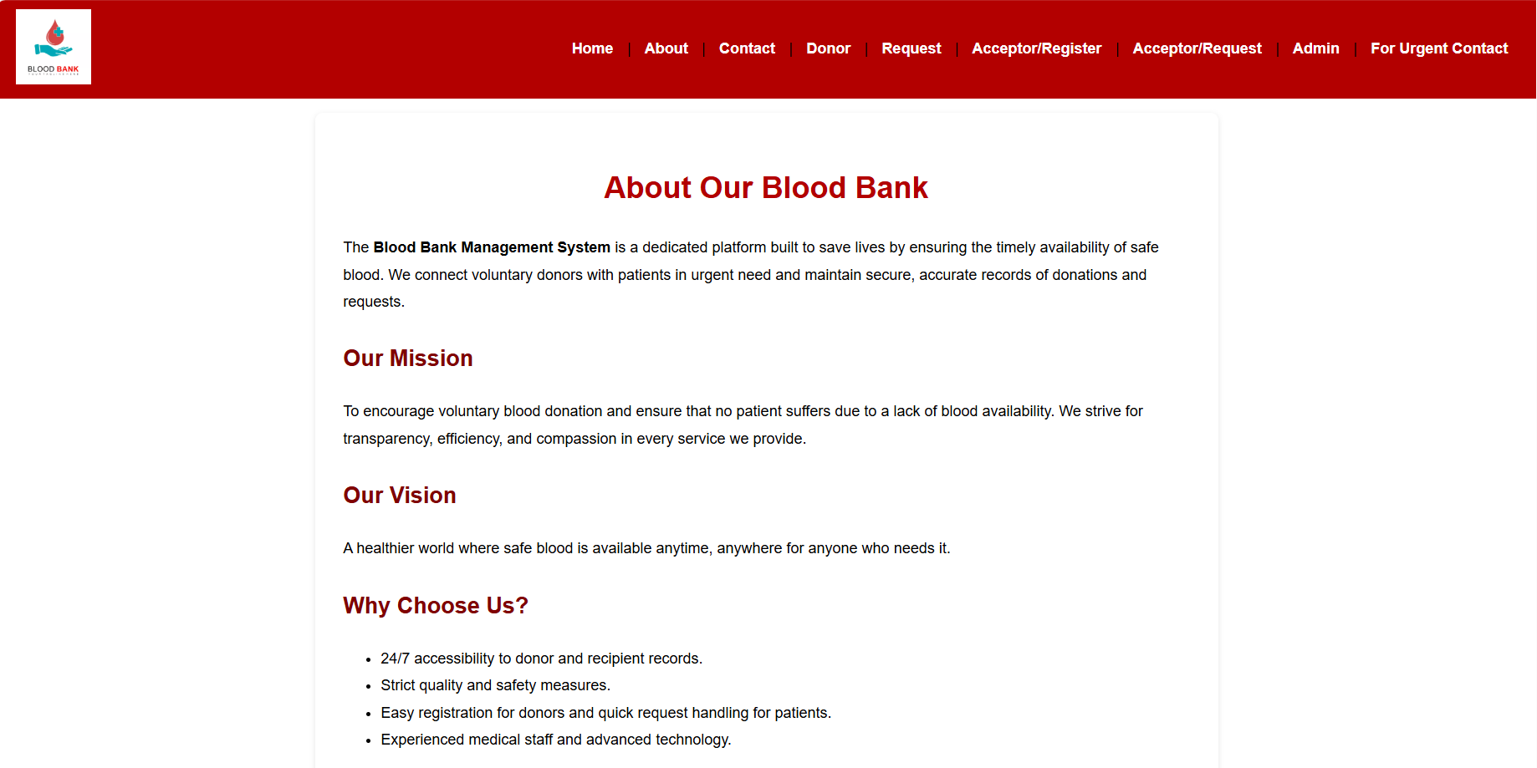
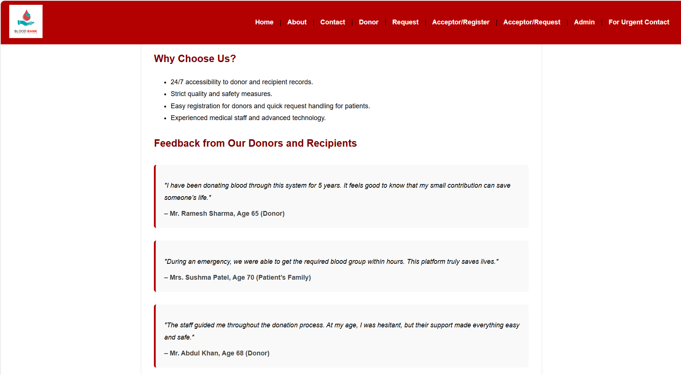
My About Page Screen is:

Slide 9
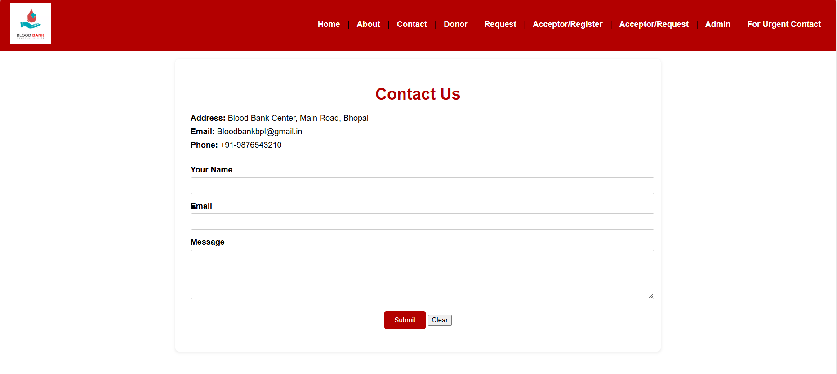
My Contact Page Screen is:

Slide 10
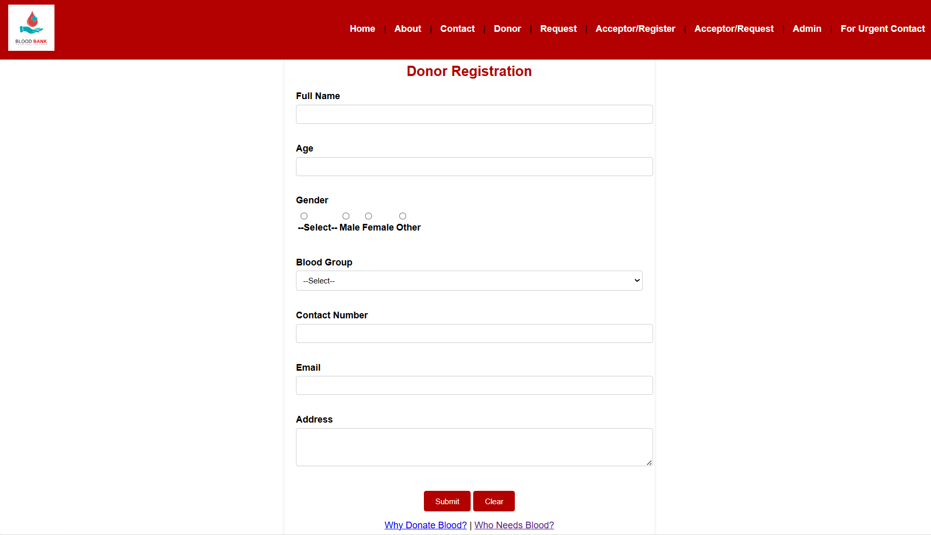
My Donor Page Screen is:

Slide 11
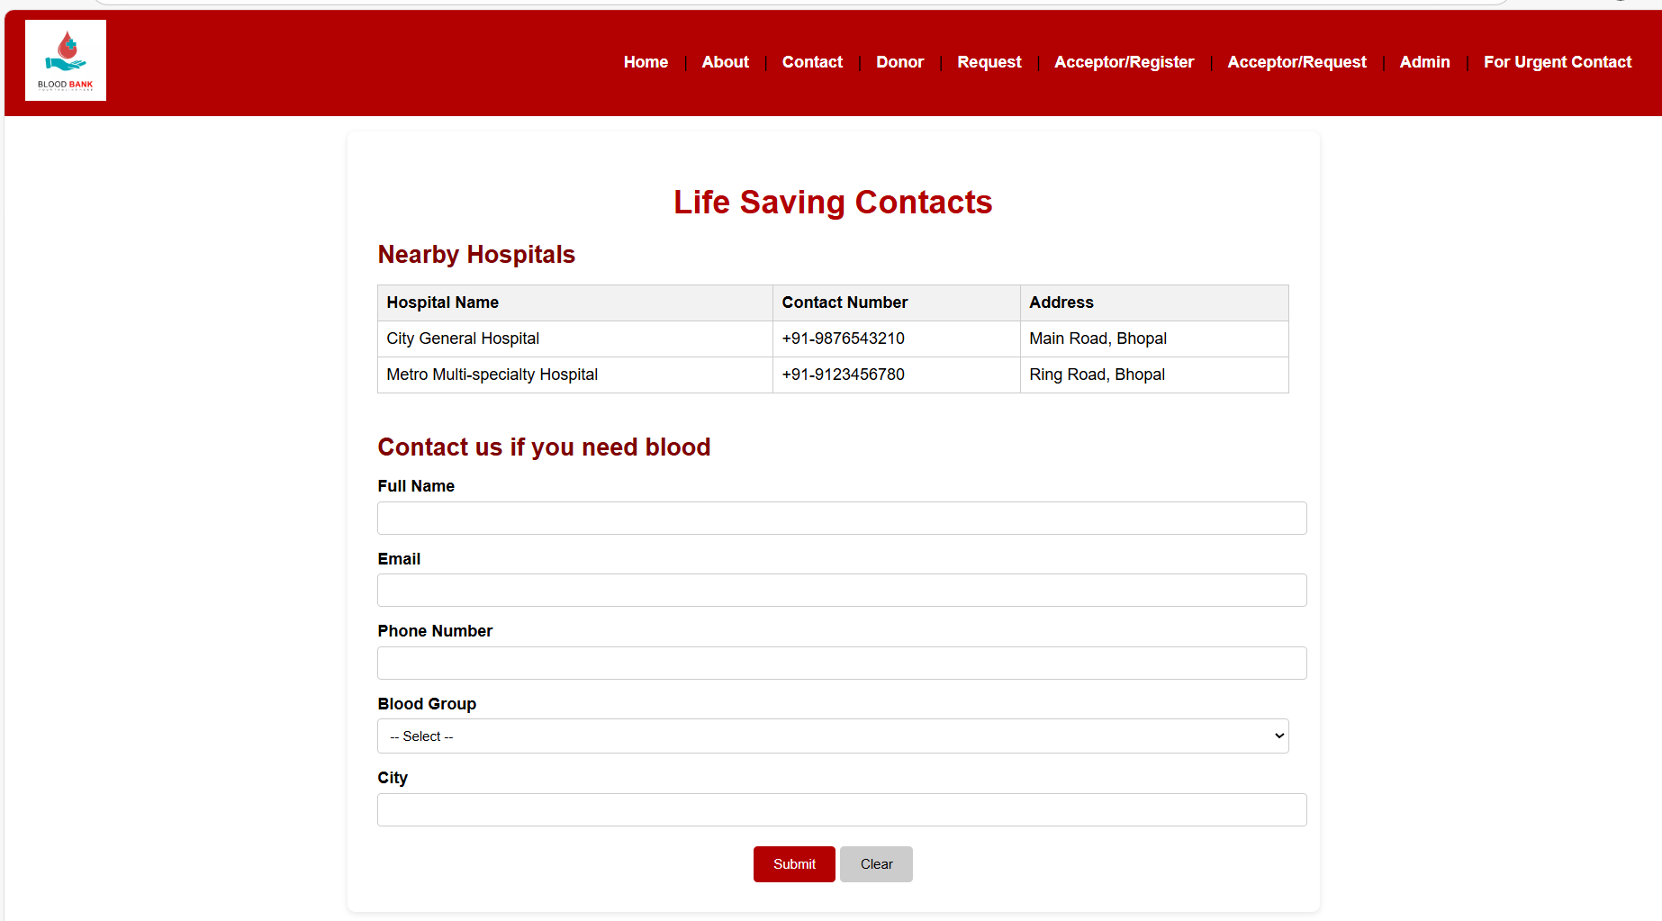
My Request Page Screen is:

Slide 12
My Acceptor Registration Page Screen is:

Slide 13
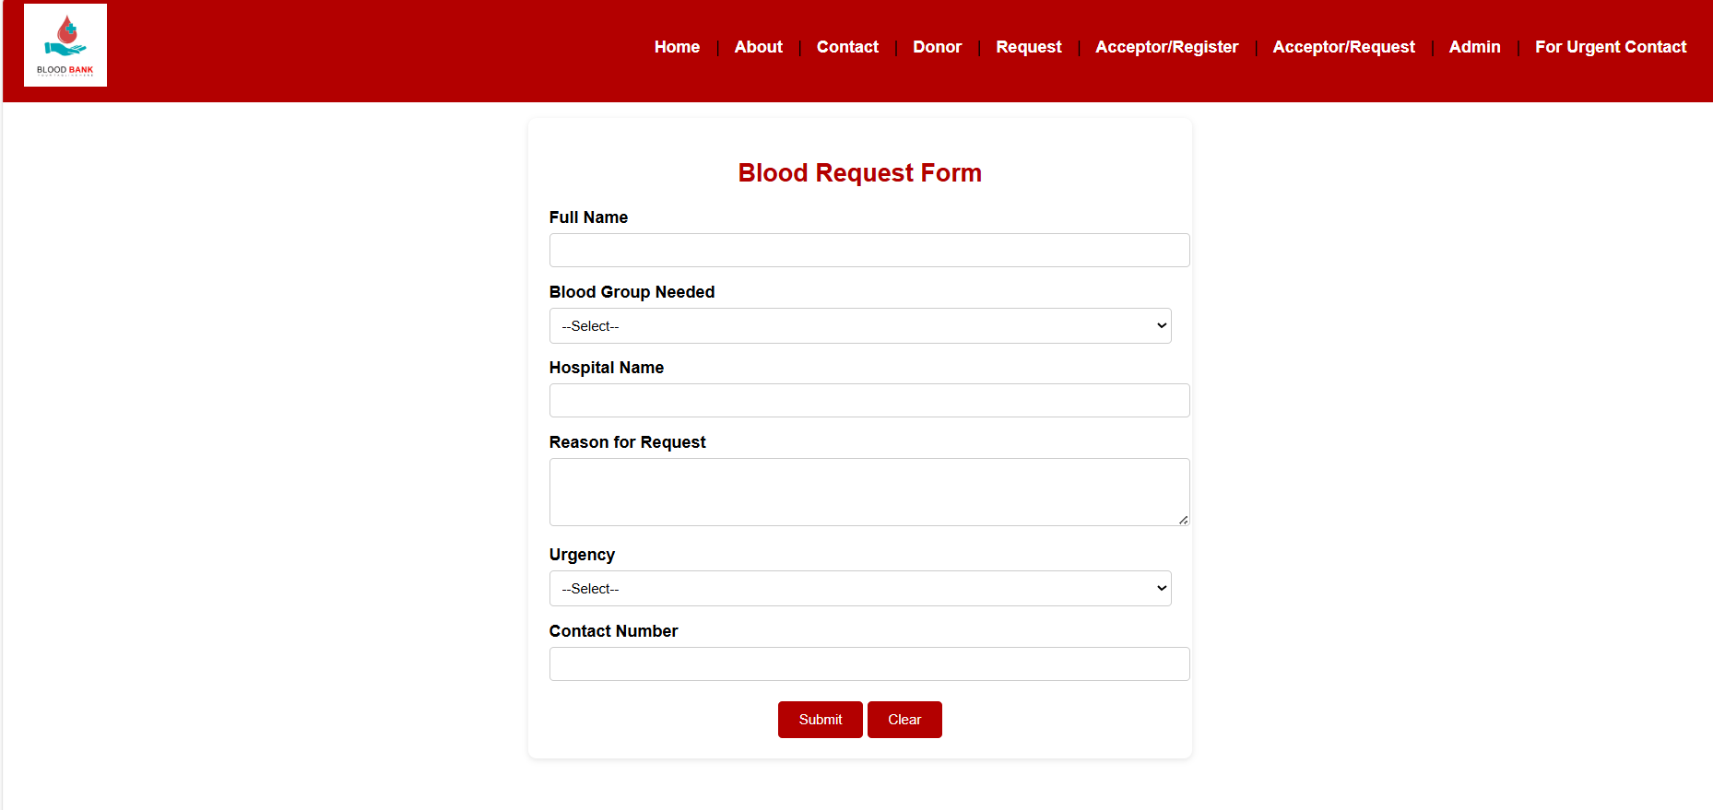
My Acceptor Request Page Screen is:

Slide 14
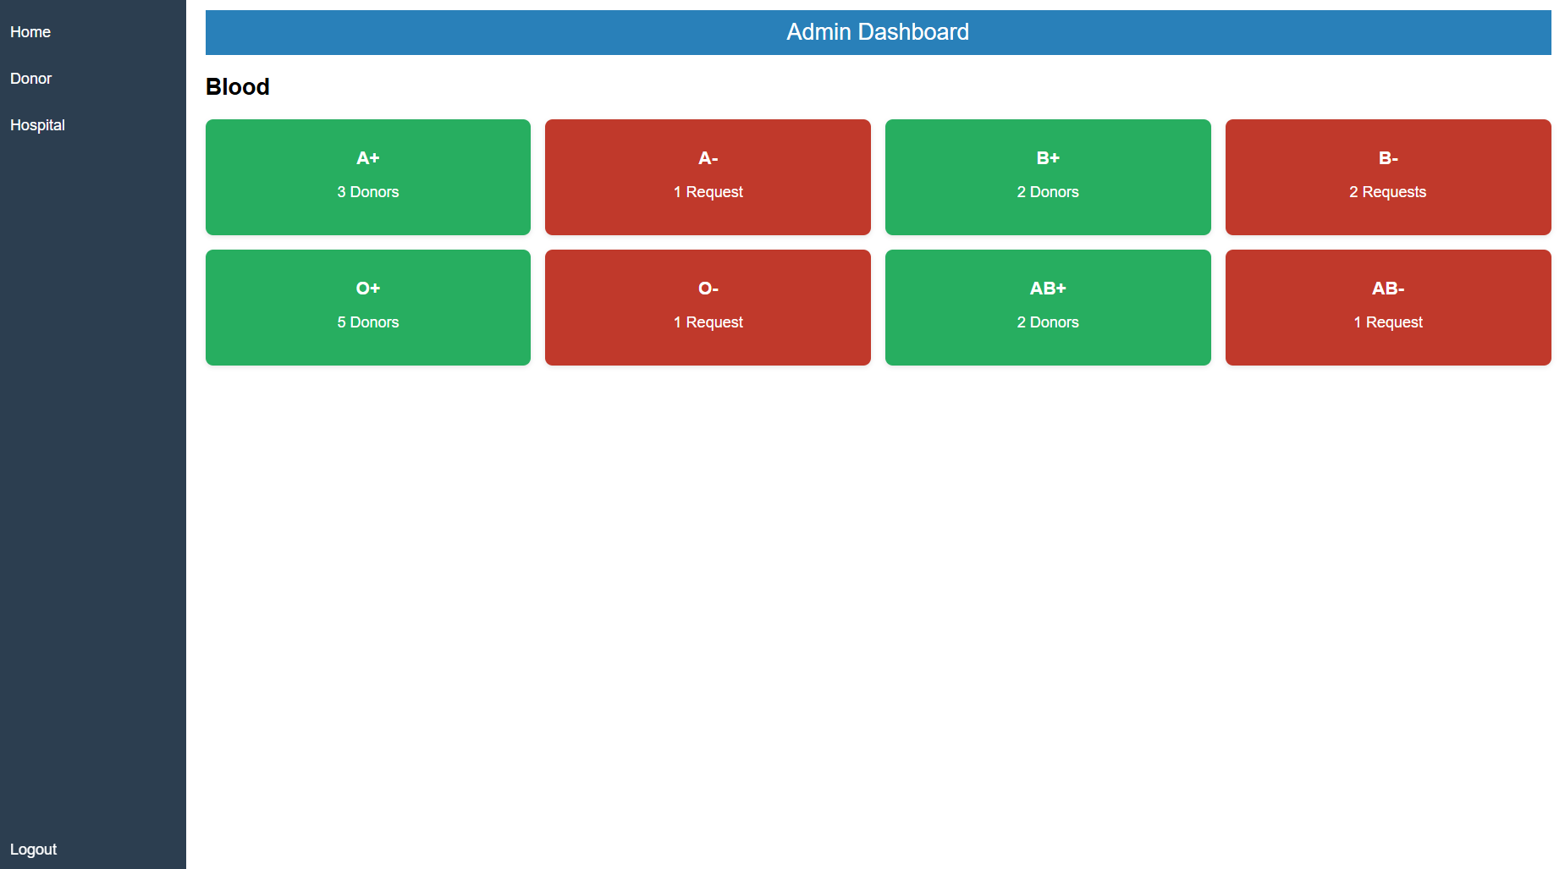
My Admin Page Screen is:

Slide 15
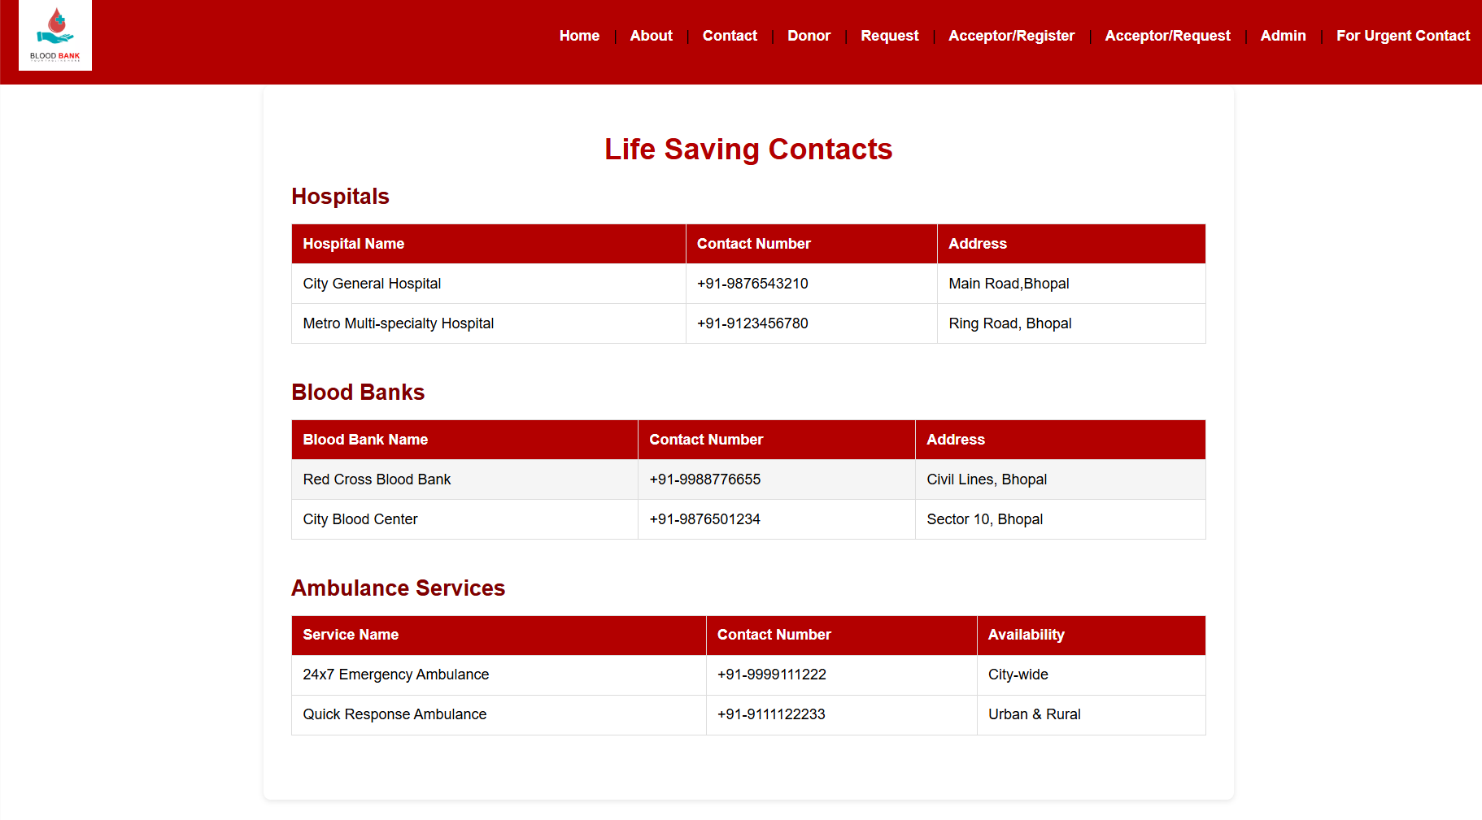
My Urgent Contact Page Screen is:

Slide 16
What further improvements can be made in the future
🚀 Future Improvements
Online portal & mobile app access.
Blood donation camp management.
Admin Page

Slide 17
References
Discussion with our Teachers
Discussion with our Group
ChatGPT
Online Blood Bank sides

Slide 18
Conclusion
With its help we can get information about blood banks from anywhere
At the time of need, it would be better to search on such a site rather than getting misled anywhere.

