Slide 1

A T E R A H E R T Z P R E S E N TAT I O N

Slide 2







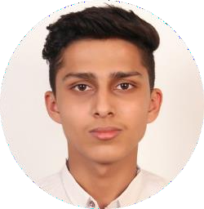
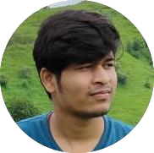

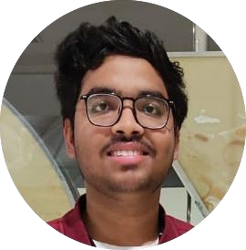
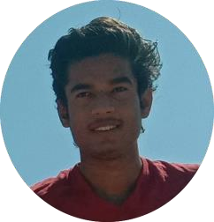















TERAHERTZ
Udit
Singh
Sourabh
Chouhan
Surbhi Sharma (Team Leader)
Nikhil
Arya
Antim Jain
Think, Feel, Collaborate

Slide 3



I R T U A L E S U M M I T^{] -} 2 0 2 1
- _{V}[
E-Cell IET DAVV Welcomes You
E-summit is a flagship events of competitions, workshops, panel discussions and speeches from the biggest names in the world of business. It provides a platform for students across India to showcase their entrepreneurial skills. It is also an excellent opportunity for them to hear and also interact with corporate leaders.

Slide 4



Slide 5


TIMELINE
1-2 June
12-10PM
REGISTRATIONS STARTS FOR ALL WORKSHOPS AND COMPETITIONS AND PITCH TO THE POTENTIALS
DAY 0
03 June
10AM-11AM
INTRODUCTION
11AM-12PM
GUEST TALKS
3-4PM
GUEST TALKS
4-6.30PM
WORKSHOP – STEEP INTO THE STARTUPS
DAY 1
12-3PM
WORKSHOP-FUEL UP ON CREATIVITY
04 June
DAY 2
10AM-2PM
PITCH TO THE POTENTIALS
2.30-3.30PM
PANEL DISCUSSION
3.30-5.30PM
COMPETITION-PITCH ME UP
05 June
11AM-2PM
WORKSHOP-AI AND ML
4-4.30PM
COMPETITON- FANDOM
5-8PM
COMPETITON- •
GAMERSZ ARENA
8-8.30PM
PRIZE DISTRIBUTION FOR COMPETITIONS
8-9PM
END CREDITS
DAY 3

Slide 6

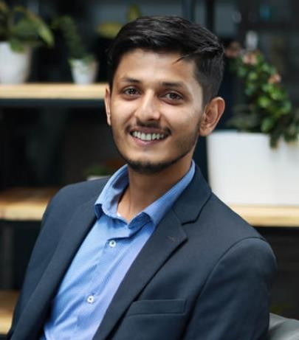
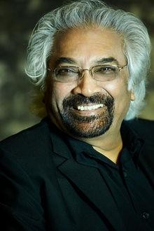
GUEST TALKS
Abhinav Dubey
Founder of Chai
Sutta Bar
MBA Dropout
Sam Pitroda
Pioneer of Indian Telecom
Revolution

Slide 7

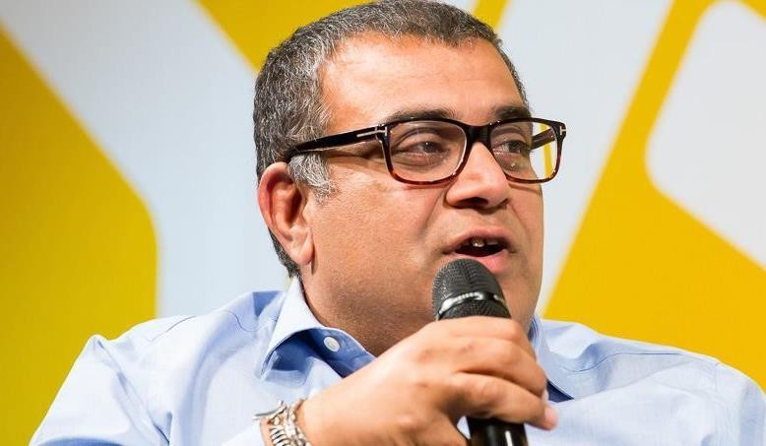
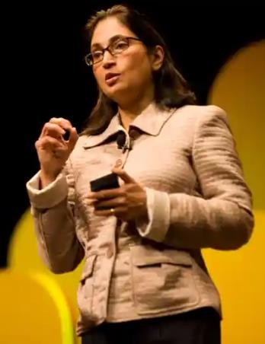
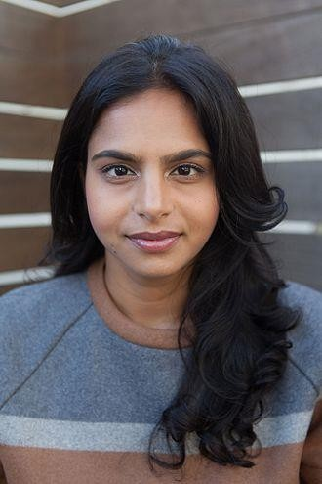
Entrepreneurship Summit 2021
PANEL DISCUSSION
Life in silicon valley
A panel discussion on the reality of life in silicon valley
What’s it like India’s silicon valley - Bangalore
Success and failures of startups
Innovation - an essential factor for startups
A large crowd of an entrepreneur giving rise to competition
Date: 4th June 2021
Timing : 2:30 - 3:30PM
OUR GUESTS
Om Malik
Indian- America web and technology
writer.
Padmasree Warrior
Indian-American businesswoman and technology executive
Ruchi Sanghvi
Indian computer engineer and
businesswoman

Slide 8
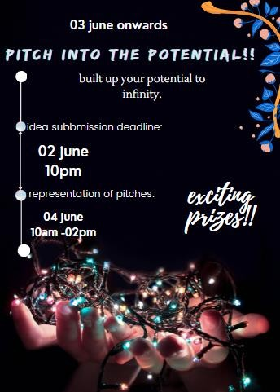
Pitch into the potentials
It will open many doors of opportunity.
Investors will provide a platform & funding for your
startup
Get feedback from our audiences about your product
Explore your real potential
Get advice from the panel of experts
Register your idea: 1st June - 2nd June (10 pm)
Entry Fee: 250
Pitch representation: 4th June (10:00 AM - 2:00 PM)
Prize distribution - 5th June
Prizes:
1st prize – Rs 2000 2nd prize – Rs 1000 3rd prize – Rs 500

Slide 9
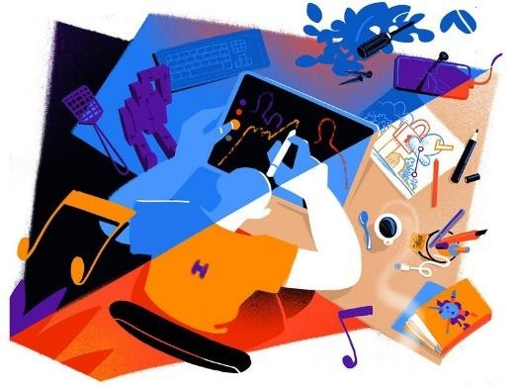


WORKSHOPS
FUEL UP ON CREATIVITY
STEEP INTO THE STARTUPS
ML AND AI

Slide 10

Workshop 1 - Fuel up on creativity
Creating a creative mindset - a new generation full of creativity
Innovation - new ideas that can change the world
An essential part of human evolution
Free study material will be provided
Certificate to all participants
10min quiz at the end to keep the session interactive
Quiz winners will be given prizes
accordingly
ENTRY FEE: Rs 250
Duration: 3 Hrs
Date: 1st June 2021
Timing:12PM – 03 PM

Slide 11

Workshop 2 – STEEP INTO THE STARTUP
How to build a successful startup
Mistakes that should be avoided
How to ensure growth
Management
Advertisement & promotion - an
important factor
How to reach the targeted audience
Free study material will be provided
Certificate to all participants
10min quiz at the end to keep the
session interactive
Quiz winners will be given prizes accordingly
Entry FEE : Rs 250
Duration: 2.5 Hrs.
Date: 3rd June 2021
Timing: 4 PM - 6.30 PM

Slide 12


WORKSHOP 3-ML AND AI
AI & ML use-cases
Trends from India’s top AI research labs
Advancing the understanding of understanding and implementation of AI + ML
Building a bright future with AI & ML
Free study material will be provided
Certificate to all participants
10min quiz at the end to keep the session interactive
Quiz winners will be given prizes accordingly
Entry Fee: Rs 250
Duration: 3 hrs
Date: 3rd June 2021
Timing: 11AM-2PM

Slide 13



COMPETITIONS
PITCH ME UP
FANDOM
GAMERZ ARENA

Slide 14



PITCH ME UP:-
Anyone can pitch in a sufficient time,but can you do the same in 2 minutes??
Can you attract someone to invest into your ideas/products in two minutes? Then you should join this competion
Register your idea: 1st June - 2nd June
(10 pm)
Entry Fee : Rs 250
Pitch representation: 4th June (3:30 - 5:30 PM)
Prize distribution - 5th June
Prizes: Gift Cards worth
Rs2000 Rs1000 Rs 500

Slide 15

GAMERZ ARENA
•Want to showoff your gaming skills and reflexes? Then is this the right competition you are looking for.
•Participate in multiplayer games like rocket league , COD mobile/pc, PUBG PC , CS:GO the last man standing wins.
•Entry fee
•Time- 5-8PM
Date -05 June
•Duration -3hrs
•Prizes - Gift Cards worth
Rs 2000
Rs 1000
Rs 500

Slide 16

Fandom
•the quiz is for all the die hard fans of the
famous movie franchises TV/web series
•Know which fan stands the last
•win exciting prizes
•Entry fee – Rs. 250
•duration – 30 Mins
•date- 05 June
•time- 4-4.30 PM
•prizes- Gift Cards worth Rs. 2000
Rs. 1000
Rs. 500

Slide 17


PRIZE DISTRIBUTION
For Pitch Me Up, Fandom and Gamers arena
1st PRIZE
RS. 2000 GIFT CARD
2nd PRIZE
RS. 1000 GIFT CARD
3rd PRIZE
RS. 500 GIFT CARD

Slide 18
TEAMS WE NEED
Content writers
PR team
Social media
Coordinator
Tech Team
Registration management team
Judges
Account management team
Gaming management team
Anchoring team
Web developers
Graphics Designers
Broadcasters
Advertisers

Slide 19


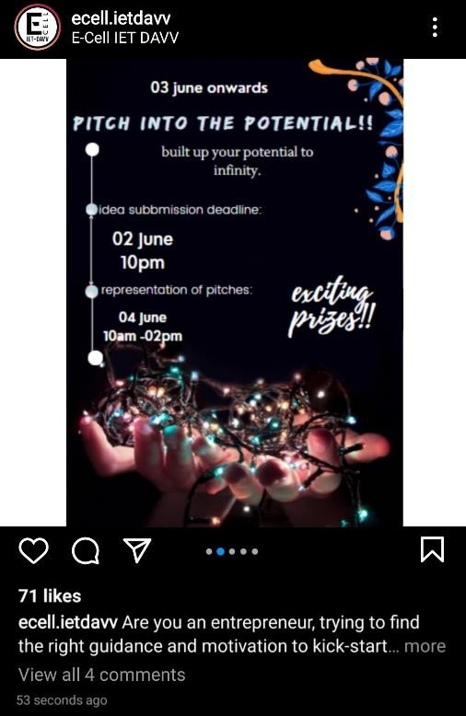


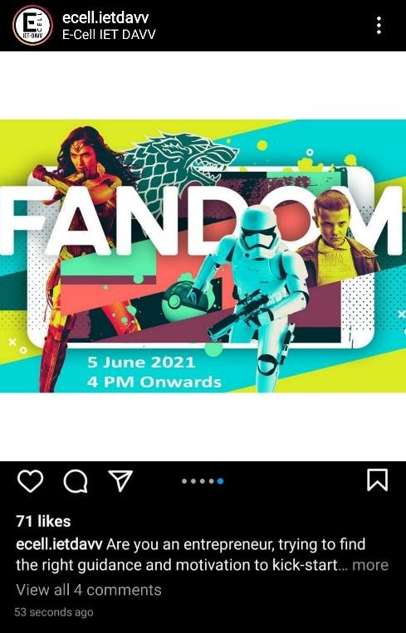
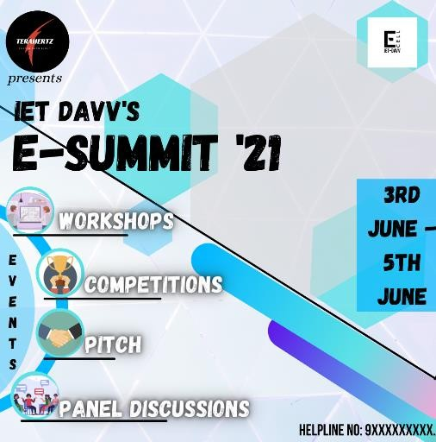
PROMOTION ON SOCIAL MEDIA

Slide 20



Choose day/times
Appropriate date & time for the session which is viable for most of the targeted audience
Speaker collateral
Creating collateral for speakers & workshops
E-SUMMIT ROADMAP
Start
Step1
Step2
Step3
Step4
Decide on a format
Deciding which workshops are going to be paid & which are
Get speakers
Reaching out to speakers
;Pitching material for e-
IET DAVV’S
E-SUMMIT’21
03 June- 05 June
Promotion
going to be free
summit to them & hiring them
Social media ; Digital promotion, advertisement ;Promoting sponsors
Event website
to speak
Info about the event
Step8
Step7
Step6
Step5
Other content
pitch, competitions
Promotional materials
Run the show
For event & For individual speaker
Pre-recording parts
Ensuring no error occurs
Preparing pre-recorded material in case anything goes wrong
during the event; Monitoring social media ; Answering help questions
Step 9a
Step 9b
Step 10
Step 11
Finish
Live event preparation
Ensuring audio & video preparations
Post-event
Credits; Survey on how the event went

Slide 21











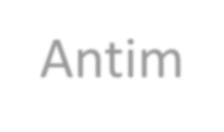

TERAHERTZ
Surbhi Sharma : Poster designing ; Content ; Power point presentation
Sourabh Chouhan : Poster designing ; Content ; Power point presentation
Udit Singh
: Poster designing ; Content ; Power point presentation
Nikhil Arya
: Poster designing ; Content ; Power point presentation
Antim Jain
: Poster designing ; Content ; Power point presentation

Slide 22






TERAHERTZ
Surbhi Sharma
Sourabh Chouhan
Udit Singh
Nikhil Arya
Antim Jain
C++(Learning)
C++(Learning)
C++(Learning)
C++(Learning)
C++(Learning)
Graphics
Designing
(Learning)
Graphics
Designing
(Learning)
Graphics
Designing
(Learning)
Graphics
Designing
(Learning)
Meme Making
Web Development (Learning)
Video Editing
(Learning)
Meme Making
Content Writing

Slide 23


