Slide 1


GDA - Network Design Proposal
Varun Mishra (vm1420)
Apurv Srivastav (as11419)
Ajay Thorve (aat414)
Archit Goyal (ag6288)
Surbhi Thole (sst390)
05/12/2018

Slide 2
Introduction
GDA is a Global Company which is planning to expand its market but facing issues of network architecture, Security, Bandwidth management, Resource management, IP addressing, Managing data centers and servers etc.

Slide 3
Issues with the Current System
Slow access to files
email delivery
Poor voice quality
Application crashes - poor network design

Slide 4
Proposed Solutions
We have come up following solutions
Redesign the Global Network Architecture
Develop new IP addressing schema
Propose new data center locations
Redesign Local LAN’s
Propose efficient protocols
Bandwidth Allocation
Server Management
Security
Notes:
IP address schema - Class A ip addresses. Proposed new data centers location at America, Europe, Asia. Proposed use of efficient protocols such as RTP, HTTPS, SMTP etc.

Slide 5
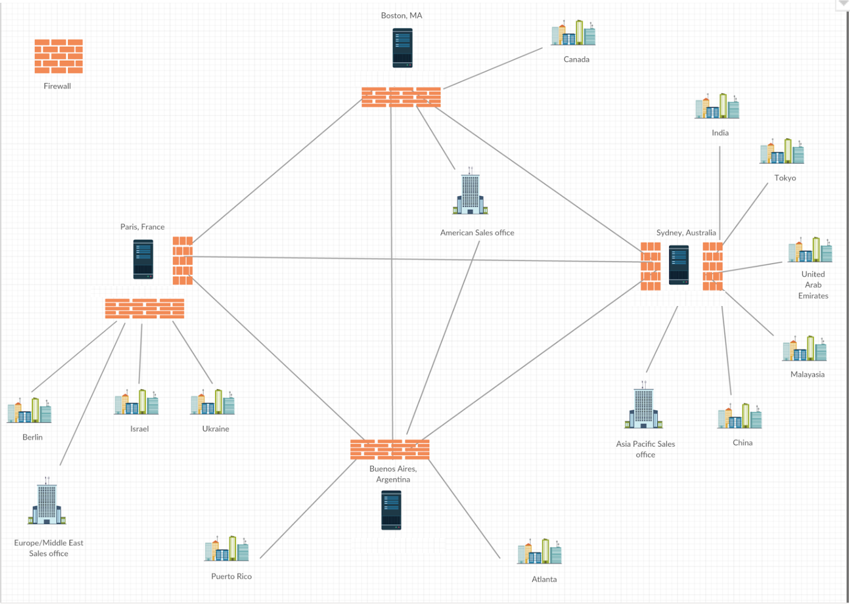
Network Design for GDA
Notes:
These are headquarters not datacenters

Slide 6
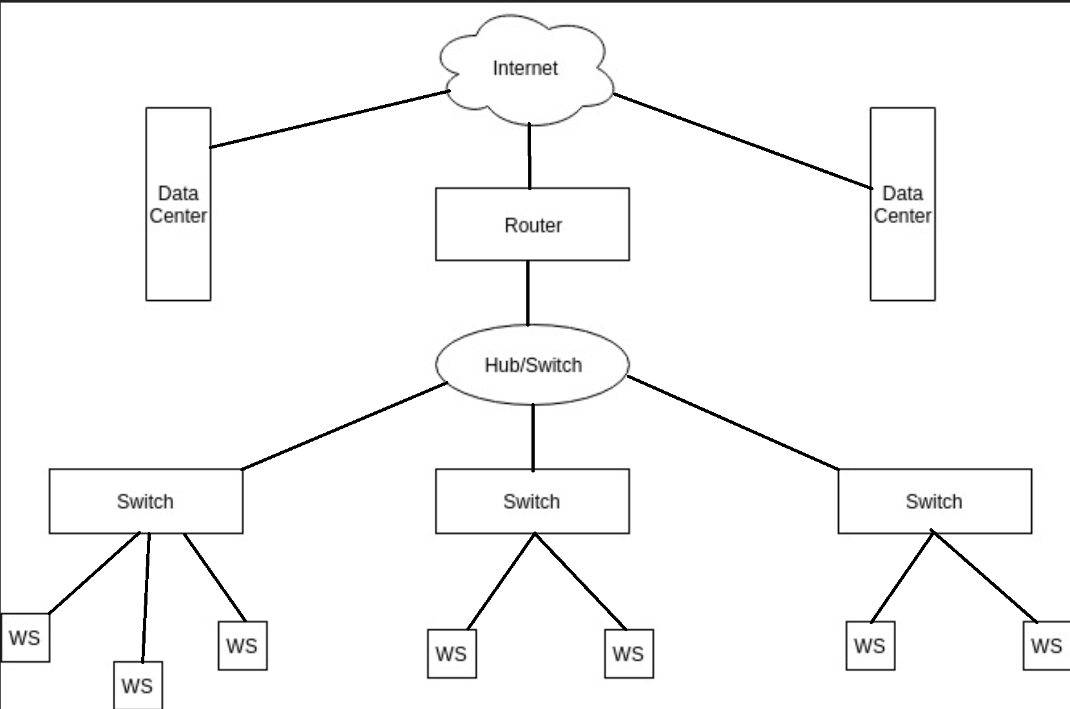
Block Diagram for Communication

Slide 7
Data Center
Key factors for Location Decision :
Servers
Power distribution and cooling
Networking equipment
Proximity to customers and skilled workforce
Geographical factors for expansion
Notes:
Servers - Always running
Cooling - proper infrastructure
Networking Equip - Switches, Ethernet cables, hard disk, routers

Slide 8
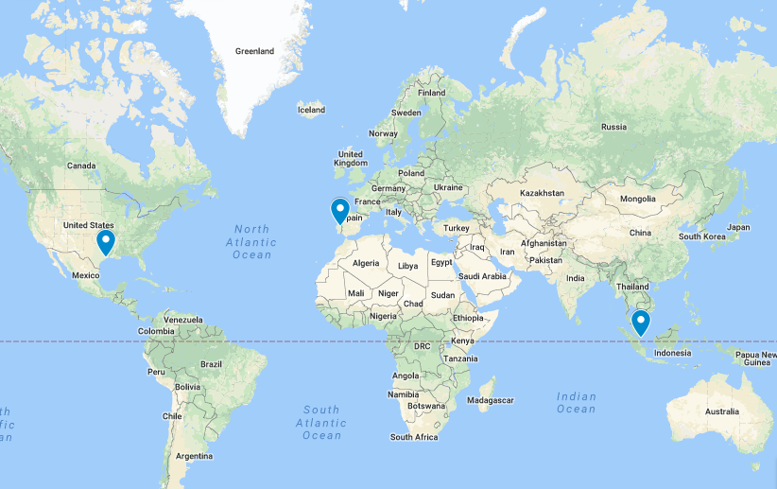
Location of Data Centers

Slide 9
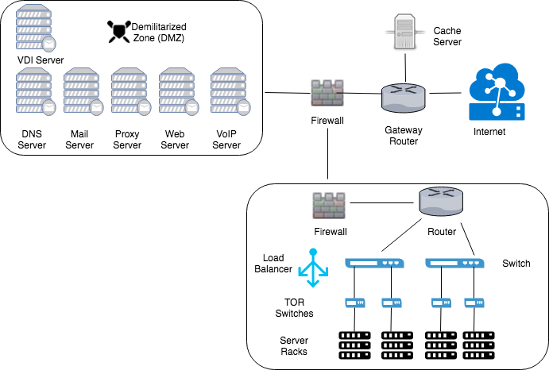
Data Center Architecture

Slide 10
IP Addressing Schema
Class A is most suitable one for the addressing schema.
Factors affected by the prospective network size:
Class of network
Network number received
Schema of IP address used for the network
Notes:
Class A starts with 0 followed by 7 bits of network ID and 24 bits of host ID

Slide 11
Assumptions and Restrictions
Private Class A address is used which is 10.0.0.0/8.
Maximum number of hosts in a VLAN is 254.
Total number of countries where the offices exist is between 15 and 128
Total number of cities in a country is less than or equal to 7.
Each city will have a maximum of 4 office buildings.
Total number of VLANs in a building is less than equal to 16.

Slide 12
Head Office and Headquarters
Total number of employees : 600
Average number of employees in one office : 150 (600/4)
Average growth rate of company expected : 30% per year
Average growth rate of employees expected in 4 years : 10% per year
Expected number of employees after 4 years : 878
Subnet for IP address in each office is : /22 which gives us 1024 IP address
Average number of resources required : 200

Slide 13
Software Development Center
Total number of employees : 300
Average number of employees in one office : 100 (300/3)
Average growth rate of company expected : 30% per year
Average growth rate of employees expected in 4 years : 10% per year
Expected number of employees after 4 years : 439
Subnet for IP address in each office is : /23 which gives us 512 IP address
Average number of resources required : 150

Slide 14
Bandwidth Allocation

Slide 15
Headquarter
Assumptions | Recommended Bandwidth
Emails: Emails Per Day Per Emp. - 50 Average email size - 250 kb Voip: G.728 Bandwidth - 32 kbps Active user - 50 Internet Usage: Avg web-page size - 5 MB Simultaneous loading - 50 Video Conferencing: HD Video call take - 3+3 Mbps Simultaneous User - 20 Shared File Services: Simultaneous User - 50 Req Speed/user - 5 Mbps | For 4 Offices, 150 employee per office Min Bandwidth required: 623.28 Mbps Recommended Bandwidth: 1.0 Gbps (Considering 10% growth year on year for 5 years) Bandwidth Delay: 1.6 ms

Slide 16
Sales (Small Office)
Assumptions | Recommended Bandwidth
Emails: Emails Per Day Per Emp. - 200 Average email size - 300 kb Voip: G.728 Bandwidth - 32 kbps Internet Usage: Avg web-page size - 5 MB Simultaneous loading - 5 Video Conferencing: HD Video call take - 3+3 Mbps Simultaneous User - 5 Shared File Services: Simultaneous User - 20 Req Speed/user - 10 Mbps | For 20 Offices, 20 employee per office Min Bandwidth required: 255.644 Mbps Recommended Bandwidth: 500 Mbps (Considering 10% growth year on year for 5 years) Bandwidth Delay: 5 ms

Slide 17
Sales (Medium Office)
Assumptions | Recommended Bandwidth
Emails: Emails Per Day Per Emp. - 300 Average email size - 300 kb Voip: G.728 Bandwidth - 32 kbps Internet Usage: Avg web-page size - 5 MB Simultaneous loading - 40 Video Conferencing: HD Video call take - 3+3 Mbps Simultaneous User - 15 Shared File Services: Simultaneous User - 50 Req Speed/user - 10 Mbps | For 10 Offices, 60 employee per office Min Bandwidth required: 792.008 Mbps Recommended Bandwidth: 1.5 Gbps (Considering 10% growth year on year for 5 years) Bandwidth Delay: 1.2 ms

Slide 18
Software Development Centers
Assumptions | Recommended Bandwidth
Emails: Emails Per Day Per Emp. - 30 Average email size - 200 kb Voip: G.728 Bandwidth - 32 kbps Active User - 20 Internet Usage: Avg web-page size - 5 MB Simultaneous loading - 70 Video Conferencing: HD Video call take - 3+3 Mbps Simultaneous User - 5 Shared File Services: Simultaneous User - 50 Req Speed/user - 10 Mbps | For 3 Offices, 100 employee per office Min Bandwidth required: 900.064 Mbps Recommended Bandwidth: 1.5 Gbps (Considering 10% growth year on year for 5 years) Bandwidth Delay: 1.1 ms

Slide 19
Lower Level Support Staff
Assumptions | Recommended Bandwidth
Emails: Emails Per Day Per Emp. - 70 Average email size - 500 kb Voip: G.728 Bandwidth - 32 kbps Active User - 50 Internet Usage: Avg web-page size - 10 MB Simultaneous loading - 100 Video Conferencing: HD Video call take - 3+3 Mbps Simultaneous User - 20 Shared File Services: Simultaneous User - 100 Req Speed/user - 10 Mbps | For 3 Offices, 167 employee per office Min Bandwidth Required: 2327.6 Mbps Recommended Bandwidth: 4.0 Gbps (Considering 10% growth year on year for 5 years) Bandwidth Delay: 0.28 ms

Slide 20
Global Client Center
Assumptions | Recommended Bandwidth
Emails: Emails Per Day Per Emp. - 300 Average email size - 200 kb Voip: G.728 Bandwidth - 32 kbps Active User - 600 Internet Usage: Avg web-page size - 5 MB Simultaneous loading - 500 Video Conferencing: HD Video call take - 3+3 Mbps Simultaneous User - 10 Shared File Services: Simultaneous User - 100 Req Speed/user - 10 Mbps | For 4 Offices, 600 employee per office Min Bandwidth Required: 3580.45 Mbps Recommended Bandwidth: 5.7 Gbps (Considering 10% growth year on year for 5 years) Bandwidth Delay: 0.4 ms

Slide 21
Call Center
Assumptions | Recommended Bandwidth
Emails: Emails Per Day Per Emp. - 300 Average email size - 200 kb Voip: G.728 Bandwidth - 32 kbps Active User - 100 Internet Usage: Avg web-page size - 5 MB Simultaneous loading - 10 Shared File Services: Simultaneous User - 100 Req Speed/user - 10 Mbps | For 1 Offices, 100 employee per office Min Bandwidth Required: 1054.54 Mbps Recommended Bandwidth: 1.6 Gbps (Considering 10% growth year on year for 5 years) Bandwidth Delay: 0.94 ms

Slide 22
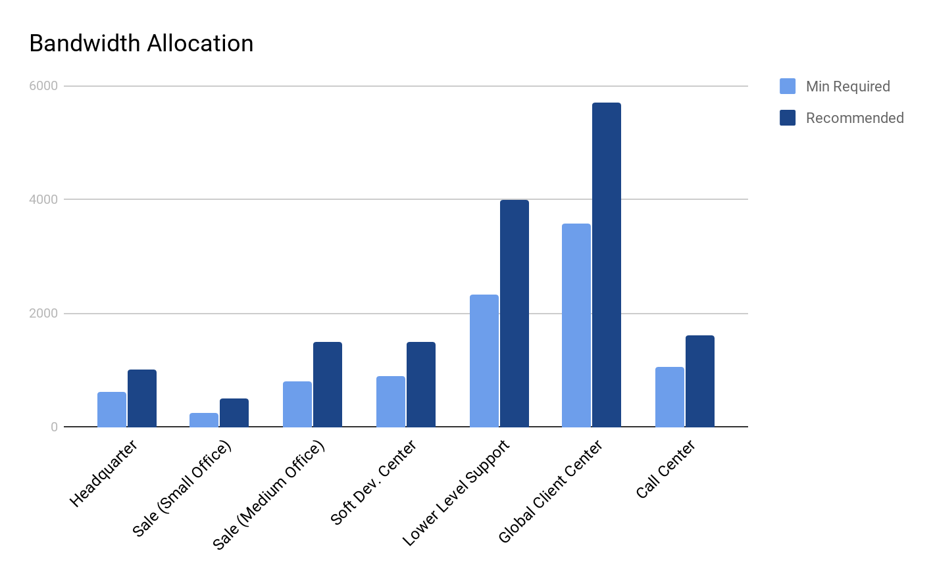
Bandwidth Allocation

Slide 23
Application Layer Protocols
Application | Application Layer Protocol | Transport Layer Protocol
Email | SMTP, IMAP | TCP
VoIP | RTP | TCP or UDP
Shared File Services​ | Citrix VDI | TCP
Video Conferencing | Audio/Video Codecs, RTP | UDP
Web | HTTPS | TCP
Multi-Protocol Label Switching (MPLS) are widely used techniques for prioritizing VoIP traffic.

Slide 24
Server Management
Web Server
Email Server
DNS Server
Load Balancer
VPN Server
VDI Server

Slide 25
Access Technologies
LAN
Local interconnected group of computers or devices that shares a same wired or wireless link within a small area
WAN
Extents to a large geographic area such as across cities, states, or countries
Connect all offices in a large region
VLAN
Used to connect different physical LANs
Network can be set up to connect different devices from different LANs with Ethernet or Wi-Fi
VPN
​Helps to access a private network from the public network and lets users to transmits data across the shared network
Notes:
VLAN

Slide 26
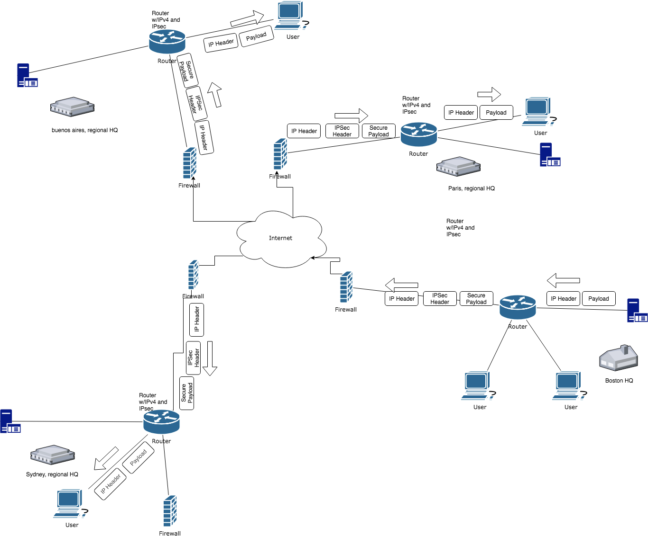
Security
VPN and IPSec
provides secure remote access to this private network
encrypting the internal traffic before sending over the public network
Demilitarized Zones (DMZs)
includes the organization’s servers that need to communicate with the outside entities
Web Servers, FTP Servers, DNS Servers, Email Servers, etc.
Proxy Servers
Used in front of hosts in internal network, to provide anonymity, block unwanted content from public network and provide web caching

Slide 27
Security
Firewalls
Allow the network administrator of the system to control access between public internet and the private network within GDA organization
Separate firewalls for DMZs and internal network
Intrusion Detection Systems (IDS)
IDS sensors generate alerts when it comes across malicious traffic
placed between hosts systems inside the private network
DMZs are also monitored by IDS sensors
Data Security and Encryption
Sensitive data should be stored and transmitted in an encrypted form
SSL/TLS should be strictly used for all the traffic, even for the internal networks, particularly the suite of applications that deal with sensitive data.
Notes:
IDS - deep packet inspection

Slide 28
Conclusion
Slow access to files
Increased bandwidth allotment, and optimized geographical locations for data centers
email delivery
Increased bandwidth
Poor voice quality
Prioritizing VoIP traffic over the network
Application crashes
Latency decreases as bandwidth increase

Slide 29
Thank you!

