Slide 1
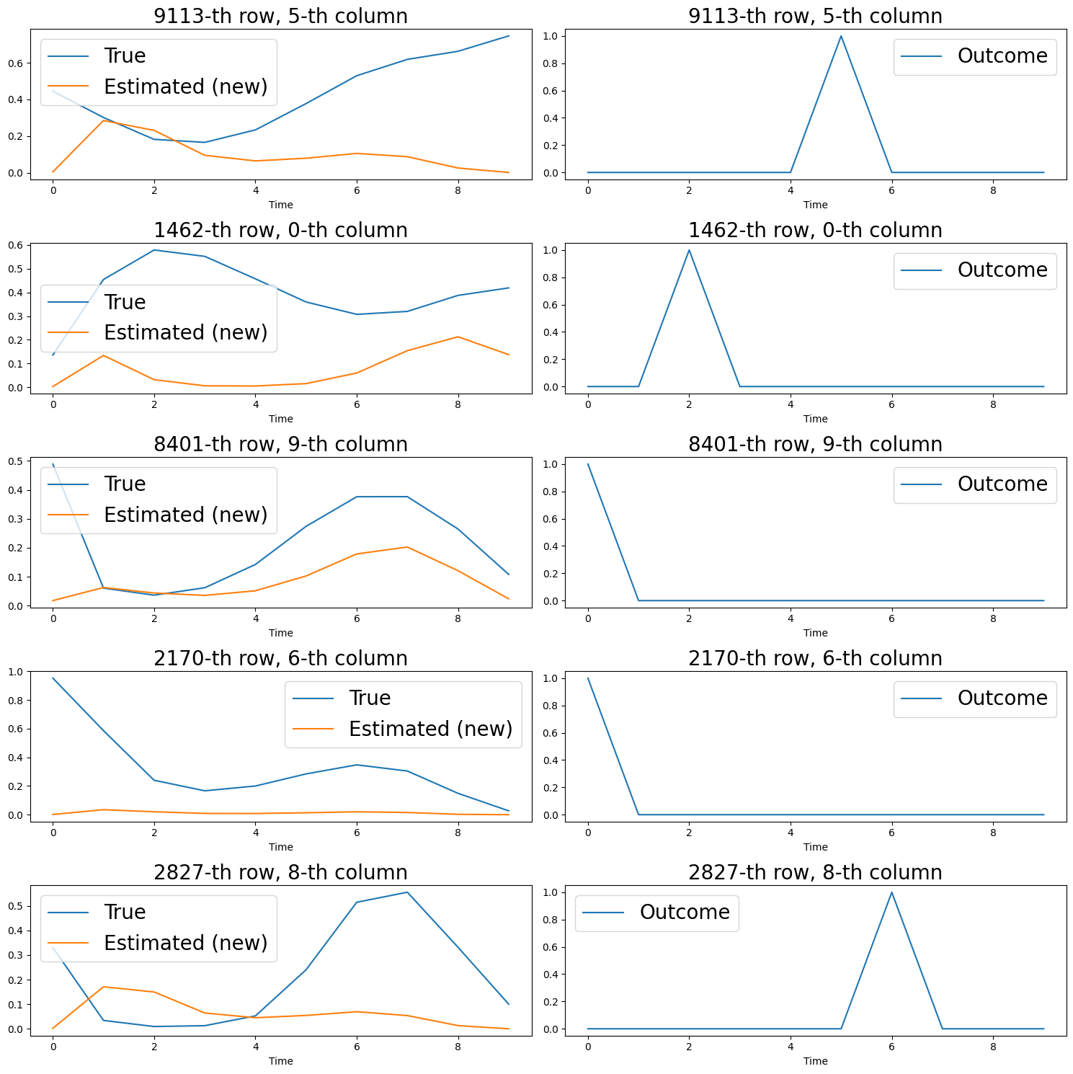
10,000 individuals, 10 time points,
10 diseases
Notes:
10,00

Slide 2
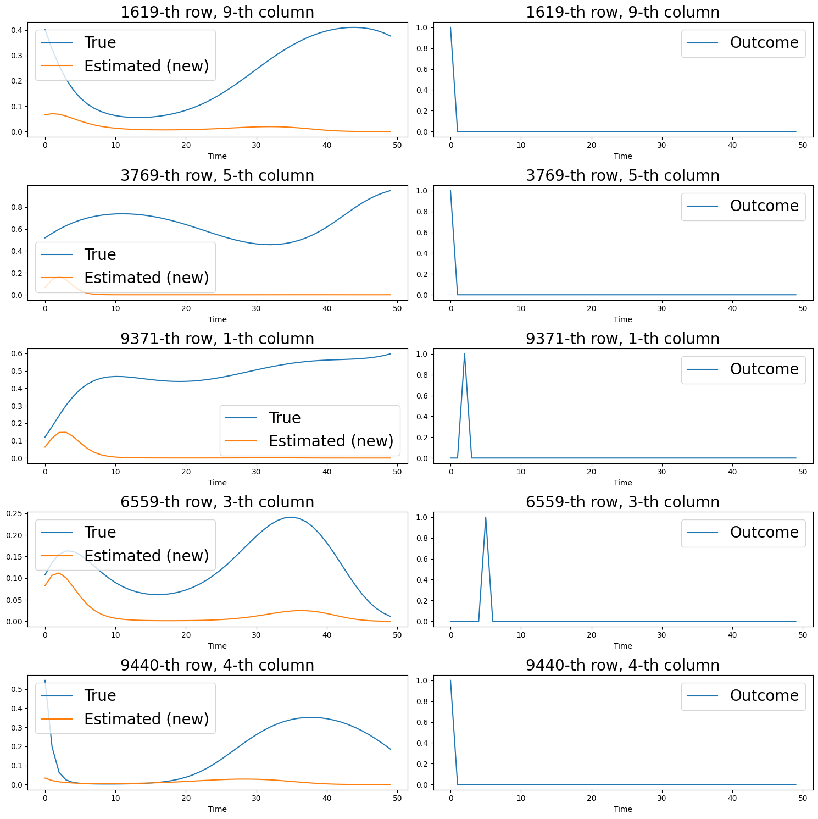
N=10,000 ;D=10; T=50

Slide 3
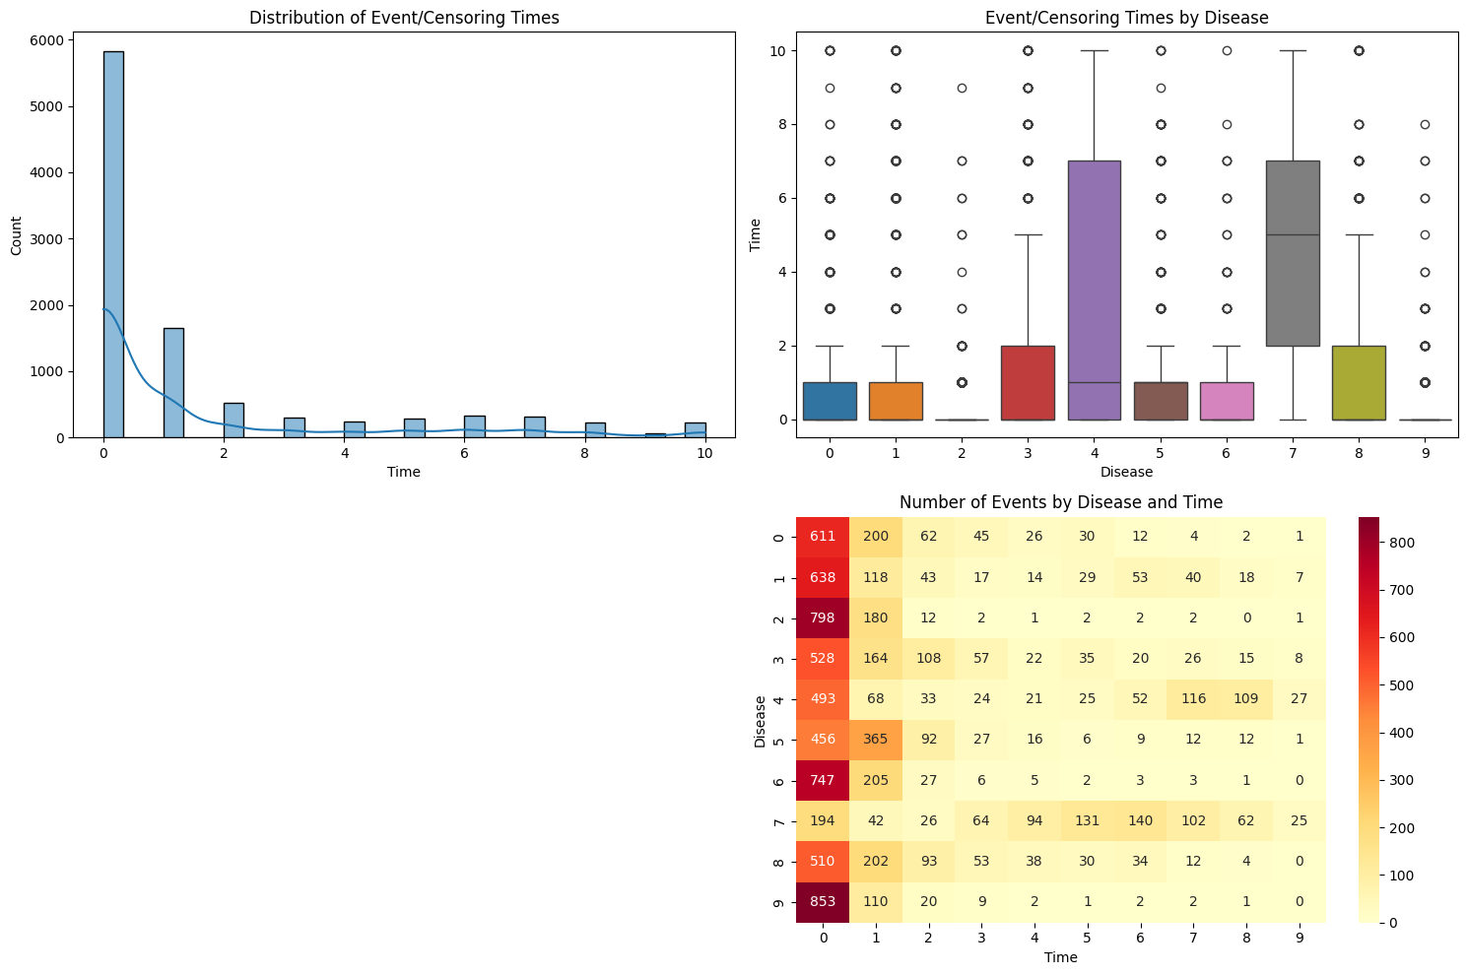

Slide 4
Same theta, Sarah

Slide 5
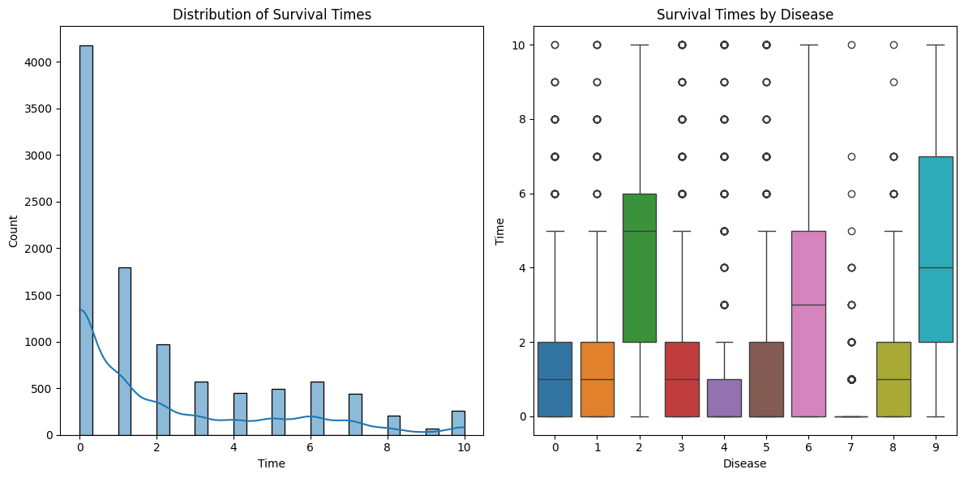

Slide 6
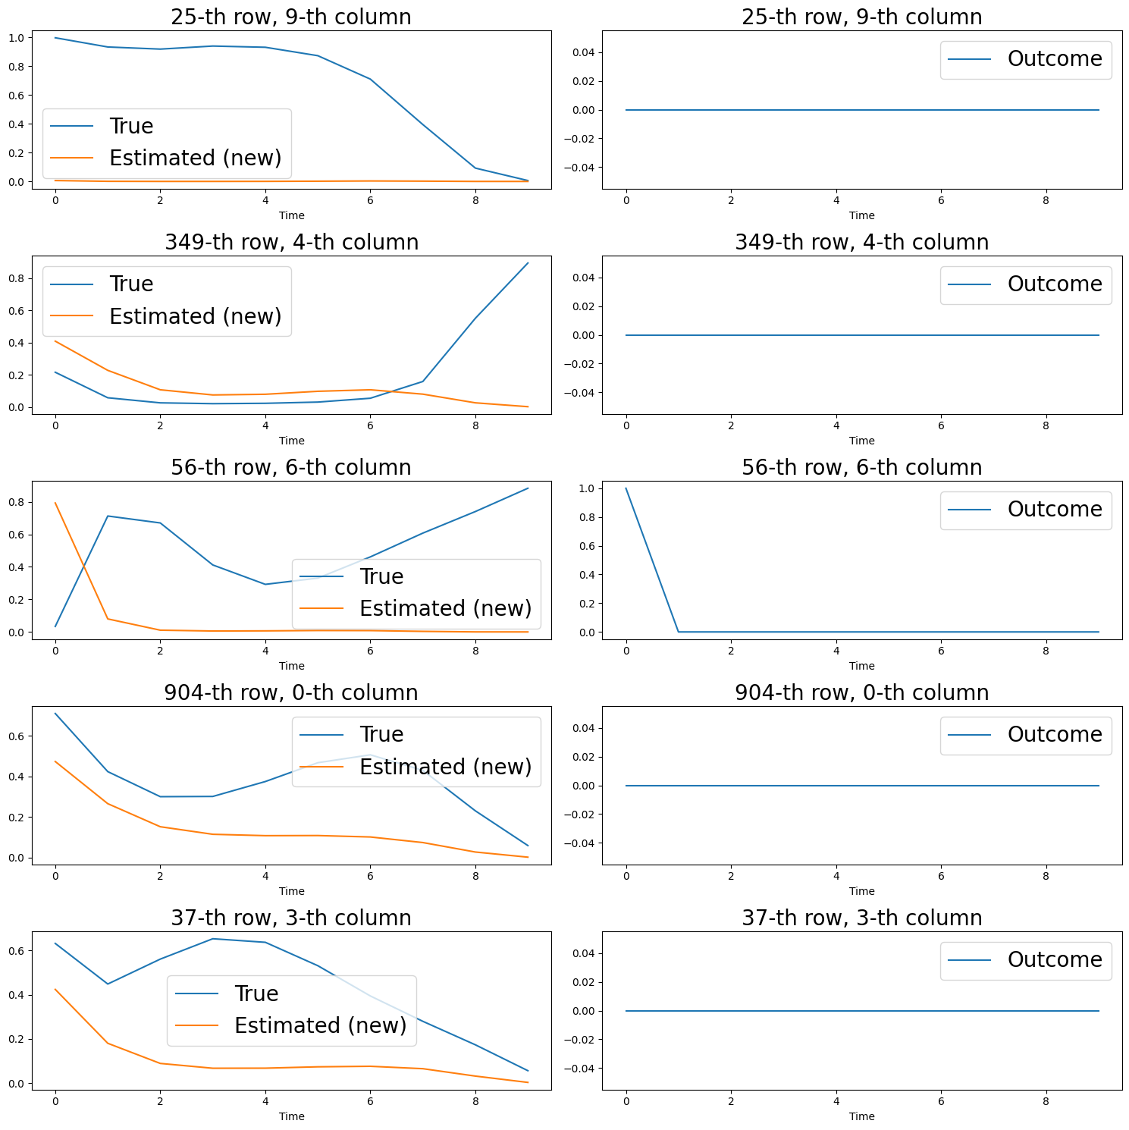
Same theta: with Chenyin (Chenyin generation, Chenyin nebula)

Slide 7
Your method ("Survival Sarah"):
Generates data as: 00010000 (0 until event, then 1, then 0s)
Uses event_times to track when the event occurred
Explicitly handles censoring through event_times
The other method ("Survival"):
Generates data as: 11111000 (1s until event or censoring, then 0s)
Implicitly encodes both event occurrence and censoring in the Y array

Slide 8
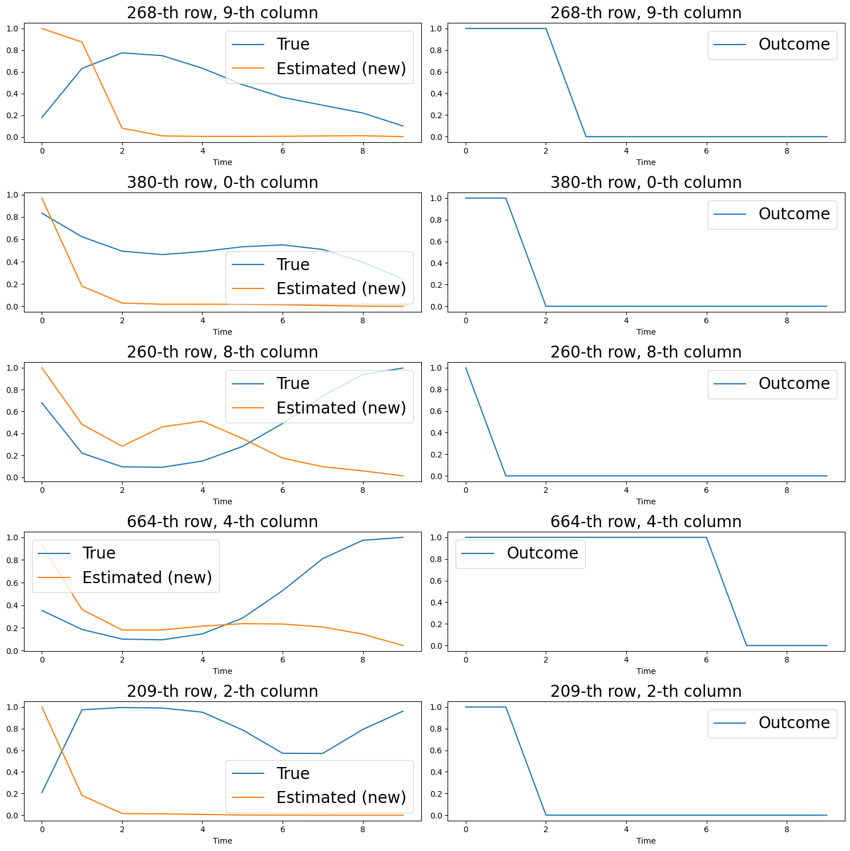
Same theta,
Generated with Sarah→ converted to Chenyin, use Chenyin Nabula
Notes:
Loss = 21.04

Slide 9
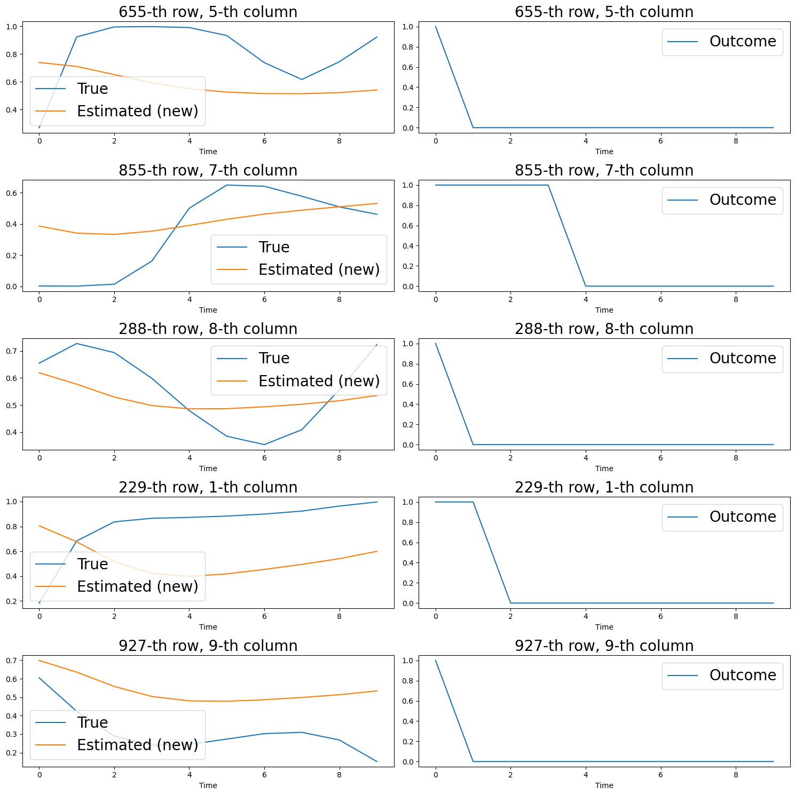
Same theta
Generated Sarah, Sarah likelihood
Notes:
Loss = 15.3

