Slide 1
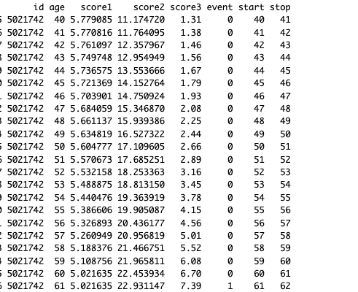
msGene FRS30 PCE

