Slide 1
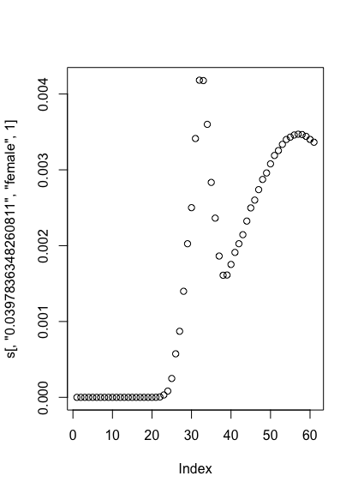
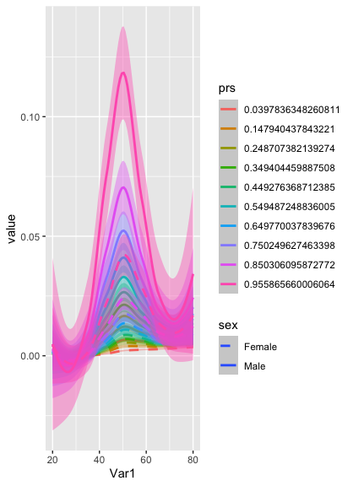
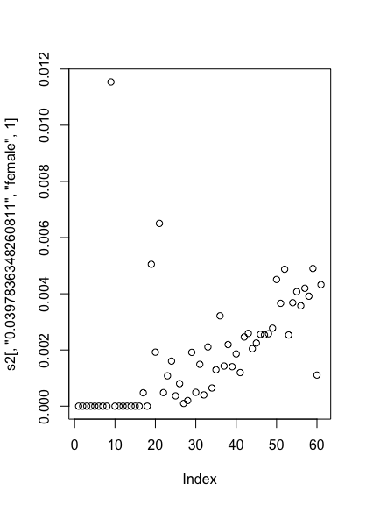
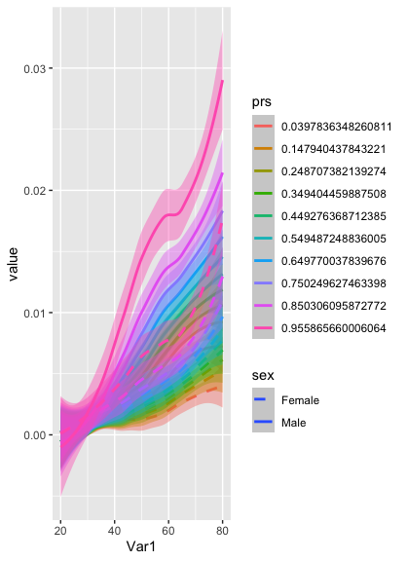
Smoothing by Coeff or By Fit: The problem of HyperLip
Notes:
Left: for a female over the life course of this PRS, what does per year risk look like
At left, we extract noisy absolute risk, plot and then extract smoothed absolute risk to form projections
At right, we smooth coefficients first, plot absolute risk for one strata, and then project risk

Slide 2
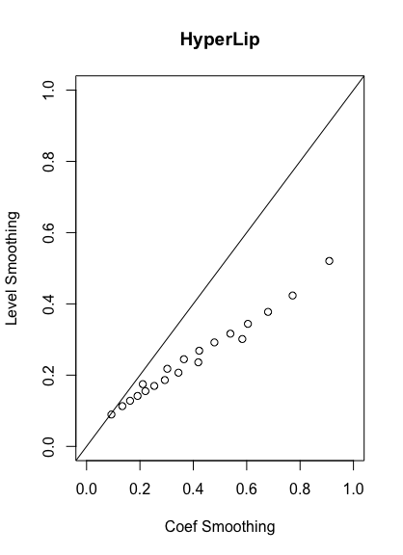
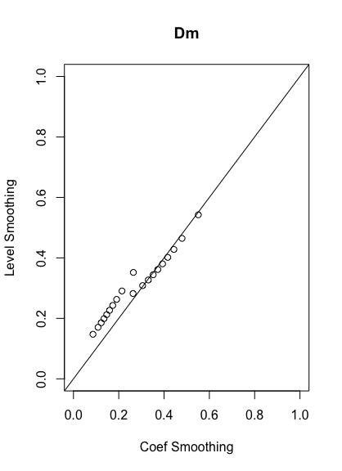
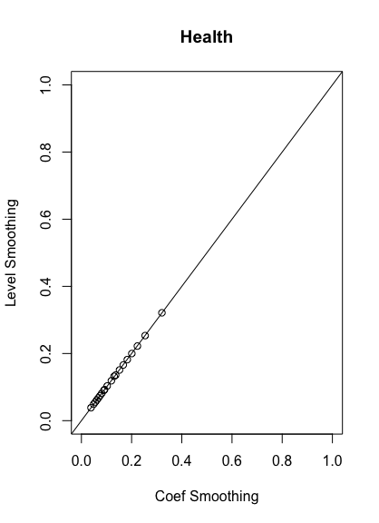
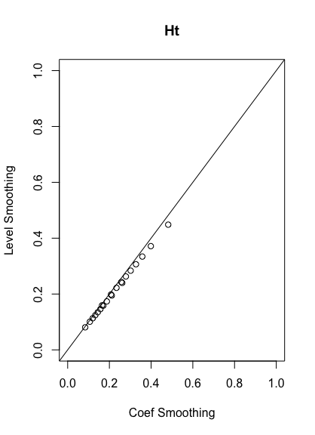
Compare Lifetime year predictions for 40 year old across PRS Strata from each single state (or health) transition to CAD

Slide 3
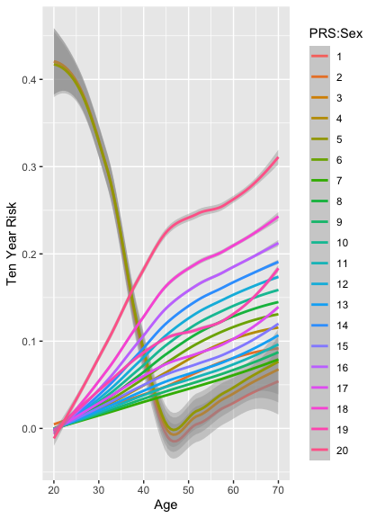
10 year and Lifetime using smoothed absolute risk

Slide 4
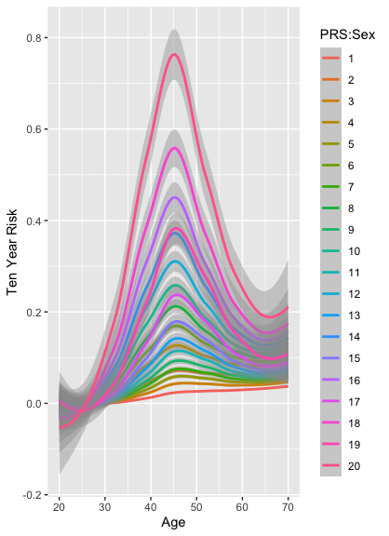
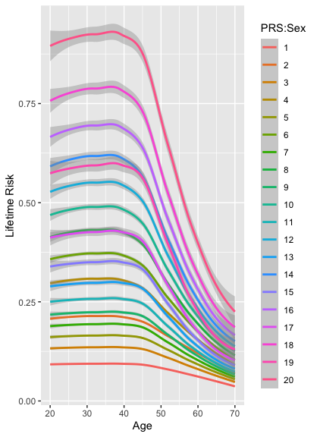
10 year and absolute using smoothed coefficients

