Slide 1
Uppaal2Yakindu
Shuo Yan

Slide 2
Outline
Introduction
UI Support
Yakindu2Uppaal
Uppaal2Yakindu
Implementation details
UI
Uppaal2Yakindu
Conclusion

Slide 3
Background
Yakindu State charts Tools
It provides an integrated modeling environment for the specification and development of reactive, event-driven systems based on the concept of state chars.
Advantage:
Yakindu provides live simulation function
It Can generate java code
Disadvantage:
lacks formal verification of models as provided by model checking tools such as UPPAAL
Before loading the application , Eclipse and JDK need to be install.
Yakindu application is a plugin based on Eclipse. Do not have its owned application.

Slide 4
Background
UPPAAL Timed Automata
Uppaal is an integrated tool environment for modeling, validation and verification of real-time systems modeled as networks of timed automata, extended with data types
Advantage:
integrated model checking, verifying models with regards to requirement specifications.
Disadvantage:
Cannot generate java code.
Knowing much more computer knowledge to use it.

Slide 5
Objective of the project
Provide a GUI to manage the software
Provide a interface to transfer Uppaal model to Yakindu Model
Become much more convenience to generate java code with Yakindu when creating a model by Uppaal.

Slide 6
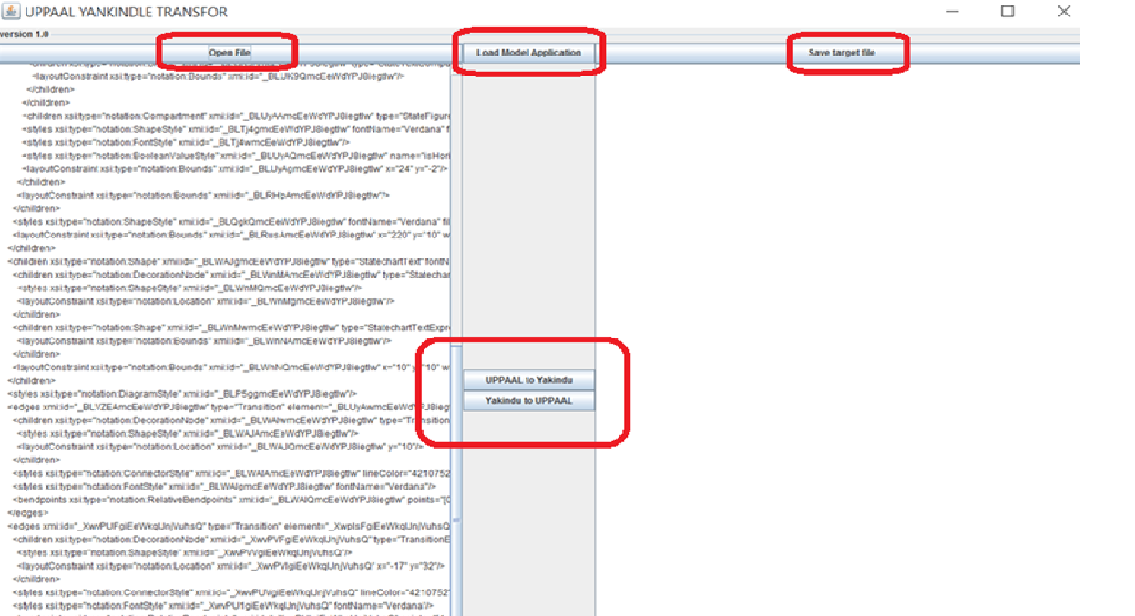
GUI

Slide 7
Support function
Loading the Uppaal application
Loading the Yakindu/Uppaal xml file
Showing the source file in left window.
Support transformation by click one button
Showing converted xml file in right window and provide a button to save it.

Slide 8
Application work flow
Main
Switch Uppaal2Yakindu or Yakindu2Uppaal transform by click different button
Load application to generate the xml file
Load the source file to left window
Convert to the target format and show it on the right window
Calling convert function to transfer
Save the content in the right window to a file

Slide 9
Transform table
Uppaal | Yakindu
int | integer | Varable
bool | boolean | Varable
chan | in event | Varable
template | region
location | state
transition | transition
declaration | specification

Slide 10
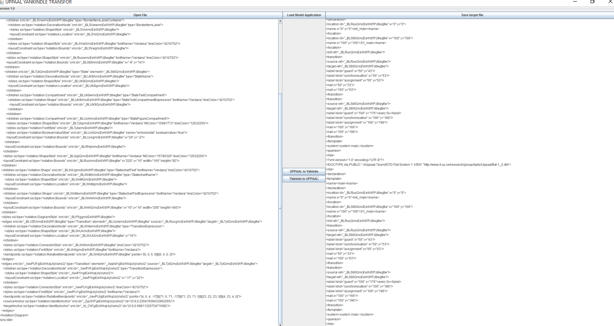
Results discussion
1. The application do not support editing xml file by GUI.

Slide 11
Results discussion
GUI design is done
Upplla2Yakindu application is under developing and had finished 80% task.
Declaration parameter had converted
State parameter had converted
Transition parameter had parsed and need to be converted to Yakindu supported format.

Slide 12
Conclusion
Next
1. optimize the UI design.
2. Complete Uppaal2Yakindu function.
QA

