Slide 1
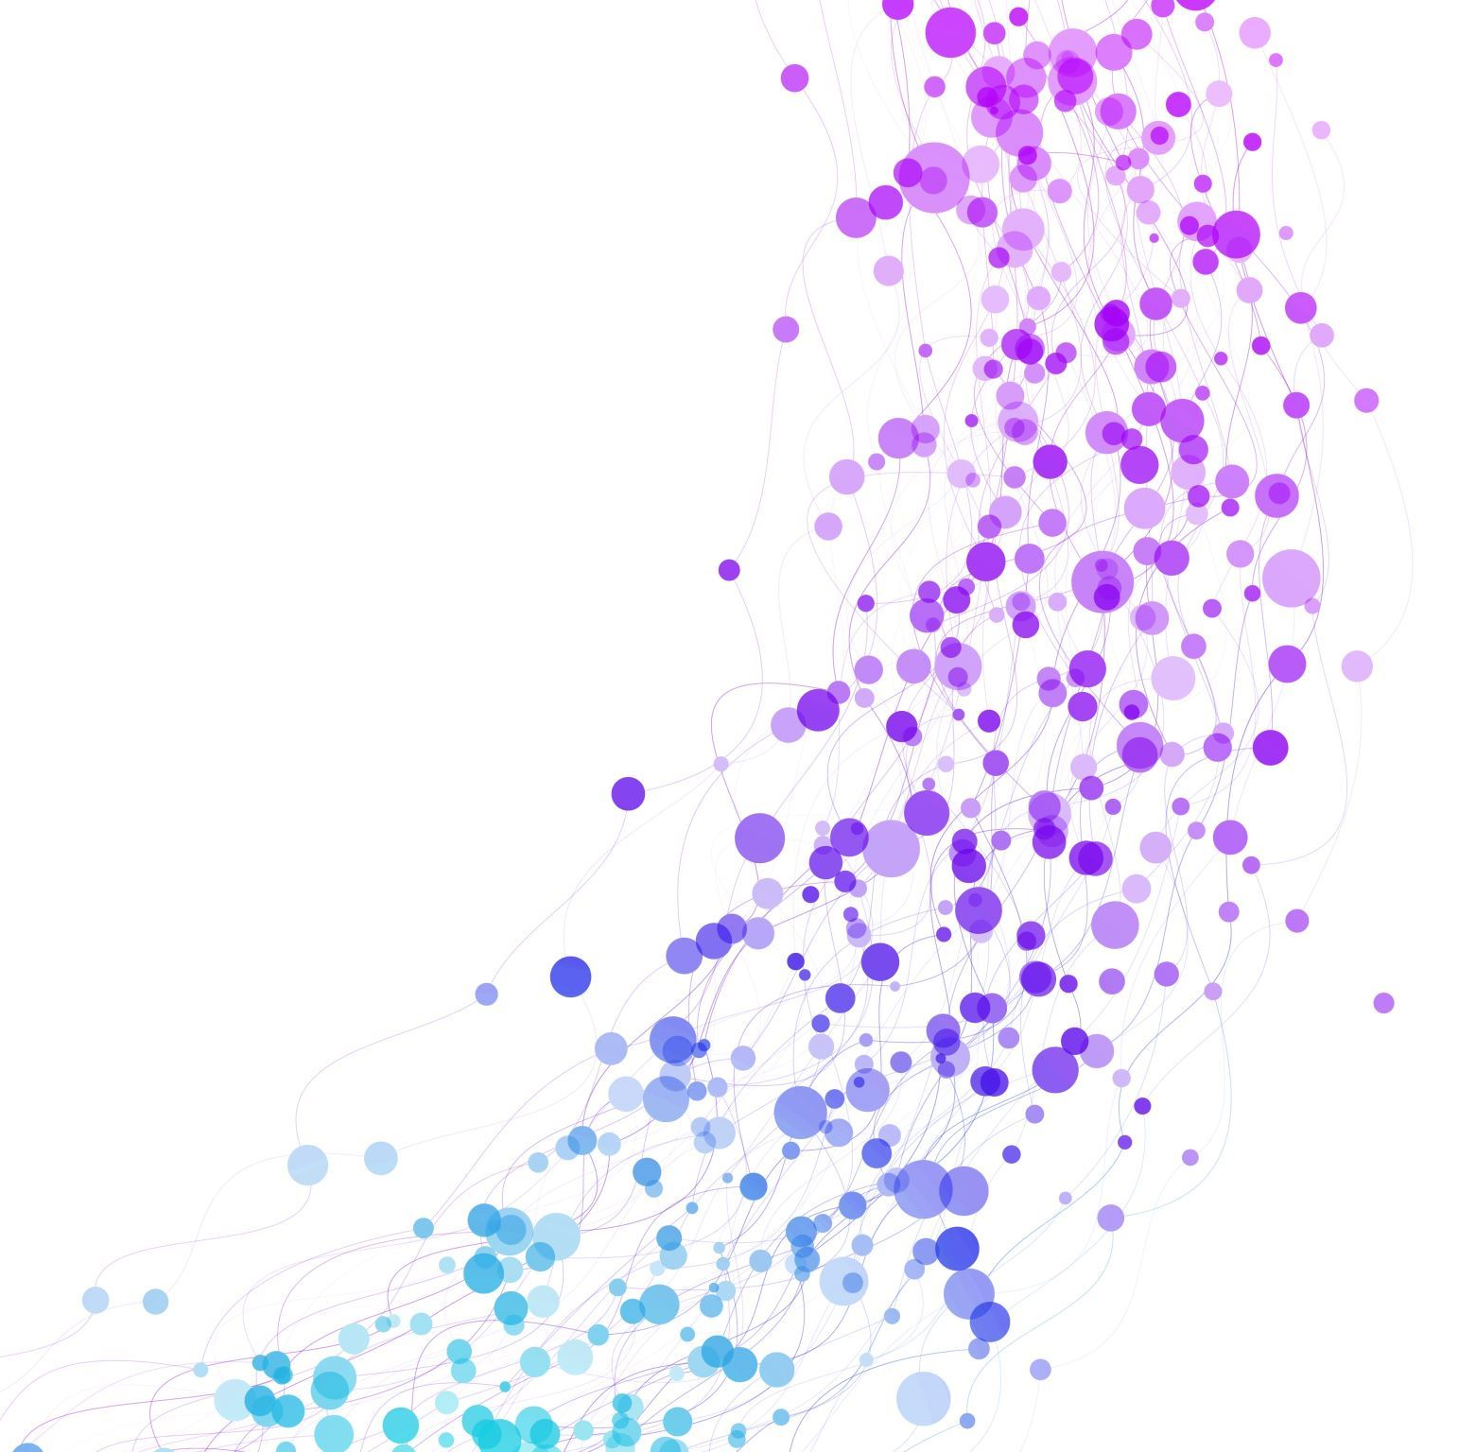
Siddharth
Billing project

Slide 2
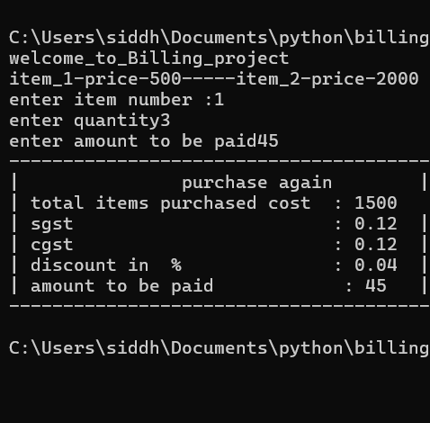
How it works
There are 2 variables item_1 item_2
In the input select item number
Next enter the quantity
And the bill will be printed

Slide 3
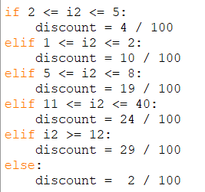
discount
The discount is calculated for every few units so the more the buyer buys the more discount they will get

Slide 4

Tax calculation
SGST and CGST are both 12 percent so it is cost multiplied by both GST types

Slide 5
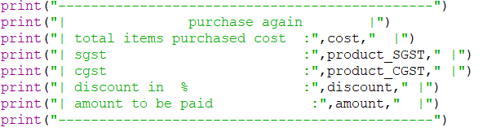
Printing the bill
The printing function will print a bill with items purchaced cost GST discount and amount to be paid

Slide 6
The total code
item_1=500 item_2=2000 print("welcome_to_Billing_project") print("item_1-price-500-----item_2-price-2000") i=int(input("enter item number :")) if i<=0: print(" ERROR ") print("ITEM DOES NOT EXIST") print("program will continue with errors") print(" restart program to continue normally") elif i>=3: print(" ERROR ") print(" ITEM DOES NOT EXIST") print("program will continue with errors") print(" restart program to continue normally") if i==1: i2=int(input("enter quantity")) cost=i2*500 elif i == 2 : i2=int(input("enter quantity")) cost=i2*2000 if 2 <= i2 <= 5: discount = 4 / 100 elif 1 <= i2 <= 2: discount = 10 / 100 elif 5 <= i2 <= 8: discount = 19 / 100 elif 11 <= i2 <= 40: discount = 24 / 100 elif i2 >= 12: discount = 29 / 100 else: discount = 2 / 100 SGST = 12 / 100 CGST = 12 / 100 product_SGST = cost * SGST product_CGST = cost * CGST product_discount =cost * discount amount=int(input("enter amount to be paid")) print("----------------------------------------------") print("| purchase again |") print("| total items purchased cost :",cost," |") print("| sgst :",product_SGST," |") print("| cgst :",product_CGST," |") print("| discount in % :",discount," |") print("| amount to be paid :",amount," |") print("----------------------------------------------")

Slide 7


