Slide 1
Team ID: Crossingz-AI-Hack16
Team Name: Team URUS
Team Members and roles:
Surekha Salunkhe (UX Designer)
Pedro , Lakhu
Networking using AI Online Hackathon by Crossingz

Slide 2
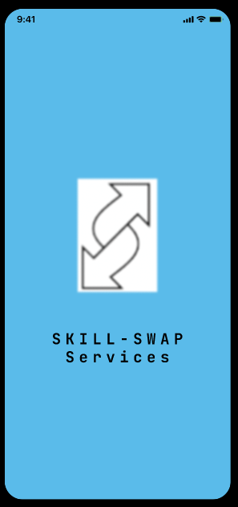
Empowering individuals
to exchange skills,
fostering growth
and community.

Slide 3
Idea and Innovation SKILL SWAP - Unleashing Potential Through Shared Expertise
SkillSwap is a futuristic service exchange platform that leverages AI and NLP to connect individuals based on their skills and needs.
SkillSwap AI classifier model and NLP technology match users with local peers who possess the exact skills they seek, ensuring personalized and relevant connections.
SkillSwap provides a welcoming environment where everyone has something valuable to contribute, empowering users to embark on a journey of continuous learning, connection, and empowerment.
Networking using AI Online Hackathon by Crossingz

Slide 4
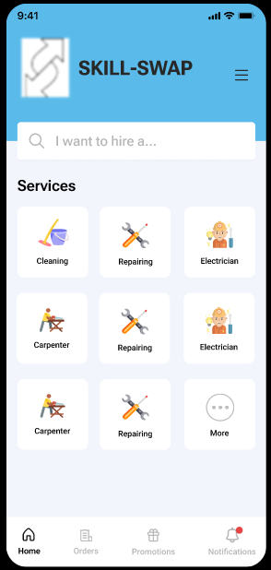
Key Features/Unique Selling Point(USP) & Go-To-Market strategy
Challenge : Find a local, reliable skill exchanges community
Skills Swap uniquely addresses this need with its AI-driven matching
system and community features.
Using AI matchmaking, user profiles, interactive skill sessions, and community boards.
Technology stack : Python for backend, React for frontend,
AI algorithm spealing and easy to understand.
Sign Up/Login: 2. Create Profile:
Search for Services: 4. View Service Listings:
Select Service Provider:
Initiate Communication: 7. Exchange Services:
8. Provide Feedback: 9. Update Profile:

Slide 5
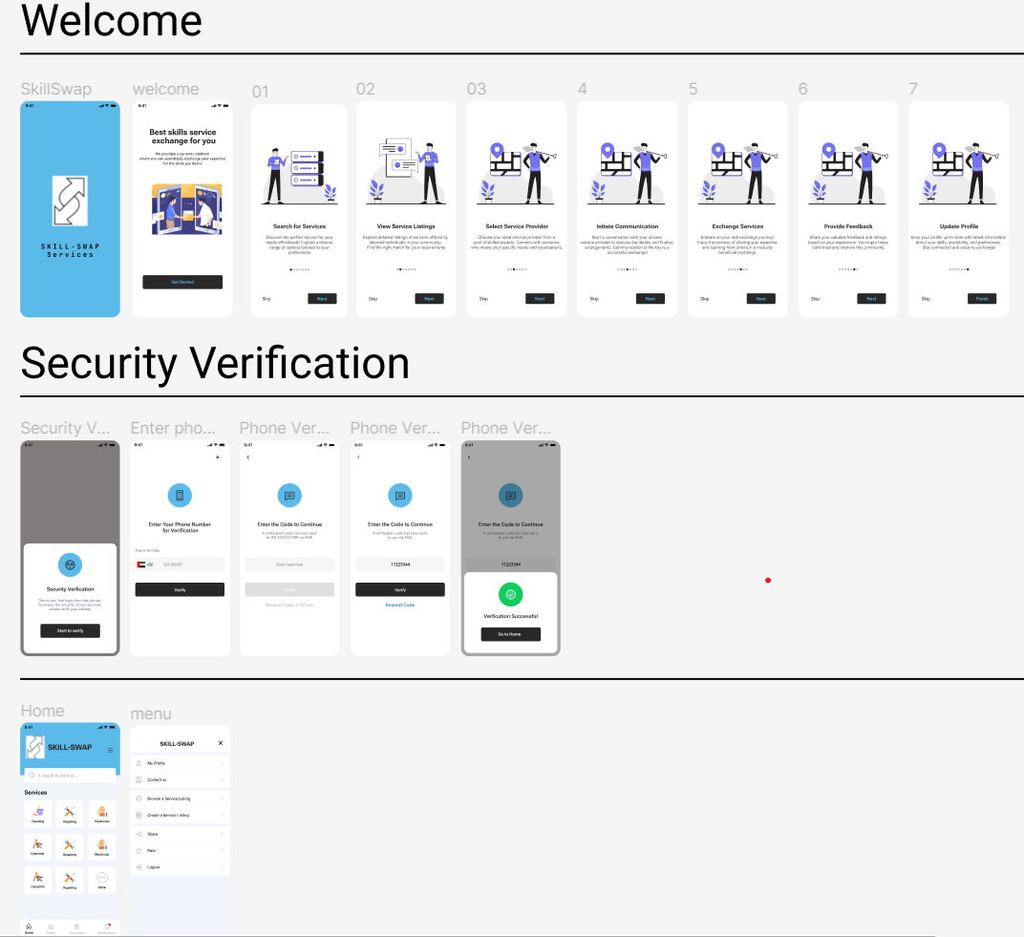

Slide 6
Demo
https://www.figma.com/proto/kAjWhPOL3Hn1COdcWjQbgi/SkILLSwap?type=design&node-id=13-5728&t=Gr3TKC6YzHcta6hu-1&scaling=scale-down&page-id=0%3A1&mode=design
Networking using AI Online Hackathon by Crossingz

