Slide 1


Angular Introduction
Date : 08/08/2019
Presented By
Surekha Gadkari
Object Edge Inc
Page : <number>

Slide 2
Agenda
What is Angular and when to use?
Pre-requisites
History
Overview of Angular Architecture
Pros and Cons
References
Object Edge Inc
Page : <number>

Slide 3
What is Angular
Type script based Front End framework to create cross platform dynamic web applications.
Single Page Application & Desktop and Mobile Apps.
Developed and supported by Google
Fully extensible and works well with other libraries.
Open Source.
Object Edge Inc
Page : <number>

Slide 4
When to use
Big and Complex project.
Apps with Dynamic Content - with respect to 3 parameters:
  Time-to-time (eg. news update web apps)
  Location-to-location (eg. Weather-report web app)
  User-to-user (eg. Gmail, Facebook type apps)
Object Edge Inc
Page : <number>

Slide 5
Pre-requisite
Developer :
HTML, CSS, Typescript and AJAX
Development :
Node.js (version 10.9.0 or later)
Node Package Manager (npm)
Object Edge Inc
Page : <number>

Slide 6
History
Version Released
Angular JS(Angular 1.0) October 2010
Angular2.0 September 2016
Angular4.0 March 2017
Angular5.0 November 2017
Angular6.0 May 2018
Angular 7.0 October 2018
Angular 8.0 May 2019
Object Edge Inc
Page : <number>

Slide 7
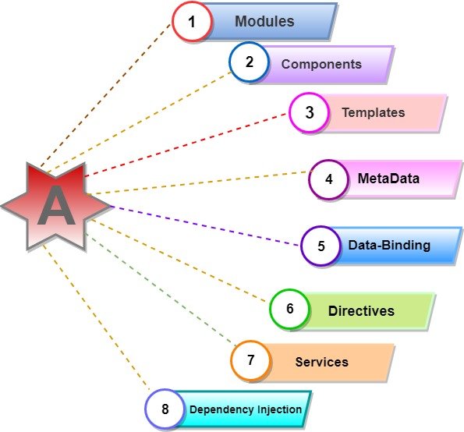
Angular Architecture
Object Edge Inc
Page : <number>

Slide 8
Module
Every Angular app has a root module, conventionally named AppModule, which provides the bootstrap mechanism that launches the application.
An app typically contains many functional modules.
Syntax :
@NgModule({
imports: [ BrowserModule ],
declarations: [ AppComponent ],
exports: [ AppComponent ],
bootstrap: [ AppComponent ]
})
export class AppModule { }
Object Edge Inc
Page : <number>

Slide 9
Component and Metadata
Every Angular app has a root component, AppComponent, which connects components with page Document Object Model.
Component (View) – Template, css, typescript(.ts)
Syntax :
@Component({
selector: ‘app-root’,
TemplateUrl: .’ /app.component.html’,
StyleUrls: [‘. /app.component.css’]
})
export class AppComponent{
}
Object Edge Inc
Page : <number>

Slide 10
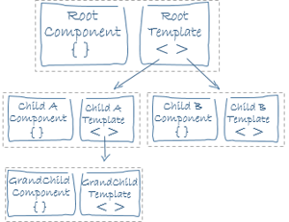
Component Hierarchy
Object Edge Inc
Page : <number>

Slide 11
Template and Data Binding
The angular template integrates the HTML with Angular mark-up that can modify HTML elements before they are displayed.
It provides program logic, and binding mark-up connects to your application data and the DOM.
Data-Binding :
  Property Binding
  e.g. <p>Name: {{student.name}} </p>
e.g. <input type="text" [value]="title"/>
  e.g. <input [(ngModel)]="title" placeholder="name"/>
  Event binding
  <button (click)="changeTitle()">Click to update title</button>
Object Edge Inc
Page : <number>

Slide 12
Directives
There are three types of Directives(modified DOM) :
Components directives: directives with a template
Structural directives : change the DOM layout by adding and removing DOM elements
For example: *ngIf, *ngFor, and *ngSwitch directive.
Attribute directives : change the appearance or behavior of an element, component, or another directive.
For example: ngClass, ngStyle etc.
<p [ngClass]="{'className': country === 'India'}> {{Name}}</p
<p [ngStyle]="{'background-color':country === 'India' ? 'red' : 'green' }">
{{Name}}</p
Object Edge Inc
Page : <number>

Slide 13
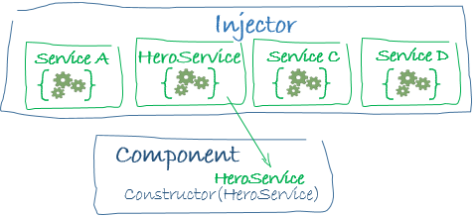
Service and Dependency Injection (DI)
Service : any value, function or feature that an app needs.
Angular distinguishes components from services to increase modularity and reusability.
A component can delegate certain tasks to services, such as fetching data from the server, validating user input, or logging directly to the console.
Angular creates an application-wide injector for you during the bootstrap process.
Object Edge Inc
Page : <number>

Slide 14
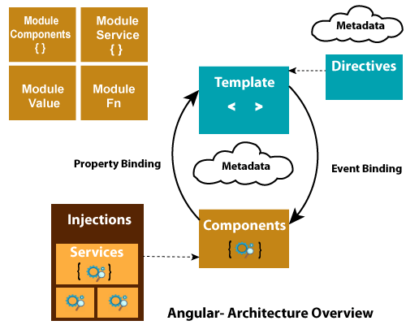
Overview of Angular Architecture
Object Edge Inc
Page : <number>

Slide 15
Code Time
        1. Component Hierarchy
        2. Data Binding
        3. Directives
        4. Service
Object Edge Inc
Page : <number>

Slide 16
Pros of Angular
Components Hierarchy:
Re-usability,
Maintainability,
Readability,
Unit-test friendly
Angular elements
Supported by Google
High Performance
Detailed documentation
An angular framework can take care of routing, which means moving from one view to another is easy in Angular.
Object Edge Inc
Page : <number>

Slide 17
Cons of Angular
Cons :
Angular is verbose and complex
Steep learning curve
CLI documentation is lacking detail
Object Edge Inc
Page : <number>

Slide 18
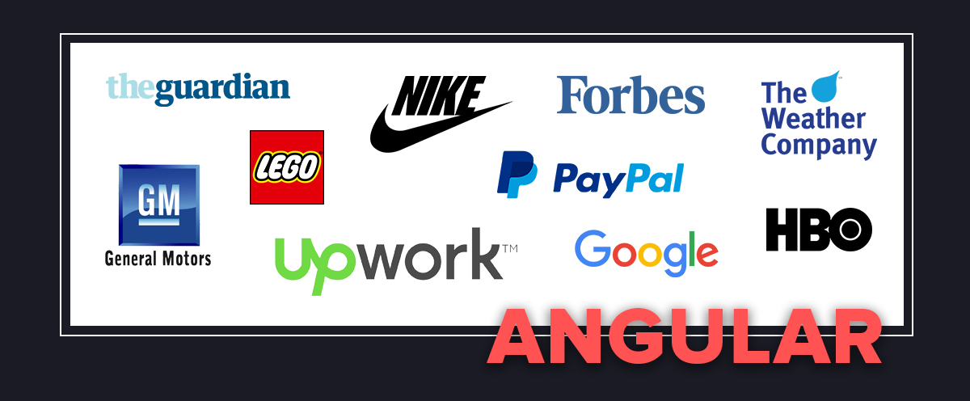
Object Edge Inc
Page : <number>

Slide 19
References
https://angular.io/
https://www.w3schools.com/
https://www.javatpoint.com/angular-8
https://www.tutorialspoint.com/typescript/
https://codeburst.io/angular-evolution-7ae670ca7932
https://programmingwithmosh.com/react/react-vs-angular/
https://www.slideshare.net/LiliaSfaxi/angular-75780093
https://www.tutorialandexample.com/angular-8-architecture/
https://www.youtube.com/results?search_query=angular+8+
https://blog.ninja-squad.com/2019/05/29/what-is-new-angular-8.0/
https://www.code-sample.com/2019/04/angular-8-7-6-5-4-2-pros-and-cons.html
Object Edge Inc
Page : <number>

Slide 20
Any Questions ?
Object Edge Inc
Page : <number>

Slide 21
Thank You
Object Edge Inc
Page : <number>

