Slide 1

Knockout Basics
Date : 19/6/2019
Presented By
Surekha Gadkari
Object Edge Inc
Page : <number>

Slide 2
Agenda
  What is Knockout.js (KO) ?
  Benefits
  Model View View Model (MVVM)
  Key Features Of KO
  Code Time
  Disadvantages
  References
Object Edge Inc
Page : <number>

Slide 3
What is Knockout.js ?
Knockout is a JavaScript library that helps you to create rich, responsive display and user interactive interfaces.
Developed and maintained by Steve Sanderson, a Microsoft employee In July 5, 2010.
Jquery Vs Knockout
Based on Model-View-View Model pattern
Object Edge Inc
Page : <number>

Slide 4
Benefits
Free, open source
Pure JavaScript (works with any web framework)
Small & lightweight (40kb minified & 13kb after Zipping)
No dependencies
Supports all mainstream browsers (IE6+, FF2+ and others)
Fully documented
Can be used for existing Website
Object Edge Inc
Page : <number>

Slide 5
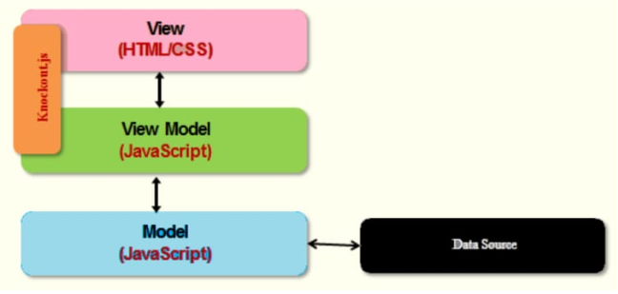
MVVM
Model - Domain Data (e.g. Database Server)
View – User Interface (HTML)
View Model
Object Edge Inc
Page : <number>

Slide 6
Key Features Of KO
Declarative Bindings : connect data to UI
Automatic UI Refresh
Dependency Tracking (using observables)
Templating
Object Edge Inc
Page : <number>

Slide 7
Observables / Properties
  data-bind attributes in HTML
  ko.observable() - the properties
  ko.applyBindings() to activate bindings
Example :
<div data-bind="text: message"> </div>
var viewModel = {
message: ko.observable('Welcome')
}
Object Edge Inc
Page : <number>

Slide 8
Code Time
Object Edge Inc
Page : <number>

Slide 9
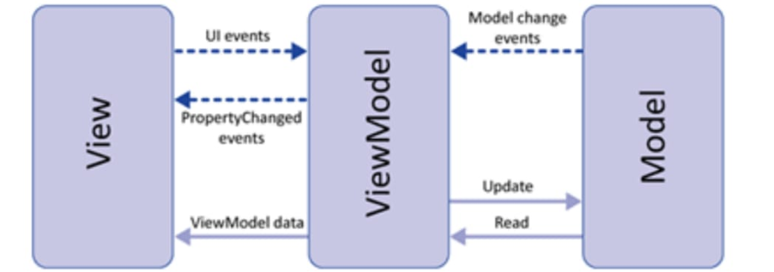
Two Way Binding
Object Edge Inc
Page : <number>

Slide 10
Declarative Bindings
Types of binding available :
  Controlling text and appearance :
  visible, text, html, css, style, attr
Control Flow Statements :
  Foreach, if, ifnot
Template Binding :
  Native templating, String-based templating
Object Edge Inc
Page : <number>

Slide 11
Continue ..
Form fields binding Value Binding Click binding Event Binding Submit Binding Enable Binding | Disable Binding Checked Binding Options Binding SelectedOptions Binding
Object Edge Inc
Page : <number>

Slide 12
Observables
Observable
Computed Observables
  this.fullName = ko.computed(function() {
  return this.firstName() + " " + this.lastName();
  }, this);
Observable Arrays
this.shoppingCart = ko.observableArray([
new Product("Beer", 10.99),
new Product("Brats", 7.99),
new Product("Buns", 1.49)]);
ADD : this.shoppingCart.push(new Product("More Beer", 10.99));
REMOVE : this.shoppingCart.remove(product);
Object Edge Inc
Page : <number>

Slide 13
Disadvantages
Hard to use templates on external files – hard to co-work
Ko is only for two way binding so need to use other tool or library for other needs.
Sometimes hard to debug.
Learning curve : Binding Expressions
Multiple view models with annoying amount of similarity
Object Edge Inc
Page : <number>

Slide 14
References
http://knockoutjs.com/
https://www.tutorialspoint.com/knockoutjs/
https://code.tutsplus.com/categories/knockoutjs
https://www.youtube.com/watch?v=yC9Lt6hTIUE&list=PLo80fWiInSIONI-Al0iVvq9NNWllM0RrT
Object Edge Inc
Page : <number>

Slide 15
Any Questions ?
Object Edge Inc
Page : <number>

Slide 16
Thank You
Object Edge Inc
Page : <number>

