Slide 1

HR-ANALYTICS—EMPLOYEE RETENTION
Kandrapu Surekha Reddy
Sourabh Dhanavade
Archana Agasti
Dhiraj Pachpol
GROUP 3

Slide 2

OVERVIEW :
KPI 1 – Average Attrition Rate for all departments
KPI 2 – Average hourly rate of male research scientist
KPI 3 – Attrition rate Vs monthly income stats
KPI 4 – Average working years for each department
KPI 5 – Job role Vs work life balance
KPI 6 – Attrition Rate Vs years since last promotion
Excel Dashboard
Tableau Dashboard
Power Bi Dashboard
SQL
Challenges Faced
Outcome of the Project
CONCLUSION

Slide 3
Introduction:
The HR Analytics Dashboard for Employee Retention offers a comprehensive view of key metrics and indicators, such as turnover rates, tenure distribution, satisfaction scores, and engagement levels.
Through interactive visualizations and customizable dashboards, HR leaders can drill down into specific departments, job roles, or demographic groups to uncover insights that inform targeted retention strategies.
By analyzing factors such as job satisfaction, work-life balance, career advancement opportunities, and manager effectiveness, HR professionals can pinpoint areas for improvement and implement targeted interventions to enhance employee engagement and loyalty.

Slide 4




Tools Used :
TOOLS

Slide 5

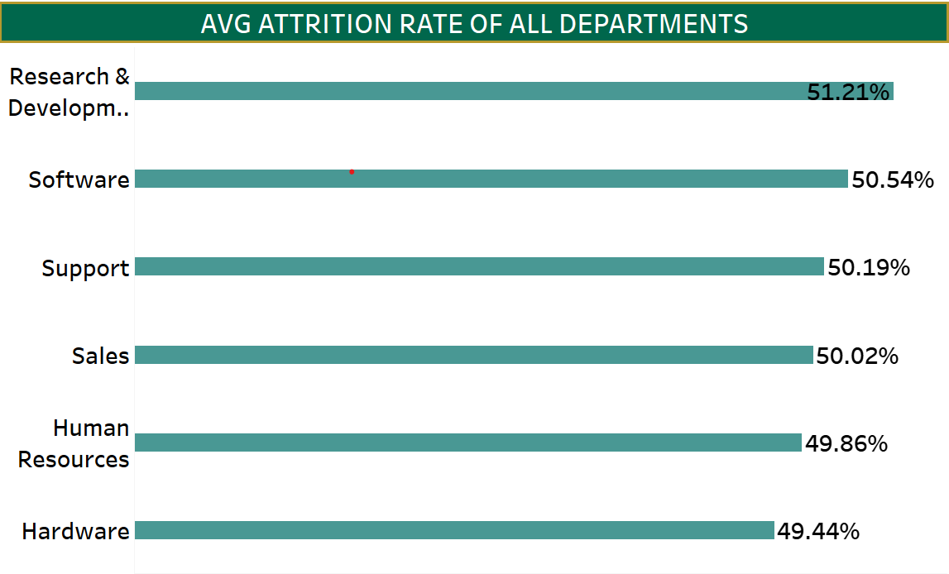
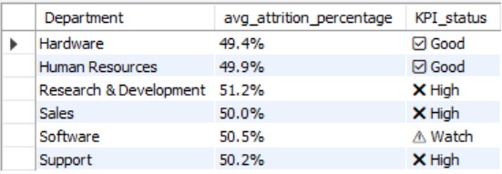
ATTRITION RATE OF ALL DEPARTMENTS
Research and development department has the highest attrition rate with 51.2%.
Software follows closely with 50.5%.
These rates are substantially above average , suggesting a need for focused attention in these areas to understand drivers of turnover – whether its workload , culture or career growth opportunities.
The second visual is SQl –driven KPI tracking shows both the research and Software are in the ‘critical’ category for attrition ,exceeding 50%.

Slide 6

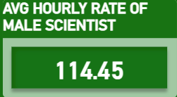

HOURLY RATE OF MALE RESEARCH SCIENTIST
This metric provides insight into compensation trends within this specific job role and gender group.
The data reveals that Male Research Scientists have an average hourly rate of 114.45.

Slide 7

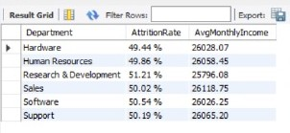
ATTRITION RATE VS MONTHLY INCOME STATS
The goal is to identify any trends or insights that can help the HR team better understand factors contributing to employee retention
Research and Development has the highest attrition but the lowest average monthly income suggesting a potential link between pay and turnover.

Slide 8

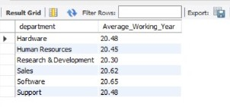
AVERAGE WORKING YEARS FOR EACH DEPARTMENT
Software & Sales teams show the longest average tenure (20.65 & 20.62 years), suggesting strong retention or experienced workforces.
R&D has the shortest tenure (20.30 years)—aligning with its highest attrition rate (51.21%), signaling potential retention risks.
Other departments (Hardware, HR, Support) cluster around 20.45–20.48 years, indicating stable but unexceptional tenure patterns.

Slide 9

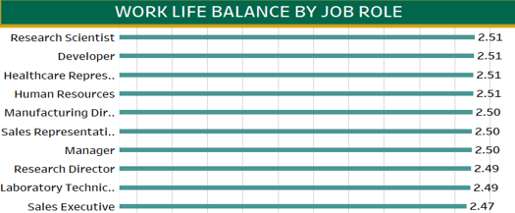
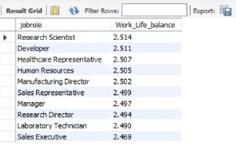
JOB ROLE VS WORK LIFE BALANCE
Research scientists tend to report the higher work-life balance scores , while sales Executive tend to report the lowest.
Consistently rank lower, potentially linked to high-pressure environments.

Slide 10
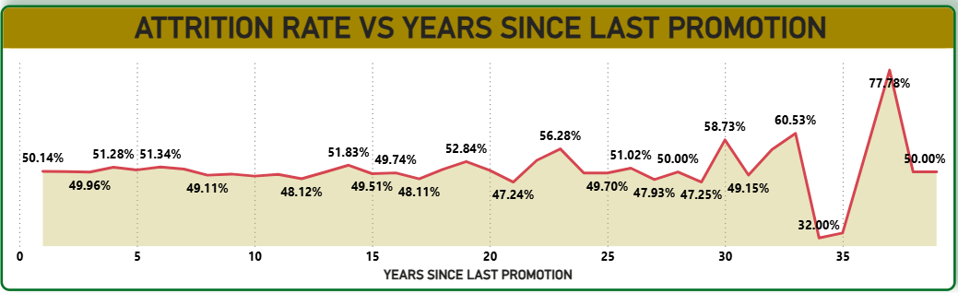
Employees who have not received a promotion in 37 years shows a significantly high attrition rate of 77.78% , indicating strong dissatisfaction or discouragement at this stage .
Similarly , those with no promotion in the past 33 years exhibit a 60.53% attrition rate , underscoring the impact of career stagnation on employee retention .
Insight
there is a clear correlation between prolonged periods without promotion and increased attrition risk .
These findings highlight the importance of career progression opportunities in retaining experienced talent .

Slide 11

ACTIONABLE STRATEGIES FOR RETENTION
Recognition for Tenure and Impact –
Year service awards .
Personalized trophies , certificates .
Legacy contributor awards to employees whose word had long-term impact .
Offer competitive and transparent compensation –
Communicate salary bands , bonus structures &equity opportunities .
Provide retention bonuses or milestone incentives .
Expand wellness benefits , education stipends , flexible PTO .
Use data to anticipate risk –
Analyze exit interviews , engagement in surveys and turnover trends .
Identify high risk roles or teams and target interventions .
Monitor early retention .
Improve work-life balance –
Offer flexible or hybrid work models .
Encourage use of PTO , mental health days .

Slide 12
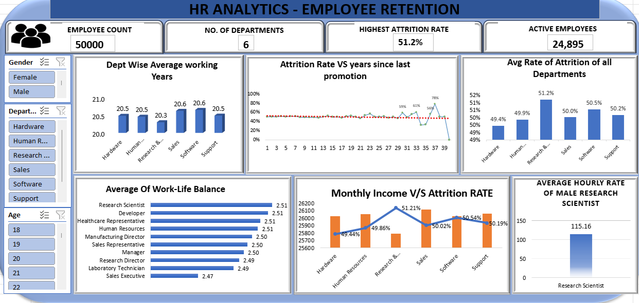
EXCEL DASHBOARD

Slide 13
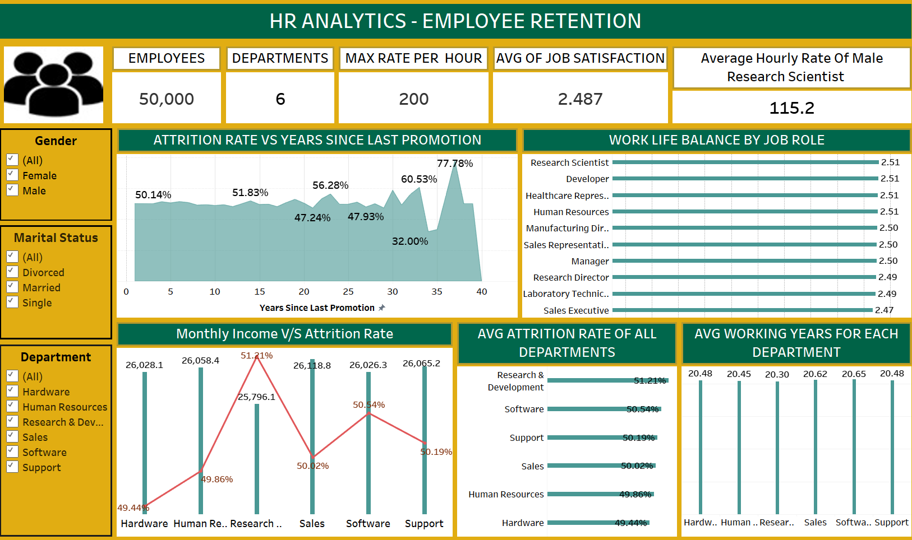
TABLEAU DASHBOARD

Slide 14
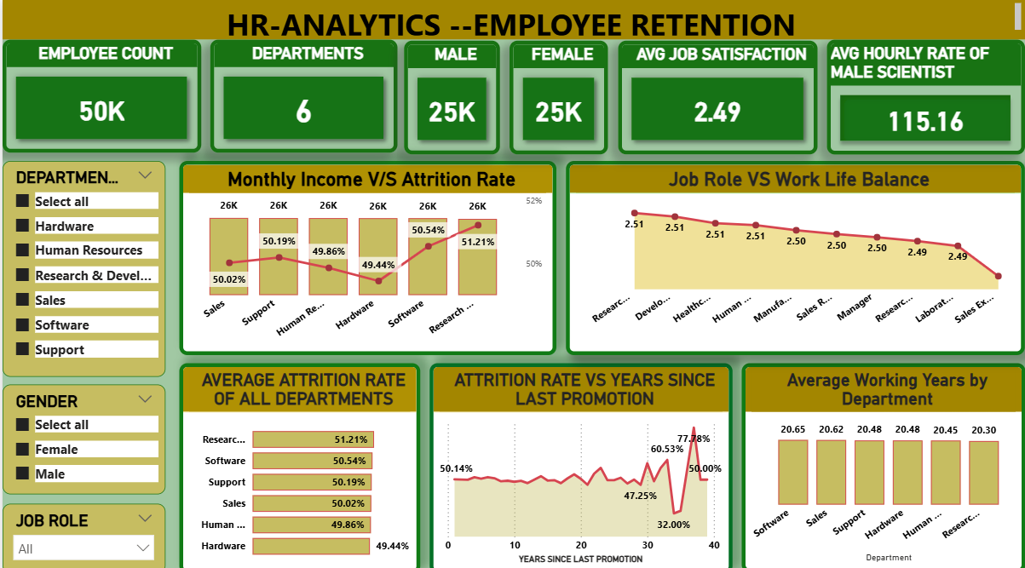
POWER BI DASHBOARD

Slide 15

CHALLENGES FACED :
Missing values in key HR fields like salary, tenure, and department.
Limited knowledge of Data Analytics tools and technique.
Without proper optimization , the data could be slow to load and interact with this can be frustrating for users and defeat the purpose of a quick and informative display.
Ensure your data queries are efficient and only retrieve the necessary information.
Pre-aggregate the data before it reaches the dashboard to improve performance

Slide 16

OUTCOME OF THE PROJECT :
The data was examined across multiple dimensions such as age, department, work-life balance, job role, distance from home, years at company, and training frequency.
The HR Analytics project aimed at understanding and addressing the issue of employee attrition through data-driven insights.
The implementation of KPIs in Excel, Tableau and Power BI helped to gain proficiency with the application of these business analytics tools.
It was also observed that certain departments like Support and Sales faced higher attrition levels.

Slide 17

CONCLUSION :
The project highlighted that factors such as long distances from home, poor work-life balance, limited career advancement, and low employee satisfaction were strongly correlated with higher attrition.
Departments like Support and Sales were found to be more vulnerable. These insights confirm the importance of adopting data-driven HR practices.
By leveraging analytics, the organization can implement proactive measures such as personalized retention strategies , career path planning, and work flexibility to reduce turnover and enhance employee satisfaction.
This analysis will help HR teams take smarter actions to retain employees such as offering better growth opportunities, improving work policies, and focusing on employee well-being.

Slide 18


