Slide 1
Labs Task based Asynchronous Pattern (TAP)

Slide 2
Lab – 01
Task and Async/Await

Slide 3
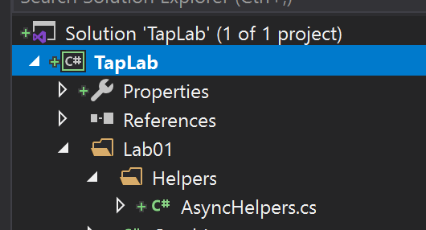
Setup Delay
Open TapLab Solution -> Lab01 folder -> Helpers -> AsyncHelpers.cs

Slide 4
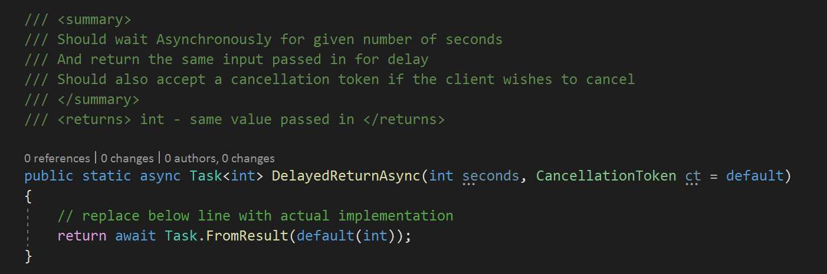
Implement DelayedReturnAsync
UnComment the Method and implement the logic to wait without blocking. Ensure it can accept cancellation tokens too.
See Notes for Help
Notes:
Hint:
Use Task.Delay and await on it. (It also takes a cancellation token)
Then, just return the passed in value as it is.

Slide 5
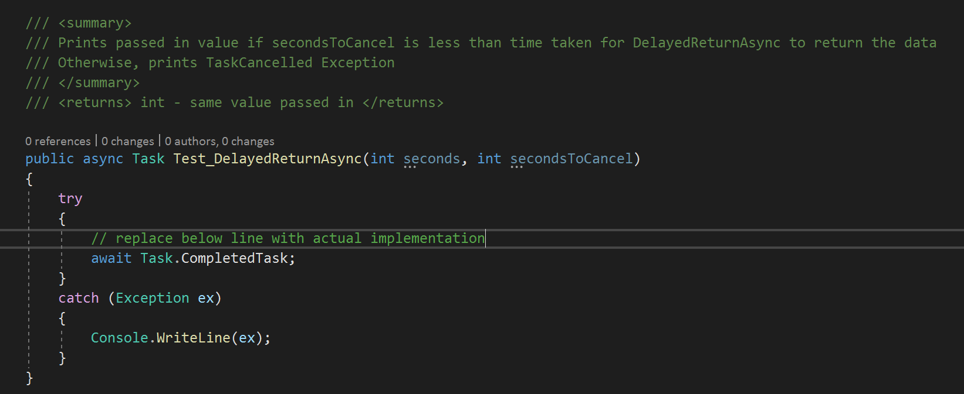
Test DelayedReturnAsync
In the same AsyncHelpers.cs, uncomment and implement the below method, that will be used to test the DelayedReturnAsync method
It should print the returned value if the execution time of DelayedReturnAsync is less than that of expiry time of CancellationToken. See Notes for Hint
Notes:
Hint:
Create a cancellation token source and pass the token from it to DelayedReturnAsync and then await on the returned task.

Slide 6
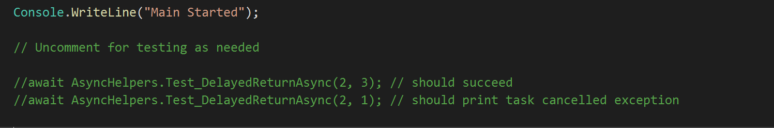
Test DelayedReturnAsync
Now in Main method of Program.cs, uncomment below two method calls and see how it is working. Comment it back after testing.

Slide 7
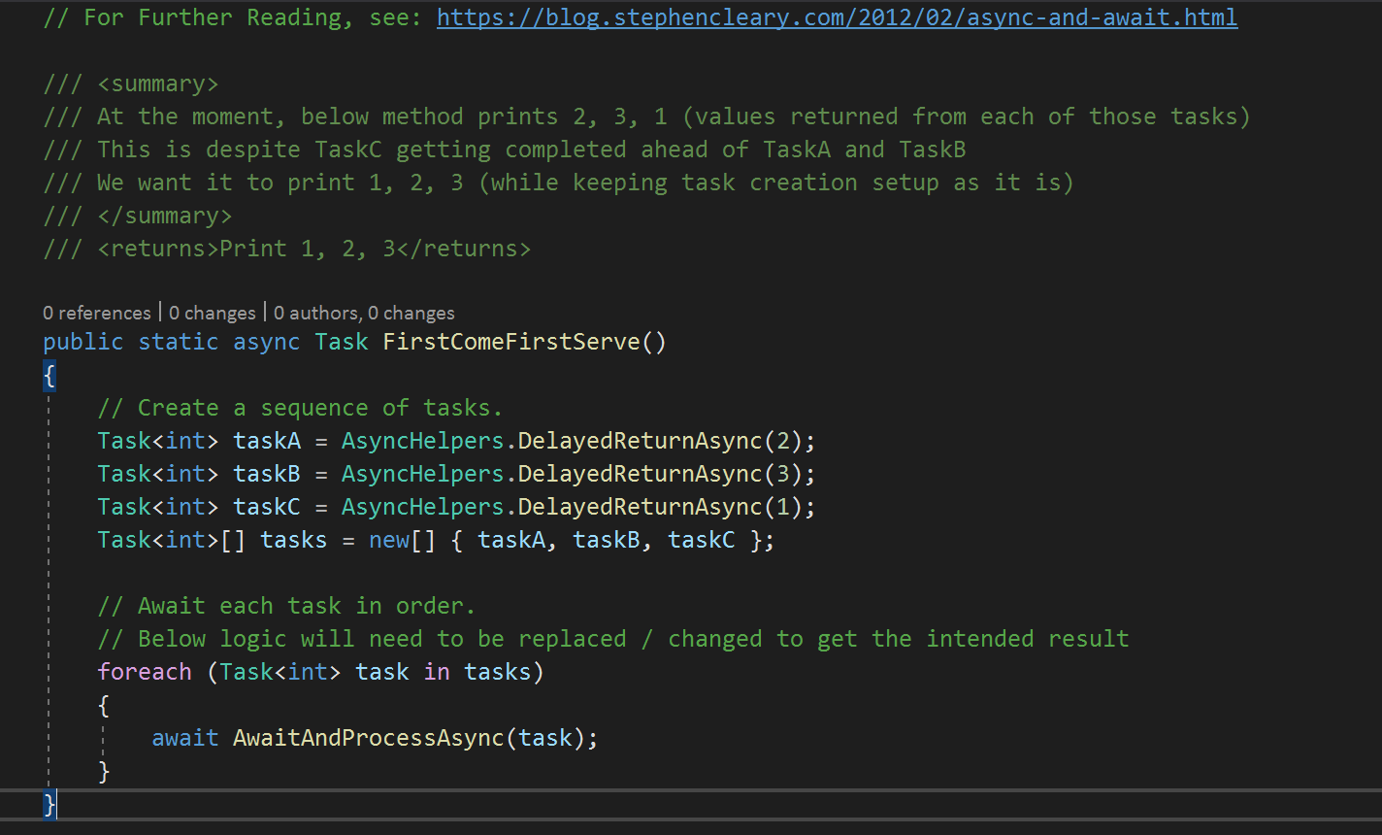
Combinator - FirstComeFirstServe
Now that we have an async method that can return some data, go to Combinator.cs and update the logic in FirstComeFirstServe(), so it prints 1,2,3 instead of 2,3,1
Notes:
Hint:
Use Linq and then do a WhenAll

Slide 8
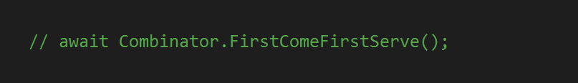
Combinator – Testout FirstComeFirstServe
Uncomment below line from Main and test out the method
Comment it back after testing

Slide 9
Lab - 02
Data Parallelism

Slide 10
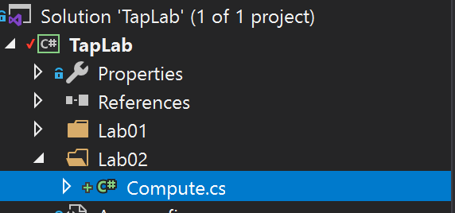
Parallel Compute Square for a range of numbers
Open Compute.cs from Lab02 folder

Slide 11
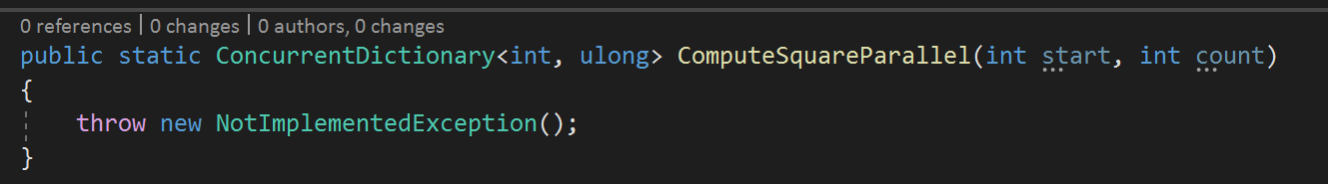
Compute Square for a range of numbers Parallelly
Implement below method using Parallel.Foreach to compute a range of numbers from start and count (For e.g. 100, 2000 should compute square of every number between 100 and 2100)
There is a single-threaded implementation available in the same class
Notes:
Hint: Use Parallel.Foreach()

Slide 12

Test out the implementation of ComputeSquareParallel
Uncomment below code from Main in Program.cs
Comment it back once testing is complete

Slide 13
Lab - 03
Exceptions

Slide 14
Avoid Void..
Open AsyncException.cs from Lab03 folder

Slide 15
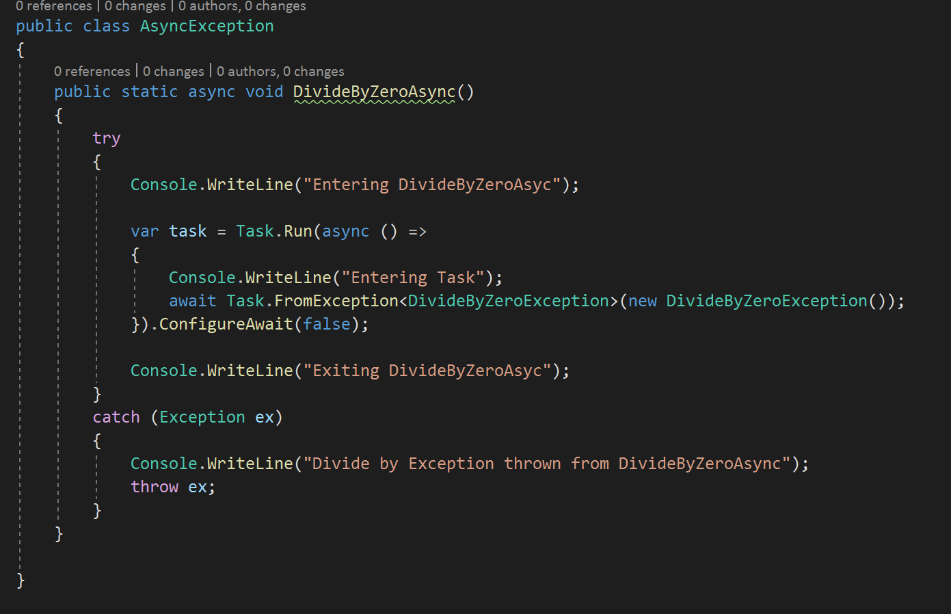
Avoid Void..
Modify the method so that the DivideByZeroException thrown from the spun-up task is caught and propagated to Main
Notes:
Hint:
Exceptions are attached to Tasks. So, the method must return a Task.
Furthermore, the executing task must also be awaited or else it becomes a fire and forget approach. (In our case, the task in question is the one that throws the exception)

Slide 16
Test if Exceptions are captured correctly
Await on the DivideByZeroAsync from Main in program.cs
The exception should be printed on the screen and will also terminate the program.
Comment it back once testing is complete

