Slide 1
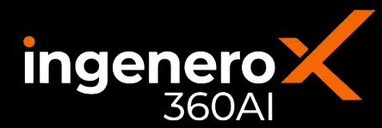






gasnet
360
MODULE OF THE
INGENEROX360 AI SUITE
Highest-margin, constraint-feasible operating and commercial plans for gas transmission & delivery networks
PRODUCT OVERVIEW
GasNetX360 is a decision-support application for gas transmission and delivery network operations, combining hydraulic and equipment-performance models with contracts, tariffs and market prices. Minimizing energy is not the same as maximizing profit, a lower-energy plan can forgo a high-value delivery, trigger imbalance penalties, or consume linepack needed before a peak. GasNetX360 finds the highest-margin plan that is still feasible against the network's real hydraulic and equipment limits, configured and commissioned per site by Ingenero engineers.
OBJECTIVE — MAXIMIZE EXPECTED CONTRIBUTION MARGIN OVER THE PLANNING HORIZON
Profit = Delivery revenue + Optionality value − Supply cost − Compression cost − Transportation charges − Penalties − Losses / emissions cost − Reliability cost
SCOPE OF SERVICES — SEVEN PHASES, EACH WITH A SIGNED DELIVERABLE
PHASE 1
›
PHASE 2
›
PHASE 3
›
PHASE 4
›
PHASE 5
›
PHASE 6
›
PHASE 7
Discovery & Basis
Data Acquisition & Assessment
Network & Equipment Model
Economic & Contractual Model
Optimization & Scenario Engine
User Application & Recommendations
Pilot, Training & Deployment
01
Network & Equipment Model
02
Economic & Commercial Model
Shown: how the optimizer weighs multiple supplies and delivery priorities
Shown: today's margin, the GasNetX360 target, and the ceiling
Supply A
Delivery A
NET CONTRIBUTION MARGIN — TODAY vs THE THEORETICAL CEILING
cheaper, farther
→
Compressor Station
raises pressure — the shared bottleneck
→
firm, high value
today
target
ceiling
Supply B
Delivery B
+20%
what GasNetX360 targets
+12%
residual headroom
costlier, closer
↓
interruptible
Linepack & Storage
Ceiling = margin under perfect foresight of demand, prices and equipment, with every physical, contractual and regulatory limit still enforced a benchmark, not a plan.
Debottlenecking (relaxing a binding limit) is valued separately, on top; the split above is quantified per site.
buffers supply / demand swings
The optimizer chooses the source, the compression and which delivery to serve first.
03
Optimization & Scenario Engine
How the optimizer works — from inputs and hard constraints to a ranked, defended plan
APPROACH genuine mathematical optimization — mixed-integer plus nonlinear terms (hydraulics, compression, discrete commercial choices), solved on a rolling horizon.
Machine learning supplies the forecasts and fast network surrogates, not a replacement for the optimizer; the exact formulation, fidelity and solution method are fixed per site in Basis Definition.
INPUTS
network & equipment model · contracts & prices · demand / price forecasts · live SCADA
Why GasNetX360, not a rule-based optimizer
HARD
CONSTRAINTS
↓
Rule-based / energy tools
GasNetX360
Max Allowable Pressure & integrity · compressor envelopes · gas-quality specs · contract & nomination terms · mass balance & reserves
Fixed rules, re-tuned by hand
Learns from operating history
OPTIMIZER
DECIDES
↓
Optimizes flow or energy alone
Optimizes margin, not just flow
physical compressor loads, pressures, routing commercial : nominations, firm vs interruptible, storage, curtailment ; reliability : standby rotation, outage timing, reserves
One best-guess forecast
Scenarios + error sensitivity
RESULTS
↓
Opaque, static output
Explains action, driver & confidence
ranked, quantified recommendations · predicted network state & bottlenecks · margin vs plan & budget · scenario & forecast-error sensitivity
Re-run by an engineer, ad hoc
Re-runs automatically each cycle
04
Opportunity and Recommended Actions
What a recommendation looks like — ranked, quantified, and traced to the constraint that drove it
MARGIN vs PLAN
BINDING NOW
PLAN HORIZON
+ illustrative $/day
Station B MAOP — 87% of limit
rolling 7 days · 1-hour steps
RANKED ACTION
EXPECTED VALUE · illustrative
VALUE · CONFIDENCE
1
Shift 35% of receipt volume Source B → Source A
+$4,100/day
receipt header · next 8 h · binding: delivered-cost spread
conf: High
2
Raise Compressor Station 2 discharge setpoint by 30 psi
+$1,800/day
Station 2 · next 4 h · binding: Station B MAOP headroom
conf: Medium
3
Build linepack 2% ahead of tomorrow's peak
+$1,200/day
Zone 3 · overnight · binding: peak-hour delivery limit
conf: High
4
Trim interruptible nomination on Route 4 by 10 MMscf/d
−$600 penalty avoided
Route 4 · day-ahead cycle · binding: imbalance tolerance
conf: Medium
Each recommendation carries rationale, constraints considered, and forecast-error sensitivity, plus a full audit trail — advisory only. $ values are illustrative pending a site value study.
05
Platform
Historian & SCADA links
Simulator & scheduler links
Real-time to planning
Gen AI assistant
Role-based dashboards
plug-and-play to plant historians and real-time feeds
runs alongside hydraulic models, nomination and ETRM systems
one engine from live operations to the monthly plan
answers network and margin questions inside the workflow
operations, scheduling and commercial each get their own view
DELIVERY
FLEXIBILITY
SCALE
Contact for a value assessment
marketing@ingenero.com
Configured, validated and commissioned per site by Ingenero engineers.
Any network topology; natural gas, extendable to NGL / refinery fuel gas.
Repeat networks reuse the configuration, with minimal rework.
Notes:
GasNetX360 A4 one-pager (DRAFT). Layout: Sections 01 (network diagram) and 02 (NCM margin ladder) sit side by side; Section 04 now carries two visuals - the opportunity bubble map (value vs ease of execution) and a new NCM margin-bridge waterfall (Current -> per-lever uplift -> Optimized). ALL numeric values (NCM index, +uplift steps, bubble sizes) are illustrative placeholders for layout - replace with real network data / a site value study before issue.

Slide 2
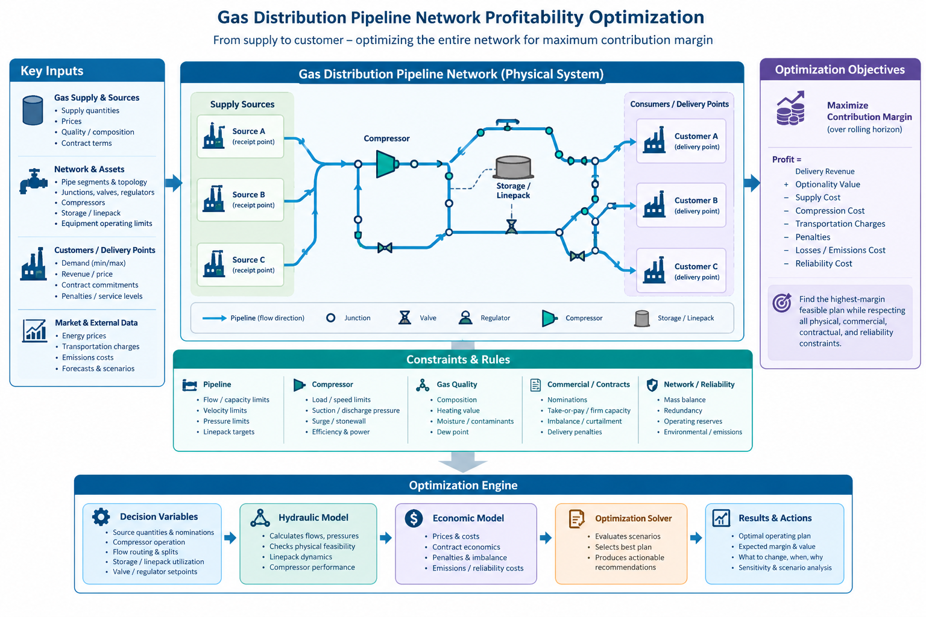
gasnet
360
MODULE OF THE
INGENEROX360 AI SUITE
The complete picture — network inputs, physical system, constraints and the optimization engine
GASNETX360 — END TO END
From supply to customer — the inputs, the physical network, the constraints and the optimization engine behind every recommendation on page 1.
IMPORTANT
• Directional, not a specification. This brochure describes Ingenero's intended approach and an indicative solution for gas transmission and delivery network profitability optimization. It is provided for evaluation and discussion only, and does not form part of any contract, offer or commitment.
• The delivered product will differ. The actual scope, optimization formulation, objective function, constraints, planning horizon, time resolution, user workflows, deliverables and schedule are defined jointly during the Discovery & Basis phase and depend on each site's network configuration, equipment, operating practice and commercial arrangements.
• Dependent on data, systems and access. Functionality and accuracy depend on the availability, quality and timeliness of operational, equipment, contractual and market data; on the existing SCADA, historian, hydraulic-simulation and scheduling systems and the interfaces that can be built to them; and on the access, permissions, cybersecurity and architecture approvals granted by the customer, together with the availability of subject-matter experts.
• All figures are illustrative. Every number, chart, waterfall, mock recommendation and screenshot shown here is a placeholder for layout purposes and is not a prediction, guarantee or typical result. Benefit potential is quantified per site in a value study; realized value depends on implementation, adoption and operating conditions, and no specific saving or margin uplift is warranted.
• Advisory system. The initial deployment is decision-support only. GasNetX360 provides recommendations; operations and control-room staff retain full authority for every decision. Closed-loop control, changes to regulatory control logic and third-party interface development, if required, are separately scoped.
• Not professional advice. Nothing here constitutes investment, financial, legal or engineering-certification advice. Commercial terms, pricing and any third-party software licensing are set out separately in the commercial proposal.
DELIVERY
FLEXIBILITY
SCALE
Contact for a value assessment
marketing@ingenero.com
Configured, validated and commissioned per site by Ingenero engineers.
Any network topology; natural gas, extendable to NGL / refinery fuel gas.
Repeat networks reuse the configuration, with minimal rework.
Notes:
Page 2: the supplied end-to-end infographic, enlarged, above a scope-and-disclaimer block. All page-1 figures, charts and recommendation mock-ups are illustrative placeholders; scope, formulation, horizon, deliverables and timeline are set during the Discovery & Basis phase.

