Slide 1
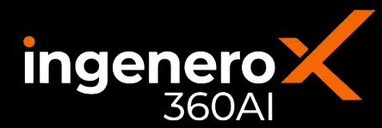



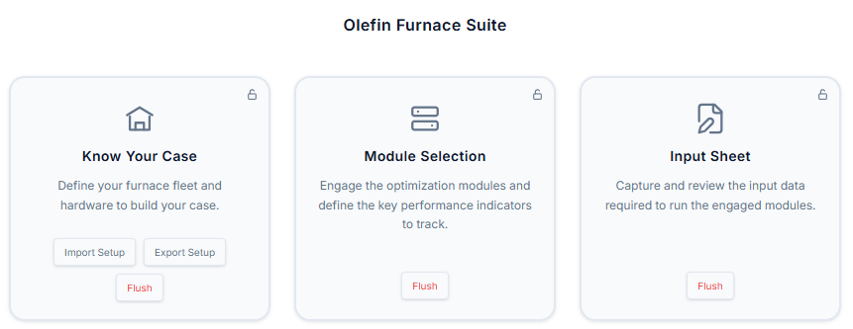
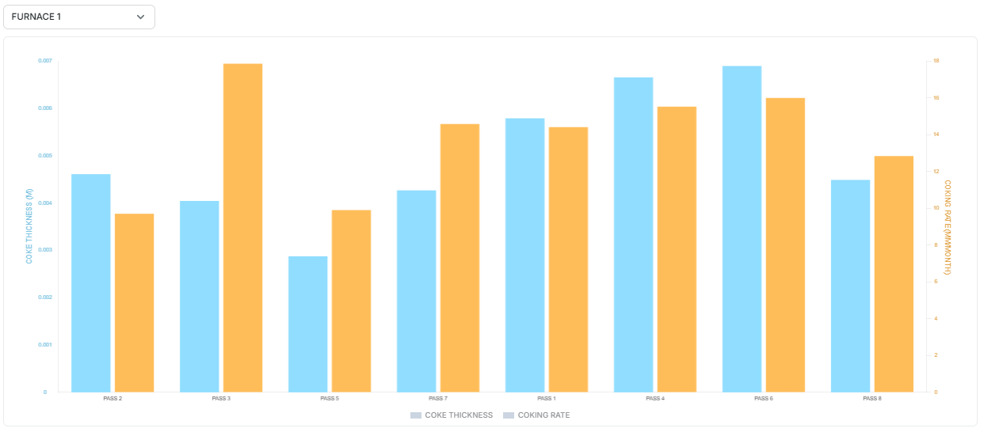
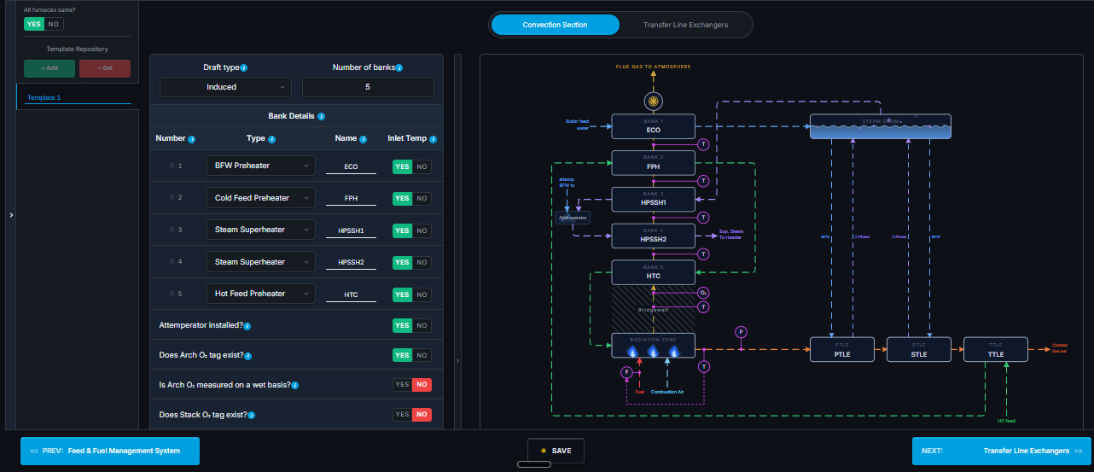
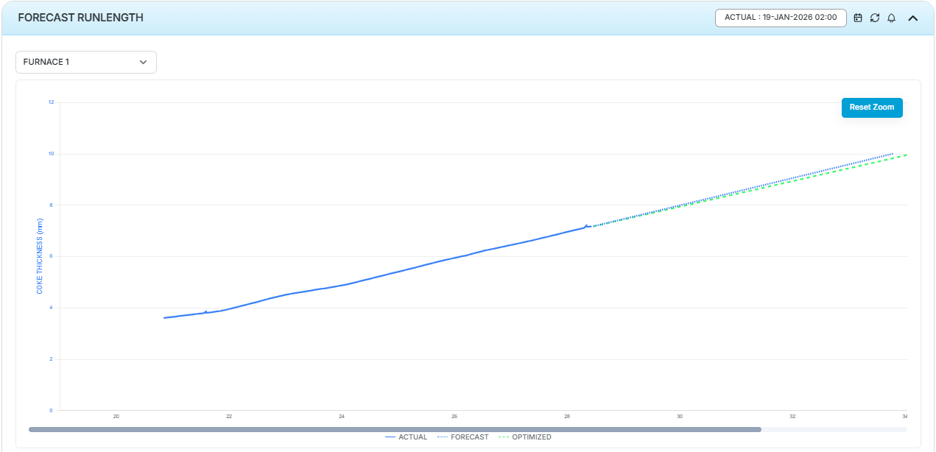

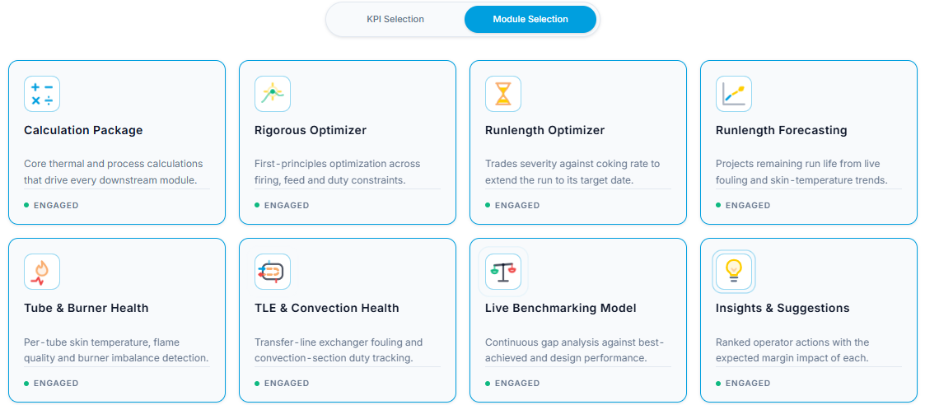

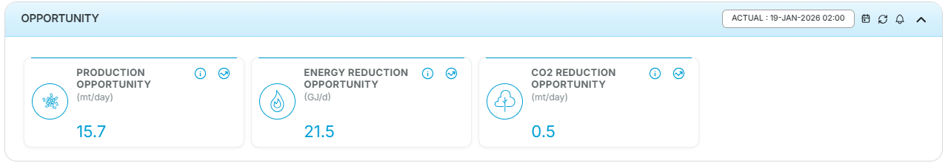
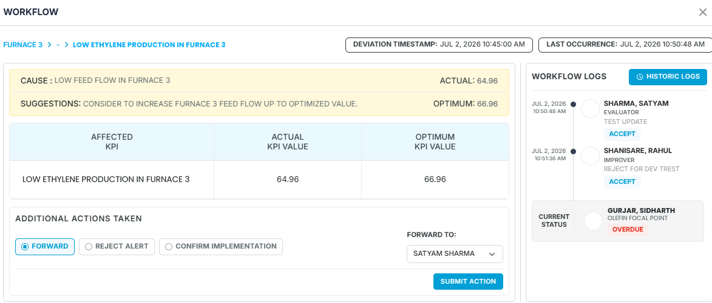
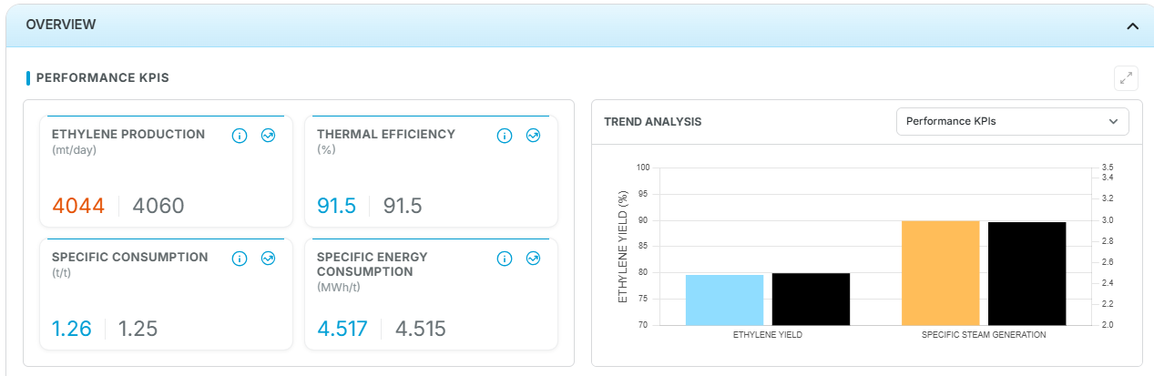

MODULE OF THE
INGENEROX360 AI SUITE
Predictive decision support for the olefin furnace unit
PRODUCT OVERVIEW
FurnaceX360 is a decision-support application for the Olefin Unit. Domain and ML agents are configured on the unit's own historian and Sensor tag data, covering the Optimization – Overall yield maximization and furnace run length optimization along with the forecast, Furnace critical KPIs calculation, Draft & Damper Optimization, Burner performance optimization, Tube Plugging probability, TLE & convection bank performances and Decoke effectiveness improvement. Output reaches the process engineer as ranked, quantified actions, each reported against the parameter that caused it. Every model agent is configured, validated and commissioned per site by Ingenero process engineers, so the deployment reflects that unit's configuration and operating envelope.
01 Unit Configuration
02 Plant Data and Model Execution
Shown: Olefin furnace suite – interactive configuration, modules and sensor entry
Shown: coke thickness & coking model, run length forecast current vs optimum.
Radiation, Convection, Feed header and Saturator interactive PFD available
Know Your Case
Configure your furnaces from feed type, radiation, convection, burner and coils
Module Selection
After configuring all furnaces, select the modules – Domain & AI agents
Inputs
Sensor tag entry along with design tag values with configuration details
Input Sheet
Based on configuration & Module selection – relevant sensor info needs to be filled
Processing
tag validation, steady state framing and furnace run identification
Interactive Config
Outputs
predicted KPIs, ranked actionable with cause, trends, alerts
03 AI-Powered Model Agent Suite
Agent/Module selection shared along with detailing of the olefin specific details
Thermal & Fuel Efficiency
Helps to compare the energy efficiency among the furnaces.
Environment KPIs
Estimate thermal and fuel NOx and warns for higher limit breach.
Decoke Efficiency
Provide efficient decoke tracking and suggestions for improvement
Tube Plugging
Estimates plugged tubes and warns early for the corrective action.
Run Length Forecasting
Forecasted value helps to do decoke scheduling along with biasing option
Feed Planner
Helps to plan feed based on future feed availability
Fouling Precursor
Soft sensor estimates precursors that cause fouling in CGC/Quench loops
04 Opportunity and Operator Actions
+1-2%
Overall Ethylene Yield
+10%
Furnace run length
5–8%
Decoke effectiveness
from overall furnace system optimization
optimum feed and COT adjustment
pass level decoke optimization wrt burning
Basis: optimization takes care of constraint/limitation of not only at furnace level but also downstream section, suggestions take care of step change which ensures smooth implementation.
05 Platform
Historian connectivity
Simulation integration
Daily reporting
Gen AI assistant
Build your own dashboard
plug and play with leading plant historians
third party simulators integrate without custom work
downloadable daily reports with interactive trends
answers plant questions in the operating workflow
engineers build the views their unit needs
DELIVERY
FLEXIBILITY
SCALE
Contact for a free trial: marketing@ingenero.com
Configured, validated and commissioned by Ingenero process engineers.
Any crude slate; selectable KPI set; selectable Virtual analyzers
Repeat sites reuse the configuration, with no/minimal rework per plant.
Notes:
CokerX360 A4 one-pager. Sections: 01 Unit Configuration, 02 Plant Data and Model Execution, 03 Model Suite (full width, twelve models), 04 Reported Gains and Operator Actions, 05 Platform. Contact name to be filled before issue.

