Slide 1



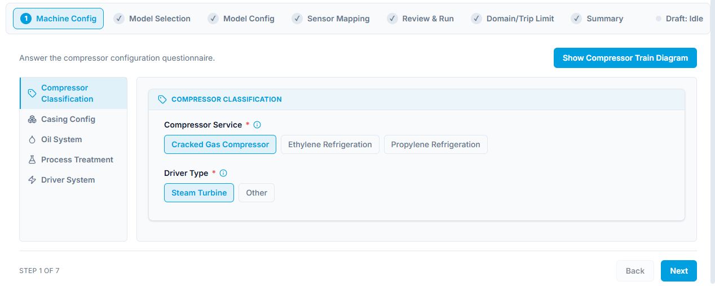
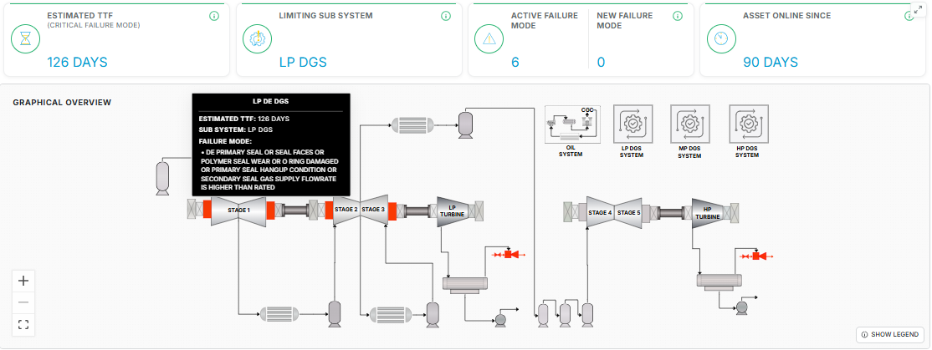
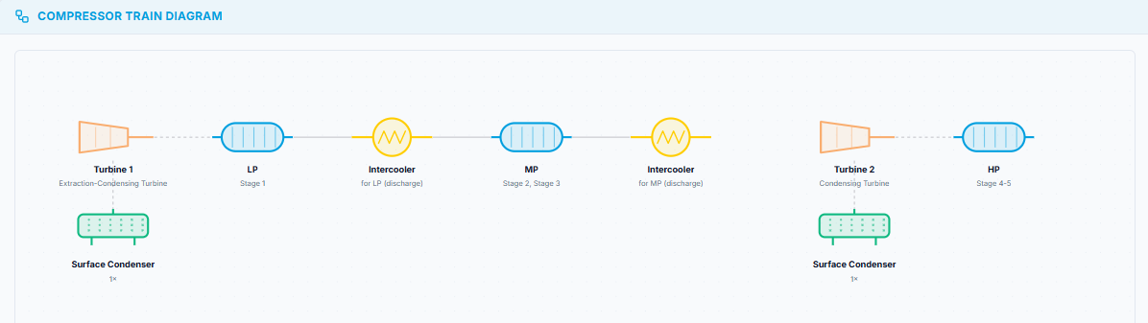
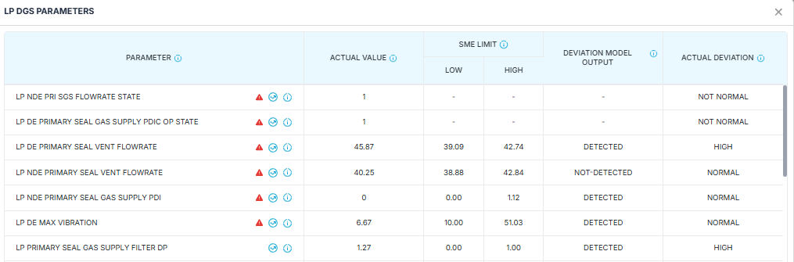








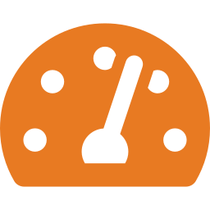

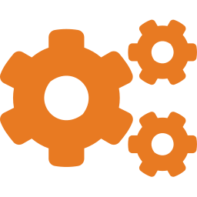

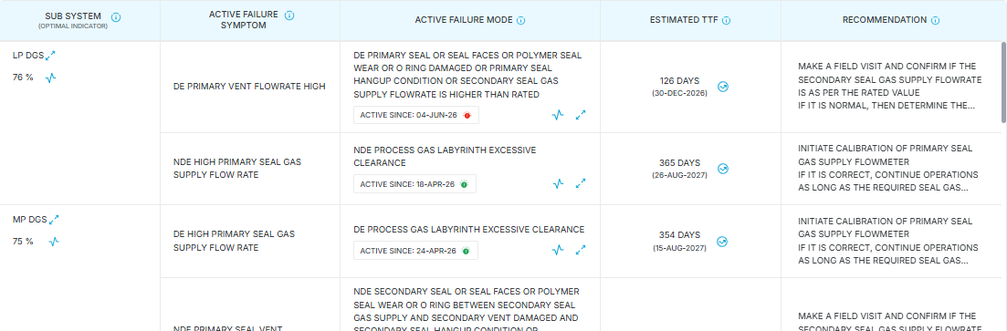
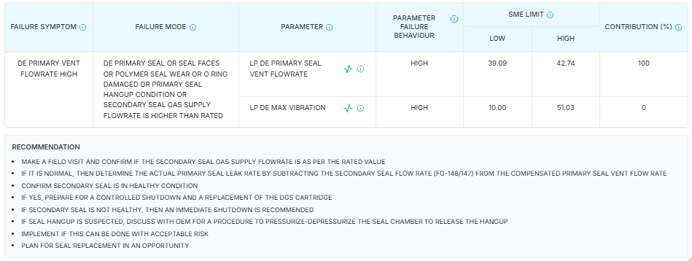

Reliability 360
MODULE OF THE
INGENEROX360 AI SUITE
Predictive decision support for critical assets
PRODUCT OVERVIEW
ReliabilityX360 is a decision-support application for critical plant assets. The current problem isn't lack of alerts — it's alerts that fire too late to prevent a trip, or too often to trust. Reliability360 combines domain and ML agents configured on the asset's own build with its historian and DCS tag data, so one framework covers a complete asset without a custom model rebuild for each — catching what's developing early enough to act on and specific enough to trust. Output reaches the reliability engineer as a named failure mode, an estimated time-to-failure and a prescribed action, reported against the parameter that caused it.
01 Asset Configuration
02 Plant Data and Model Execution
Shown: the guided compressor build, then the train diagram it generates.
Shown: the machine as a live schematic, and parameter behavior
Asset build
compressor service, driver type, casing count and stage grouping
Inputs
Sensor tag entry, OEM/rated/design data, configuration details
Sub-systems
dry gas seals, mechanical, oil system, turbine, condenser, process stages
Processing
tag validation, failure mode matrix build and scoring, failure prediction
Sensor mapping
available tags mapped against a predefined list — adapts automatically
Outputs
active failure mode, parameter forecast, estimated TTF, prescription, alerts
Model depth
deviation detection, failure mode identification, failure prediction
03 AI-Powered Model Agent Suite
Model selection is shared across assets — each model's behavior is tuned to the asset's own failure modes
Smart Feature Engineering
Inferred tags engineered per asset from asset specific domain knowledge
Failure Mode Identification
Correlates parameters against domain logic to name the failure mode
Tacit Knowledge, Encoded
Engineers' tacit knowledge built directly into every model and limit
Time-to-Failure Estimation
Estimates time to failure before a parameter crosses a threshold
Deviation from Design
Tracks how equipment behavior drifts from design and rated conditions
Parameter Contribution
Ranks each parameter's contribution to the active failure mode
Early Deviation Detection
Deep learning models learns normal behavior and catches deviations early
Sub-System Health Ranking
Scores every sub-system and names the one limiting the asset
Failure Mode Matrix
One setup run builds the asset's symptom, mode and parameter matrix
Workflow Suggestions
Prescribed action per mode, routed to the engineer for closeout
04 Opportunity and Operator Actions
30+ days
Advance warning
$2M+/yr
Savings potential
<2%
False alert rate
on every alert, before failure
per critical asset protected
alerts an engineer can act on
Basis: avoided unplanned trips, controlled versus forced shutdown, lead time and false alert rate measured verified against actual site data
05 Platform
Historian connectivity
API Integration
Daily reporting
Gen AI assistant
Build your own dashboard
plug and play with leading plant historians
enriches models with CMMS/EAM history
downloadable daily reports with interactive trends
answers plant questions in the operating workflow
engineers assemble the views their reliability team needs
DELIVERY
FLEXIBILITY
SCALE
Contact for a free trial: marketing@ingenero.com
Configured, validated and commissioned by Ingenero reliability engineers.
Any asset build; selectable model depth; selectable sensor set
Repeat assets and sites reuse the configuration, with no/minimal rework.

