Slide 1
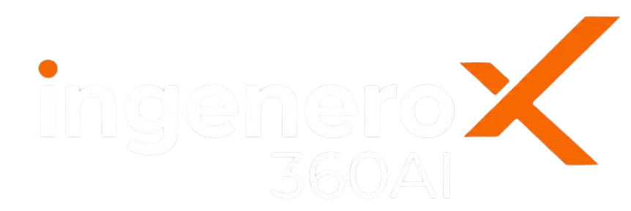
brochure.ingenero360.ai
FIRST-PRINCIPLES & KINETICS-BACKED INDUSTRIAL AI
THE INDUSTRIAL AI SUITE DELIVERING MEASURABLE PLANT VALUE
Purpose-built AI agents embedding rigorous chemical thermodynamics, non-linear reaction kinetics, and first-principles physics. IngeneroX360AI continuously negotiates operating limits for yield, throughput, energy, asset reliability, and carbon emissions.
>$100M+ USD
Registered Economic Benefits
Global Petrochemical Leaders
1–3%
Operational & Energy Gains
Continuous Unit Yield Uplift
14 Complexes
Global Enterprise Footprint
Multi-Plant Implementations
90 Days
Value Creation Playbook
POC to Production Deployment
IngeneroX360AI Suite Brochure Portal: https://brochure.ingenero360.ai
Contact: marketing@ingenero.com • 8 Complete Suites • 21 Specialized Modular Solutions

Slide 2
brochure.ingenero360.ai
AGENTIC ARCHITECTURE ECOSYSTEM
THREE TIERS OF INDUSTRIAL AI AGENTS
IngeneroX360AI unifies specialized process unit kinetic twins with cross-process asset intelligence and enterprise-wide platform orchestration.
TIER 1 · PROCESS UNIT AGENTS
Unit Kinetic Optimization
▸ Ammonia & Methanol Suite (2 Modules)
▸ Olefins Complex Suite (6 Modules)
▸ Refinery Upgrading Suite (3 Modules)
▸ Gas Processing & Transmission (2 Modules)
▸ Polymer Manufacturing Suite (1 Module)
▸ Utility & Steam Network (1 Module)
TIER 2 · CROSS-PROCESS ASSET AGENTS
Equipment & Diagnostics
▸ MaintenanceX360 Cost Benchmarking
▸ ReliabilityX360 Critical Asset Health
▸ ControllerX360 APC & Loop Diagnostics
▸ OutlierX360 Multivariate Sensor Validation
▸ 14-30 Day Anomaly Lead Warnings
▸ Normalized Bad Actor Isolation
TIER 3 · ENTERPRISE PLATFORM
Industrial GenAI & Workflows
▸ GenX360 Conversational Assistant
▸ WorkflowX360 Governed Execution Engine
▸ EnergyX360 Site-Wide Multi-Header MILP
▸ Historian & DCS Bi-Directional Bridge
▸ Automated Shift Handover Reports
▸ Enterprise RBAC & Full Audit Logging

Slide 3
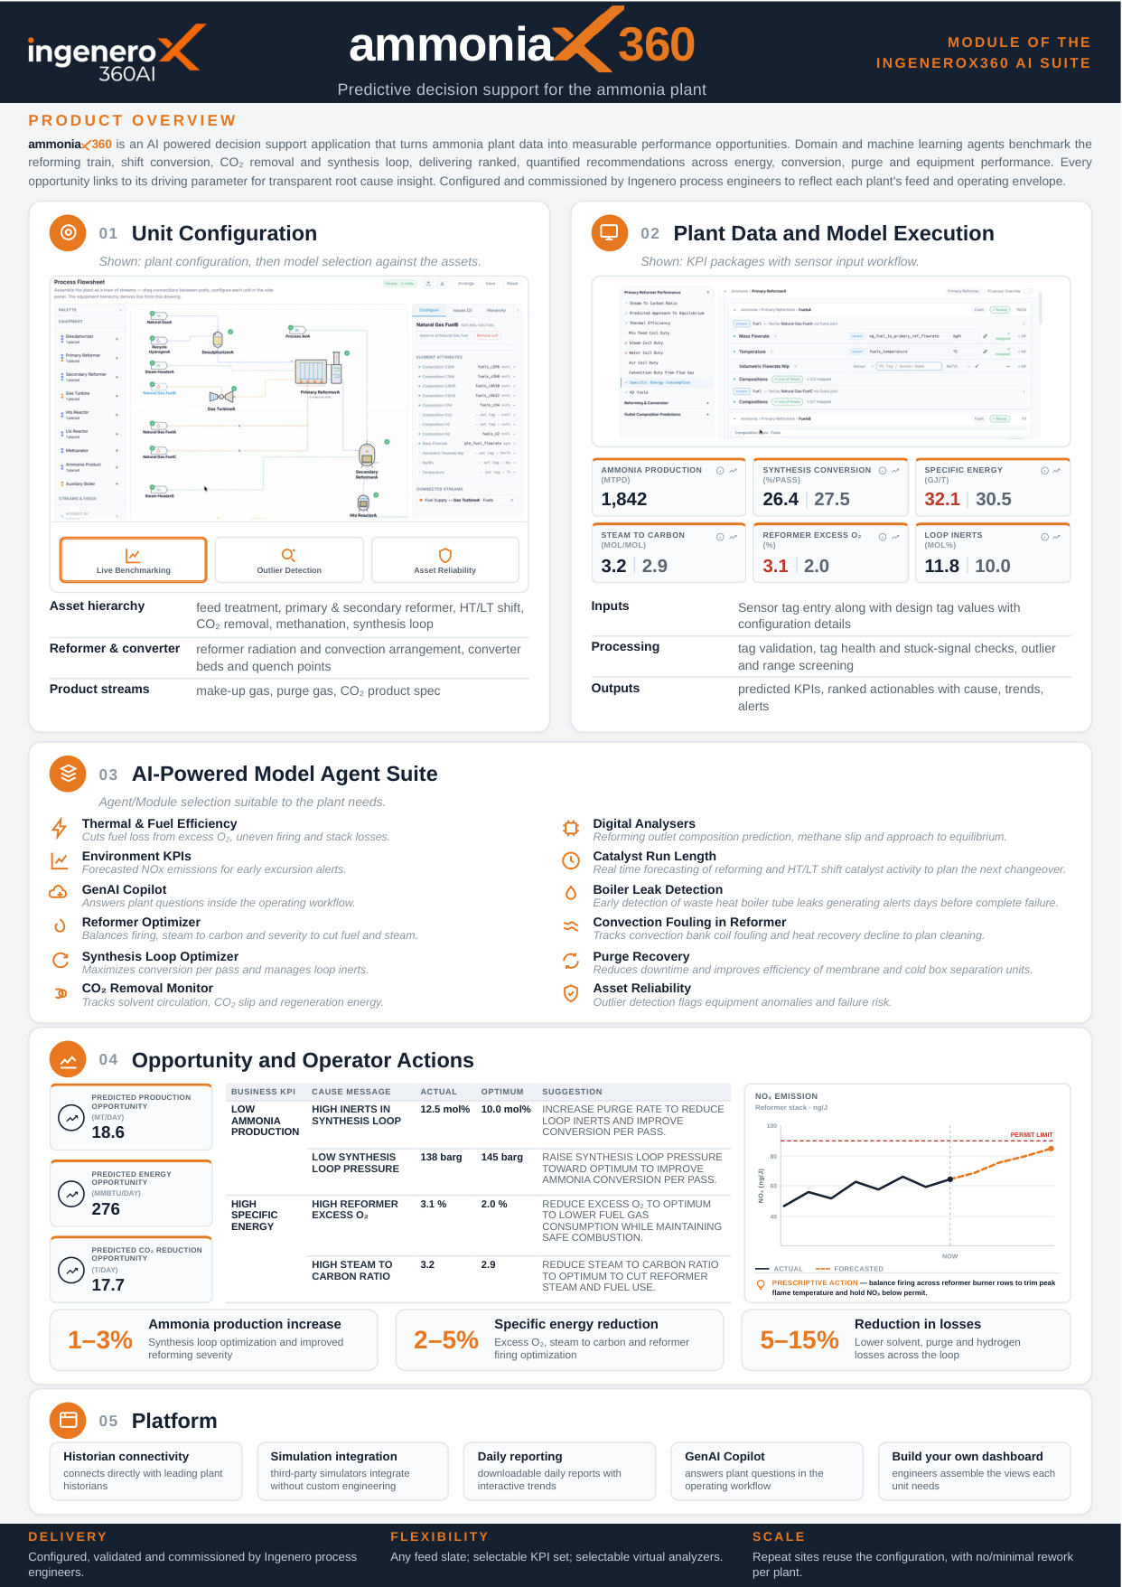
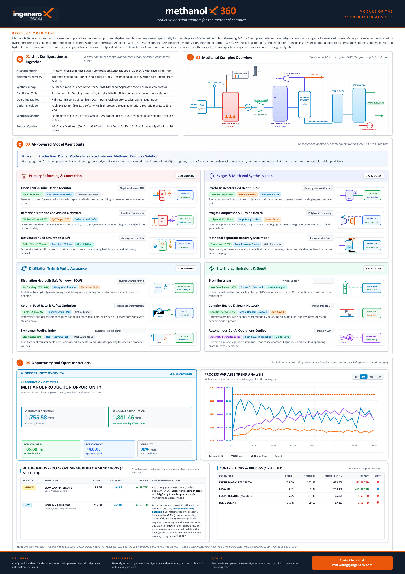
brochure.ingenero360.ai
SUITE 1 OF 8 • PETROCHEMICALS & SYNTHESIS GAS
Ammonia and Methanol Suite
Synthesis Loop, Reforming & Reactor Yield Optimization. Embedding thermodynamic equilibrium models and catalytic kinetic envelopes to maximize production margin and cut fuel consumption.
0.8–2.2% Yield Uplift
1.5–3.0% Reformer Fuel Gas Savings
6–12 Mo Catalyst Life Extension
AmmoniaX360
Reformer & Synthesis Loop Equilibrium Co-Pilot
• Dynamic primary & secondary reformer steam-to-carbon ratio optimization
• Multi-bed synthesis converter temperature profile & NH3 yield tracking
• Cryogenic purge gas recovery loop & loop pressure loss minimization
• Predictive catalyst activity degradation & remaining life forecasting
MethanolX360
Autothermal & Steam Reforming Syngas Balancer
• Reformer tube wall temperature (TMT) balancing and hot-spot prevention
• Syngas stoichiometric number (SN) dynamic control for synthesis reactor
• Distillation train energy reduction across topping & refining columns
• Compressor interstage cooling and recycle loop power minimization

Slide 4
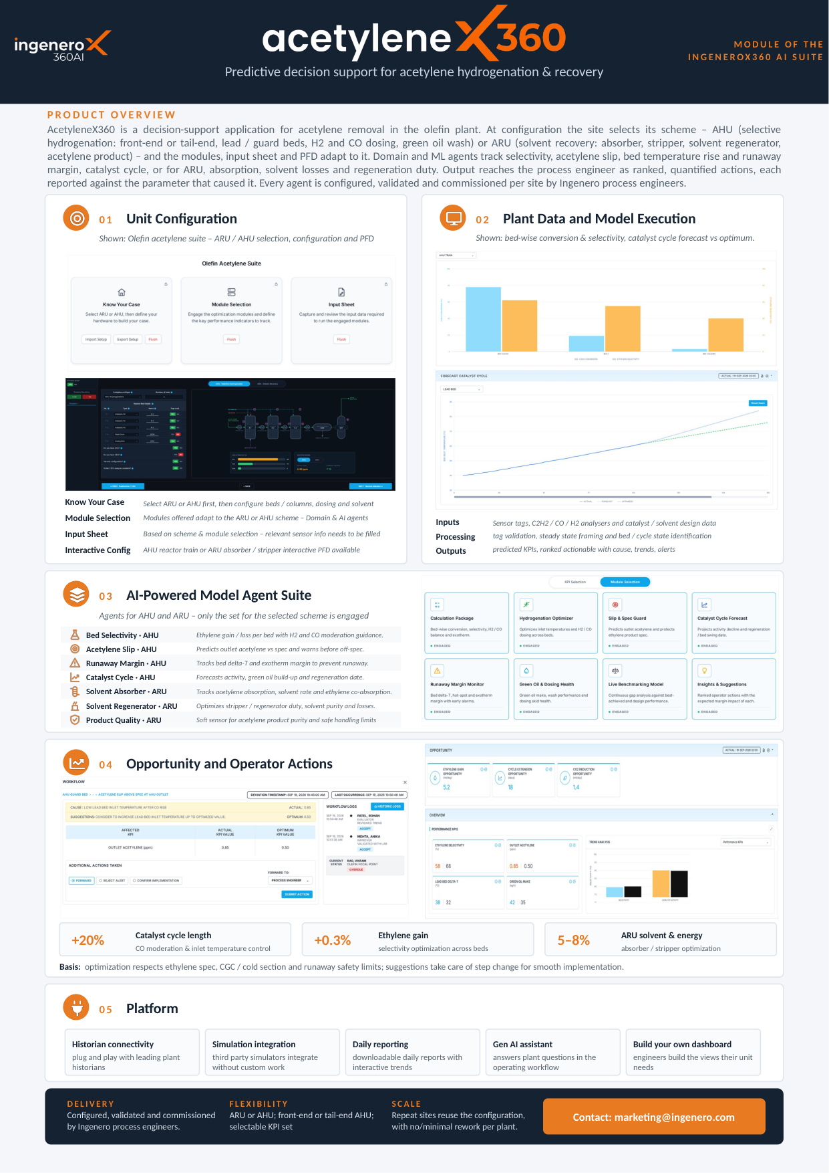
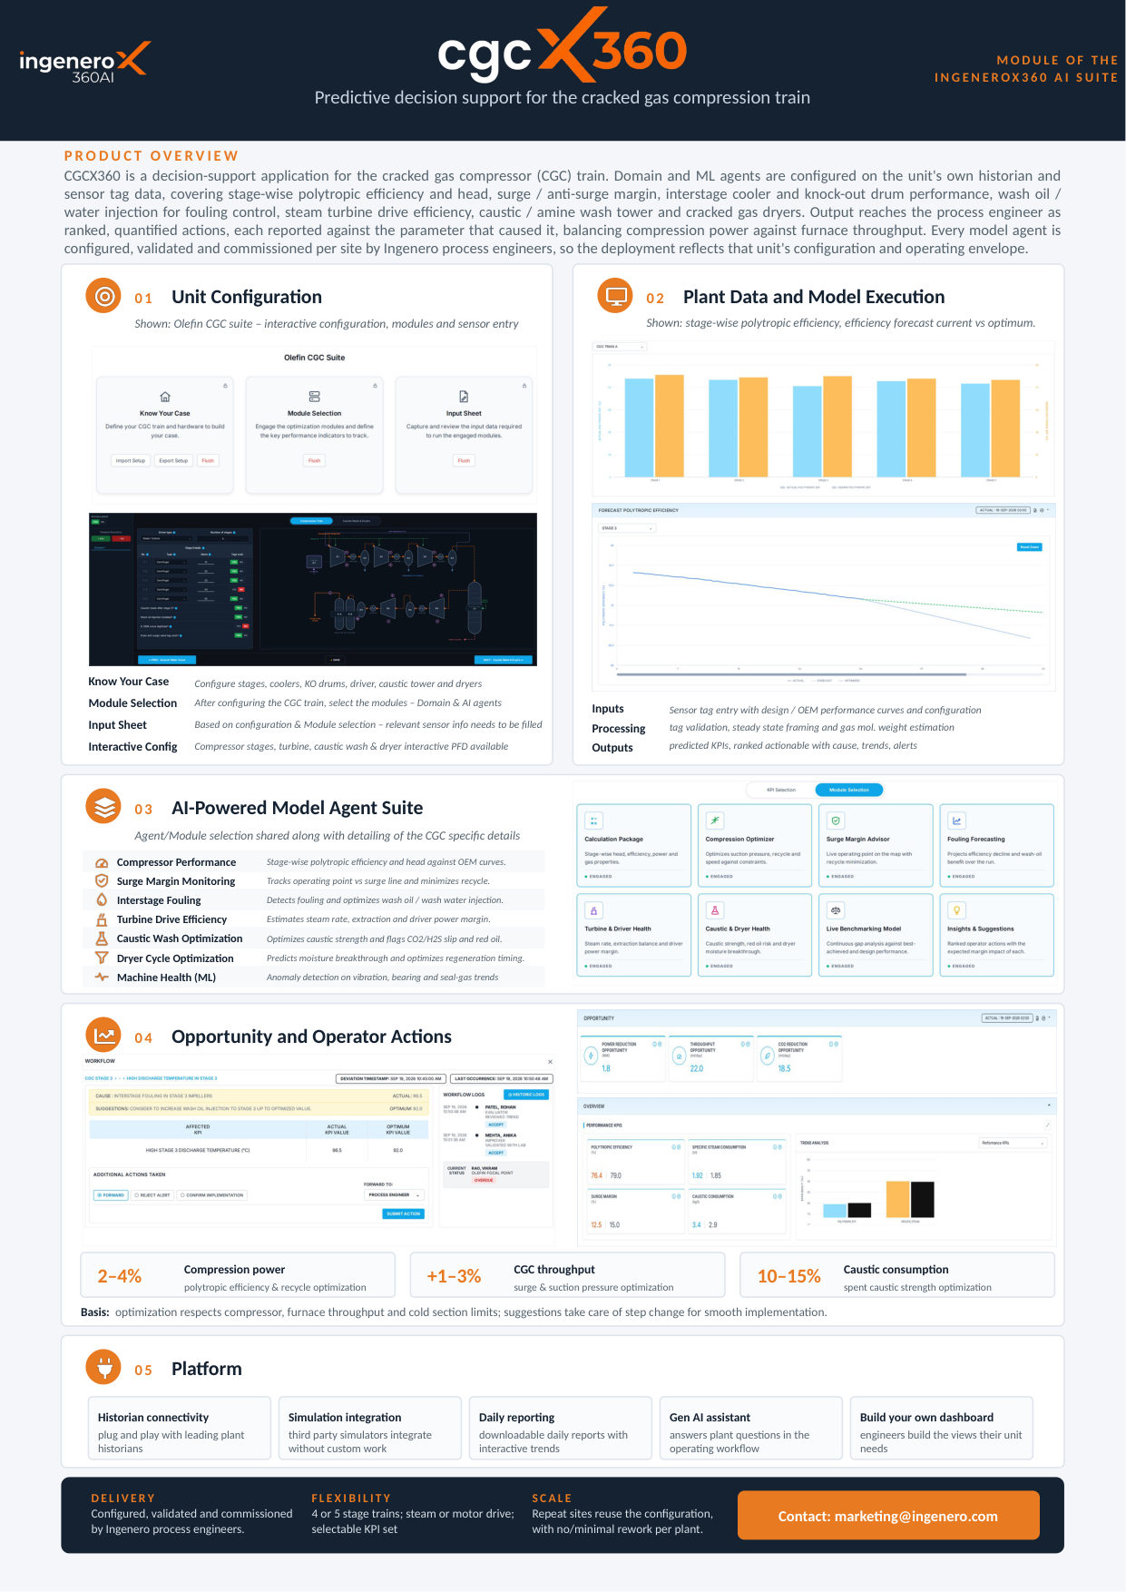
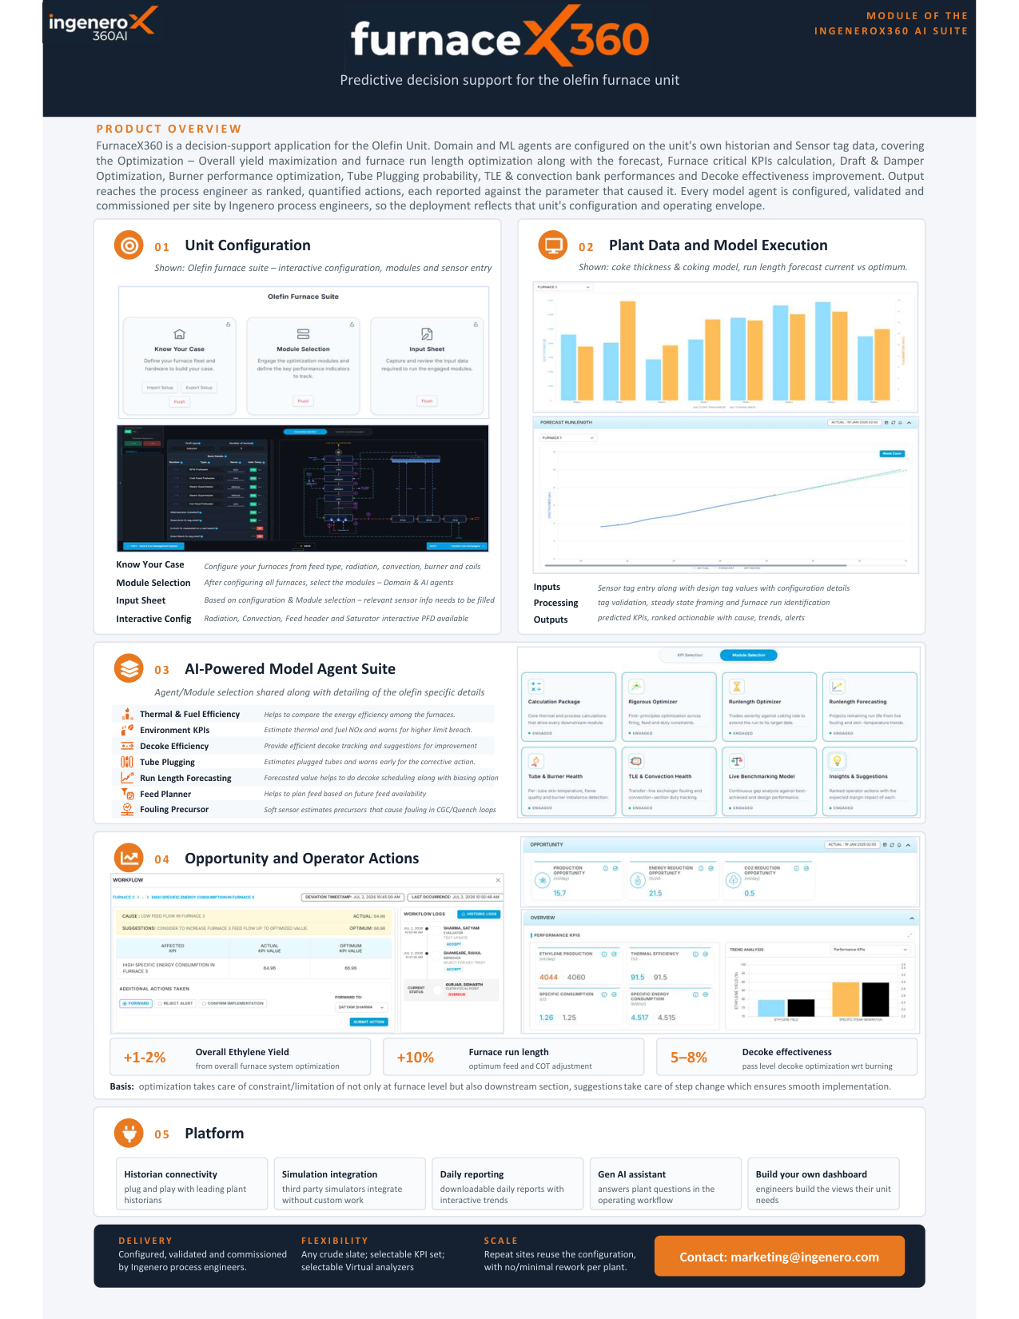
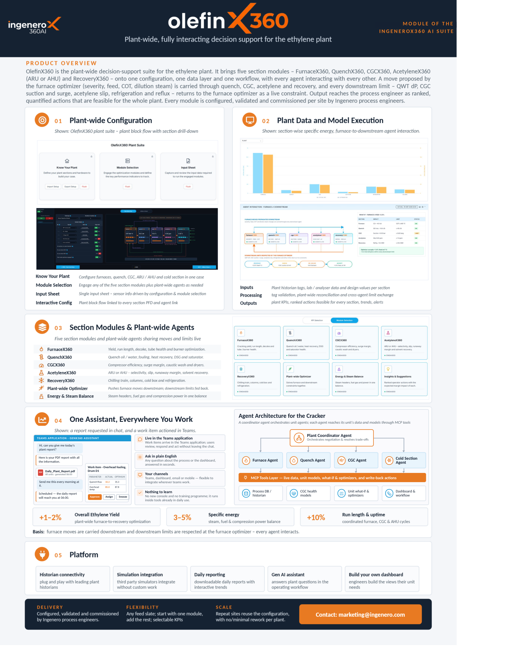


brochure.ingenero360.ai
SUITE 2 OF 8 • ETHYLENE & PROPYLENE COMPLEX
Olefin Suite
End-to-End Cracking, Compression & Cold Separation Intelligence. Unifying furnace yield maximization, CGC anti-surge margins, quench water dynamics, and cold train fractionation under a coordinated multi-agent envelope.
10–15% Longer Olefins Furnace Run Lengths
0.5–1.2% Ethylene Recovery Gain
14–30 Days CGC Compressor Anomaly Lead Time
AcetyleneX360
Selective Hydrogenation & Green Oil Mitigation...
• Front-end and tail-end acetylene hydrogenation reactor selectivity control...
CgcX360
Cracked Gas Compression Train Efficiency & Surge Protection...
• Stage-by-stage polytropic efficiency, head, and wash oil dosing optimizatio...
FurnaceX360
Olefin Cracking Yield Maximization & 10-15% Longer Run Lengths...
• Coil Outlet Temperature (COT) and Tube Metal Temperature (TMT) balancing...
OlefinX360
Plantwide Ethylene Complex Digital Orchestration...
• Integrated decision co-pilot unifying hot section and cold recovery train...
QuenchX360
Quench Tower & Dilution Steam System Process Health...
• Quench oil and quench water tower heat balance & emulsion prevention...
RecoveryX360
Cold Box, Demethanizer & Splitter Super-Fractionation...
• Cold chilling train multi-stage refrigeration loop power minimization...

Slide 5
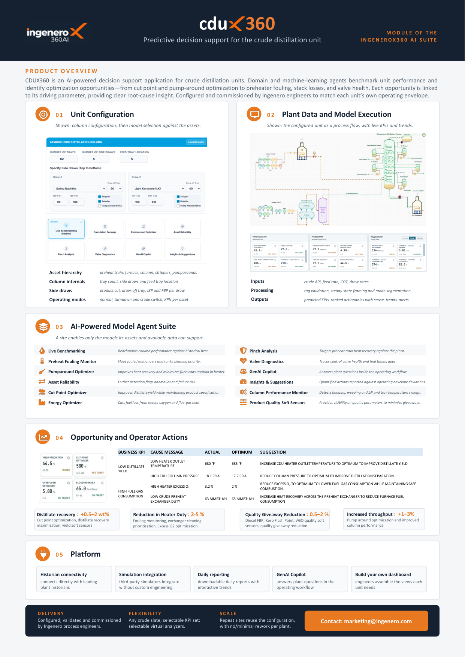
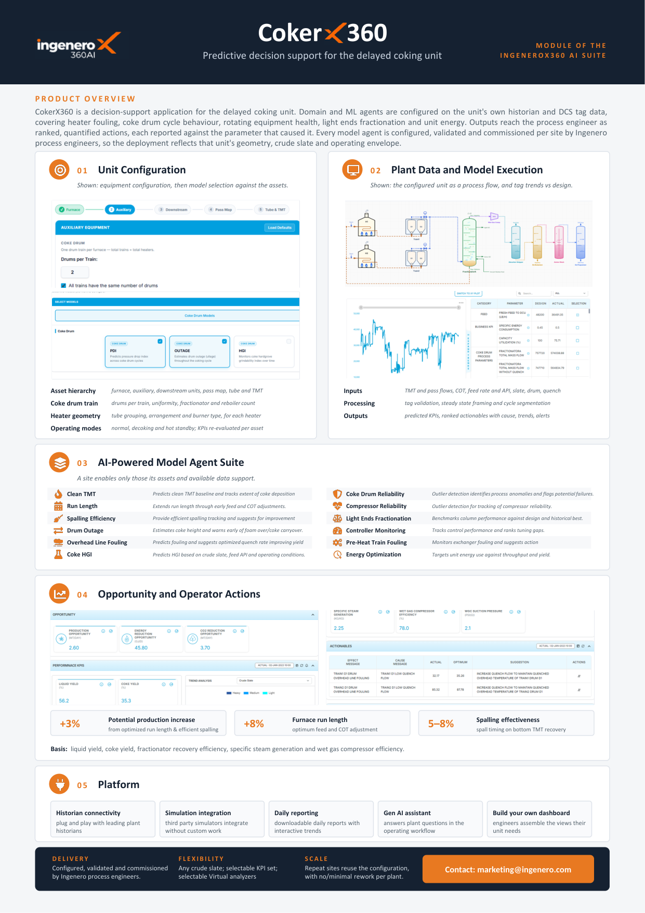
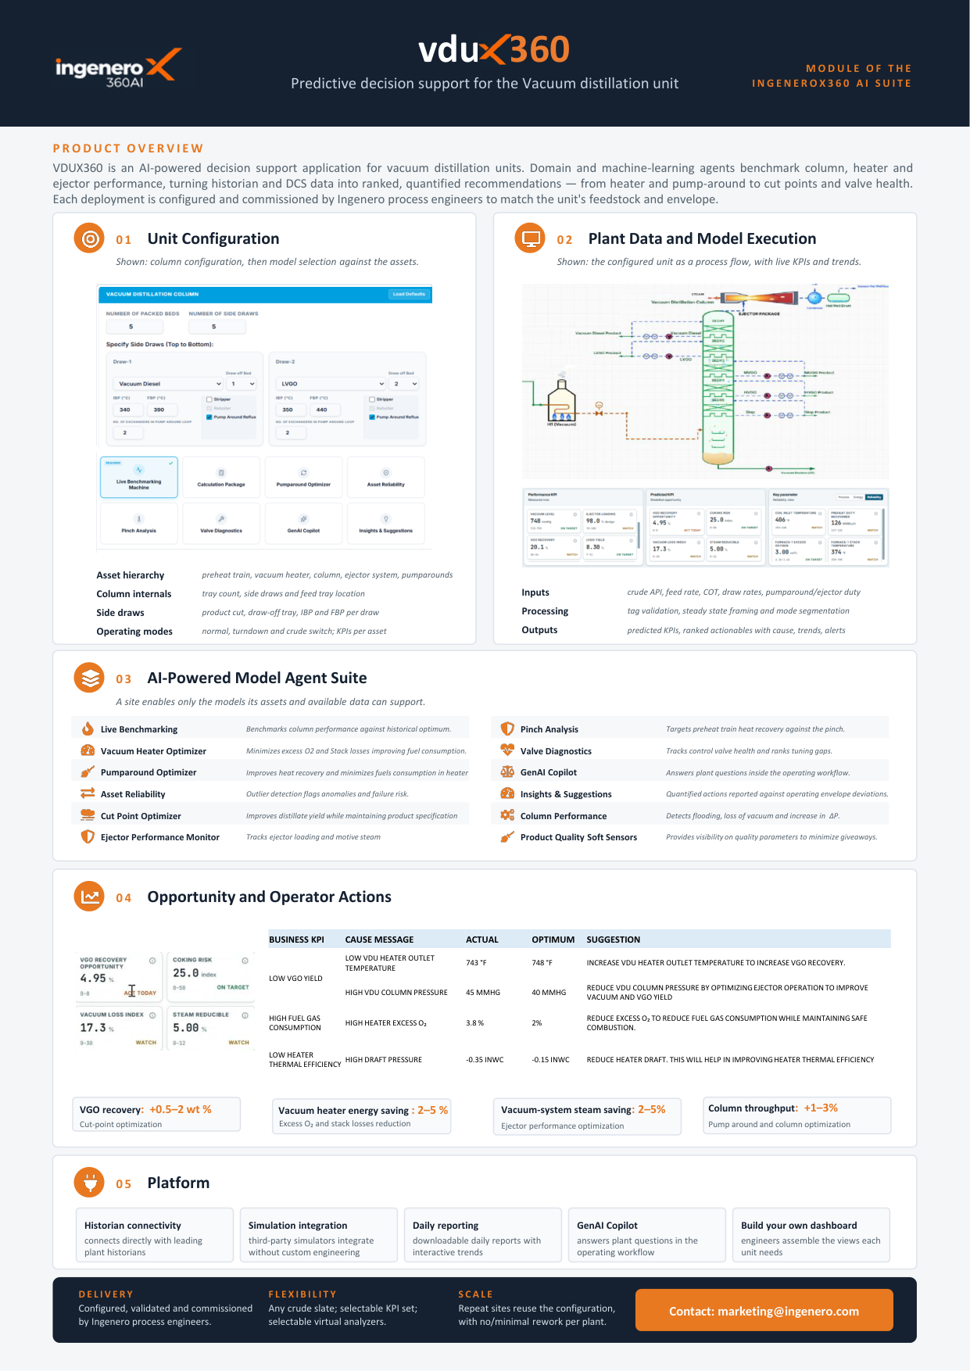
brochure.ingenero360.ai
SUITE 3 OF 8 • CRUDE & HEAVY OIL UPGRADING
Refinery Suite
Crude Distillation, Delayed Coking & Vacuum Tower Process AI. Real-time crude blend tracking, cut-point optimization, coker drum thermal stress management, and vacuum tower energy minimization.
0.4–1.0% Distillate Recovery Uplift
15–25 Min Coker Cycle Time Cut
2–4% Fired Heater Fuel Optimization
CDUX360
Atmospheric Crude Distillation Cut-Point Optimization
• Crude blend characterization soft-sensors updating TBP curves in real time
• Atmospheric column tray flooding and jet flooding margin prediction
• Kero, diesel, and heavy naphtha cut-point shifts targeting maximum gross margin
• Crude preheat train fouling tracking and furnace fuel gas reduction
CokerX360
Delayed Coking Drum Cycle Acceleration & Thermal Stress Guard
• Drum switch, quench, and warm-up cycle acceleration (15-25 min savings)
• Fired heater coking rate estimation and velocity steam optimization
• Anti-foam injection optimization preventing costly foam-over into fractionator
• Heavy coker gas oil (HCGO) yield maximization for downstream hydrocrackers
VDUX360
Vacuum Distillation Deep Cut & Flash Zone Optimization
• Vacuum tower absolute pressure minimization and ejector train monitoring
• Flash zone wash section entrainment prevention and asphalt cut control
• Heavy Vacuum Gas Oil (HVGO) recovery lift while meeting metal specs
• Furnace transfer line coking mitigation under severe deep-cut conditions

Slide 6
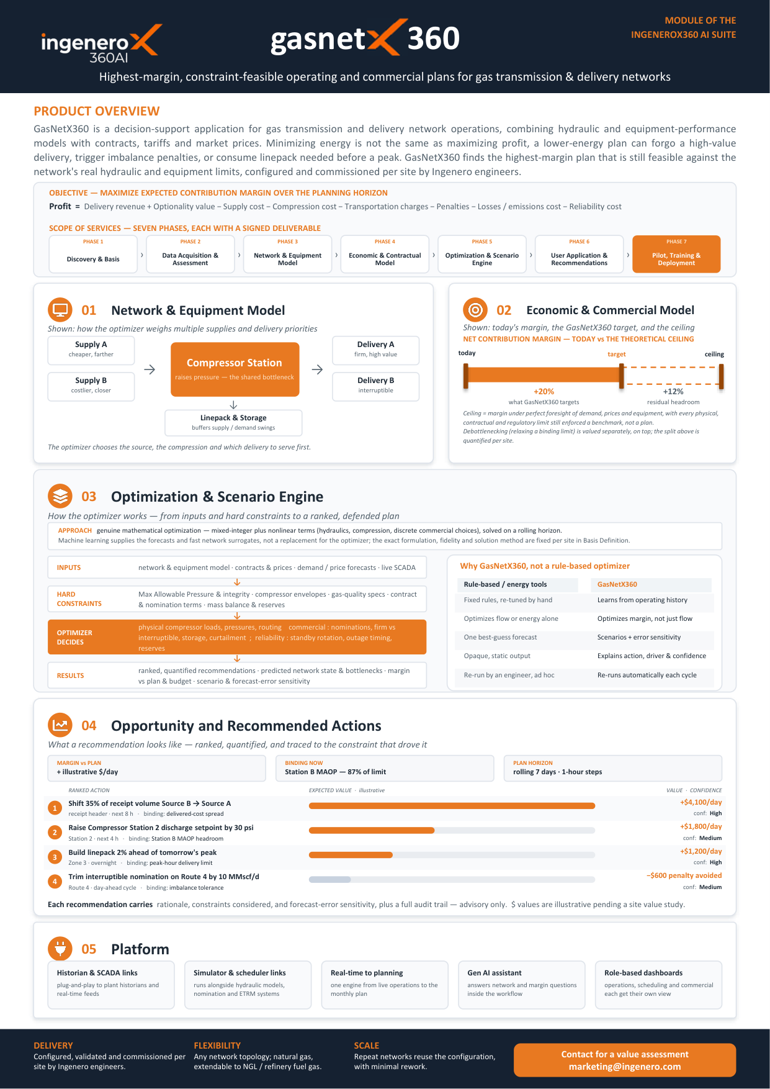
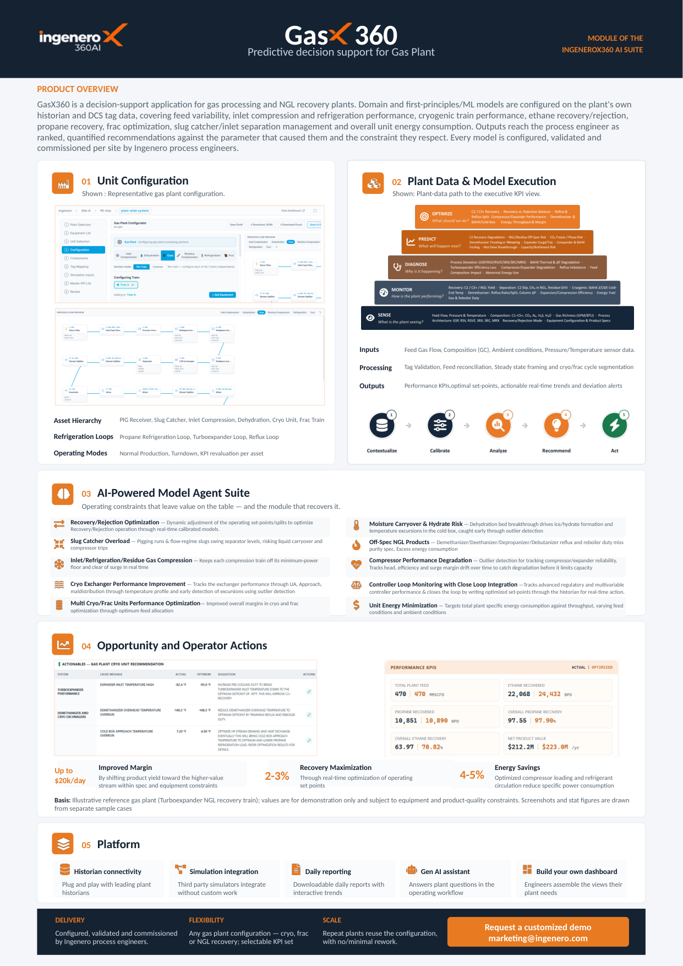
brochure.ingenero360.ai
SUITE 4 OF 8 • TRANSMISSION, NGL & CRYOGENIC GAS
Gas Suite
Gas Plant Processing & High-Margin Pipeline Network Optimization. Reconciling rigorous hydraulic models, linepack thermodynamics, and market tariffs to find the constraint-feasible, highest-margin delivery schedule.
1.5–3.2% NGL Recovery Improvement
4–8% Compression Fuel Reduction
100% Hydraulic Constraint Compliance
GasnetX360
Highest-Margin, Constraint-Feasible Pipeline Optimization
• Rigorous transient hydraulics combined with commercial tariffs & fuel costs
• Linepack thermodynamics optimization across variable delivery demands
• Compressor station fuel minimization while guaranteeing delivery pressures
• Imbalance penalty avoidance and multi-scenario commercial dispatching
GasX360
Gas Processing, Cryogenic NGL & Fractionation Optimization
• Inlet separation and slug catcher liquid surge protection
• Cryogenic turbo-expander and refrigeration train power minimization
• Dynamic ethane recovery vs. rejection economics based on real-time prices
• Demethanizer, deethanizer, and depropanizer heat integration

Slide 7
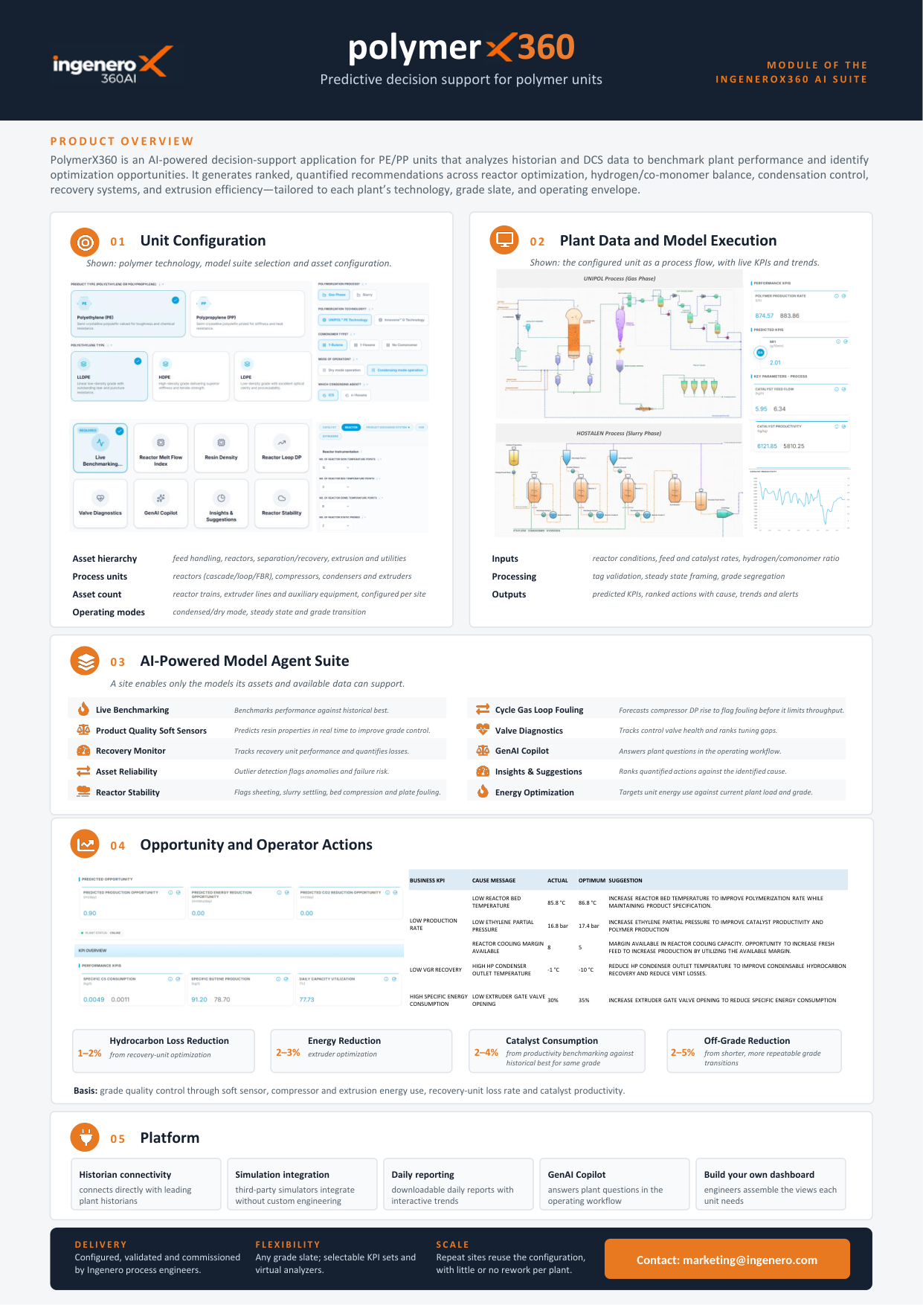
brochure.ingenero360.ai
SUITE 5 OF 8 • POLYOLEFINS & PLASTICS MANUFACTURING
Polymer Suite
Reactor MI Control & High-Speed Grade Transition Intelligence. Virtual Melt Index analyzers combined with non-linear transition trajectories to cut off-spec production and safeguard fluidized bed stability.
25–40% Grade Transition Time Cut
30–50% Off-Spec Material Reduction
±1.5% Real-Time MI Prediction Accuracy
PolymerX360
Fluidized Bed MI Prediction & Fast Grade Transition
• Virtual Melt Index (MI) & Density soft sensor trained on reactor kinetics
• 25-40% faster grade transitions minimizing intermediate off-spec material
• Fluidized bed electrostatic charge and hot-spot / sheeting early detection
• Extruder specific energy and melt pump pressure stabilization

Slide 8
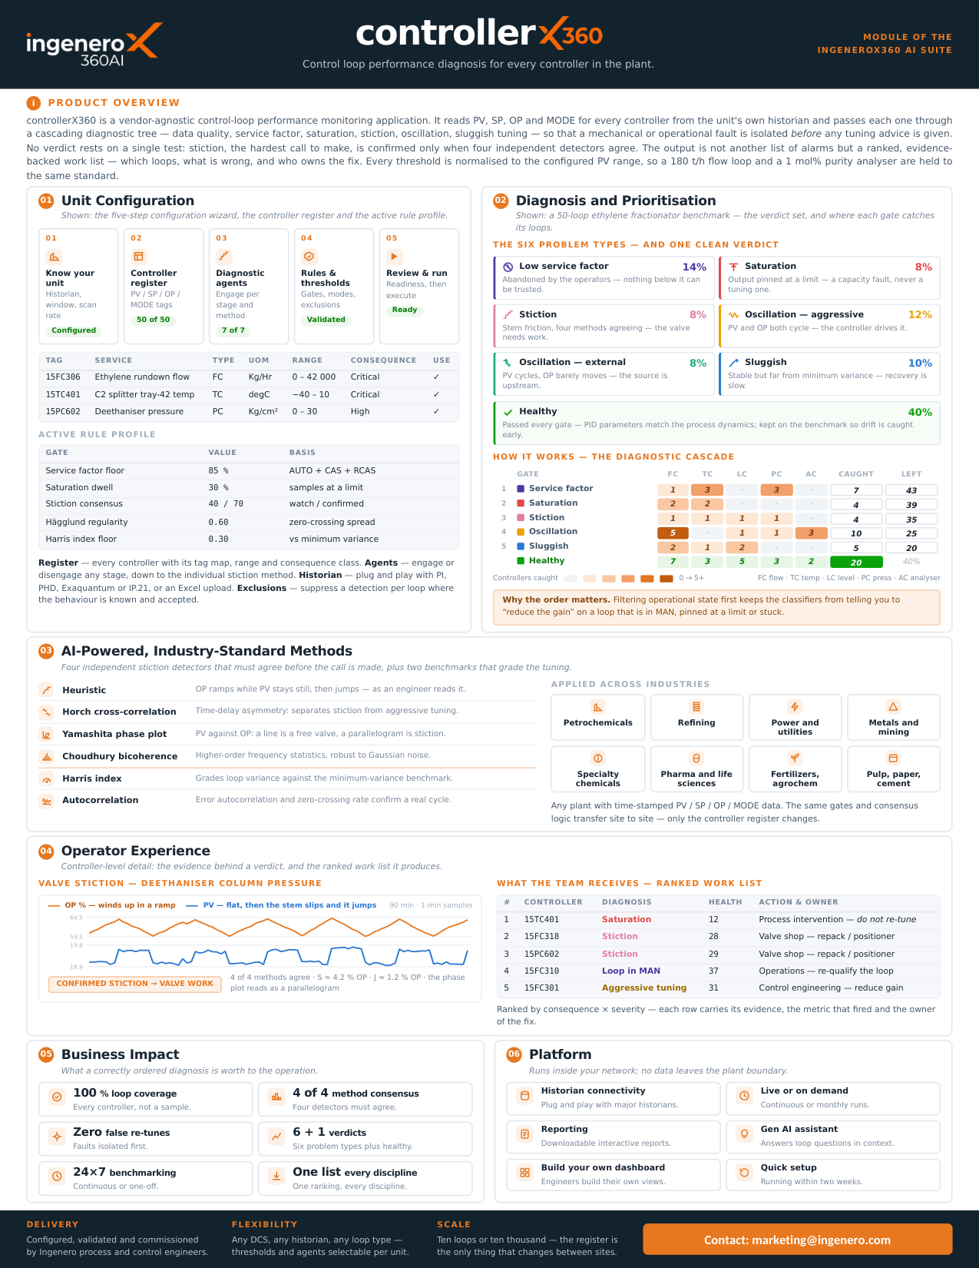
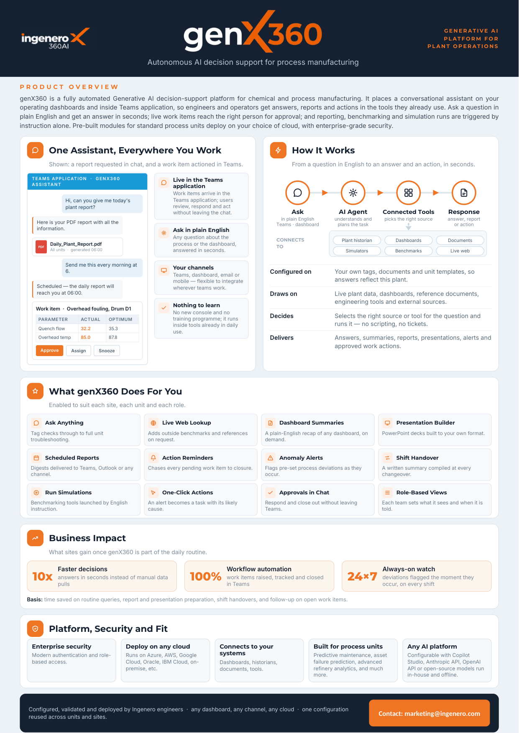
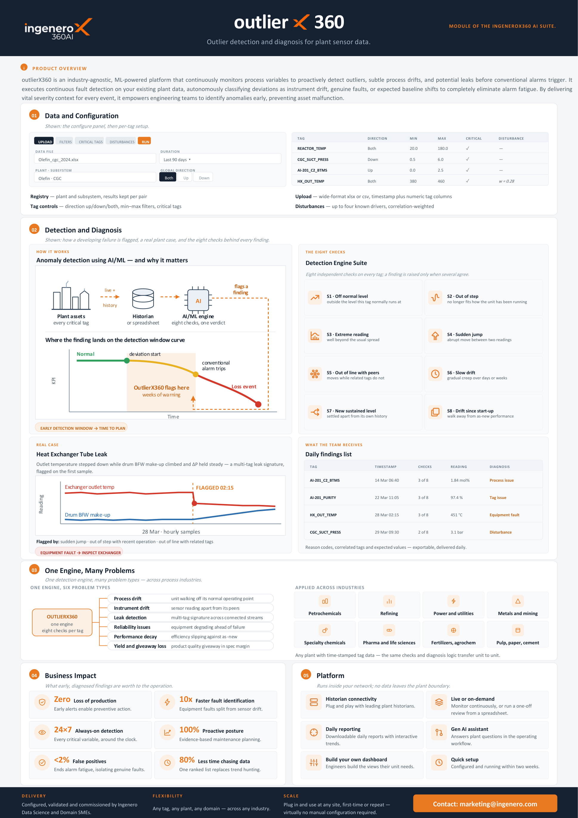
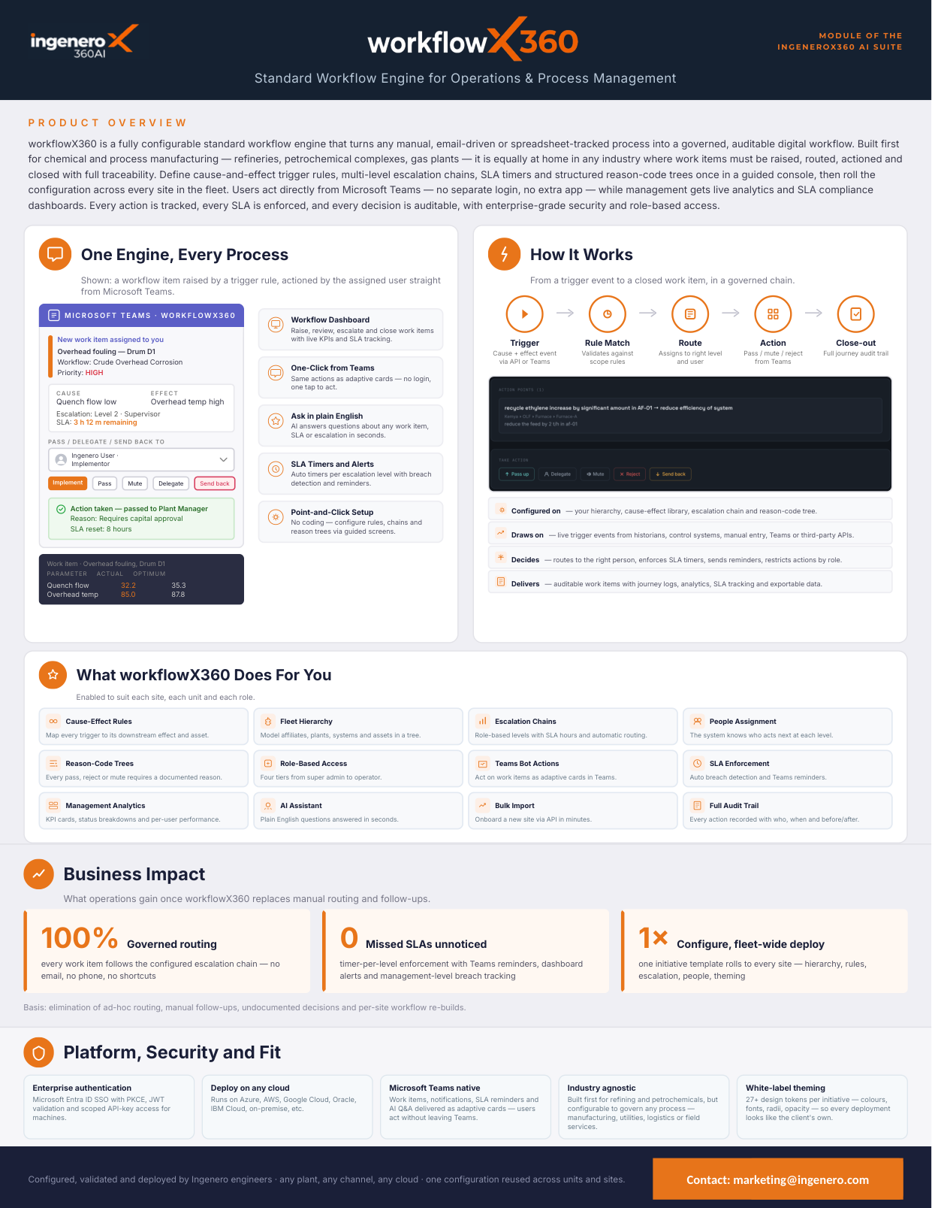
brochure.ingenero360.ai
SUITE 6 OF 8 • AGENTIC FOUNDATION & INDUSTRIAL GENAI
Diagnostic and Agentic AI Tools Suite
Autonomous Diagnosis, Loop Health, Anomaly Detection & AI Workflows. Continuous cascaded loop tuning, multivariate sensor drift filtering, automated workflow routing, and conversational generative AI for plant operations.
100% Control Loops Monitored
80%+ False Alarm Fatigue Cut
<3 Sec Instant Historian & SOP Answers
ControllerX360
Cascading Multi-Test Loop Diagnostics & Automated Tuning...
• Vendor-agnostic DCS historian ingestion (PV, SP, OP, MODE) across every loo...
GenX360
Autonomous Generative AI Decision Support in Teams & Web...
• Natural-language querying connected live to plant historian & lab telemetry...
OutlierX360
Multivariate Sensor Drift & Anomaly Isolation...
• Continuous multivariate validation over thousands of real-time process tags...
WorkflowX360
Governed Digital Execution for Industrial Operations...
• Eliminates unmanaged email threads and spreadsheets with digital workflows...

Slide 9
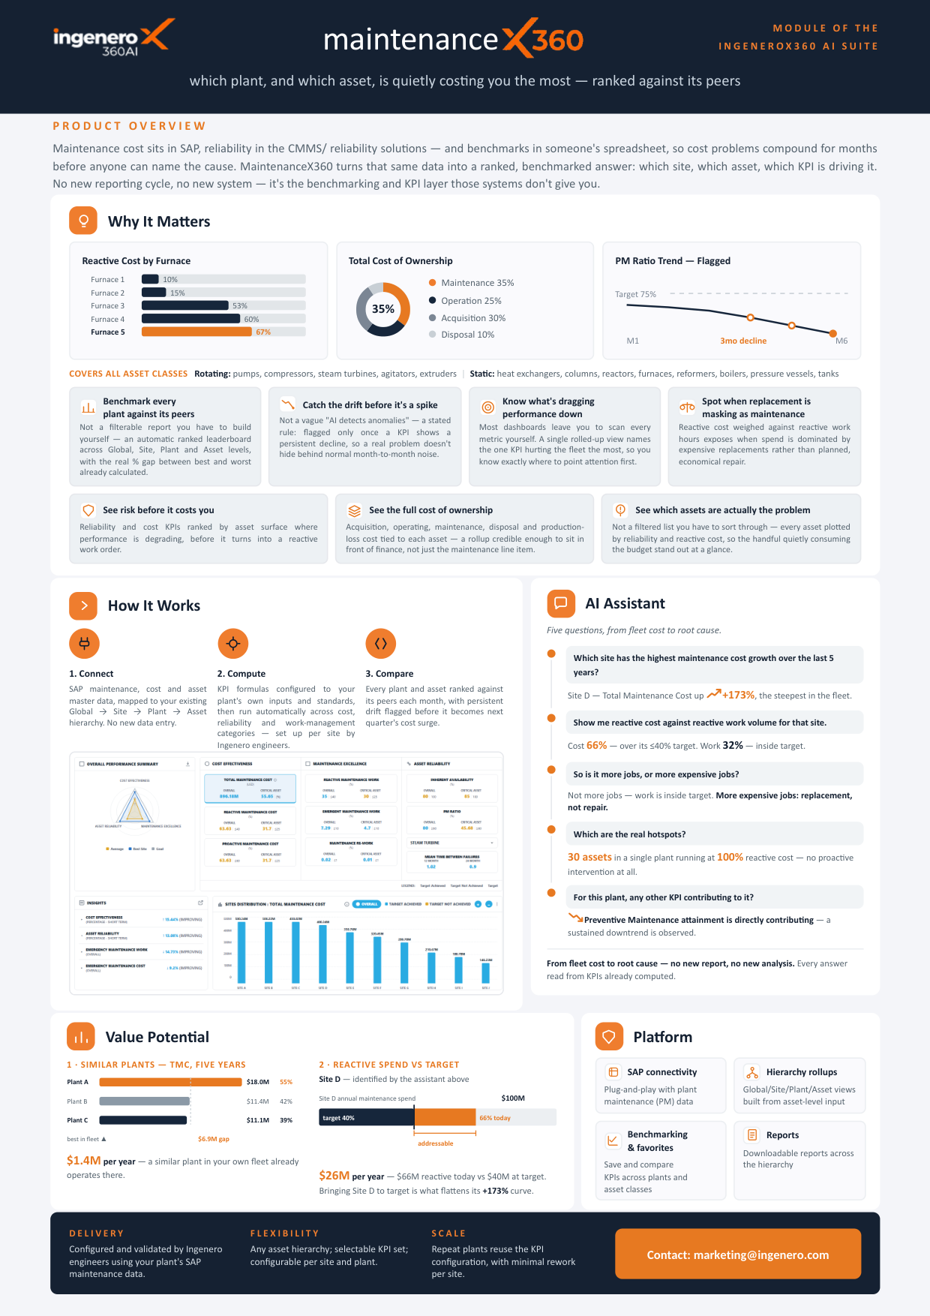
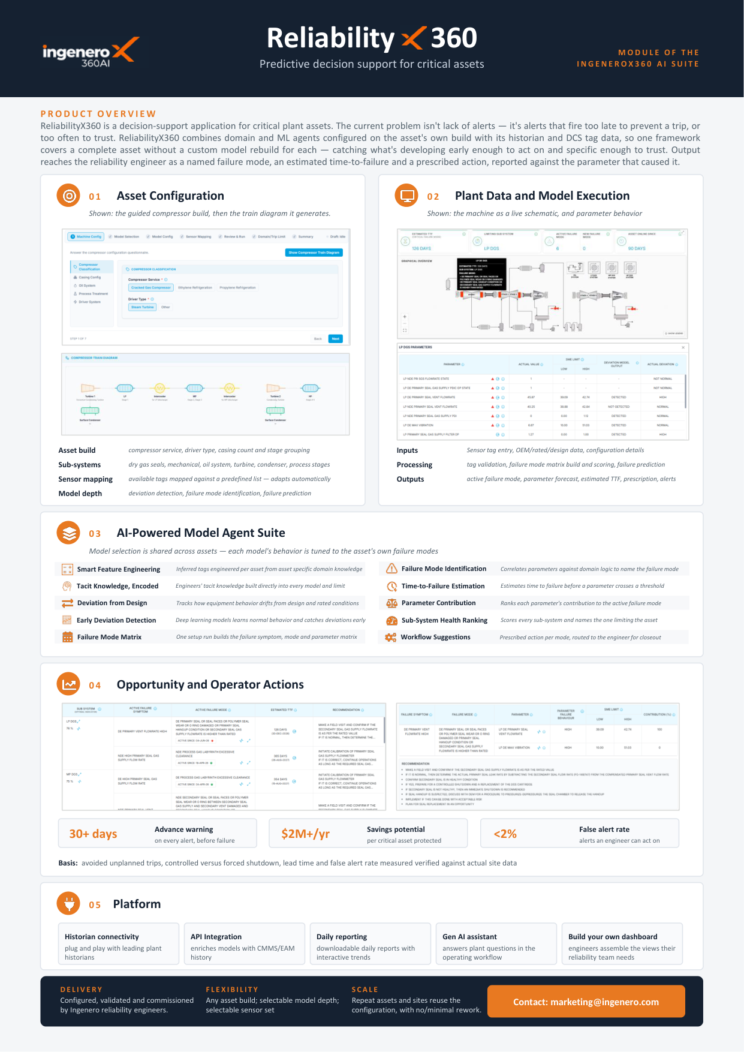
brochure.ingenero360.ai
SUITE 7 OF 8 • CRITICAL ASSETS & PREDICTIVE UPTIME
Maintenance and Reliability Suite
Predictive Asset Health, Failure Lead Times & Maintenance Ranking. Unifying CMMS/SAP maintenance costs with vibration, thermal, and electrical telemetry to isolate quiet cost sinkholes weeks before catastrophic trips.
14–30 Days Pre-Trip Warning Horizon
12–20% Unplanned Trip Reduction
15–25% Maintenance Cost Avoidance
MaintenanceX360
Cross-Plant Asset Cost Benchmarking & Bad Actor Elimination
• Correlates SAP PM maintenance expenditure with CMMS reliability records
• Ranks units and machines against identical peers to isolate quiet money pits
• Spares consumption forecasting based on actual operating stress hours
• Turnaround maintenance scope optimization to avoid unnecessary overhauls
ReliabilityX360
Predictive Health & 14-30 Day Lead Anomaly Detection
• Physics-informed ML models for compressors, pumps, turbines & blowers
• Vibration spectral signature and bearing temperature early warning
• Lube oil degradation, mechanical seal leak, and impeller cavitation flags
• Replaces reactive trip alarms with actionable pre-failure maintenance horizons

Slide 10
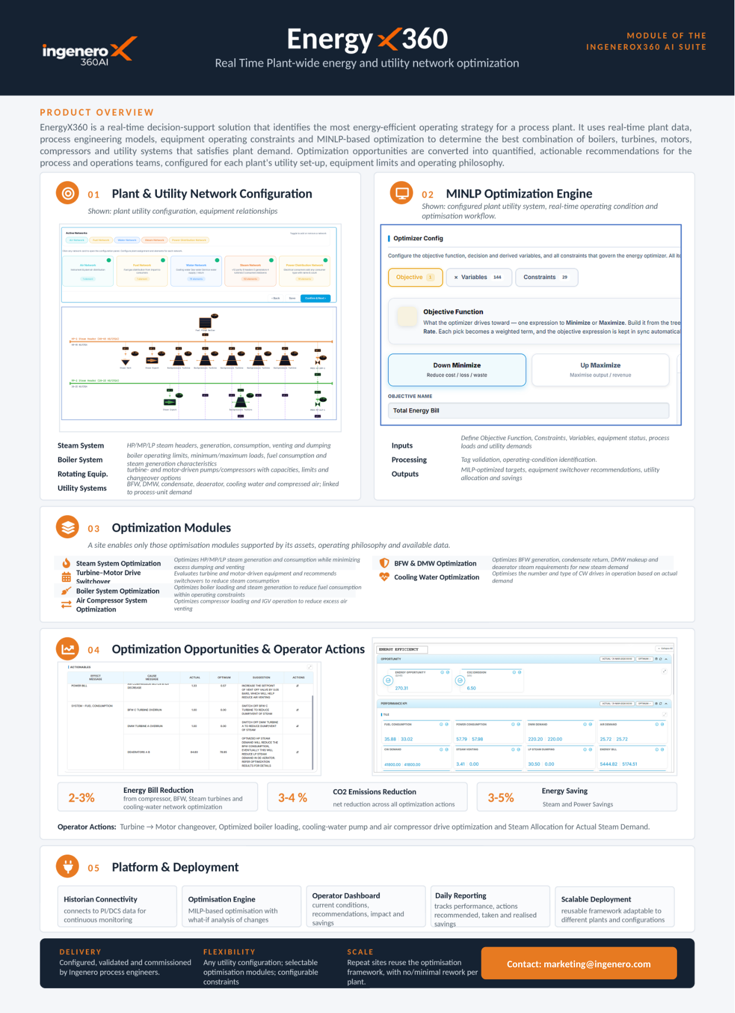
brochure.ingenero360.ai
SUITE 8 OF 8 • SITE-WIDE ENERGY, STEAM & POWER
Utility Suite
Mixed-Integer Linear Programming for Multi-Header Energy Optimization. Real-time optimization of boilers, steam turbines, letdown stations, and electrical import/export to eliminate venting and slash carbon emissions.
1–3% Site-Wide Energy Cost Cut
2–5% Scope-1 Carbon Emission Drop
0 Event Steam Header Pressure Trip
EnergyX360
Site-Wide Steam & Power Mixed-Integer Linear Programming
• Real-time mass and energy balance across multi-header steam networks (HP/MP/LP)
• Turbine-vs-motor driver economic dispatching based on electricity spot tariffs
• Eliminates steam venting, letdown degradation, and boiler fuel waste
• Continuous Scope-1 & Scope-2 greenhouse gas emission minimization

Slide 11
brochure.ingenero360.ai
VALUE CREATION DISCOVERY
READY TO DEPLOY PURPOSE-BUILT INDUSTRIAL AI?
Experience verified gains in chemical yield, energy efficiency, and equipment uptime within 90 days. Our domain chemical engineers partner with your plant operations, DCS, and reliability teams to unlock high-impact margins.
Access All 21 Product Brochures & Interactive Portals
https://brochure.ingenero360.ai
Direct Inquiry: marketing@ingenero.com • Website: ingenerox.ai
Headquarters: Houston, TX | Global Engineering Centers

