Slide 1
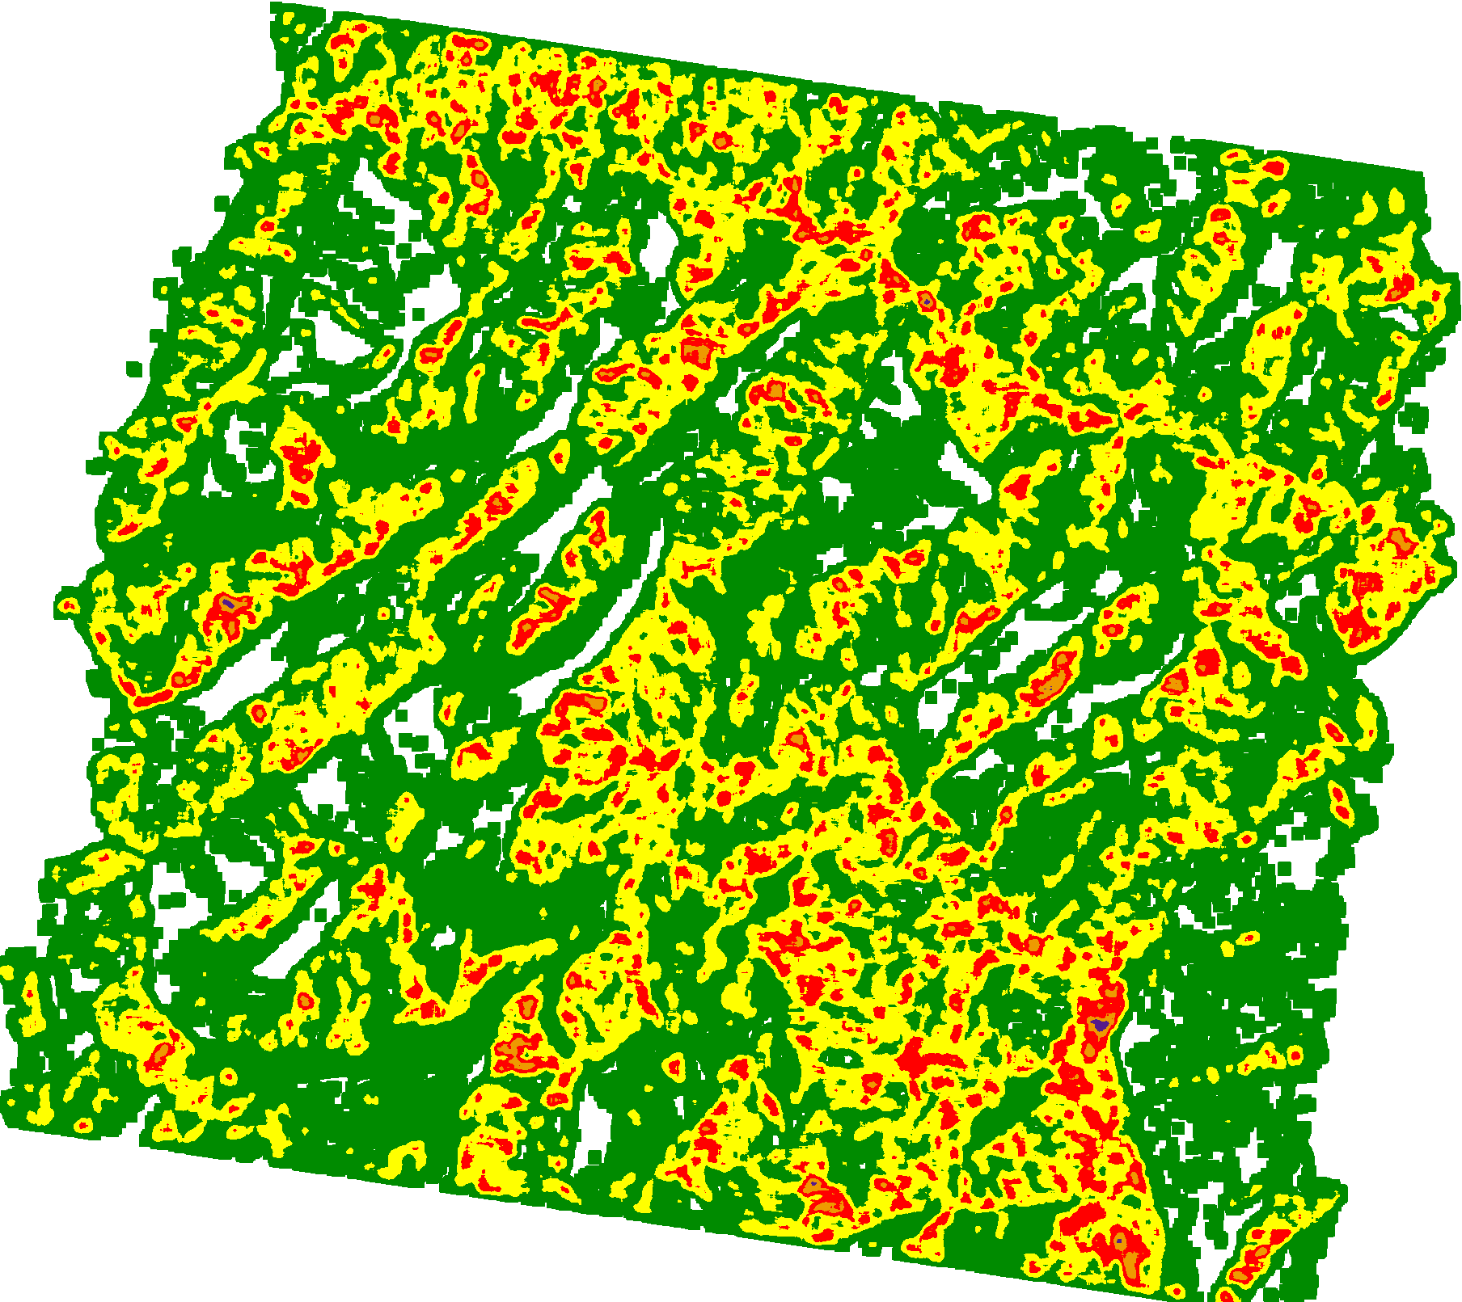
07Feb 2012

Slide 2
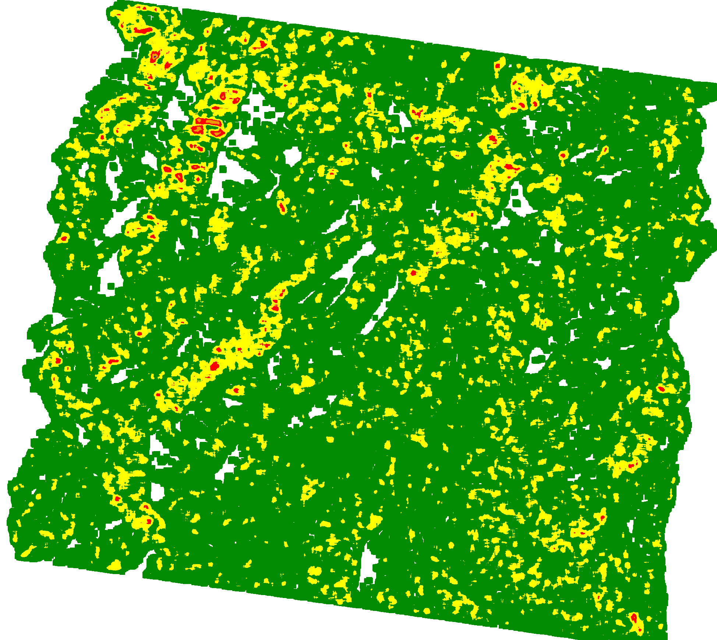
14 Feb 2012

Slide 3
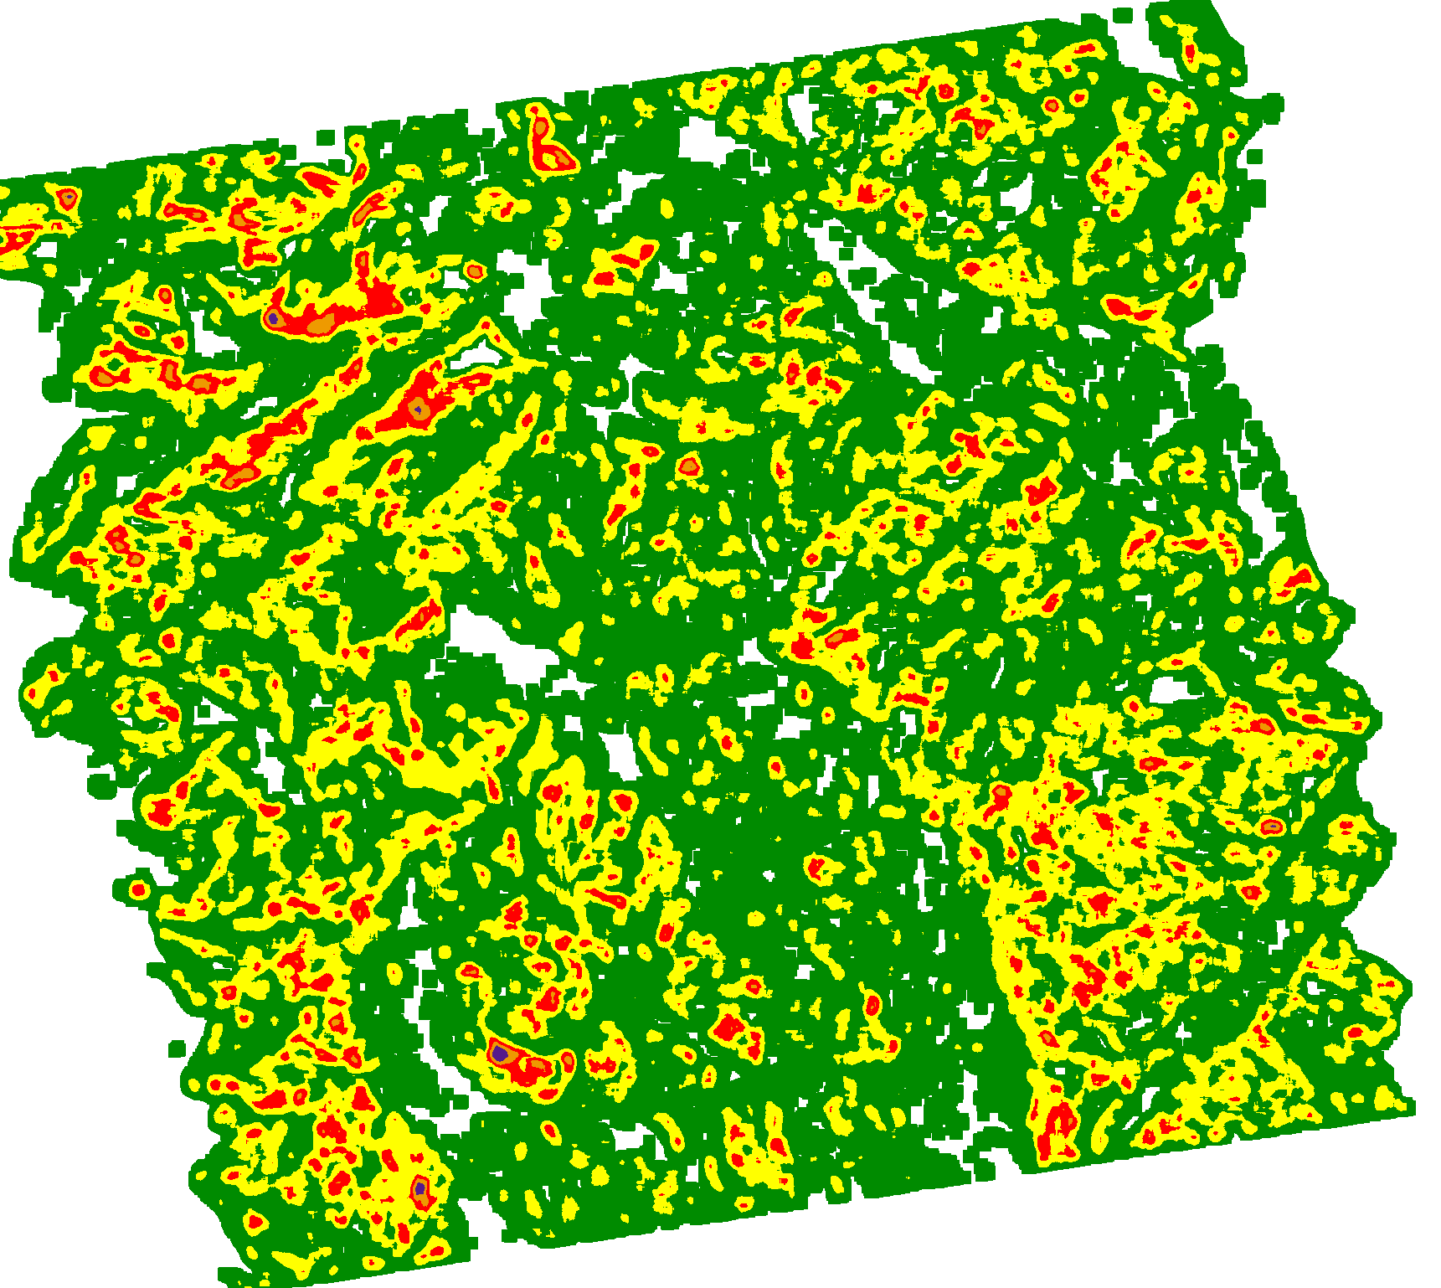
06 Feb 2013

Slide 4
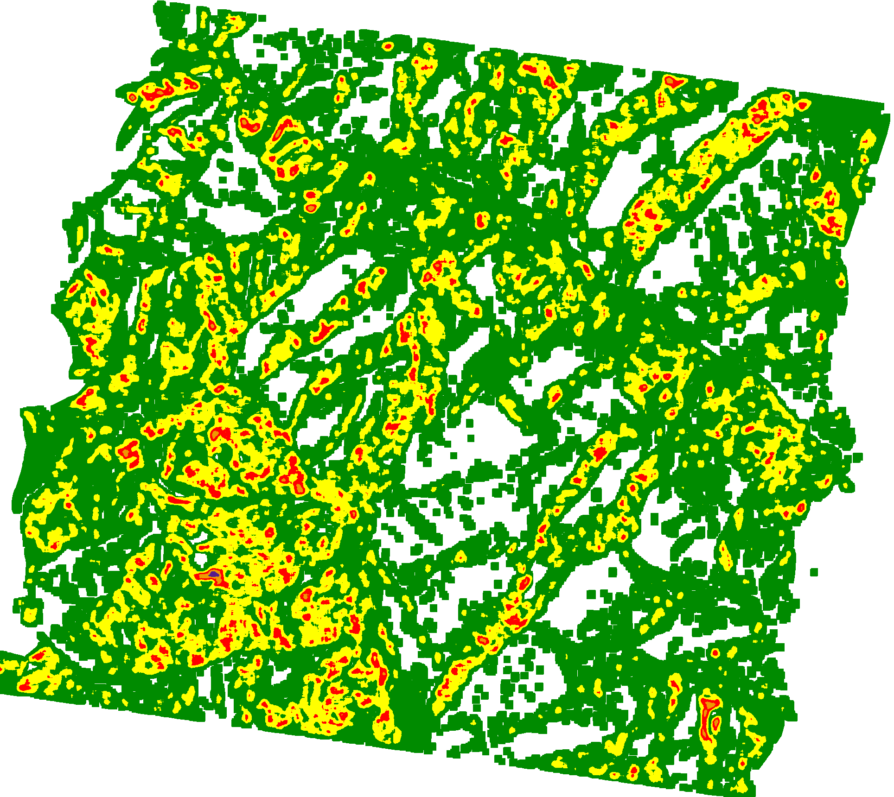
08 Feb 2013

Slide 5
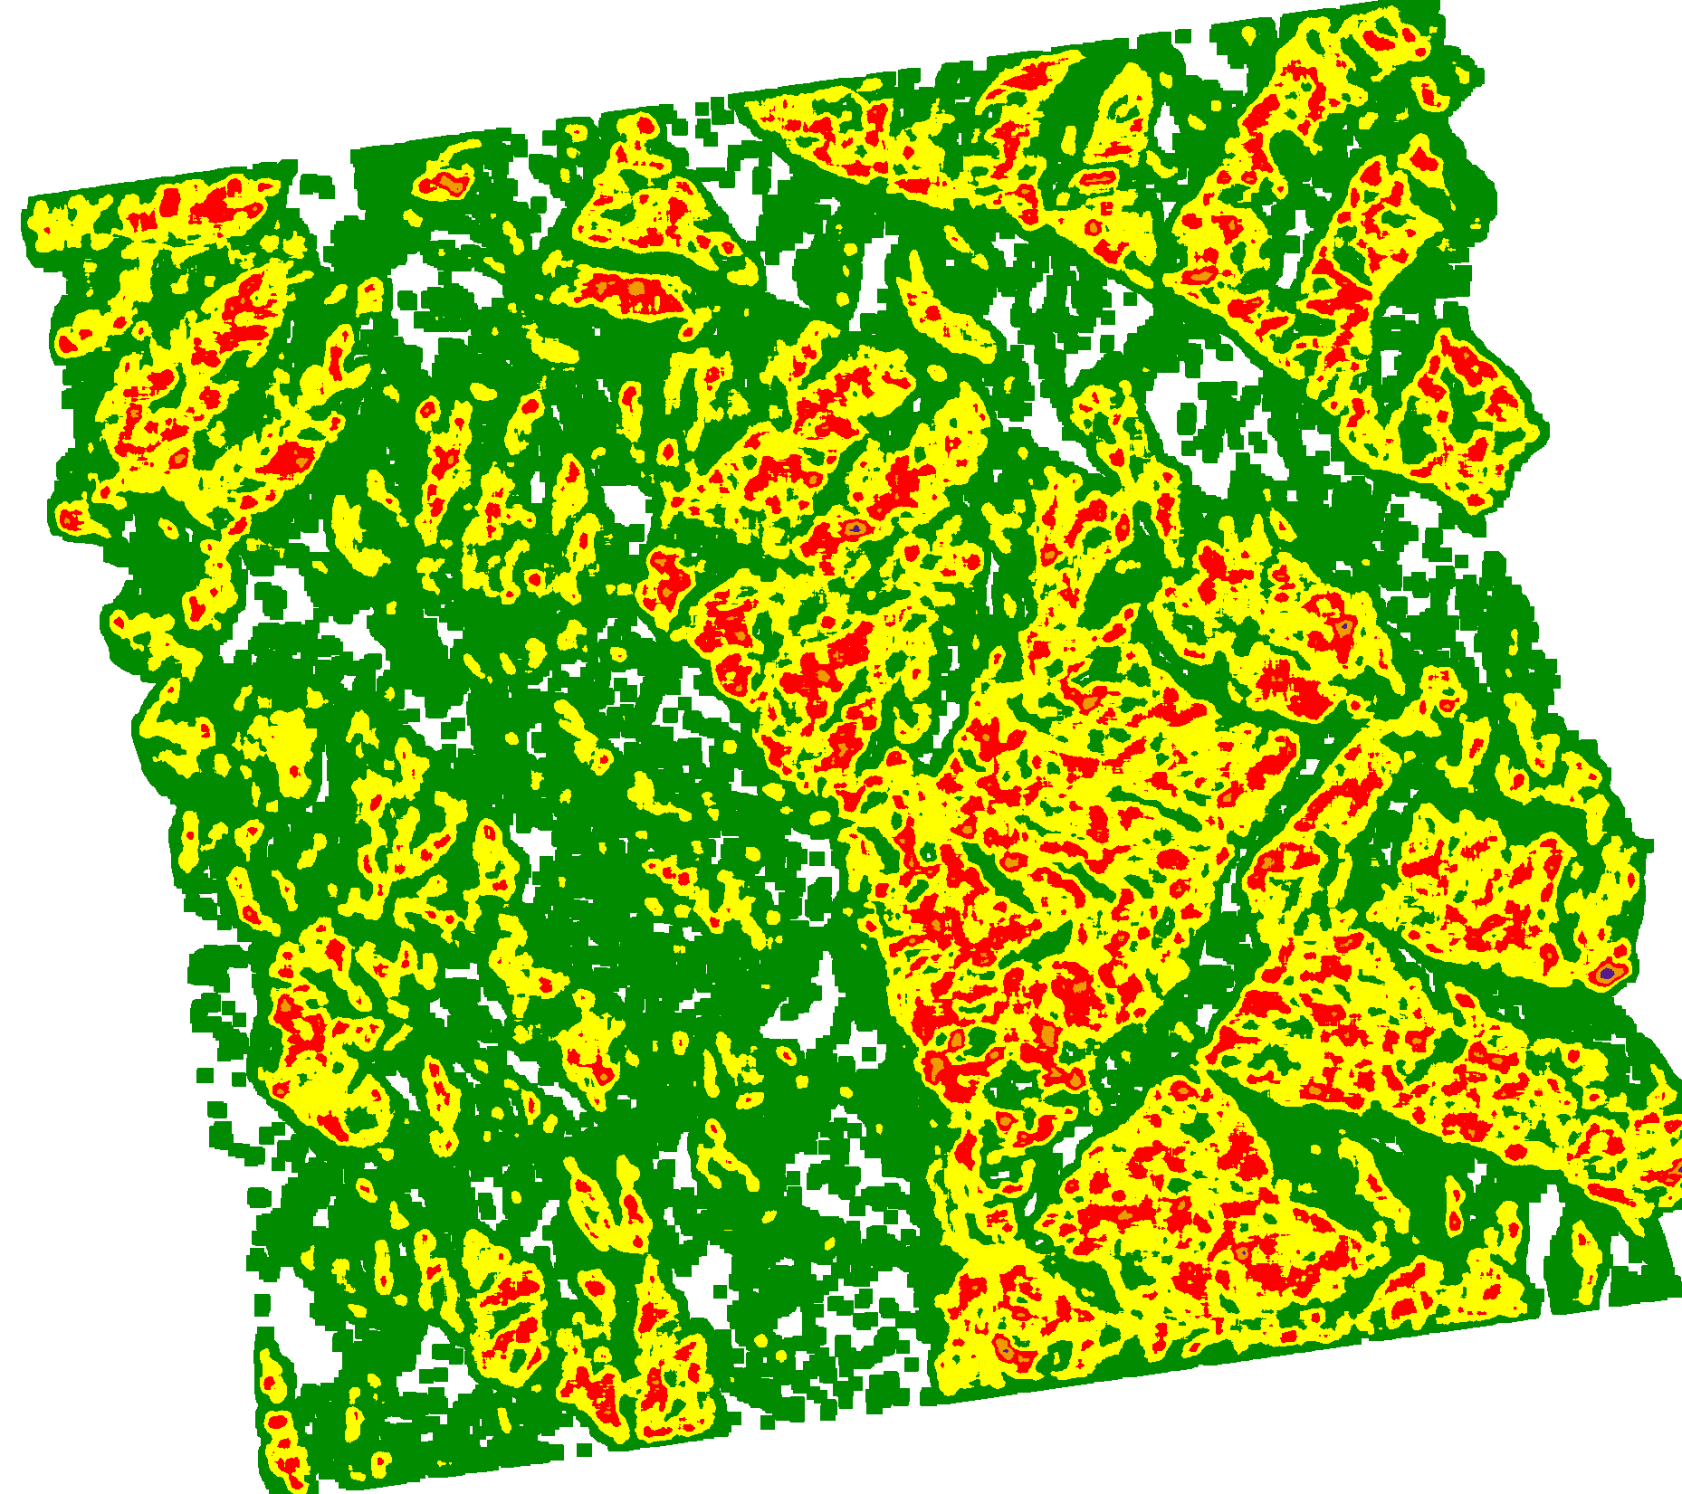
18 Feb 2014

Slide 6
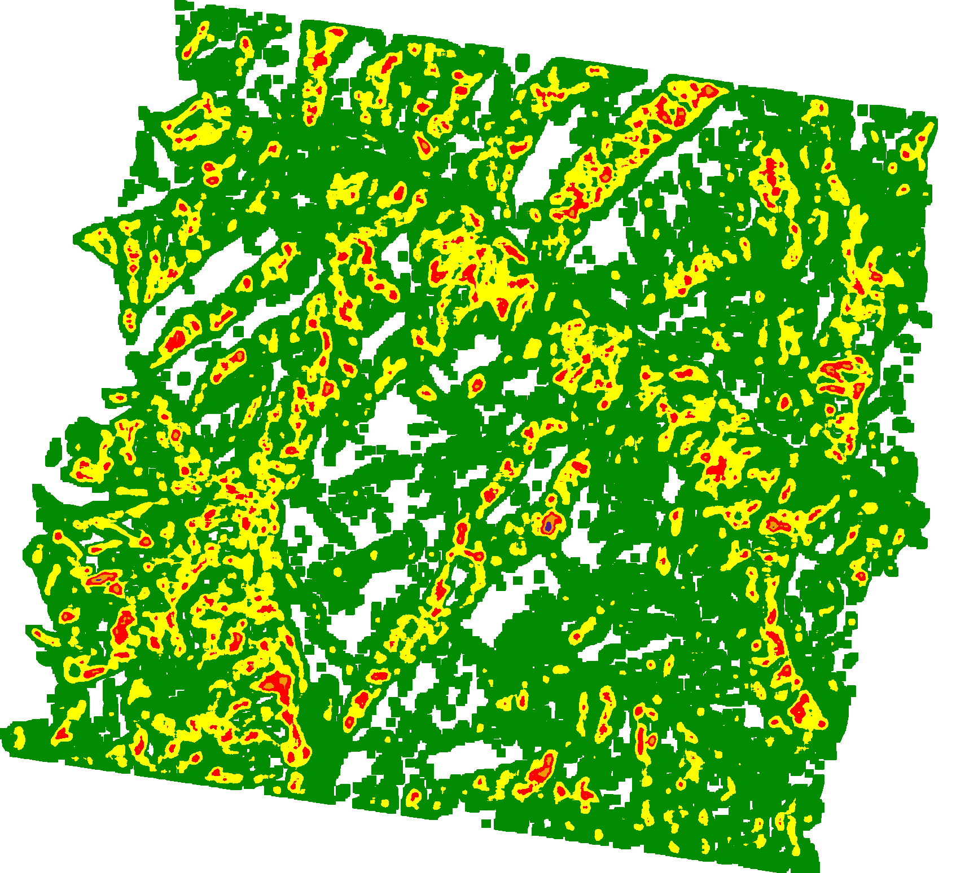
20 Feb 2014

Slide 7
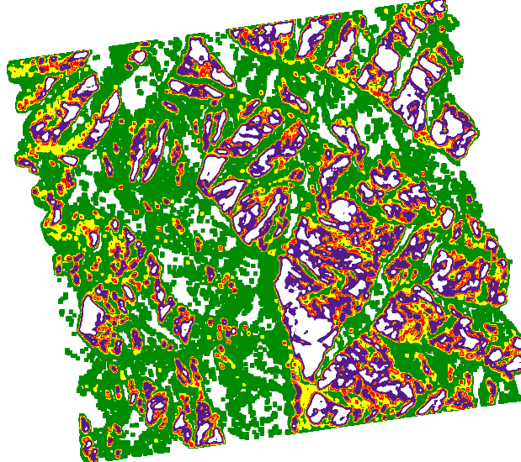
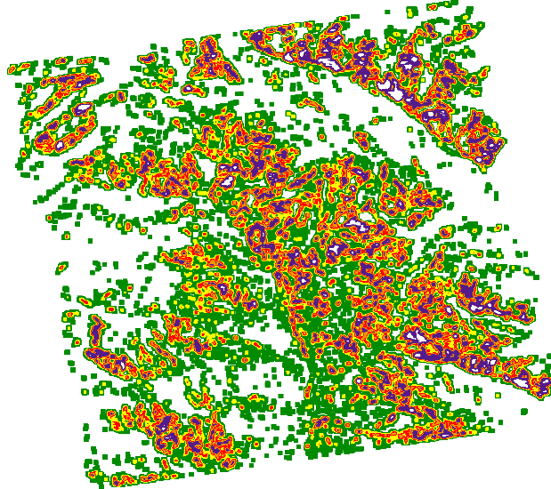
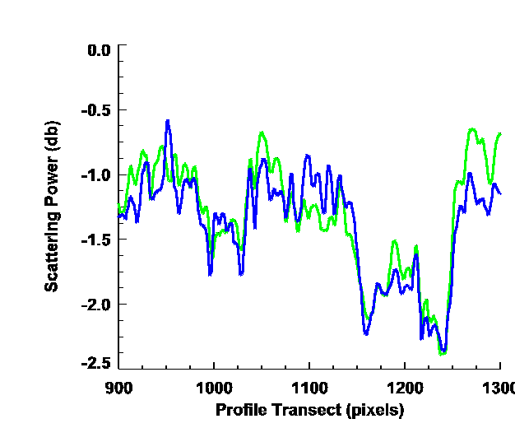
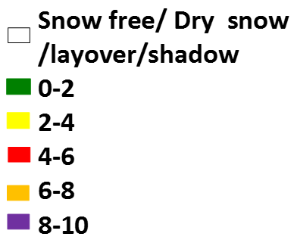

Surface Snow Wetness Map
Volume Snow Wetness Map
Weightage of surface scattering W_{s}= P_{s}/P_{s}+P_{v}
Weightage of volume scattering W_{v}= P_{v}/P_{s}+P_{v}
W_{s} + W_{v} = 1
Effective Snow Wetness
SW_{eff} = W_{s} * SW_{s} + W_{v} * SW_{v}
Where
Ps & P_{v} - surface & volume scattering of snow cover
SW_{s} & SW_{v} - surface & Volume snow wetness
Effective Snow Wetness Map

Slide 8
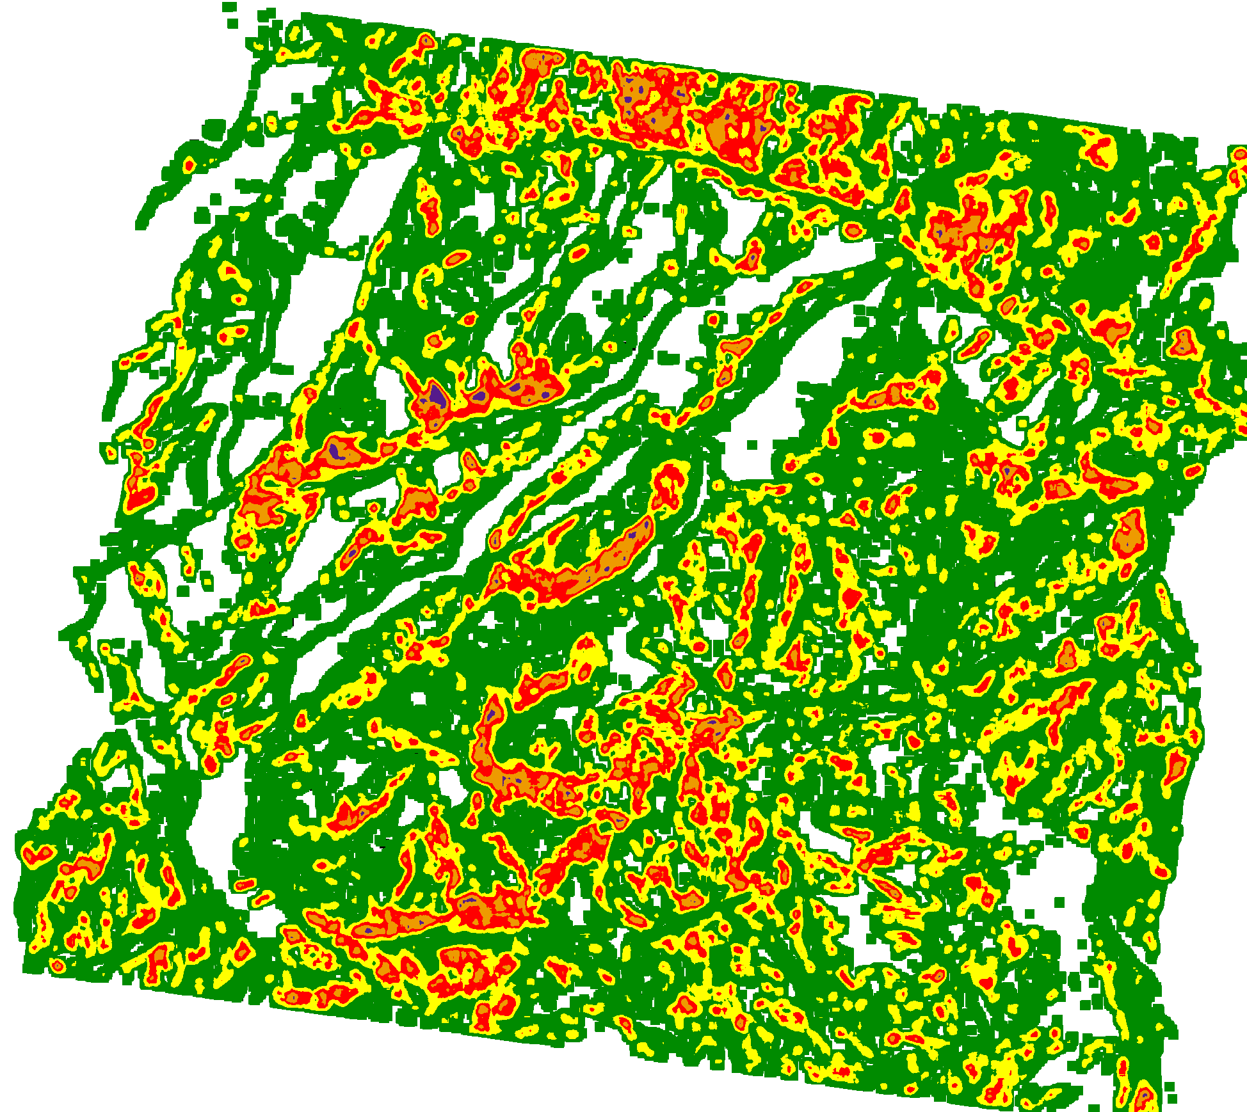
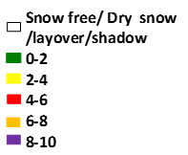
14 Feb 2012
Shi & Dozzier

Slide 9
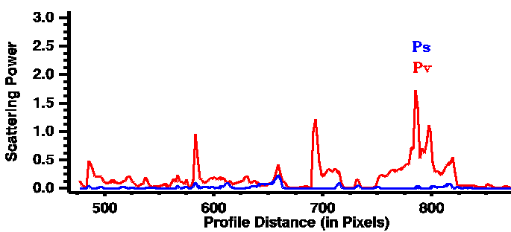
Surface Snow Wetness Map
Volume Snow Wetness Map
Effective Snow Wetness Map

Slide 10
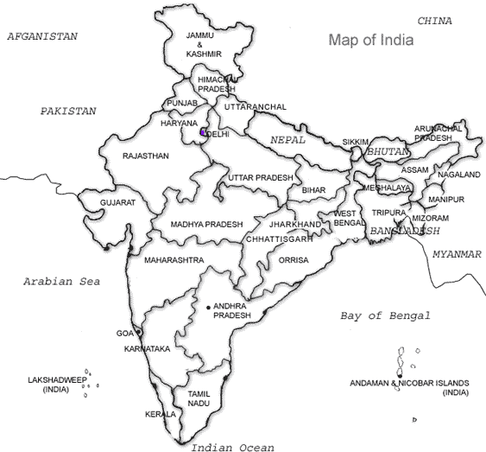
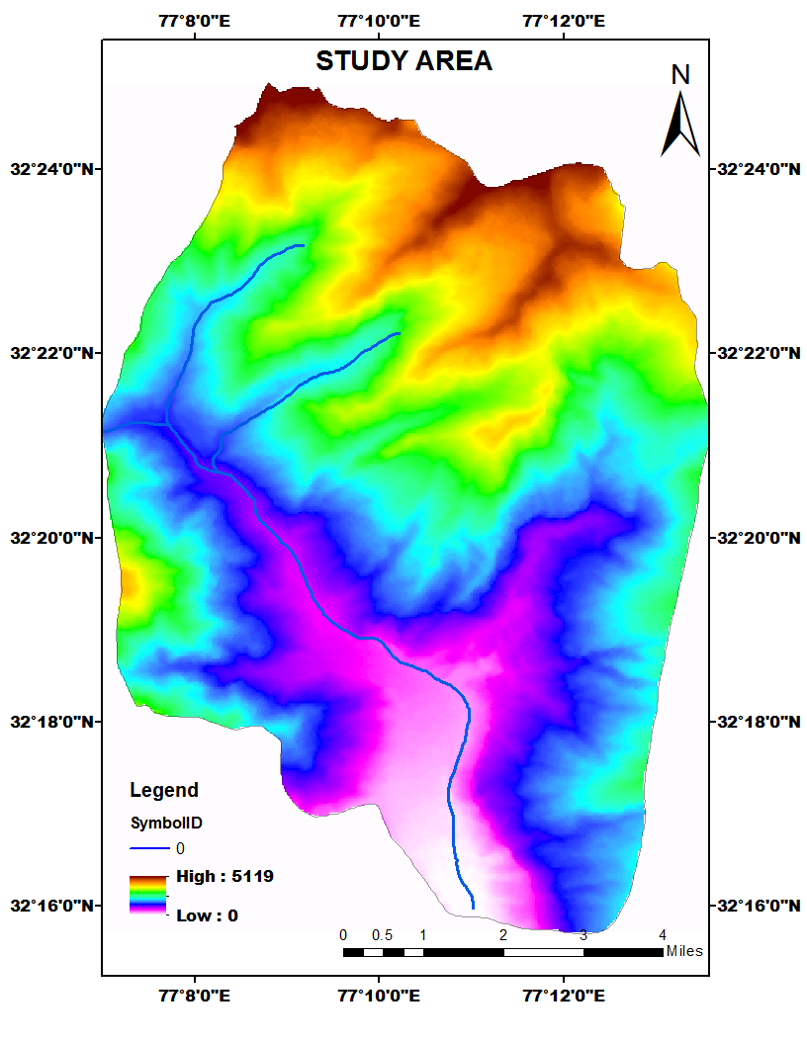
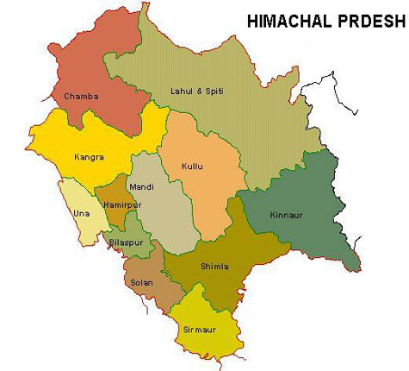

Slide 11
