Slide 1
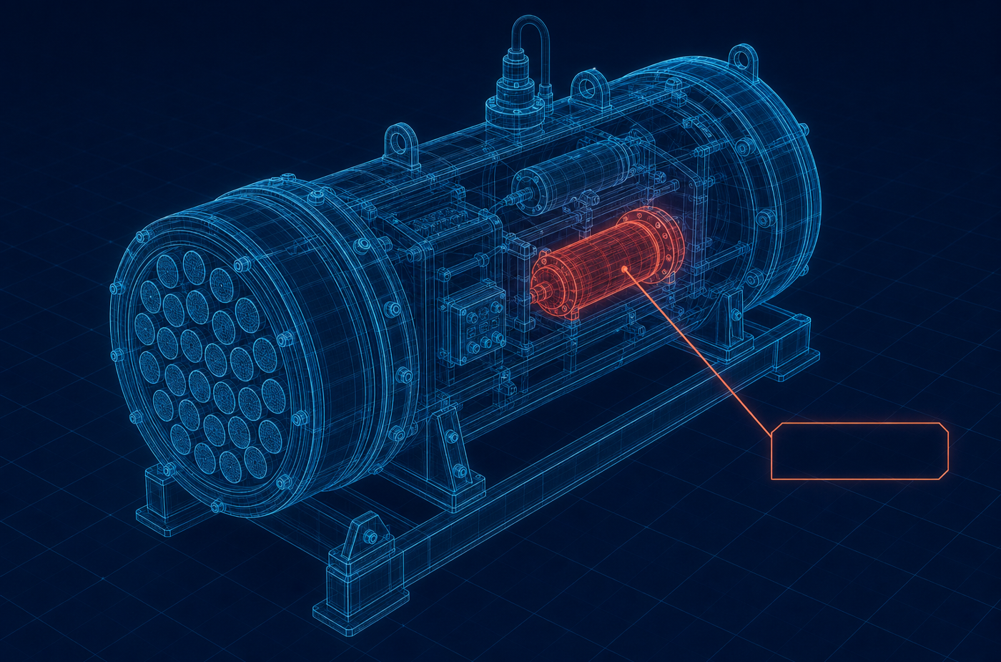
TITLE PAGE
SMART INDIA HACKATHON 2026
Problem Statement ID
26075
Problem Statement Title
CAPACITY CONNECT — A Digital Capacity Building and Learning Management Portal
Theme
Smart Education
PS Category
Software
Digital Twin concept (illustrative)
ORGANISATION
Team ID
Team ID
Ministry of Earth Sciences (MoES)
Team Name (Registered on portal)
Team Name
DEPARTMENT
India Meteorological Department
One portal for training, assessment and competency — that keeps working when the network does not.
@SIH Idea submission- Template
1
Team Name

Slide 2
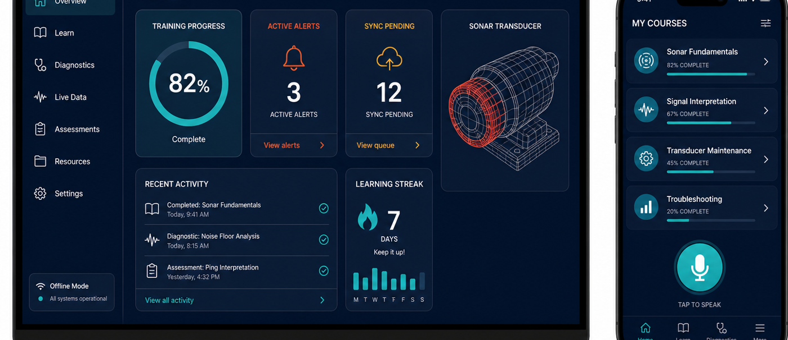
IDEA TITLE
CAPACITY CONNECT — one offline-first portal for learning, assessment, competency mapping and AI-assisted field troubleshooting
❖ Proposed Solution (Describe your Idea/Solution/Prototype)
Detailed explanation of the proposed solution
Single portal, three roles. Trainee, Trainer and Admin — secure signup/login with Admin approval and role management.
Trainee: professional profile (qualifications, experience, skills, interests, certificates), course enrollment, learning resources, subject-wise MCQ assessments and course feedback.
Trainer: competency declaration, questionnaires with deadlines, participation and performance monitoring, and a Trainer Library of recorded lectures, presentations and study material.
Concept UI mockup — offline dashboard and mobile learning app
Admin: user approval, role management, dashboards for courses / enrollments / certifications / assessments / participation, plus homepage publishing of notifications, announcements and achievements.
Innovation and uniqueness of the solution
Competency mapping engine scores trainers against subject requirements to objectively identify the right trainer.
Offline is the default, not a fallback — the local DB is an operating database, not a cache
Local AI engine, no cloud LLM — deterministic retrieval pipeline on 127.0.0.1
Offline-first edge app: a real local database plus a local AI node on 127.0.0.1, so work continues at sea and at remote sites.
Learning fused with operations — a fault maps to the asset and to the training that covers it
How it addresses the problem
3D Digital Twin guidance — SONAR-001 → Mesh_042 shown CRITICAL from a cached GLB
Replaces scattered drives, mail and spreadsheets with one auditable source of truth for learning and competency.
Objective competency mapping — fit computed from skills, certificates and outcomes
Removes the connectivity barrier: every feature works offline and reconciles automatically on reconnect.
Auditable sync ledger — every offline action is versioned and conflict-checked
Turns tacit instrument know-how into retrievable, guided diagnostic procedures.
@SIH Idea submission- Template
2
Team Name

Slide 3
TECHNICAL APPROACH
Technologies to be used (programming languages, frameworks, hardware)
CLIENT
LOCAL AI
3D & MEDIA
BACKEND & OPS
· Flutter 3 / Dart, Material 3
· Python 3.11 · FastAPI on 127.0.0.1
· GLTF / GLB cached locally
· FastAPI · SQLAlchemy · Pydantic
· Riverpod state · GoRouter
· Normalize · language detect · tokenize
· Mesh mapping + fault state layer
· PostgreSQL + Alembic migrations
· Drift + SQLite (SQLCipher)
· Keyword / phrase / RapidFuzz match
· Chunked resumable downloads
· Celery workers · JWT + refresh
· flutter_secure_storage · Dio
· TF-IDF knowledge retrieval
· Streaming video · PDF viewer
· Docker · GitHub Actions CI
· Android · Windows · Linux · Web
· Pluggable local LLM slot
· Optional speech-to-text input
· pytest · flutter test/analyze
Methodology and process for implementation
A. System architecture — edge application works with zero connectivity; cloud platform is independently deployable
Flutter Client (Material 3)
Local AI Node 127.0.0.1
Local DB SQLCipher
Digital Twin GLTF/GLB
Sync Ledger (encrypted)
FastAPI /api/v1
PostgreSQL + workers
Admin Portal & Dashboards
B. Local AI troubleshooting pipeline — returns structured JSON, confidence is a defined weighted score
Input
Normalize
Tokenize
Keyword + Phrase
Fuzzy Match
Knowledge Retrieval
Component + Severity
3D Mesh Mapping
Worked example: "Sonar transducer showing abnormal vibration and casing fracture" → SONAR-001 · Sonar Transducer Array · Mesh_042 · severity HIGH · confidence 0.94 → Digital Twin highlight + diagnostic procedure + diagnostic record saved offline.
@SIH Idea submission- Template
3
Team Name

Slide 4
FEASIBILITY AND VIABILITY
Analysis of the feasibility of the idea
Technically proven stack
No exotic hardware
Flutter, FastAPI and PostgreSQL are mature and fully open-source; one Dart codebase covers Android, Windows, Linux and Web.
Runs on existing MoES/IMD field tablets and vessel workstations; backend is containerised on existing infrastructure.
Zero licensing cost
Incremental rollout
Entirely open-source; no per-seat fees, so scaling to more users and institutes costs only storage and compute.
Portal features usable from day one; AI and Digital Twin layers extend the same schema without rework.
Potential challenges and risks → Strategies for overcoming these challenges
CHALLENGE / RISK
MITIGATION STRATEGY
Poor / no connectivity at sea and remote sites
Offline-first architecture: local operating DB + local AI node; sync ledger drains automatically on reconnect.
Large 3D models on low-end field devices
Decimated LOD meshes by default, full-resolution GLB as optional download; renderer degrades to metadata-only view.
Offline credential caching weakens authentication
Admin-approved devices only, Argon2id verifier (never the password), bounded grace window, audit + re-verification on sync.
Sync conflicts on shared records
Per-entity strategies (version compare, field merge, manual queue); diagnostic records are never silently overwritten.
Digital literacy and user adoption
Role-tailored simple UI, localisation-ready strings for Indian languages, optional voice input, in-app guided demo scenario.
Storage exhaustion on field devices
Storage manager with per-category usage, resumable downloads, permissioned removal of optional assets only.
@SIH Idea submission- Template
4
Team Name

Slide 5
IMPACT AND BENEFITS
Potential impact on the target audience
TRAINEES / FIELD ENGINEERS
TRAINERS
ADMINISTRATION / MoES
· Learn, test and certify with zero connectivity — at sea and at remote sites
· One versioned library for lectures, presentations and material
· Live dashboards of enrollment, certification and assessment
· Guided AI diagnostics instead of waiting for shore support
· Questionnaires with deadlines, auto-scoring, live participation view
· Objective trainer selection via competency mapping
· Portable, verifiable competency profile
· Feedback shows which content actually works
· Complete audit trail for governance and reporting
Benefits of the solution (social, economic, environmental)
SOCIAL
ECONOMIC
ENVIRONMENTAL
Equitable access to training for remote and shipboard staff; skill recognition through verifiable certificates; localisation-ready for Indian-language expansion; safer field work through guided procedures.
Lower instrument downtime and fewer avoidable failures; reduced travel and physical-classroom cost; open-source stack with no licensing fees; reusable across INCOIS, NCPOR and NIOT on the same core.
Fewer service trips and paper-free assessments; longer instrument life through timely preventive maintenance; better-maintained ocean and weather sensors mean higher-quality earth-science data.
100%
core features usable offline
↓ 40%
target fault-resolution time
3
roles, one governed platform
4
platforms, one codebase
@SIH Idea submission- Template
5
Team Name

Slide 6
RESEARCH AND REFERENCES
Details / Links of the reference and research work
Problem & organisational context
Standards & frameworks referenced
· SIH 2026 Problem Statement 26075 — Ministry of Earth Sciences (MoES) — sih.gov.in
· SCORM / xAPI (Experience API) — learning-record interoperability
· moes.gov.in | India Meteorological Department — mausam.imd.gov.in
· IEEE 1484 LOM — learning-object metadata for the course catalog
· MoES Annual Report — capacity building & human-resource development
· NIST SP 800-63B — digital identity & authentication guidance
· National Education Policy 2020 — digital, competency-based learning
· OWASP ASVS + Mobile Top 10 — application security verification baseline
· SIH 2026 portal guidelines — idea submission format and evaluation criteria
· NIST SP 800-38D — AES-256-GCM authenticated encryption
· ISO/IEC 27001 Annex A — access control, logging, audit-trail controls
Technology documentation
Domain & prior art studied
· Flutter & Dart — docs.flutter.dev | Riverpod, GoRouter, Drift
· Digital Twin concepts for marine instrumentation (ISO 23247 framing)
· FastAPI — fastapi.tiangolo.com | SQLAlchemy, Alembic, Pydantic official docs
· Argo programme documentation — argo.ucsd.edu — float operations
· SQLCipher — full-database encryption for SQLite (zetetic.net/sqlcipher)
· Offline-first patterns; CRDT vs. ledger-based synchronisation literature
· Khronos glTF 2.0 specification — 3D asset format for the Digital Twin
· Open-source LMS study (Moodle, Open edX) — role model & gap analysis
· PostgreSQL 16 docs | Docker Compose deployment reference
· RapidFuzz / TF-IDF retrieval literature — basis of the confidence score
Note: all cited standards and libraries are open or publicly available; the solution uses no proprietary or licence-restricted component.
@SIH Idea submission- Template
6
Team Name

