Slide 1

Team
Name
SMART INDIA
HACKATHON
2026
TITLE PAGE
SMART INDIA HACKATHON 2026
Problem Statement ID
26075
Problem Statement Title
CAPACITY CONNECT — A Digital Capacity Building and Learning Management Portal
Theme
Smart Education
PS Category
Software
Digital Twin concept (illustrative)
Team ID
Team ID
ORGANISATION
Ministry of Earth Sciences (MoES)
Team Name (Registered on portal)
Team Name
DEPARTMENT
India Meteorological Department
One portal for training, assessment and competency — that keeps working when the network does not.
@SIH Idea submission- Template
1

Slide 2
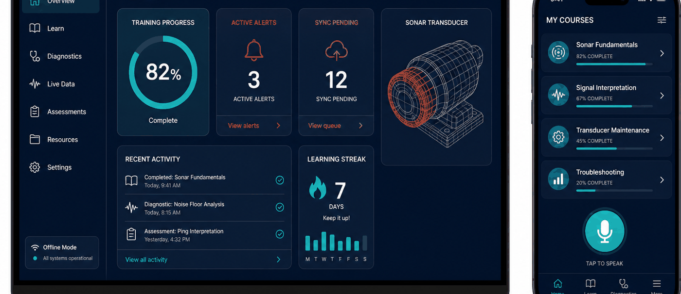
Team
Name
IDEA TITLE
SMART INDIA
HACKATHON
2026
CAPACITY CONNECT — one offline-first portal for learning, assessment, competency mapping and AI-assisted field troubleshooting
❖ Proposed Solution (Describe your Idea/Solution/Prototype)
Detailed explanation of the proposed solution
Single portal, three roles. Trainee, Trainer and Admin — secure signup/login with Admin approval and role management.
Trainee: professional profile (qualifications, experience, skills, interests, certificates), course enrollment, learning resources, subject-wise MCQ assessments and course feedback.
Trainer: competency declaration, questionnaires with deadlines, participation and performance monitoring, and a Trainer Library of recorded lectures, presentations and study material.
Concept UI mockup — offline dashboard and mobile learning app
Admin: user approval, role management, dashboards for courses / enrollments / certifications / assessments / participation, plus homepage publishing of notifications, announcements and achievements.
Innovation and uniqueness of the solution
Competency mapping engine scores trainers against subject requirements to objectively identify the right trainer.
Offline is the default, not a fallback — the local DB is an operating database, not a cache
Local AI engine, no cloud LLM — deterministic retrieval pipeline on 127.0.0.1
Offline-first edge app: a real local database plus a local AI node on 127.0.0.1, so work continues at sea and at remote sites.
Learning fused with operations — a fault maps to the asset and to the training that covers it
How it addresses the problem
3D Digital Twin guidance — SONAR-001 → Mesh_042 shown CRITICAL from a cached GLB
Replaces scattered drives, mail and spreadsheets with one auditable source of truth for learning and competency.
Objective competency mapping — fit computed from skills, certificates and outcomes
Removes the connectivity barrier: every feature works offline and reconciles automatically on reconnect.
Auditable sync ledger — every offline action is versioned and conflict-checked
Turns tacit instrument know-how into retrievable, guided diagnostic procedures.
@SIH Idea submission- Template
2

Slide 3
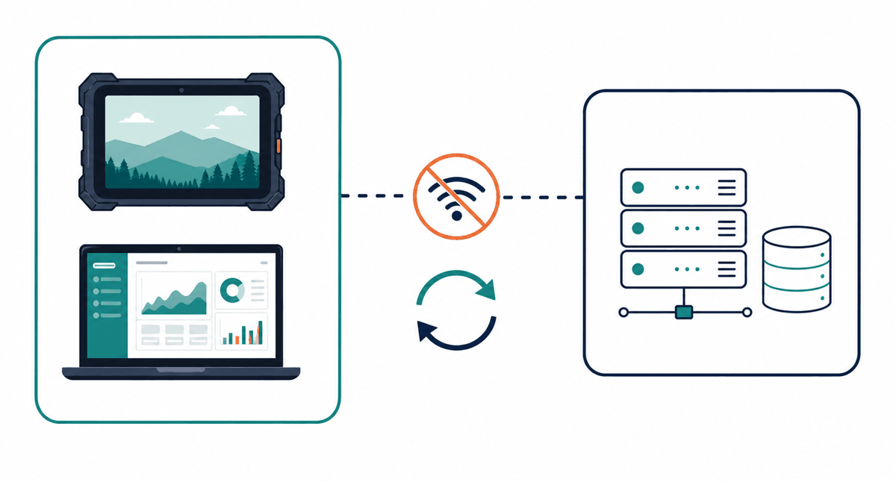
Team
Name
TECHNICAL APPROACH
SMART INDIA
HACKATHON
2026
Technologies to be used (programming languages, frameworks, hardware)
CLIENT
LOCAL AI
3D & MEDIA
BACKEND & OPS
- Flutter 3 / Dart, Material 3
- Python 3.11 - FastAPI on 127.0.0.1
- GLTF / GLB cached locally
- FastAPI - SQLAlchemy - Pydantic
- Riverpod state - GoRouter
- Normalise - detect - tokenize
- Mesh mapping + fault state
- PostgreSQL + Alembic
- Drift + SQLite (SQLCipher)
- Keyword / phrase / RapidFuzz
- Resumable chunked downloads
- JWT + refresh - Docker - CI
- Android - Windows - Linux - Web
- TF-IDF retrieval, pluggable LLM
- Streaming video - PDF viewer
- pytest - flutter test/analyze
Methodology and process for implementation
A. System architecture - the edge application works with zero connectivity
Flutter Client
Local AI 127.0.0.1
Local DB SQLCipher
Digital Twin GLTF/GLB
Sync Ledger
Cloud API + DB
B. Local AI troubleshooting pipeline - returns structured JSON
Input
Normalise + tokenize
Keyword / fuzzy match
Knowledge retrieval
Component + severity
3D mesh mapping
Offline-first edge + cloud, joined by a sync ledger
Worked example: "Sonar transducer showing abnormal vibration and casing fracture" -> SONAR-001 - Mesh_042 - severity HIGH - confidence 0.94 -> twin highlight, diagnostic procedure and record saved offline.
@SIH Idea submission- Template
3

Slide 4

Team
Name
FEASIBILITY AND VIABILITY
SMART INDIA
HACKATHON
2026
Analysis of the feasibility of the idea
Technically proven stack
No exotic hardware
Flutter, FastAPI, PostgreSQL - one Dart codebase covers Android, Windows, Linux, Web.
Runs on existing field tablets and vessel workstations; backend is containerised.
Zero licensing cost
Incremental rollout
Entirely open-source - scaling costs only storage and compute, no per-seat fees.
Portal usable from day one; AI and Digital Twin extend the same schema later.
Target user: MoES / IMD field and shipboard personnel
Potential challenges and risks -> Strategies for overcoming these challenges
CHALLENGE / RISK
MITIGATION STRATEGY
Poor / no connectivity at sea and remote sites
Offline-first architecture: local operating DB + local AI node; the sync ledger drains on reconnect.
Large 3D models on low-end field devices
Decimated LOD meshes by default, full-resolution GLB optional; degrades to metadata-only view.
Offline credential caching weakens authentication
Admin-approved devices only, Argon2id verifier, bounded grace window, audit + re-verification.
Sync conflicts on shared records
Per-entity strategies with a manual-resolution queue; diagnostics are never silently overwritten.
Digital literacy and user adoption
Role-tailored simple UI, localisation-ready strings, optional voice input, in-app guided scenario.
Storage exhaustion on field devices
Storage manager with per-category usage, resumable downloads, permissioned asset removal.
@SIH Idea submission- Template
4

Slide 5

Team
Name
IMPACT AND BENEFITS
SMART INDIA
HACKATHON
2026
Potential impact on the target audience
TRAINEES / FIELD ENGINEERS
TRAINERS
ADMINISTRATION / MoES
- Learn, test and certify with zero connectivity
- One versioned library for lectures and material
- Dashboards: enrollment, certification, assessment
- Guided AI diagnostics instead of waiting for shore support
- Questionnaires with deadlines and auto-scoring
- Objective trainer selection via competency mapping
- Portable, verifiable competency profile
- Live participation and performance view
- Complete audit trail for governance
Trainers and trainees on one governed platform
Benefits of the solution (social, economic, environmental)
SOCIAL
ECONOMIC
ENVIRONMENTAL
Equitable access to training for remote and shipboard staff; skill recognition through verifiable certificates; localisation-ready for Indian languages; safer field work through guided procedures.
Lower instrument downtime and fewer avoidable failures; reduced travel and classroom cost; open-source stack with no licensing fees; reusable across INCOIS, NCPOR and NIOT.
Fewer service trips and paper-free assessments; longer instrument life through timely preventive maintenance; better-maintained sensors mean higher-quality earth-science data.
100%
core features usable offline
40%
target cut in fault-resolution time
3
roles, one governed platform
4
platforms, one codebase
@SIH Idea submission- Template
5

Slide 6

Team
Name
RESEARCH AND REFERENCES
SMART INDIA
HACKATHON
2026
Details / Links of the reference and research work
Problem & organisational context
Standards & frameworks referenced
- SIH 2026 Problem Statement 26075 - sih.gov.in
- SCORM / xAPI - learning-record interoperability
- Ministry of Earth Sciences - moes.gov.in
- IEEE 1484 LOM - learning-object metadata
- India Meteorological Department - mausam.imd.gov.in
- NIST SP 800-63B - identity and authentication
- MoES Annual Report - capacity building programmes
- NIST SP 800-38D - AES-256-GCM encryption
- National Education Policy 2020 - competency-based learning
- OWASP ASVS + Mobile Top 10; ISO/IEC 27001 Annex A
Standards, manuals and prior art reviewed
Technology documentation
Domain & prior art studied
- Flutter & Dart - docs.flutter.dev
- Digital Twin for marine instrumentation (ISO 23247)
- Riverpod, GoRouter, Drift (drift.simonbinder.eu)
- Argo programme documentation - argo.ucsd.edu
- FastAPI, SQLAlchemy, Alembic, Pydantic docs
- Offline-first patterns; CRDT vs ledger-based sync
- SQLCipher - encrypted SQLite (zetetic.net)
- Open-source LMS study (Moodle, Open edX)
- Khronos glTF 2.0 specification; PostgreSQL 16
- RapidFuzz / TF-IDF retrieval - confidence scoring
Note: all cited standards and libraries are open or publicly available; the solution uses no proprietary or licence-restricted component.
@SIH Idea submission- Template
6

