Slide 1
Docker

Slide 2
Understanding VM and containers Docker Why do we need it? What are they used for?
Agenda

Slide 3
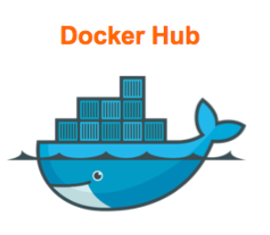
My Docker Story
Docker Registry - storage and distribution system for named docker images

Slide 4

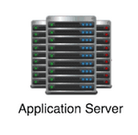
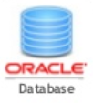

Thank God, it is history!!!
Webserver
Application Server
Database
Caching
Compatibility & Dependency
Libraries
Dependencies
Long setup time
OS
Different Dev/Test/Prod environment
Hardware Infrastructure

Slide 5



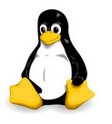
Operating Systems
Software
Software
Software
Software
OS Kernel
Notes:
Linux delivery
OS Kernal : same across all linux/unix
Software : Different software across linux/unix.

Slide 6

What are containers
Processes
Network
Mounts
Processes
Network
Mounts
Processes
Network
Mounts
Processes
Network
Mounts
Docker
OS Kernel
Notes:
Dockers shares the kernel (same across linux/unix)
Each docker container has only the delta of software it wants.

Slide 7
app
lib
bin
BARE METAL
kernel
hardware
Notes:
Underutilization
Typical utilization -> 15-20%

Slide 8
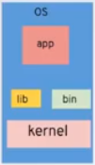
HYPERVISOR
Hypervisor
Kernel
Hardware
Notes:
Emulate the underlying hardware

Slide 9






App
App
App
HYPERVISOR
hardware
Notes:
BIOS,
MBR : Master Boot Root
Init – init.d : what should happen during startup.

Slide 10


kernel
hardware

Slide 11
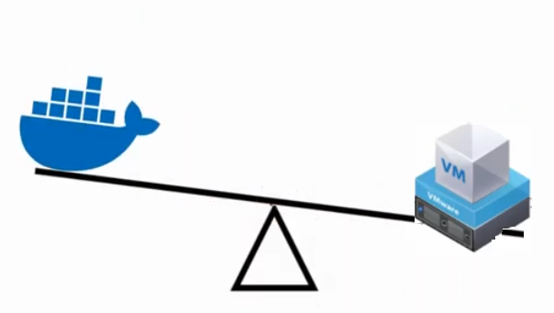
Docker v/s Virtual machine

Slide 12
App
App
App
App
App
App
HYPERVISOR
hardware
hardware

Slide 13



INDEPENDANT HOUSES
ROW HOUSES
APARTMENTS

Slide 14
What is a Docker container?
Consist of two parts:
A disk image holding the software you want to run
An “engine” or container runtime, designed to configure the kernel to run that image in an isolated kernel namespace.

Slide 15


Images v/s Containers
Docker container 1
Docker Image
Docker container 2

Slide 16
Docker Installation
$ curl -fsSL https://get.docker.com -o get-docker.sh
$ sudo sh get-docker.sh

Slide 17
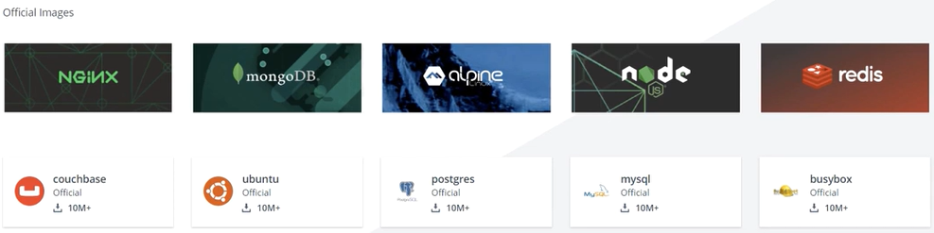
DockerHub

Slide 18
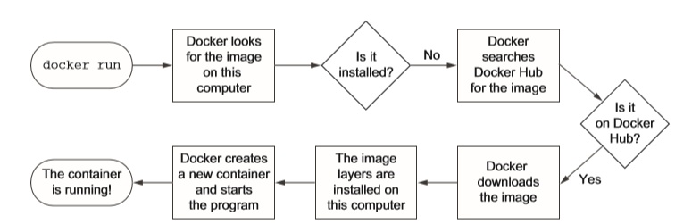
Running your first container

Slide 19
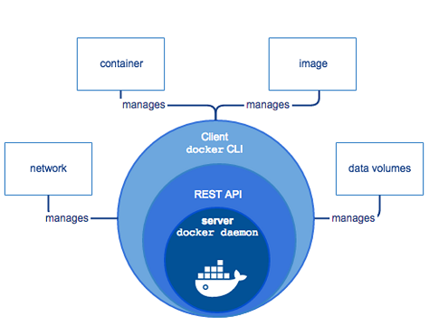
Docker Architecture

Slide 20
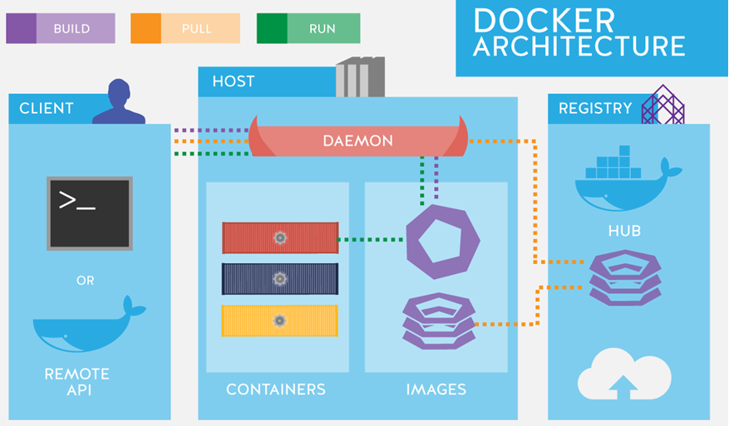
Docker Architecture

Slide 21
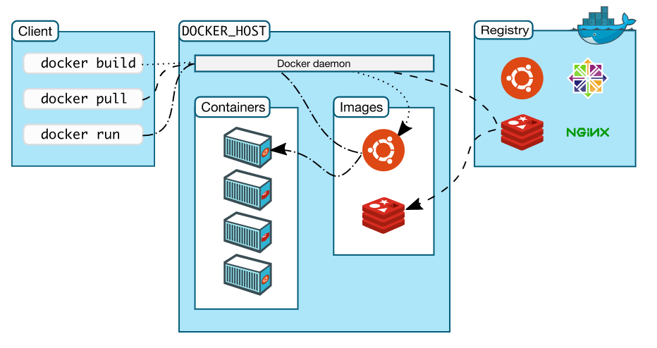
Docker Architecture

Slide 22
Docker Engine
Docker Daemon
A persistent background process that manages Docker images, containers, networks, and storage volumes. The Docker daemon constantly listens for Docker API requests and processes them.
Docker Engine REST API
API used by applications to interact with the Docker daemon
Docker CLI
A command line interface client for interacting with the Docker daemon.

Slide 23
Docker Objects
Images: read-only binary template used to build containers.
Containers: encapsulated environments in which you run applications
Networks: provide the capability to networking between containers through the use of network drivers
Storage: stores data within the writable layer of a container

Slide 24
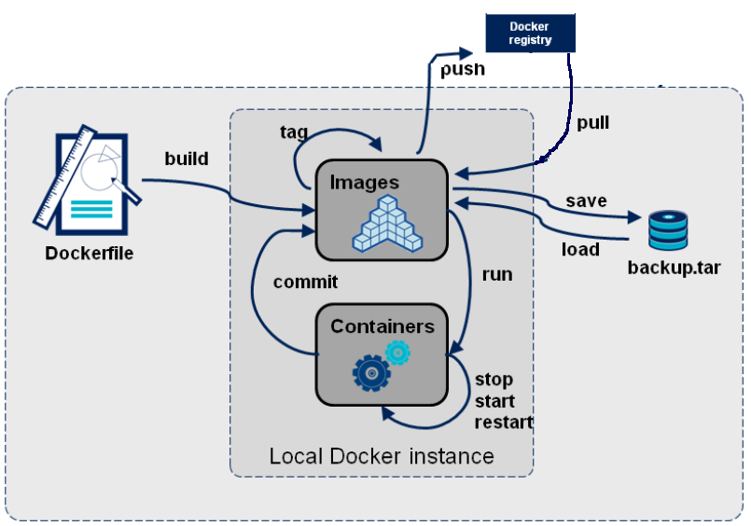
Docker Lifecycle

Slide 25
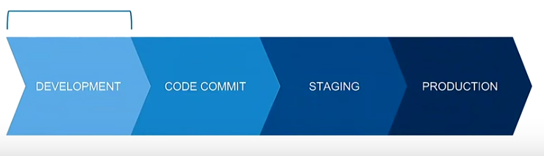
Development workflow

Slide 26
Development pipeline ?
Define Environment as code
Environmental consistency
Multiple versions without headache

Slide 27
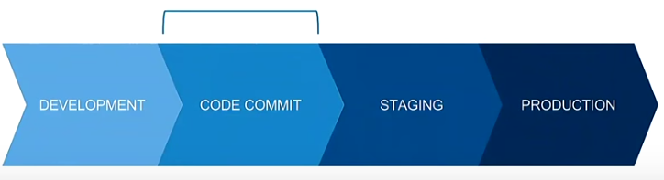
Development pipeline ?
Test with clean environment
Run any CI requirements
Automation

Slide 28
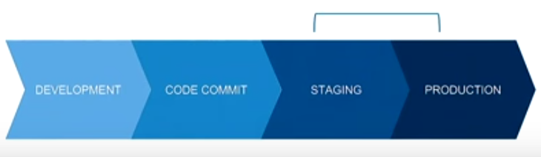
Deployment
Deploy containers anywhere
Improved resource utilization
Highly scalable
Image is the entire package

Slide 29
Advantages of Docker
Lightweight
Portability
Simplify DevOps
CI/CD
Micro services
Isolation

