Slide 1
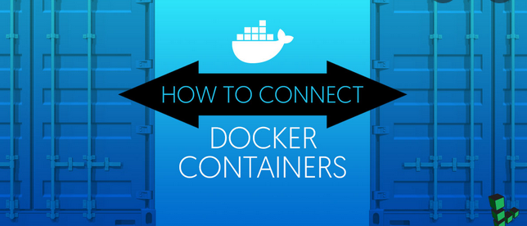
Container Networking

Slide 2
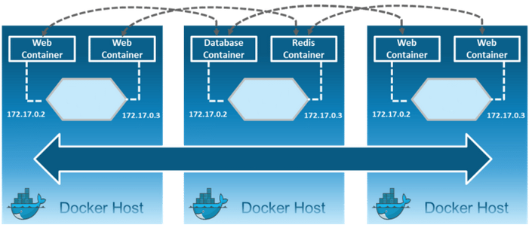
Need for docker networking

Slide 3
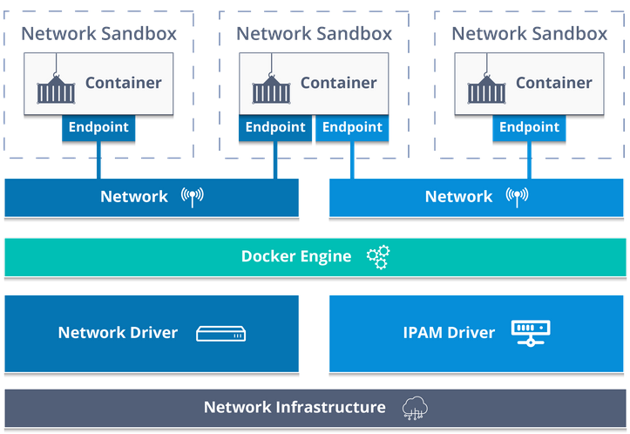
Container Network Model(CNM)

Slide 4
Docker Networking
Default Docker Bridge
eth0
IP Tables
docker0
C1
C2

Slide 5
Docker Networking commands
List all networks: docker network ls
Inspect a network: docker network inspect <network>
Create a new network: docker network create
Exp:- docker network create -d bridge my-bridge-network
Remove an existing network: docker network rm <network-name>
Notes:
Inspect a network: To see a specific network’s configuration details like subnet information, network name, IPAM driver, network ID, network driver, or connected containers, use the docker network inspect command.
List all networks: Run docker network ls to display all networks (along with their type and scope) present on the current host.
Create a new network: To create a new network, use the docker network create command and specify if it's of type bridge (default), overlay or macvlan.
Run or connect a container to a specific network: Note first of all, the network must exist already on the host. Either specify the network at container creation/startup time (docker create or docker run) with the --net option; or attach an existing container by using the docker network connect command. For example:
docker network connect my-network my-container
Disconnect a container from a network: The container must be running to disconnect it from the network using the docker network disconnect command.
Remove an existing network: A network can only be removed using the command docker network rm if there are no containers attached to it. When a network is removed, the associated bridge will be removed as well.

Slide 6
Docker Networking commands
Connect a running container to a specific network
$ docker network connect <network-name> <container-name>
Disconnect a running container from a network
$ docker network disconnect -f <network-name> <container-name>
Notes:
Inspect a network: To see a specific network’s configuration details like subnet information, network name, IPAM driver, network ID, network driver, or connected containers, use the docker network inspect command.
List all networks: Run docker network ls to display all networks (along with their type and scope) present on the current host.
Create a new network: To create a new network, use the docker network create command and specify if it's of type bridge (default), overlay or macvlan.
Run or connect a container to a specific network: Note first of all, the network must exist already on the host. Either specify the network at container creation/startup time (docker create or docker run) with the --net option; or attach an existing container by using the docker network connect command. For example:
docker network connect my-network my-container
Disconnect a container from a network: The container must be running to disconnect it from the network using the docker network disconnect command.
Remove an existing network: A network can only be removed using the command docker network rm if there are no containers attached to it. When a network is removed, the associated bridge will be removed as well.

Slide 7
Network Drivers
Bridge
None
Overlay
host
Macvlan
Notes:
Bridge – Default network assigned. Private internal network created by Docker. Containers can access each other using the internal network.
Host - Network isolation. For Exp:- If you want to start a webserver on port 5000. No no need to publish it.

Slide 8
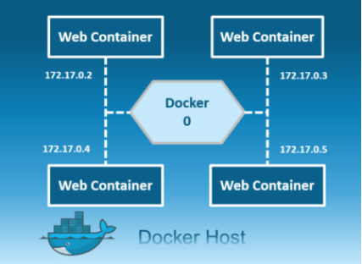
Bridge
$ docker network create -d bridge my-bridge-net
Private network restricted to single host
All containers inside this bridge can communicate with each other
Each containers are placed in its own network namespace
Notes:
Private default internal network created by docker on the host.

Slide 9
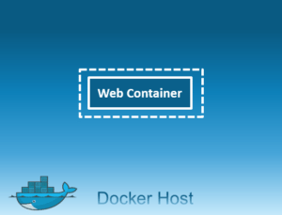
None
Containers are not attached to any network
Don’t have access to the external network or other containers
Notes:
containers are not attached to any network and do not have any access to the external network or other containers.

Slide 10
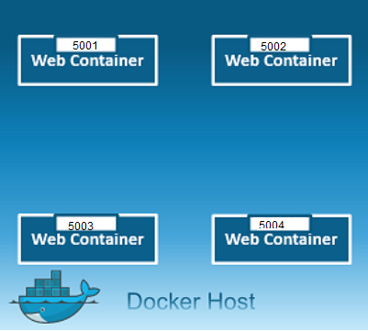
Host
$ docker network create -d host my-host-net
Uses the host’s networking directly to communicate between containers and to the host
Notes:
This driver removes the network isolation between the docker host and the docker containers to use the host’s networking directly.
You will not be able to run multiple web containers on the same host, on the same port as the port is now common to all containers in the host network.

Slide 11
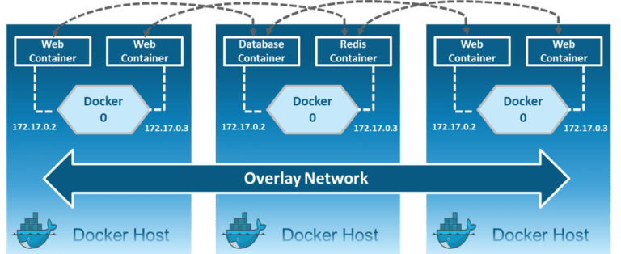
Overlay
Overlay network driver is used for multi-host network communication.
$ docker network create -d overlay --subnet=192.168.10.0/24 my-overlay-net
Notes:
Creates an internal private network that spans across all the nodes participating in the swarm cluster.
Overlay networks facilitate communication between a swarm service and a standalone container, or between two standalone containers on different Docker Daemons.
http://blog.nigelpoulton.com/demystifying-docker-overlay-networking/

Slide 12
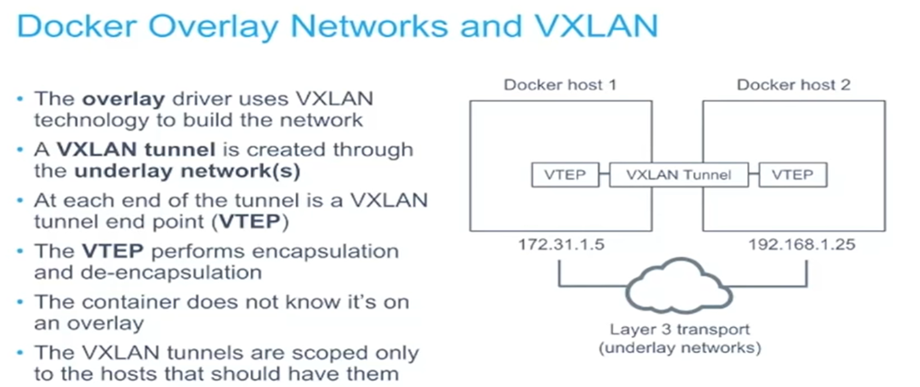
Overlay

Slide 13
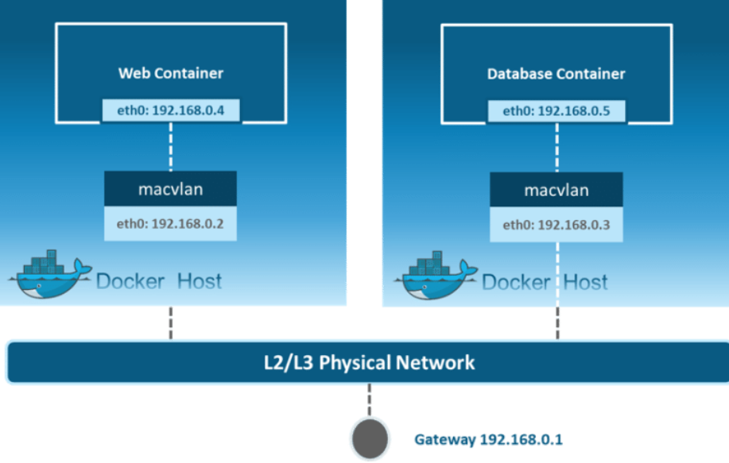
Macvlan
docker network create -d macvlan \
--subnet=192.168.40.0/24 \
--gateway=192.168.40.1 \
-o parent=eth0 my-macvlan-net
Notes:
Allows you to assign a MAC address to a container, making it appear as a physical device on your network. Then, the Docker daemon routes traffic to containers by their MAC addresses. Macvlan driver is the best choice when you are expected to be directly connected to the physical network, rather than routed through the Docker host’s network stack

Slide 14
Docker Best Practices
Prefer minimal base images
Package a single application per container
Optimize for the Docker build cache
Remove unnecessary tools
Build the smallest image possible
Properly tag your images
Notes:
https://cloud.google.com/blog/products/gcp/7-best-practices-for-building-containers

Slide 15
Docker Security Best Practices
Least privileged user
Sign and verify images to mitigate attacks
Scan your docker images for known vulnerabilities
Don’t leak sensitive information to docker images
Use multi-stage builds for small secure images

Slide 16
Best practices
https://docs.docker.com/develop/develop-images/dockerfile_best-practices/
https://www.docker.com/blog/intro-guide-to-dockerfile-best-practices/
https://cloud.google.com/blog/products/gcp/7-best-practices-for-building-containers

Slide 17

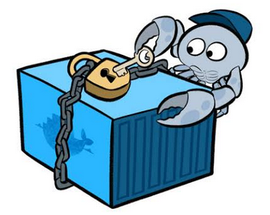

Slide 18
Docker Security Risks
Introducing vulnerabilities from container images
Hard coding credentials in images
Large attack surface
Lateral network movement
Notes:
https://blog.aquasec.com/docker-security-best-practices
https://resources.whitesourcesoftware.com/blog-whitesource/docker-container-security-challenges-and-best-practices

Slide 19
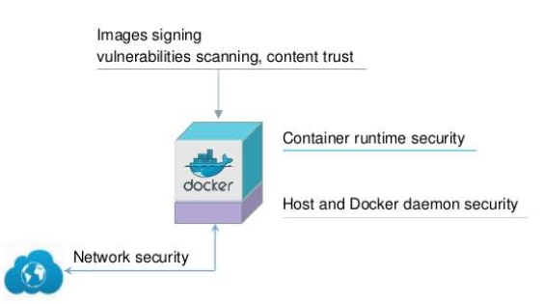
Docker Security Tips
Use a Third-Party Security Tool
Manage Vulnerability
Monitor and Audit Container Activity
Enable Docker Content Trust to digitally sign
Use Docker Bench for Security

Slide 20
Docker Security Tips Cntd.
Use a Third-Party Security Tool
Manage Vulnerability
Monitor and Audit Container Activity
Enable Docker Content Trust to digitally sign
Use Docker Bench for Security

