Slide 1
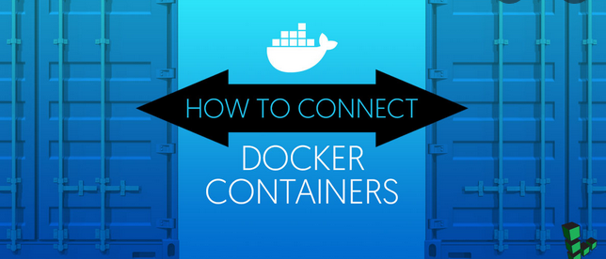
Container Networking

Slide 2
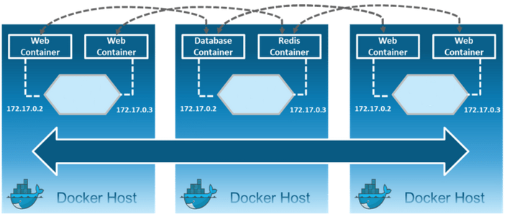
Need for docker networking

Slide 3
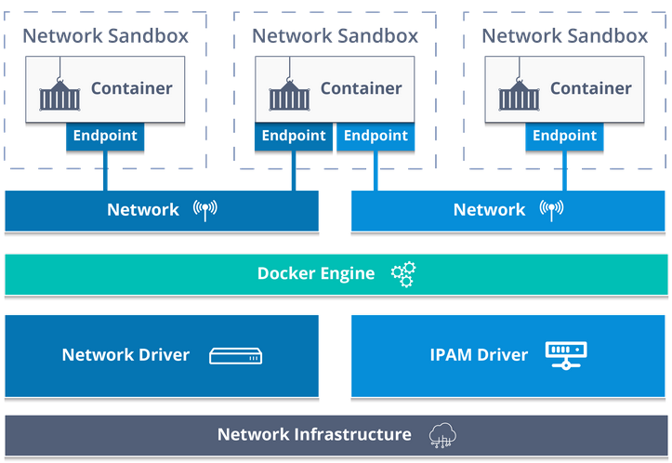
Container Network Model(CNM)

Slide 4
Docker Networking
Default Docker Bridge
eth0
IP Tables
docker0
C1
C2

Slide 5
Network Objects
IP Address
Internet Protocol Address
Numerical label to uniquely identify on a network
Location address
IPv4 and IPv6
MAC Address
Media access control
Unique identifier assigned to device.
Notes:
Inspect a network: To see a specific network’s configuration details like subnet information, network name, IPAM driver, network ID, network driver, or connected containers, use the docker network inspect command.
List all networks: Run docker network ls to display all networks (along with their type and scope) present on the current host.
Create a new network: To create a new network, use the docker network create command and specify if it's of type bridge (default), overlay or macvlan.
Run or connect a container to a specific network: Note first of all, the network must exist already on the host. Either specify the network at container creation/startup time (docker create or docker run) with the --net option; or attach an existing container by using the docker network connect command. For example:
docker network connect my-network my-container
Disconnect a container from a network: The container must be running to disconnect it from the network using the docker network disconnect command.
Remove an existing network: A network can only be removed using the command docker network rm if there are no containers attached to it. When a network is removed, the associated bridge will be removed as well.

Slide 6
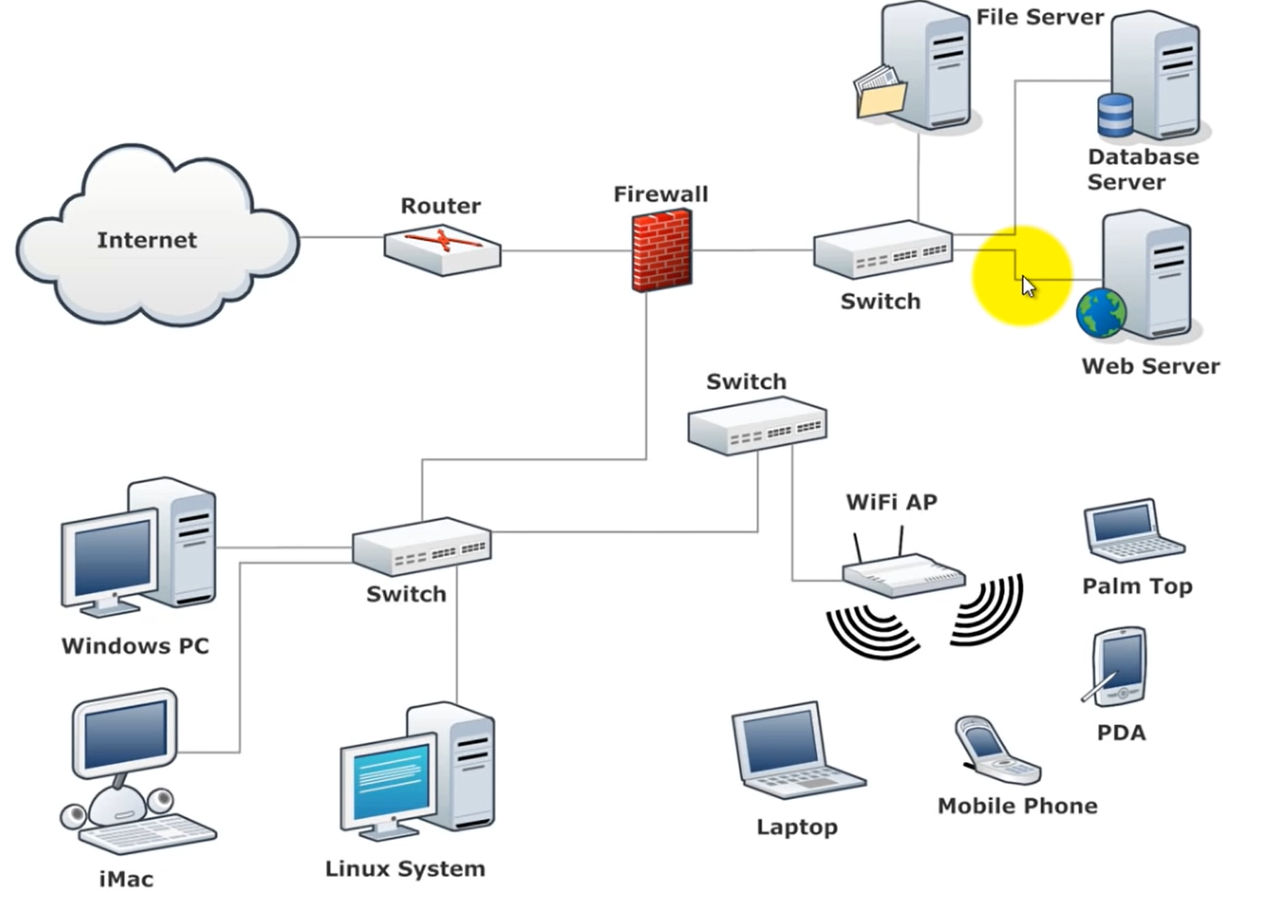
Network Objects
Subnet Mask
Subnetting an IP Network
Divides a huge IP network into smaller networks
NIC
Network Interface Card
NAT
Network address translator
Gateway
Notes:
Inspect a network: To see a specific network’s configuration details like subnet information, network name, IPAM driver, network ID, network driver, or connected containers, use the docker network inspect command.
List all networks: Run docker network ls to display all networks (along with their type and scope) present on the current host.
Create a new network: To create a new network, use the docker network create command and specify if it's of type bridge (default), overlay or macvlan.
Run or connect a container to a specific network: Note first of all, the network must exist already on the host. Either specify the network at container creation/startup time (docker create or docker run) with the --net option; or attach an existing container by using the docker network connect command. For example:
docker network connect my-network my-container
Disconnect a container from a network: The container must be running to disconnect it from the network using the docker network disconnect command.
Remove an existing network: A network can only be removed using the command docker network rm if there are no containers attached to it. When a network is removed, the associated bridge will be removed as well.

Slide 7
Network Objects
Subnet Mask
Subnetting an IP Network
Divides a huge IP network into smaller networks
i.e. facilitates subnetting
Computers on a subnet mask cannot talk to devices on a different subnet mask unless the security privileges are validated.
NIC
Network Interface Card
NAT
Network address translator
picks up the public IP
assigns private IP : dynamic.
maintains IP table.
Notes:
Inspect a network: To see a specific network’s configuration details like subnet information, network name, IPAM driver, network ID, network driver, or connected containers, use the docker network inspect command.
List all networks: Run docker network ls to display all networks (along with their type and scope) present on the current host.
Create a new network: To create a new network, use the docker network create command and specify if it's of type bridge (default), overlay or macvlan.
Run or connect a container to a specific network: Note first of all, the network must exist already on the host. Either specify the network at container creation/startup time (docker create or docker run) with the --net option; or attach an existing container by using the docker network connect command. For example:
docker network connect my-network my-container
Disconnect a container from a network: The container must be running to disconnect it from the network using the docker network disconnect command.
Remove an existing network: A network can only be removed using the command docker network rm if there are no containers attached to it. When a network is removed, the associated bridge will be removed as well.

Slide 8
Network Objects
HUB
Transmits to all communication
Switch
Learns from previous communication.
Identifies network objects through MAC address.
Keeps a table of devices connected.
Router
Routes data from one network to the other based on the IP
Gateway of the network.
Notes:
Inspect a network: To see a specific network’s configuration details like subnet information, network name, IPAM driver, network ID, network driver, or connected containers, use the docker network inspect command.
List all networks: Run docker network ls to display all networks (along with their type and scope) present on the current host.
Create a new network: To create a new network, use the docker network create command and specify if it's of type bridge (default), overlay or macvlan.
Run or connect a container to a specific network: Note first of all, the network must exist already on the host. Either specify the network at container creation/startup time (docker create or docker run) with the --net option; or attach an existing container by using the docker network connect command. For example:
docker network connect my-network my-container
Disconnect a container from a network: The container must be running to disconnect it from the network using the docker network disconnect command.
Remove an existing network: A network can only be removed using the command docker network rm if there are no containers attached to it. When a network is removed, the associated bridge will be removed as well.

Slide 9
Network Objects
Ip addr show
Network objects
IP address
IPv4 or IPv6
NIC
en – ethernet
w – wlan
enp5s25 – 5th port, 25th slot
Notes:
Inspect a network: To see a specific network’s configuration details like subnet information, network name, IPAM driver, network ID, network driver, or connected containers, use the docker network inspect command.
List all networks: Run docker network ls to display all networks (along with their type and scope) present on the current host.
Create a new network: To create a new network, use the docker network create command and specify if it's of type bridge (default), overlay or macvlan.
Run or connect a container to a specific network: Note first of all, the network must exist already on the host. Either specify the network at container creation/startup time (docker create or docker run) with the --net option; or attach an existing container by using the docker network connect command. For example:
docker network connect my-network my-container
Disconnect a container from a network: The container must be running to disconnect it from the network using the docker network disconnect command.
Remove an existing network: A network can only be removed using the command docker network rm if there are no containers attached to it. When a network is removed, the associated bridge will be removed as well.

Slide 10
Transfer Control Protocol (TCP)/ Internet Protocol(IP)
IP
Controls routing of information within devices
Routable Protocol
Manages IP, subnet mask, gateway ect.
Node discovery
With in subnet – communicate through switches
Outside subnet – communicates through Routers
Layer 3 in OSI model
Notes:
Inspect a network: To see a specific network’s configuration details like subnet information, network name, IPAM driver, network ID, network driver, or connected containers, use the docker network inspect command.
List all networks: Run docker network ls to display all networks (along with their type and scope) present on the current host.
Create a new network: To create a new network, use the docker network create command and specify if it's of type bridge (default), overlay or macvlan.
Run or connect a container to a specific network: Note first of all, the network must exist already on the host. Either specify the network at container creation/startup time (docker create or docker run) with the --net option; or attach an existing container by using the docker network connect command. For example:
docker network connect my-network my-container
Disconnect a container from a network: The container must be running to disconnect it from the network using the docker network disconnect command.
Remove an existing network: A network can only be removed using the command docker network rm if there are no containers attached to it. When a network is removed, the associated bridge will be removed as well.

Slide 11
Transfer Control Protocol (TCP)/ Internet Protocol(IP)
TCP
How do computers talk after Node discovery
which language
How fast
Windowing
Layer 4 OSI model
Notes:
Inspect a network: To see a specific network’s configuration details like subnet information, network name, IPAM driver, network ID, network driver, or connected containers, use the docker network inspect command.
List all networks: Run docker network ls to display all networks (along with their type and scope) present on the current host.
Create a new network: To create a new network, use the docker network create command and specify if it's of type bridge (default), overlay or macvlan.
Run or connect a container to a specific network: Note first of all, the network must exist already on the host. Either specify the network at container creation/startup time (docker create or docker run) with the --net option; or attach an existing container by using the docker network connect command. For example:
docker network connect my-network my-container
Disconnect a container from a network: The container must be running to disconnect it from the network using the docker network disconnect command.
Remove an existing network: A network can only be removed using the command docker network rm if there are no containers attached to it. When a network is removed, the associated bridge will be removed as well.

Slide 12
OSI Model
7 Logical layers
Layer 7 is closest to user and Layer 1 is away from user
Notes:
Inspect a network: To see a specific network’s configuration details like subnet information, network name, IPAM driver, network ID, network driver, or connected containers, use the docker network inspect command.
List all networks: Run docker network ls to display all networks (along with their type and scope) present on the current host.
Create a new network: To create a new network, use the docker network create command and specify if it's of type bridge (default), overlay or macvlan.
Run or connect a container to a specific network: Note first of all, the network must exist already on the host. Either specify the network at container creation/startup time (docker create or docker run) with the --net option; or attach an existing container by using the docker network connect command. For example:
docker network connect my-network my-container
Disconnect a container from a network: The container must be running to disconnect it from the network using the docker network disconnect command.
Remove an existing network: A network can only be removed using the command docker network rm if there are no containers attached to it. When a network is removed, the associated bridge will be removed as well.

Slide 13
Docker Networking commands
List all networks: docker network ls
Inspect a network: docker network inspect <network>
Create a new network: docker network create
Exp:- docker network create -d bridge my-bridge-network
Remove an existing network: docker network rm <network-name>
Notes:
Inspect a network: To see a specific network’s configuration details like subnet information, network name, IPAM driver, network ID, network driver, or connected containers, use the docker network inspect command.
List all networks: Run docker network ls to display all networks (along with their type and scope) present on the current host.
Create a new network: To create a new network, use the docker network create command and specify if it's of type bridge (default), overlay or macvlan.
Run or connect a container to a specific network: Note first of all, the network must exist already on the host. Either specify the network at container creation/startup time (docker create or docker run) with the --net option; or attach an existing container by using the docker network connect command. For example:
docker network connect my-network my-container
Disconnect a container from a network: The container must be running to disconnect it from the network using the docker network disconnect command.
Remove an existing network: A network can only be removed using the command docker network rm if there are no containers attached to it. When a network is removed, the associated bridge will be removed as well.

Slide 14
Docker Networking commands
Connect a running container to a specific network
$ docker network connect <network-name> <container-name>
Disconnect a running container from a network
$ docker network disconnect -f <network-name> <container-name>
Notes:
Inspect a network: To see a specific network’s configuration details like subnet information, network name, IPAM driver, network ID, network driver, or connected containers, use the docker network inspect command.
List all networks: Run docker network ls to display all networks (along with their type and scope) present on the current host.
Create a new network: To create a new network, use the docker network create command and specify if it's of type bridge (default), overlay or macvlan.
Run or connect a container to a specific network: Note first of all, the network must exist already on the host. Either specify the network at container creation/startup time (docker create or docker run) with the --net option; or attach an existing container by using the docker network connect command. For example:
docker network connect my-network my-container
Disconnect a container from a network: The container must be running to disconnect it from the network using the docker network disconnect command.
Remove an existing network: A network can only be removed using the command docker network rm if there are no containers attached to it. When a network is removed, the associated bridge will be removed as well.

Slide 15
Network Drivers
Bridge
None
Overlay
host
Macvlan
Notes:
Bridge – Default network assigned. Private internal network created by Docker. Containers can access each other using the internal network.
Host - Network isolation. For Exp:- If you want to start a webserver on port 5000. No no need to publish it.

Slide 16
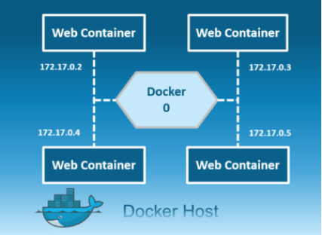
Bridge
$ docker network create -d bridge my-bridge-net
Private network restricted to single host
All containers inside this bridge can communicate with each other
Each containers are placed in its own network namespace
Notes:
Private default internal network created by docker on the host.

Slide 17
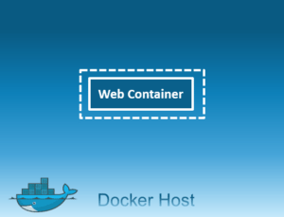
None
Containers are not attached to any network
Don’t have access to the external network or other containers
Notes:
containers are not attached to any network and do not have any access to the external network or other containers.

Slide 18
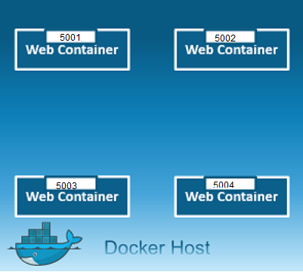
Host
$ docker network create -d host my-host-net
Uses the host’s networking directly to communicate between containers and to the host
Notes:
This driver removes the network isolation between the docker host and the docker containers to use the host’s networking directly.
You will not be able to run multiple web containers on the same host, on the same port as the port is now common to all containers in the host network.

Slide 19
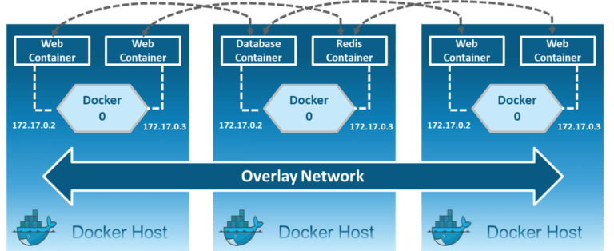
Overlay
Overlay network driver is used for multi-host network communication.
$ docker network create -d overlay --subnet=192.168.10.0/24 my-overlay-net
Notes:
Creates an internal private network that spans across all the nodes participating in the swarm cluster.
Overlay networks facilitate communication between a swarm service and a standalone container, or between two standalone containers on different Docker Daemons.
http://blog.nigelpoulton.com/demystifying-docker-overlay-networking/

Slide 20
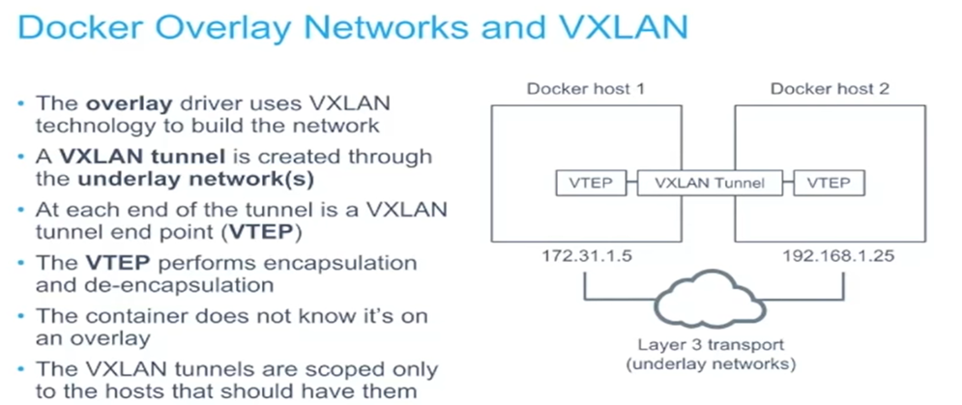
Overlay

Slide 21
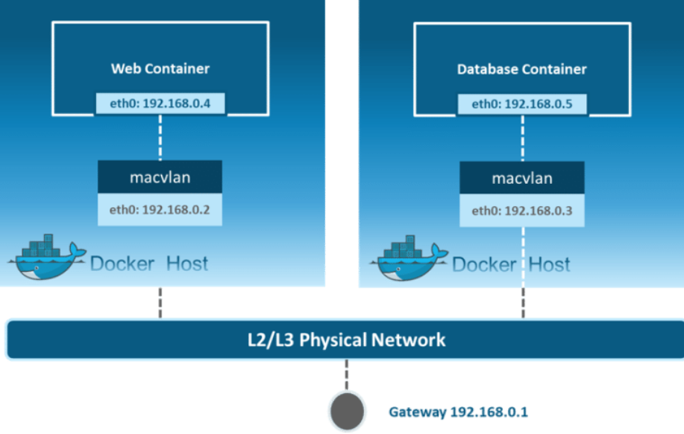
Macvlan
docker network create -d macvlan \
--subnet=192.168.40.0/24 \
--gateway=192.168.40.1 \
-o parent=eth0 my-macvlan-net
Notes:
Allows you to assign a MAC address to a container, making it appear as a physical device on your network. Then, the Docker daemon routes traffic to containers by their MAC addresses. Macvlan driver is the best choice when you are expected to be directly connected to the physical network, rather than routed through the Docker host’s network stack

Slide 22
Docker Best Practices
Prefer minimal base images
Package a single application per container
Optimize for the Docker build cache
Remove unnecessary tools
Build the smallest image possible
Properly tag your images
Notes:
https://cloud.google.com/blog/products/gcp/7-best-practices-for-building-containers

Slide 23
Docker Security Best Practices
Least privileged user
Sign and verify images to mitigate attacks
Scan your docker images for known vulnerabilities
Don’t leak sensitive information to docker images
Use multi-stage builds for small secure images

Slide 24
Best practices
https://docs.docker.com/develop/develop-images/dockerfile_best-practices/
https://www.docker.com/blog/intro-guide-to-dockerfile-best-practices/
https://cloud.google.com/blog/products/gcp/7-best-practices-for-building-containers

Slide 25

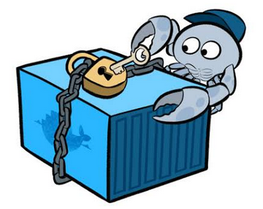

Slide 26
Docker Security Risks
Introducing vulnerabilities from container images
Hard coding credentials in images
Large attack surface
Lateral network movement
Notes:
https://blog.aquasec.com/docker-security-best-practices
https://resources.whitesourcesoftware.com/blog-whitesource/docker-container-security-challenges-and-best-practices

Slide 27
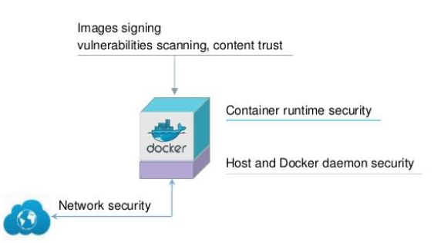
Docker Security Tips
Use a Third-Party Security Tool
Manage Vulnerability
Monitor and Audit Container Activity
Enable Docker Content Trust to digitally sign
Use Docker Bench for Security

Slide 28
Docker Security Tips Cntd.
Use a Third-Party Security Tool
Manage Vulnerability
Monitor and Audit Container Activity
Enable Docker Content Trust to digitally sign
Use Docker Bench for Security

