Slide 1


PANIMALAR ENGINEERING COLLEGE DEPARTMENT OF COMPUTER SCIENCE AND ENGINEERING CS8811 PROJECT WORK CAB MANAGEMENT FOR AN ORGANIZATION USING OCR AND PYTHON DJANGO
Guide Name:
Mahendran M, M.Tech,.
Team Members:
Surendhar S [211418104276]
Yogeshwaran J [211418104317]
Durai Shanmugaraj R [211418104321]

Slide 2
INTRODUCTION
In today’s world, “Time is precious” is more relatable than anything. Almost every employee travel 2 to 3 hours every day or even more.
IT organization provide cab services to employees of their organization to reduce time. But this cab management systems are not efficient because there is no proper logs of available drivers in the current system which will affect the employee’s time and organizations time consumption.
The aim of purposed system is to use ML Algorithm OpenCV, python Tesseract to read the in and out time of the taxis to improve the efficiency and optimizes the cab management operation.
The above system will read the live video feed from the camera which will split that into images and read the number plate. Then we will store the data in a data base to record the logs of entries and exits of the car. We are designing this module as an API.

Slide 3
LITERATURE SURVEY
AUTHOR NAME | PAPER NAME | DESCRIPTION
R. Naren Babu, V. Sowmya and K. P. Soman (2019) | Indian Car number Plate Recognition using Deep Learning | The existing works on variety plate recognition primarily section the number plate characters and use optical character recognition (OCR) . There are numerous ANPR techniques carried out in Asian country and their potency is incredibly less.
Irina Valeryevna Pustokhina,Denis Alexandrovich, Pustokhin, Joel J.P.C. Rodrigues,Deepak Gupta,Ashish Khanna | Automatic Vehicle License Plate Recognition Using Optimal K-Means with Convolutional Neural Network for Intelligent Transportation Systems | Due to recent developments in route analysis and exaggerated application of vehicles, there has been vital interest paid on rearmost, effective, and precise intelligent installation (ITS). The proposed OKM-CNN model operates on three main stages. In the first stage, the LP localization and discovery process take place using IBA and CCA model.
Fatemeh Golpayegani ,Maxime Guériau, Pierre,Antoine-Laharotte,Saeedeh Ghanadbashi | Online Scheduling of Car-Sharing Request Pairs between Two Locations with Advance Bookings | In our model, each client submits a request brace between the two locales. For a single auto, we anatomized the goods that different constraints on the booking time of request dyads on the competitive rate that can be achieved. We proved that no deterministic online algorithm.

Slide 4
PROBLEM STATEMENT
Time delay not only costs time of a person but also costs money when it comes to large scale industries.
Cab management systems are slow, and availability of cabs are not generally known. The driver must manually enter the entry and exit of cab to the in-charge each time to schedule further cab arrangement and to know the availability of cabs.
Our proposed can solve the problem by using machine learning algorithms to capture the in-coming and out-going cars and enters the data automatically and will show the availability of car to the in-charge.
On a large scale this algorithm can be implemented in several locations like streets, parks, medical centers

Slide 5
DEVELOPMENT ENVIRONMENT
HARDWARE REQUIREMENTS
Hardware - I5 Processor
Speed - 2.5 GHz or above
RAM - 8 GB or above
Hard Disk - 500 GB or above
SOFTWARE REQUIREMENTS
Operating System - Windows 10
Machine Learning Framework – Open CV(SVM)
Language – PYTHON
Python-tesseract - Library
Django for Creating GUI

Slide 6
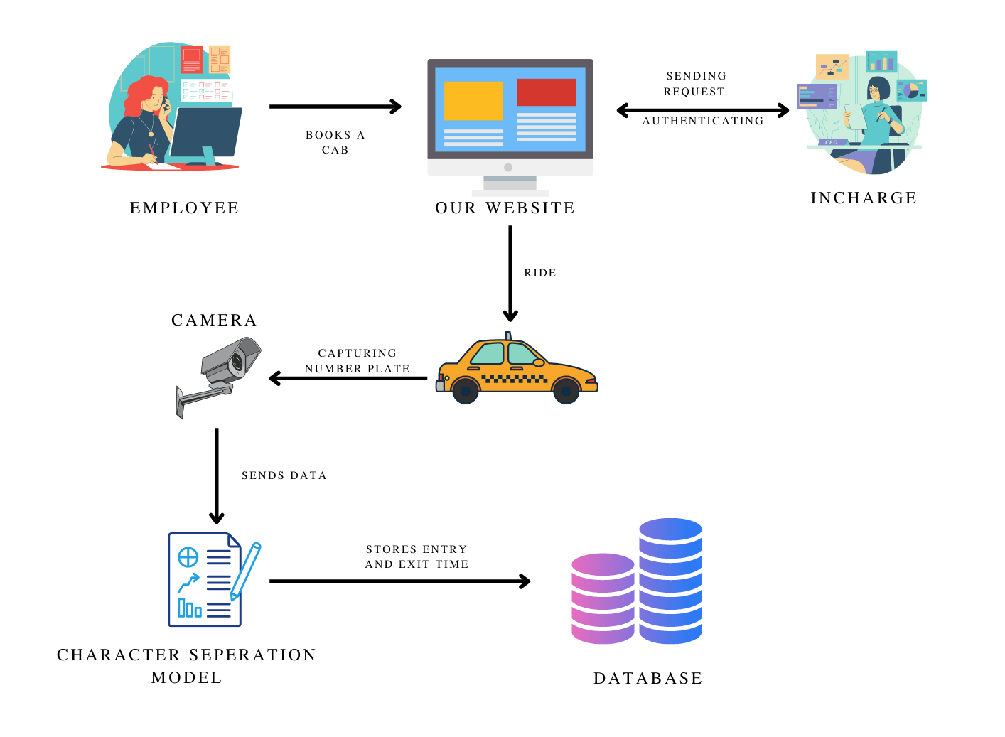
SYSTEM ARCHITECTURE

Slide 7
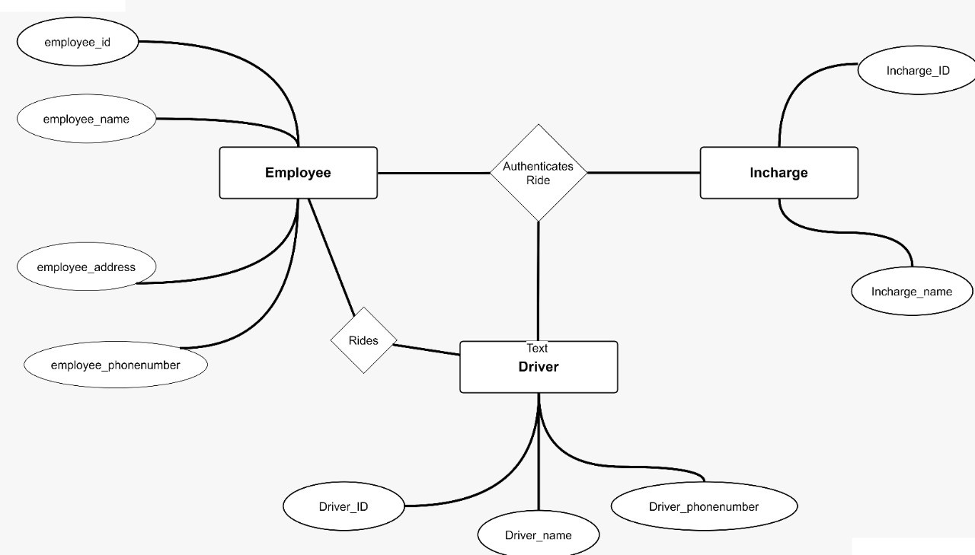
E-R DIAGRAM

Slide 8
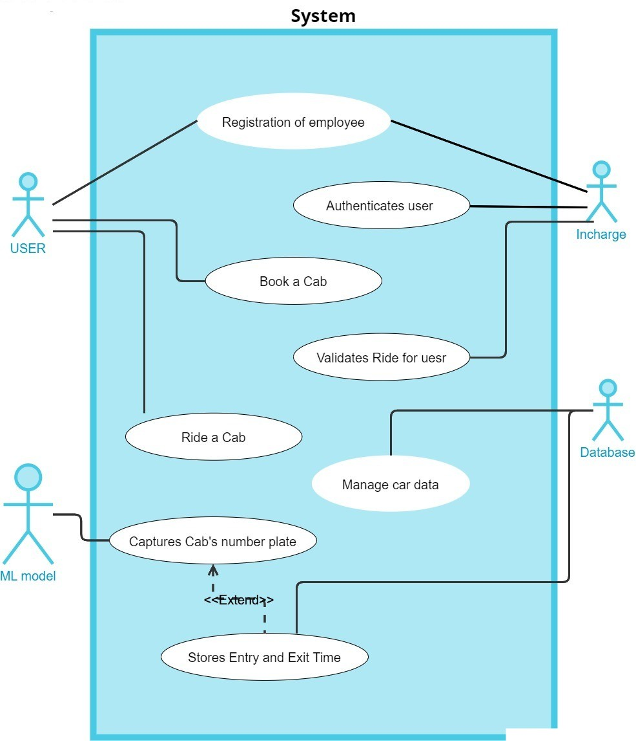
USE CASE DIAGRAM

Slide 9
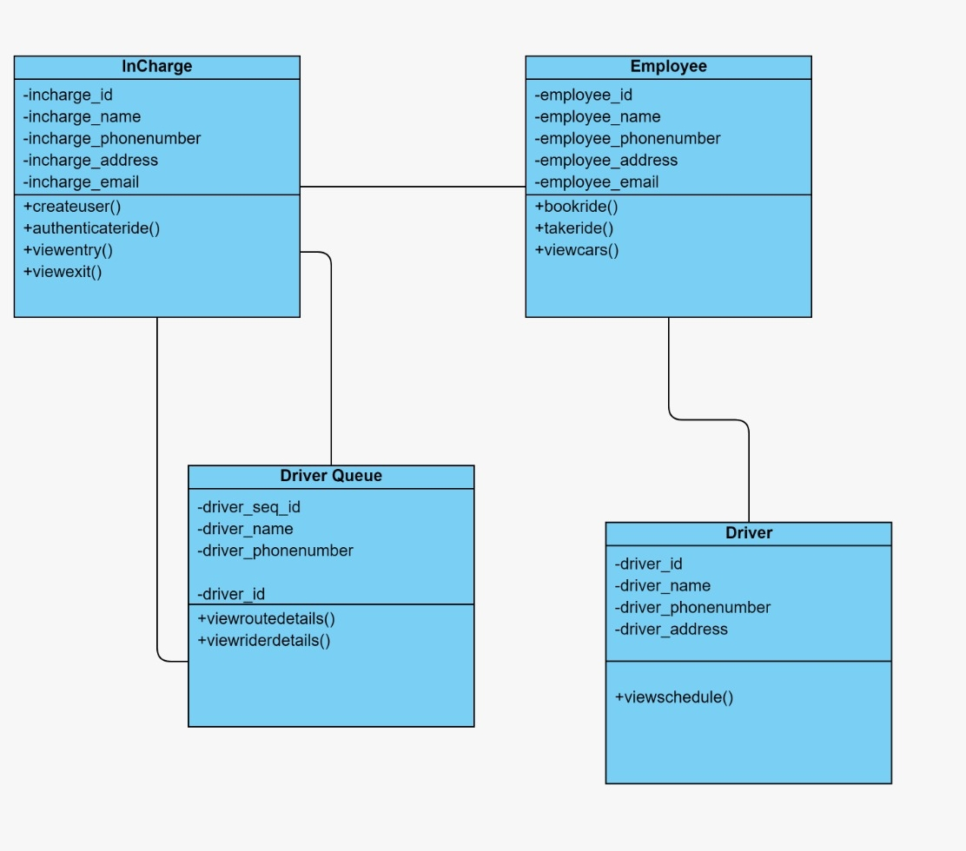
CLASS DIAGRAM

Slide 10
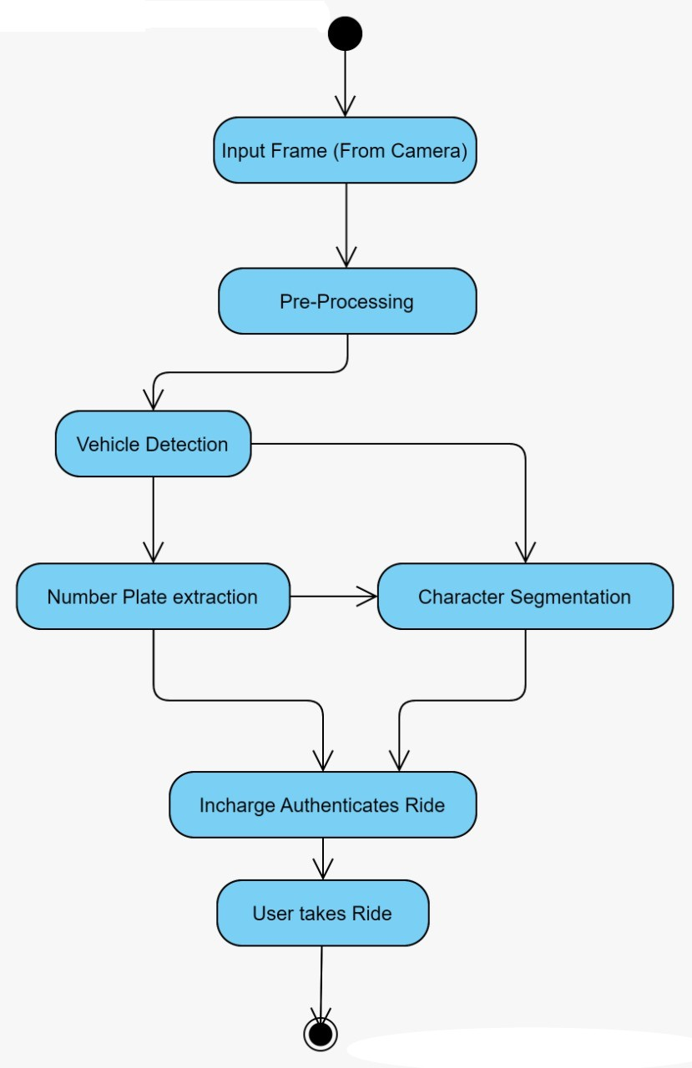
ACTIVITY DIAGRAM

Slide 11
MODULE DESCRIPTION
License Plate recognition system
Template Creation
Feature Extraction from Test Image
Matching Template and Test Image

Slide 12
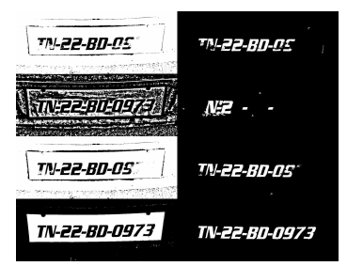
License Plate recognition system
The core of license plate recognition system involves the following processes:
Text localization
Template Creation
Feature extraction from text image
Matching template and text image
Effective collaboration of the above-mentioned processes are what helps in arriving at a license plate recognition system which can give the necessary input to the Transman for further processing.
BINARIZATION

Slide 13
Template Creation
The approach described in this work can select the best binarization technique for different regions of the image out of different binarization techniques like Otsu’s method, Sauvola, Niblack and Wolf. Some images with their binarized images by applying different Binarization method is depicted.
Run connected component analysis on the binarized image. Then apply a threshold-based approach to remove small components as noises.
De-skew the image. We have applied Hough transform to estimate the skew.
Extract the features that have been defined. These feature vectors are Vertical Projection, Horizontal Projection, Contour, and Stroke direction.
Store the cab details along with the features in a .XML file with the format: 448-Dimensional feature vector.

Slide 14
Feature Extraction from Test Image
The images captured by the security person needs to undergo some image processing before sending the features to the back end. The method is described here. The flow chart of the method is shown below,
Steps:
Binarize the image.
Correct the skew using Hough transformation
Run Connected component analysis on the skew corrected image
Remove small and large components
Apply Line segmentation
Normalize each component to 48x48
Extract the features
Match the features against the same set of features stored in the database.

Slide 15

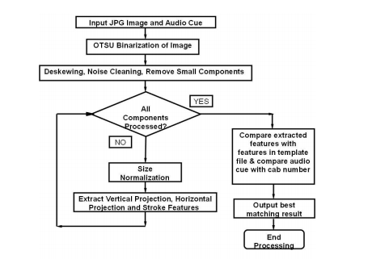
FLOW CHART OF NUMBER CHART OF NUMBER PLATE DETECTIONAND RECOGNITION

Slide 16
Matching Template and Test Image
Accuracy of the system is mostly dependent on this step. While matching the numbers we found that the relative location of a number in the test image and template is very important. Say for example, if we must match the car number ending with 6365 in the test image with 6365 and 9263.
Now if the binarized output image of 6365 is not very accurate and only 63 are recognizable, then it will match with both the images in the template with same accuracy.
But the location-based feature helps us to mark the best match. We have also observed that the number plates have the alphanumeric characters written in either one row or two rows.

Slide 17
FRONT END PORTAL USING DJANGO
A web-based administrative backend is a standard feature of modern websites. The administrative interface, or admin for short, allows trusted site administrators to create, edit and publish content, manage site users, and perform other administrative tasks.
we will explore the basics of the Django admin—create a superuser login, register models with the admin, customize how our models are viewed in the admin, add and edit model data, and learn how to manage users in the admin.

Slide 18
When you ran startproject , Django created and configured the default admin site for you. All you need to do now is create an admin user (superuser) to log into the admin site.
To create an admin user, run the following command from inside your virtual environment:
python manage.py createsuperuser
Enter your desired username and press enter:
Username: admin
Django then prompts you for your email address:
Email address: admin@example.com
The final step is to enter your password. Enter your password twice, the second time to confirm your password:
Password: **********
Password (again): *********
Superuser created successfully.

Slide 19
NUMBER PLATE DETECTION
Image obtained once segmentation is done is Grayscale Before making ready the model for each of the characters for more use, we'd like to do some processing on the pictures.
The subsequent are the operations that are performed. Binarization and Inversion of intensity of the characters. Realize the connected component that represents the character and realize the smallest rectangular region containing these connected components.
We then compare with the pixel values of the matrix of segmented character and also the model matrix, and for each match we tend to add 1 to the matching score and for each mismatch we tend to decrement 1, which is done for all 225 pixels. The match score is generated for each model and also the one which gives the very best score is taken to be the recognized character. Character sets are used for recognition.

Slide 20
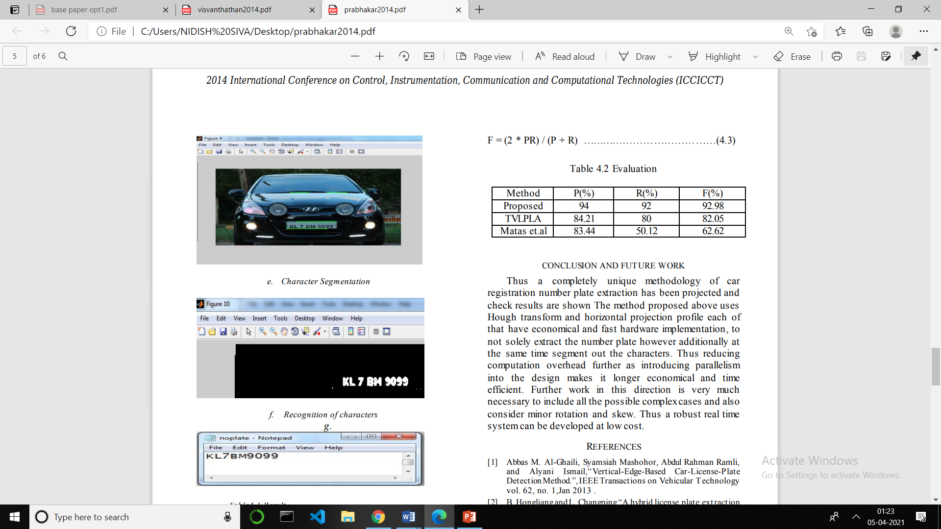
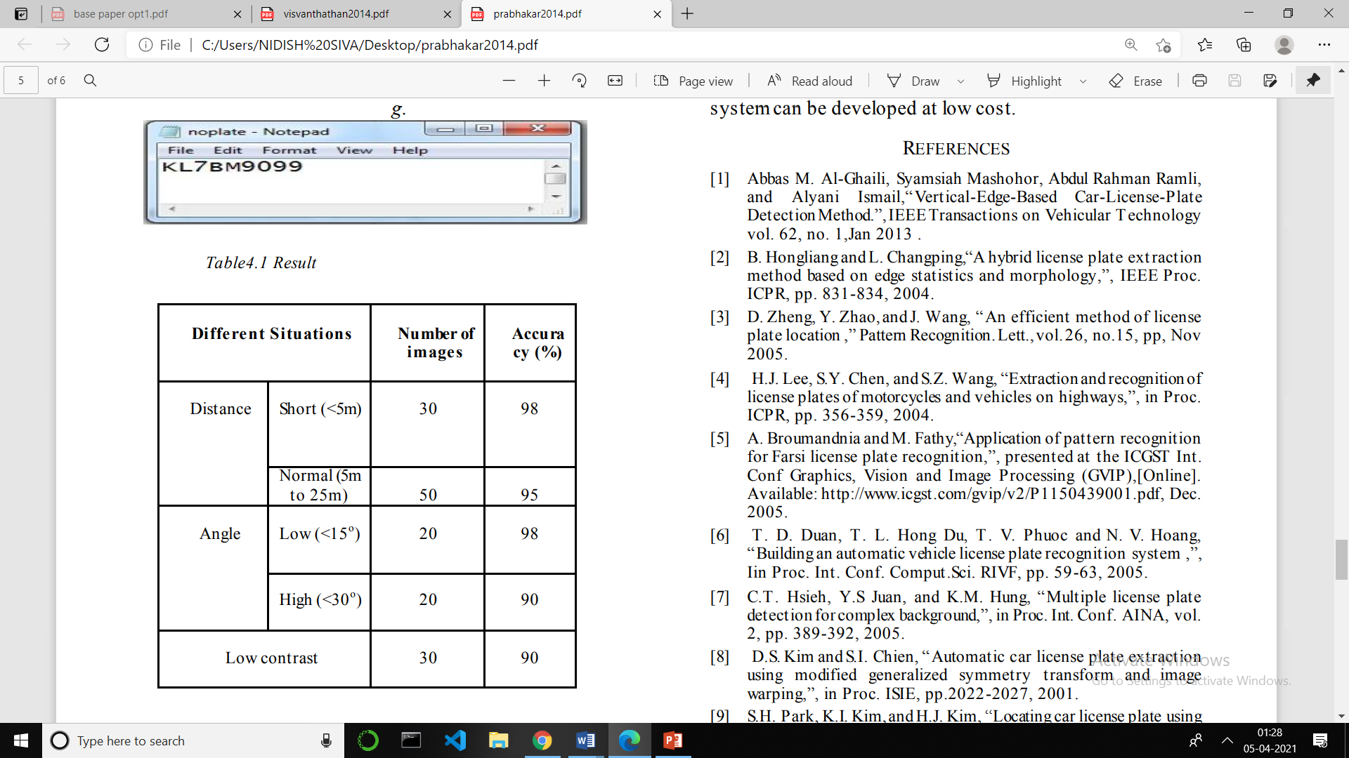
CAR NUMBER DETECTION
NUMBER PLATE SEGMENTATION
EXTRACTING DATA TO TEXT
DATA REPRESENTATION WITH RESPECT TO DISTANCE

Slide 21
RESULT
Thus, a completely unique methodology of car registration number plate extraction has been projected and check results are shown The method proposed above uses transform methods and horizontal projection profile each of that have economical and fast hardware implementation, to not solely extract the number plate however additionally at the same time segment out the characters.
Thus, reducing computation overhead further as introducing parallelism into the design makes it longer economical and time efficient. Further work in this direction is very much necessary to include all the possible complex cases and consider minor rotation and skew. Thus, a robust real time system can be developed at low cost.

Slide 22
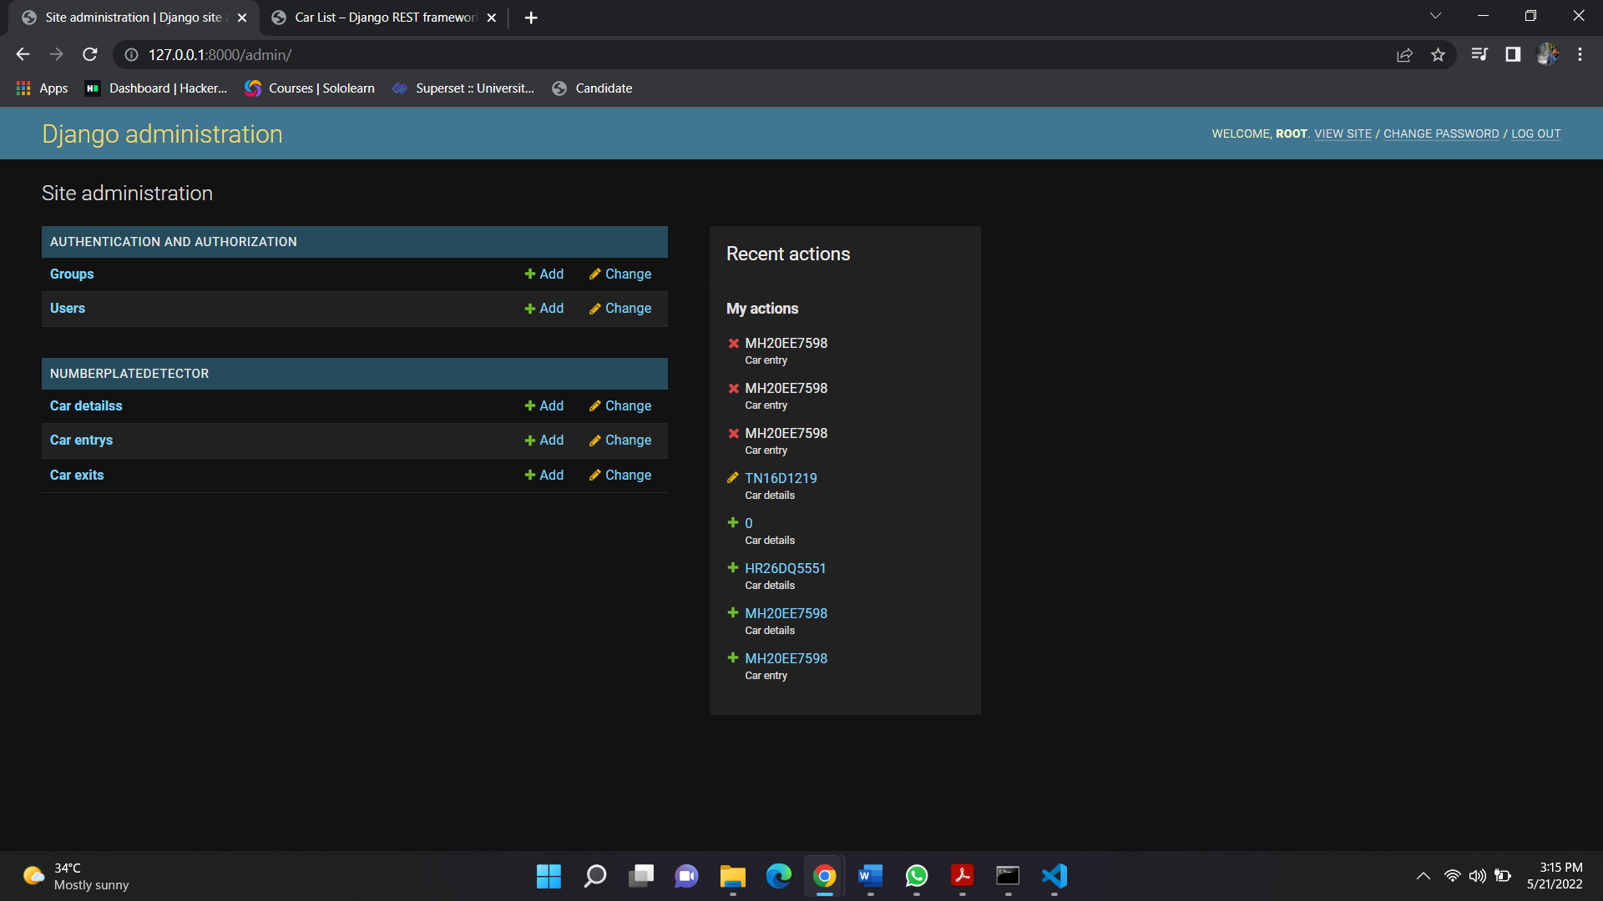
Details of entry and exits of different cars

Slide 23
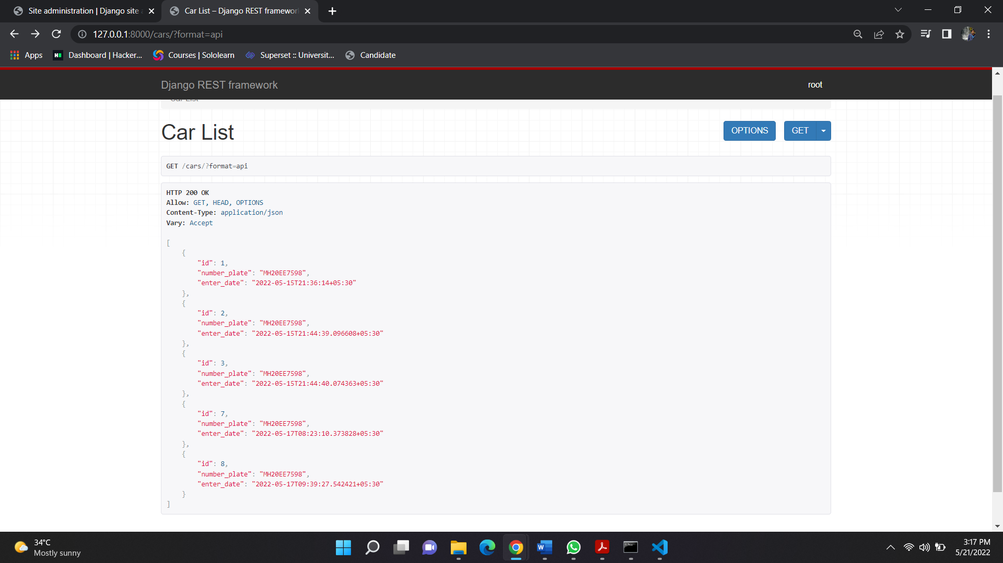
JSON format data representation of List of cars entered with timings

Slide 24
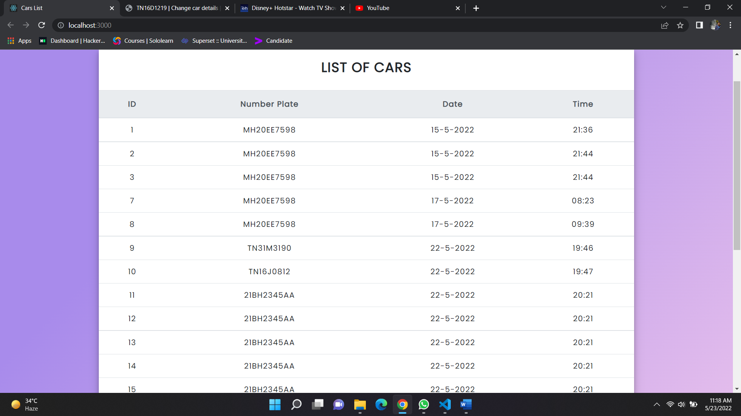
Projecting the Entry Details of Cars in a table using React js

Slide 25
CONCLUSION
In this proposed method we have used image retrieval machine learning approach to match the car number plate against an image in the template. In the proposed system we have used a technique which is computationally less expensive yet robust.
Our method faces the major limitation when the binarization technique fails. We are trying to use multi-modal fusion where the security person is asked to speak the car number and subsequently Proceedings of the 19thInternational Conference on Digital Signal Processing speech recognition might be used to rectify the error of image.

Slide 26
REFERENCES
[1] R. Naren Babu, V. Sowmya and K. P. Soman, "Indian Car Number Plate Recognition using Deep Learning," 2019 2nd International Conference on Intelligent Computing, Instrumentation and Control Technologies (ICICICT), 2019, pp. 1269-1272, doi: 10.1109/ICICICT46008.2019.8993238.
[2] Pustokhina, Irina & Pustokhin, Denis & Rodrigues, Joel & Gupta, Deepak & Khanna, Ashish & Shankar, K. & Seo, Changho & Joshi, Gyanendra Prasad. (2020). Automatic Vehicle License Plate Recognition Using Optimal K-Means With Convolutional Neural Network for Intelligent Transportation Systems. IEEE Access. PP. 1-1. 10.1109/ACCESS.2020.2993008.
[3] Babu, R & Vishvanathan, Sowmya & Kp, Soman. (2019). Indian Car Number Plate Recognition using Deep Learning. 1269-1272. 10.1109/ICICICT46008.2019.8993238.
[4] Özbaysar, Emrah & Borandağ, Emin. (2018). Vehicle plate tracking system. 1-4. 10.1109/SIU.2018.8404648.

