Slide 1
Multi-Module PCB: pH, Turbidity, and TDS
Surendhar d(ece)

Slide 2
Abstract:
This project aims to consolidate three independent turbidity, TDS, and pH sensor modules into a single, integrated PCB board using KiCad software. The unified design will reduce board size and complexity, streamline component placement and routing, and enhance overall efficiency and cost-effectiveness. The methodology involves creating a unified schematic, consolidating footprints onto a single PCB layout, generating gerber files, fabricating the PCB, and assembling the components. The successful outcome will be a single PCB board seamlessly integrating three sensor modules, offering significant advantages in size, complexity, and assembly.

Slide 3
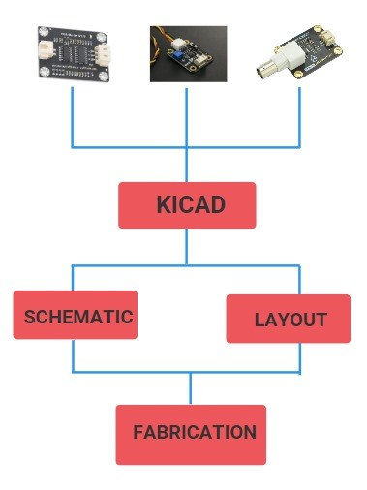
Design:

Slide 4
Methodology:
Schematic Design: Create a new project and schematic in KiCad for each individual module. Add components, assign reference designators, and draw connections between components using correct net names. Save each schematic as a .sch file.
Footprint Import: Import the footprints for all components into the PCB layout using the "Footprint Library Editor" tool.
PCB Layout Creation: Create a new PCB layout in KiCad. Place the imported footprints on the layout, ensuring correct positioning and orientation.
Trace Placement: Draw traces between the footprints to connect the components, adhering to correct net names for each trace.
Design Review: Use the Design Rule Check (DRC) tool to identify and rectify any design errors.
Gerber Generation: Generate gerber files from the finalized PCB layout using the "Gerber Files Generator" tool.
Fabrication and Assembly: Fabricate the PCB using the generated gerber files and assemble the PCB by soldering components to the board.

Slide 5
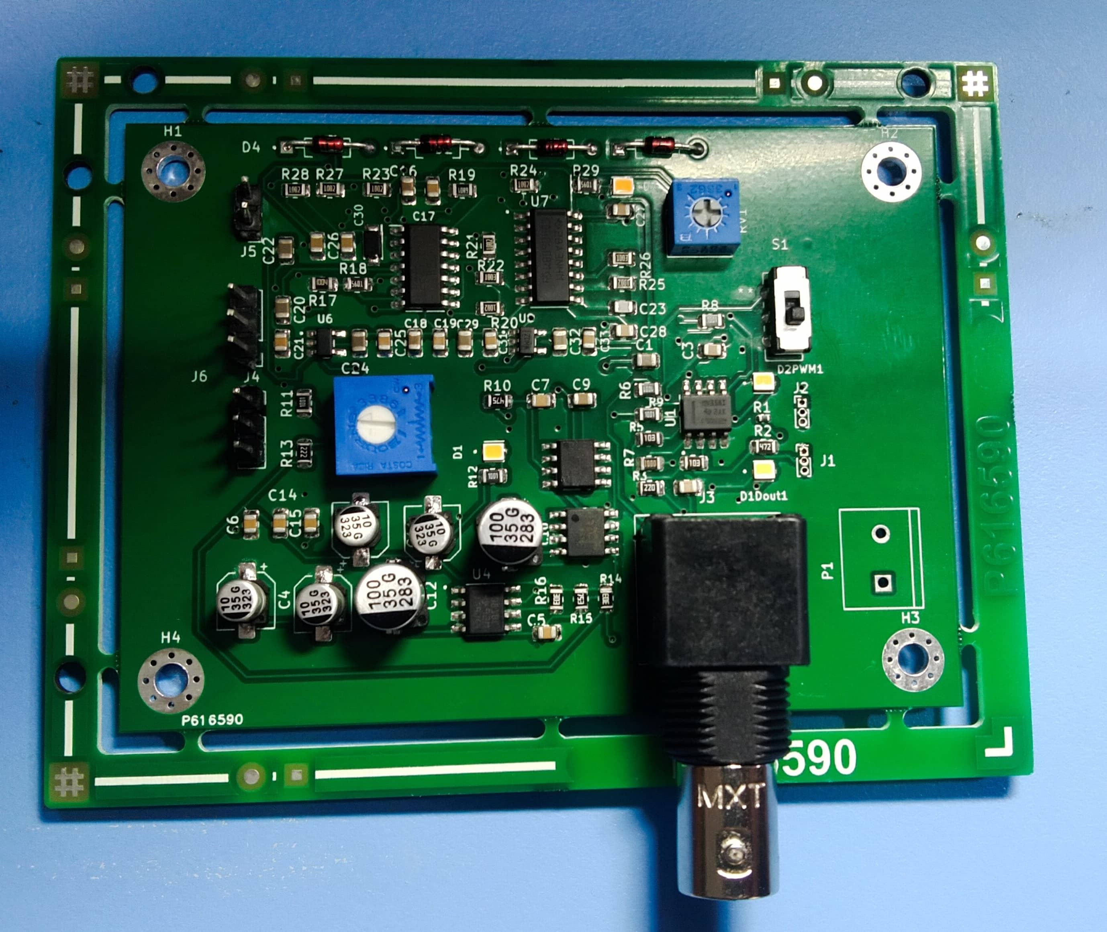
Demonstration:

Slide 6
Results and Discussion:
Successfully designing a single PCB board for three individual modules using KiCad resulted in a more compact and integrated solution. The combined schematic and PCB layout streamlined the design process and facilitated easier component placement and routing. The generated gerber files enabled seamless PCB fabrication, and the assembled PCB successfully integrated the three modules into a single unit. This project demonstrated the effectiveness of KiCad in consolidating multiple modules onto a single PCB, reducing board size and complexity while maintaining functionality.

Slide 7


