Slide 1

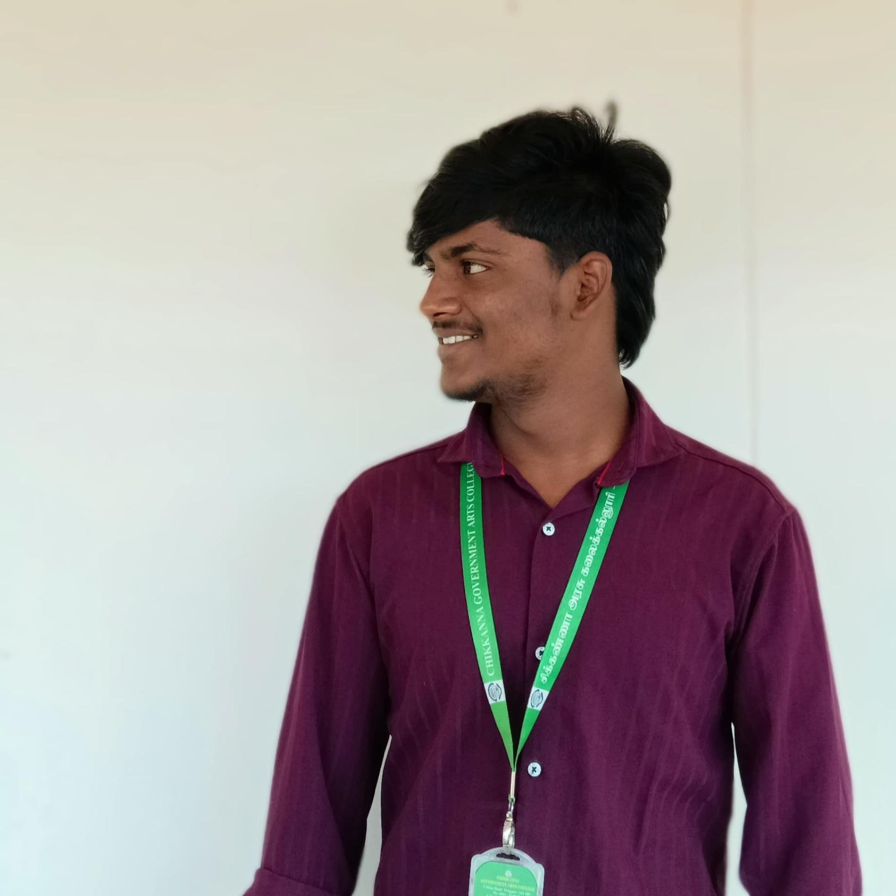
Portfolio Project
By Surendhar - BCA Student

Slide 2
About ME
STUDENT NAME : Surendhar P
REGISTER NO & NMID : 2422J1124 & asbru062422j1124
DEPARTMENT : BCA
COLLEGE : CGAC(Tiruppur)

Slide 3
AGENDA
1.Problem Statement
2.Project Overview
3.End Users
4. Tools and Technologies
5.Portfolio design and Layout
6.Features and Functionality
7.Results and Screenshots
8.Conclusion
9.Github Link

Slide 4
Introduction
A personal portfolio website with Anime/Gamer themes (Ben 10, Solo Leveling, Naruto). It highlights skills, projects, and creativity with modern design.

Slide 5
Problem Statement
Traditional resumes lack creativity and fail to showcase skills effectively. There is a need for a more engaging and interactive presentation of work.

Slide 6
Project Overview
The Anime/Gamer Portfolio is a responsive, interactive web project with:
- Neon UI & 3D tilt effects
- Themed visuals
- Skills, Projects, Timeline, and Contact sections

Slide 7
End Users
- Students creating digital portfolios
- Freelancers showcasing work
- Anime/gamer enthusiasts
- Recruiters looking for creative candidates

Slide 8
Tools and Technologies
- HTML5, CSS3, JavaScript
- Google Fonts: Orbitron, Rajdhani, Inter
- Animations, Particle Background, Responsive Design

Slide 9
Portfolio Design and Layout
- Sections: Hero, About, Skills, Projects, Timeline, Contact
- Theme switcher: Ben 10, Solo Leveling, Naruto
- Neon colors, glowing effects, 3D animations

Slide 10
Features and Functionality
- Interactive 3D tilt cards
- Particle-based animated background
- Theme switching
- Responsive design
- Contact form with resume download

Slide 11
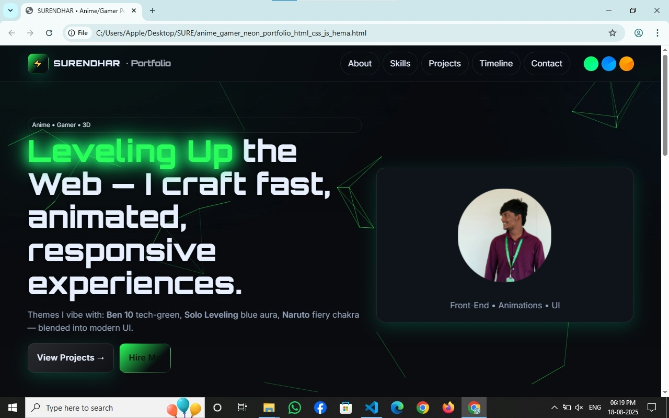
Results and Screenshots
The portfolio successfully delivers:
- Anime-inspired creative UI
- Project showcases with Ben 10, Solo Leveling, Naruto themes
- Modern skills and responsive design

Slide 12
Conclusion
This project is both a resume and creative showcase. It reflects technical skills, creativity, and personal interests.

Slide 13
GitHub Link
Repository: [Insert GitHub Link Here]

