Slide 1


GROWTH WITHOUT MORE SPEND
WHAT THE PLAYER DATA ACTUALLY SAYS
ABOUT WHERE REVENUE CAN GROW
EXECUTIVE READOUT
FOUR ANALYSES
→
120 DAYS OF TELEMETRY · 80,295 PLAYERS · FOUR ANALYSES, ONE RECOMMENDATION
Notes:
1.7.2013
1
‹#›

Slide 2
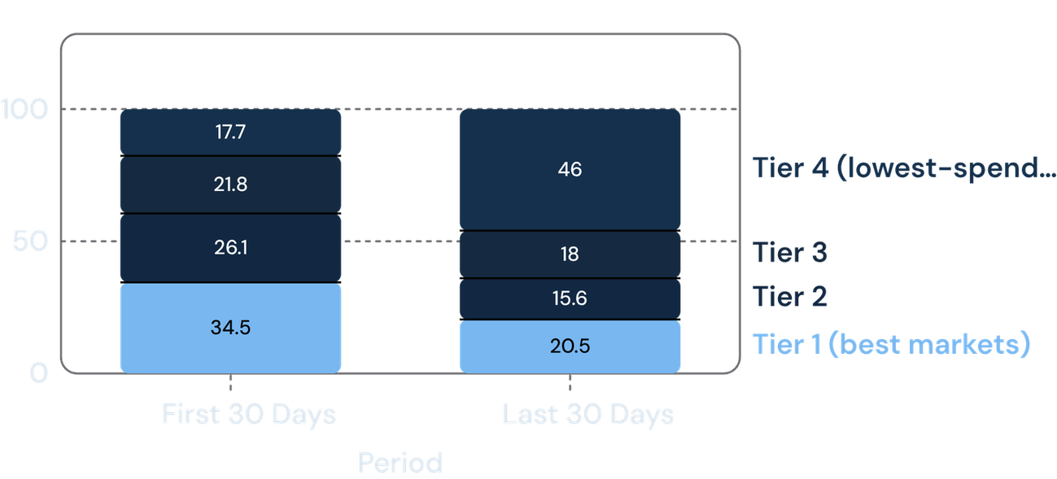
FINDING 1 · THE HEADLINE METRIC
ARPDAU FELL 16.7% — BUT NO MARKET SPENT LESS
SHARE OF ACTIVE PLAYERS, BY MARKET TIER
-16.7%
OVERALL ARPDAU
FIRST 30 DAYS → LAST 30 DAYS
OF THE TRACKED WINDOW
Every single country tier improved or held flat over the same period
SIMPSON'S PARADOX: THE AVERAGE IS A BLEND, AND THE BLEND SHIFTED HARD TOWARD THE LOWEST-SPENDING TIER.
Notes:
1.7.2013
2
‹#›

Slide 3
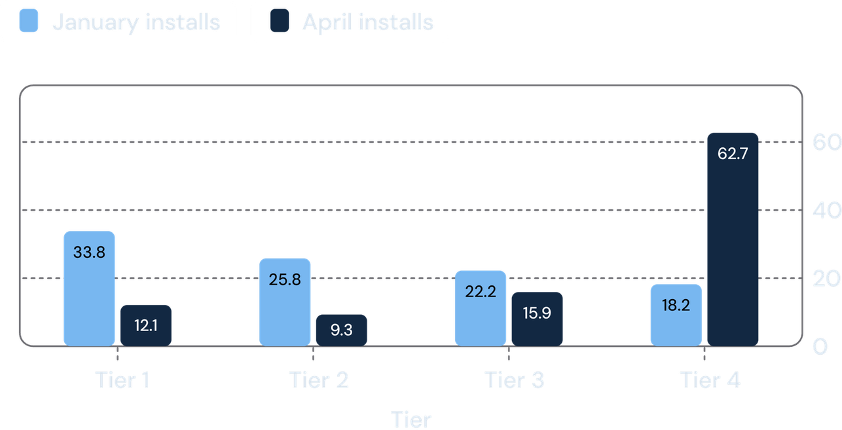
FINDING 2 · ROOT CAUSE
THE SHIFT STARTS AT ACQUISITION, NOT RETENTION
NEW INSTALL DISTRIBUTION ACROSS MARKET TIERS
18% → 63%
OF ALL NEW INSTALLS NOW COME FROM TIER 4 — THE LOWEST-SPENDING MARKETS
This is a UA (user acquisition) question, not a monetization one.
No pricing or economy change is justified — the mix of who we acquire moved, not how people spend.
Notes:
1.7.2013
3
‹#›

Slide 4
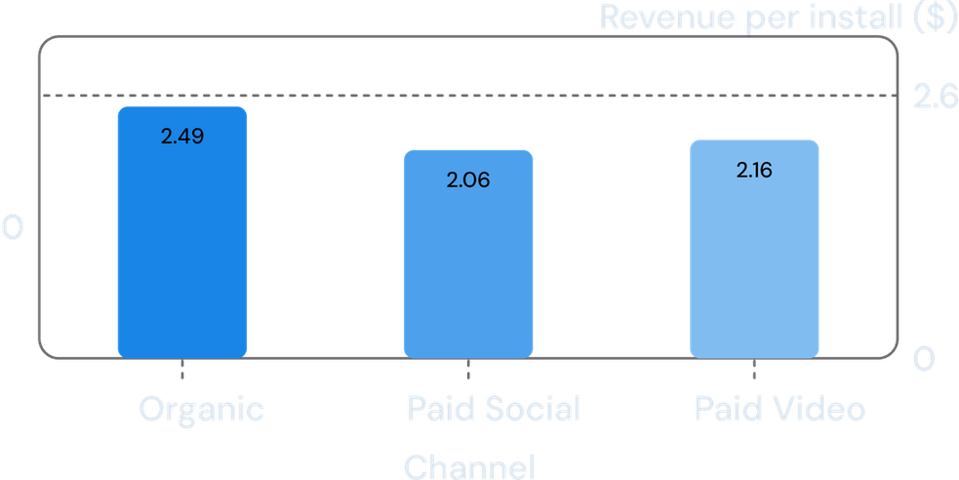
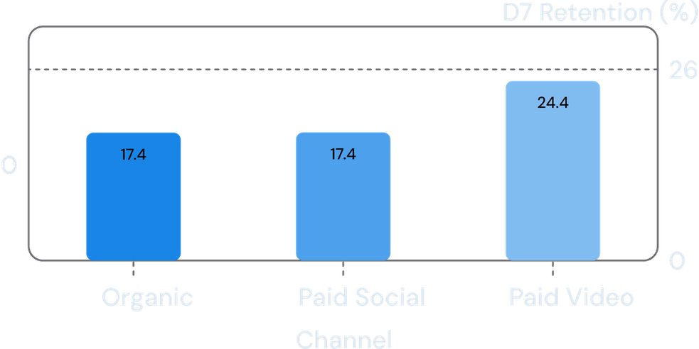
FINDING 3 · WHERE TO SPEND
NO SINGLE “BEST” CHANNEL — IT DEPENDS ON THE MARKET
TIER 1 (BEST MARKETS) — REVENUE PER INSTALL
TIER 4 (LOW-SPEND MARKETS) — DAY-7 RETENTION
ORGANIC BEATS PAID SOCIAL — STATISTICALLY SIGNIFICANT (95% CI EXCLUDES ZERO). ORGANIC VS. PAID VIDEO LOOKS SIMILAR BUT ISN’T PROVABLE YET (SMALL SAMPLE).
PAID VIDEO GENUINELY RETAINS BETTER IN LOW-TIER MARKETS — LARGE, ROBUST GAP (95% CI: +5.8 TO +8.3 POINTS).
Notes:
1.7.2013
4
‹#›

Slide 5
FINDING 4 · MONETIZATION
KEEP THE SALE CADENCE — DON’T CUT IT, DON’T CHASE IT
of all revenue comes from players who NEVER pay full price — sales aren’t stealing this spend, they’re creating it.
24%
SHARE OF TOTAL REVENUE, BY BUYER TYPE
Buyer type | Revenue share
Full-price only (43%) | 43.09%
Buys both (33%) | 32.84%
Sale-only (24%) | 24.07%
difference in spending for our highest-value payers, on sale days vs. not — no sign they’re just “waiting.”
~0
No reliable “quiet period” exists to compare against — 90%+ of days sit within 3 days of a sale.
—
Notes:
1.7.2013
5
‹#›

Slide 6
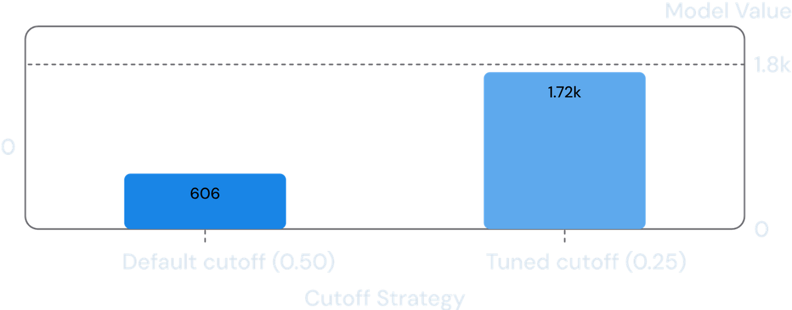
FINDING 5 · RETENTION TOOL
A CHURN MODEL THAT WORKS — WITH ONE MISSING INPUT
TARGETING AT THE RIGHT CUTOFF — NOT THE DEFAULT — NEARLY TRIPLES VALUE
0.72
ROC-AUC
CORRECTLY RANKS A CHURNER
ABOVE A STAYER 72% OF THE TIME
39,942
active players scored
25.4% churn in 14 days
ILLUSTRATIVE, UNDER AN ASSUMED OFFER COST AND SAVE RATE — THE REAL OPTIMUM DEPENDS ON NUMBERS LIVE-OPS HASN’T SUPPLIED YET. UNDER PRICIER OR LESS-EFFECTIVE OFFERS, THE MATH CAN FLIP NEGATIVE ENTIRELY.
Notes:
1.7.2013
6
‹#›

Slide 7
SO WHAT
WHAT THIS MEANS FOR THE BUDGET CONVERSATION
Don’t touch pricing or the game economy.
No segment's spending behavior declined — the ARPDAU drop is a mix effect, not a monetization problem.
Make a deliberate call on the Tier 4 acquisition mix.
It's likely cheaper, but lower-value — that trade-off needs cost-per-install data to resolve.
Lean into Paid Video for low-tier markets; keep Organic strong in Tier 1.
Both are real, tier-specific edges backed by significance testing.
Keep the current sale cadence.
A real, sizeable revenue segment (24%) depends on it; there's no evidence more sales would grow it further.
Pilot the churn model at a tuned threshold, not the default.
But confirm real offer cost and save-rate numbers first — the business case depends on them.
Notes:
1.7.2013
7
‹#›

Slide 8
BEFORE ACTING ON THIS
WHAT WE’RE STILL UNCERTAIN ABOUT
ACQUISITION COST DATA
CHANNEL SAMPLE SIZE
No marketing cost / cost-per-install data exists in this dataset — we can see the Tier 4 acquisition shift, but not whether it’s worth its price.
The Organic vs. Paid Video gap in Tier 1 looks real but isn’t statistically provable yet — the sample there is too small to be sure.
LIVE-OPS PARAMETERS
COHORT BIAS IN VALUATION
The churn-targeting threshold depends on offer cost and real save-rate data we don’t have — get these before setting it live.
The install-value model (Task 4b) was trained only on early, higher-tier cohorts — it may understate what a typical install looks like today.
FULL METHODOLOGY, SQL, DATA-QUALITY NOTES, AND ALL FOUR UNDERLYING ANALYSES ARE IN THE APPENDIX.
Notes:
1.7.2013
8
‹#›

Slide 9
METHODOLOGY, RECONCILIATION & MODEL AUDIT
APPENDIX — PLAYER DATA ANALYSIS
Methodology, data-quality decisions, model detail, dead ends, and the next week of work behind the executive readout.
TECHNICAL APPENDIX
SECTIONS 01 – 09
120 DAYS OF TELEMETRY · 80,295 PLAYERS · RECONCILED TABLES & MODEL DIAGNOSTICS
Notes:
1.7.2013
Appendix cover slide. Outlines methodology, audit reconciliation, data-quality adjustments, and modeling constraints behind the core findings.
1
‹#›

Slide 10
DATA PIPELINE · RECONCILIATION & COHORT COVERAGE
Revenue, retention, and engagement now reconcile to their source tables
REVENUE RECONCILIATION
~15.5%
Daily health | 240 rows across 120 days × 2 platforms
Retention | 49 weekly cohorts across Day 1/7/14/30; milestones outside Jan 1–Apr 30 remain NULL, not 0%
Boundary caveat | Last 2–3 cohorts are slightly understated; final cohort D1 is 35.2% versus a typical ~47–50%
Early join revenue undercount — fixed
Revenue is computed independently of player_day.
Validation: total revenue matches the raw purchase table exactly; maximum active-purchaser rate is 6.4%.
Notes:
1.7.2013
Reconciled daily health table across 120 days and 2 platforms. Fixed the 15.5% revenue undercount bug caused by player_day join dependencies. Retention cohorts outside observation bounds kept as NULL.
2
‹#›

Slide 11
Three data-quality corrections changed what we trust
AD TIMESTAMPS
DUPLICATE PURCHASES
Shifted back 8 hours; the correction exposed an isolated 48-hour outage on March 5–6.
All 122 duplicated purchase IDs were checked pair-by-pair. Identical transaction details confirmed logging duplicates, so the earliest occurrence was kept.
REFUNDS
IDENTITY
226 negatives; 222 matched an earlier purchase, while 4 on the final day remain likely boundary artifacts.
112 device-ID chains such as A→B→C remain unresolved for future canonical-player analysis.
Notes:
1.7.2013
Three core data-quality adjustments: 8-hour ad timestamp correction (uncovered March 5-6 outage), pair-by-pair audit of 122 duplicate purchases, and 222 of 226 refunds matched. 112 device-ID chains noted for future graph work.
3
‹#›

Slide 12
PAYER ECONOMICS · CONCENTRATION & CADENCE
Player value is concentrated, but repeat behavior is not uniform
PAYER DISTRIBUTION (N = 11,054)
REPEAT PURCHASE TIMING
REWARDED-AD CAP AUDIT
60.3%
No Dominant Rhythm
Caps Rarely Binding
~30% repeat within 7 days
~44% repeat between 8–29 days
~26% wait 30+ days to repeat
Cap-5 Player-Days:
1.06% – 1.27% hit daily limit
From Top 10% of Payers
• Top 1%: 9.32% of total revenue
• Top 10%: 60.26% of total revenue
• Top 50%: 90.92% of total revenue
Cap-8 Player-Days:
0.02% hit daily limit
Exclusion: 110 players whose first purchase predated install timestamp were excluded after uncovering 1–4 day logging inconsistencies.
Daily ad view caps do not artificially suppress monetization; almost no players hit ceiling constraints.
Ranking payers only avoids diluting "top 1%" across the 86% of players who never pay.
REPEAT PURCHASES DISPLAY BIMODAL DECAY RATHER THAN A FIXED WEEKLY OR MONTHLY CYCLE.
Notes:
1.7.2013
Analyzed 11,054 payers. Concentration: top 1% = 9.32%, top 10% = 60.26%, top 50% = 90.92%. Excluded 110 corrupted install timestamps. Repeat timing spans fast repeats (30% in week 1) and long tails (26% at 30+ days). Ad caps are rarely binding.
4
‹#›

Slide 13
Sales cadence is not obviously shifting spend
BEHAVIORAL SEGMENTATION
DAY-LEVEL BASELINE TEST
43.09% full-price-only
32.84% buy both — the highest-value segment spends nearly the same on sale and non-sale days.
24.07% sale-only — no full-price purchase to shift.
Sales recur in roughly two-week blocks with a sharp 1–2 day spike.
The day-level baseline test failed: only 8 of 120 days qualified as quiet, and half were unrepresentative start-of-window days.
Conclusion: Keep cadence steady; use a holdout experiment to settle incrementality.
Notes:
1.7.2013
Day-level baseline comparison proved invalid due to frequent sales (only 8 quiet days in 120, half during window initialization). Payer segmentation reveals 24.07% are sale-only and buy-both payers spend equally on sale/non-sale days. A holdout test is required.
5
‹#›

Slide 14
ATTRIBUTION & GEO ANALYSIS · STATISTICAL TESTING
Channel performance flips once market mix is controlled
CONFOUNDING CHANNEL COMPOSITION
paid_video is 71% Tier 4 installs versus ~35% for organic and paid_social. Raw cross-channel comparisons severely penalize paid_video by confounding acquisition channel efficacy with low-monetizing country mix.
TIER 1 MONETIZATION (REVENUE / INSTALL)
TIER 4 ENGAGEMENT & RETENTION
Organic vs Paid Social:
Paid Video Engagement Advantage:
+$0.426 / player · 95% CI (0.043, 0.809)
+7.04 pts
Statistically significant advantage for Organic in Tier 1.
Organic vs Paid Video:
95% CI: (5.76, 8.32) · n = 20,336
+$0.329 / player · 95% CI (-0.216, 0.874)
Operational Reality: With no cost-per-install (CPI) data by channel and country tier, channel shifts cannot be finalized into a definitive media budget.
Interval crosses zero at n=2,271 — directional, not provable.
STRATIFIED COMPARISONS REVERSE UNADJUSTED METRICS: VIDEO WINS RETENTION IN T4, ORGANIC WINS MONETIZATION IN T1.
Notes:
1.7.2013
Controlled for tier mix (paid_video is 71% Tier 4). In Tier 1, Organic beats Paid Social by $0.426 (95% CI: 0.043, 0.809). Organic vs Paid Video is +$0.329 but crosses zero. In Tier 4, Paid Video shows a robust +7.04 pt engagement advantage. Lacking CPI precludes budget allocation.
6
‹#›

Slide 15
The churn model has signal, but threshold economics decide the action
39,942 players active before Mar 17; 25.4% churned in the following 14 days
ROC-AUC is 0.719, but the default threshold catches only 18% of churners
Active days and sessions were 0.91 correlated; dropping the redundant feature barely changed performance
Longer-tenured players churn more: 121 versus 70 average days, consistent with a burnout point rather than a data error
Under cheap offers and effective saves, targeting ~20–25% yields $1,715–$7,976 net value; under expensive or low-save assumptions, net value turns negative
Notes:
1.7.2013
7
‹#›

Slide 16
LTV FORECASTING · COHORT MATURITY & BIDDING LIFT
The install-value model answers the bidding question, with a cohort caveat
MODEL PERFORMANCE · 25,494 PLAYERS
4.85×
COHORT MATURITY · 90-DAY WINDOW
68% of all players were excluded because their revenue was not fully observable; 25,494 players had a complete 90-day window.
The training population is early and Tier-1-heavy, unlike today’s more Tier-4-heavy mix.
Top-decile lift: captures 48.5% of future revenue from 10% of installs.
Spearman correlation: 0.3245.
Log-transformed revenue prevents the 89% of zero-spenders from being dominated by a few whales.
REVALIDATE ON A RECENT COHORT BEFORE TREATING THE RANKING AS CURRENT BIDDING TRUTH.
Notes:
1.7.2013
8
‹#›

Slide 17
FEATURE ENGINEERING · COLLINEARITY DIAGNOSTICS
Multicollinearity was a model risk, not a footnote
CASE 1 · CHURN MODEL
CASE 2 · INSTALL-VALUE MODEL
r = 0.91
r = 0.84–0.99
active_days_14d and total_sessions_14d
Install-value features
Correlated at 0.91; removing one barely moved performance.
active_days_first7, total_sessions_first7, and total_playtime_first7 correlated 0.84–0.99 with max_level_first7.
Keeping one clean signal fixed a nonsensical negative coefficient with no performance cost.
METHODOLOGICAL LESSON: FEWER INTERPRETABLE FEATURES BEAT A CROWDED MODEL THAT TELLS THE WRONG STORY.
Notes:
1.7.2013
Multicollinearity review: Churn features active_days and total_sessions correlated at 0.91; dropping one retained performance. In the LTV model, first-7-day active days, sessions, and playtime correlated 0.84-0.99 with level, producing nonsensical negative coefficients until pruned.
9
‹#›

Slide 18
NEXT STEPS · OPERATING WORKSTREAM
One more week would turn caveats into operating inputs
Get real churn-offer cost and save-rate numbers from live-ops records or a controlled test
01
Revalidate the install-value model against a recent, Tier-4-heavy cohort
02
Resolve the 112 device-ID chains recursively before analyses that assume canonical identity
03
Notes:
1.7.2013
Three prioritized workstreams for the upcoming week: get real churn unit costs from live-ops, revalidate install-value scoring against recent Tier 4 heavy cohorts, and run recursive graph resolution on the 112 multi-hop device ID chains.
10
‹#›

