Slide 1
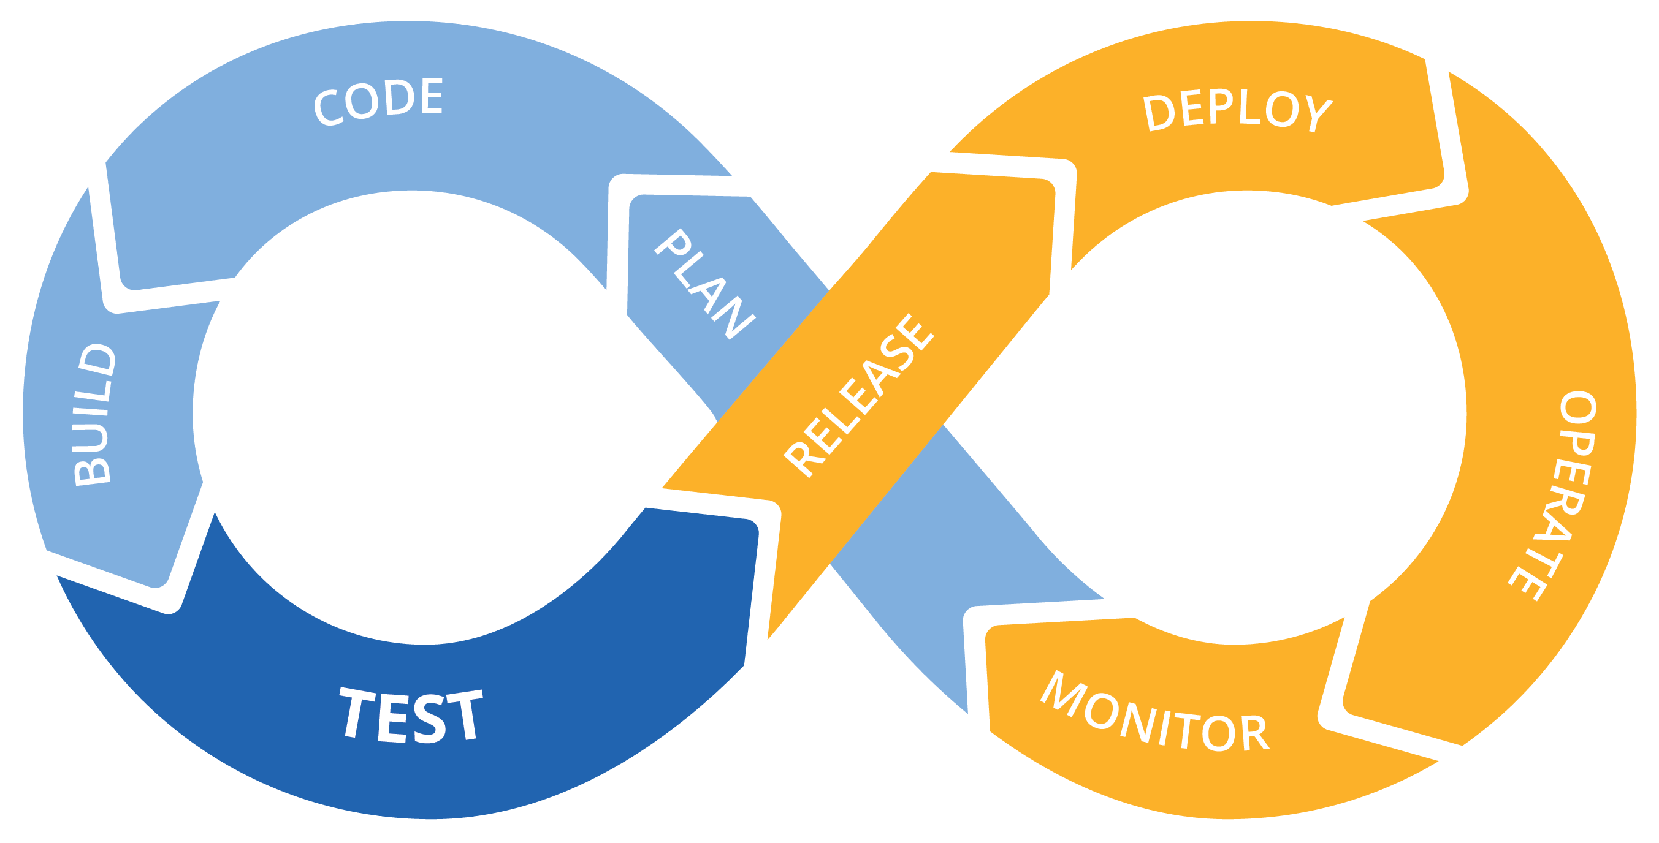
Ops
Dev
DevOps Project

Slide 2
Tools used in this project

Slide 3

DevOps Tools

Slide 4

DevOps Tools

Slide 5

DevOps Tools

Slide 6

DevOps Tools

Slide 7

DevOps Tools

Slide 8

DevOps Tools

Slide 9

DevOps Tools

Slide 10
Simple DevOps Project

Slide 11

DevOps Flow

Slide 12


DevOps Flow
check-in

Slide 13

DevOps Flow
Continuous build
check-in

Slide 14
DevOps Flow
Continuous build
Continuous Delivery
check-in

Slide 15
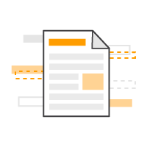

DevOps Flow
Continuous build
Continuous Delivery
Docker Image Push
check-in

Slide 16

Continuous build
Continuous Delivery
Docker Image Push
check-in
Deployment
Docker Image Pull

Slide 17
Thank you

