Slide 1

Build Automation / Project Management
Tool

Slide 2
Topics to discuss
What is Maven?
What does Maven do?
Maven Architecture
Maven Setup
Maven build life cycle
Create a Java project with Eclipse
Create a java project on Linux server
Project Object Modal (POM.xml) file

Slide 3
What is Maven

Slide 4




How to do?
Build
Dependencies
check-in
Unit Test
Deploy

Slide 5

Maven can do that
Build
Dependencies
check-in
Unit Test
Deploy

Slide 6
Sample Projects
Uniform builds
Transplant migration
To new features

Slide 7
First maven build
App.java → App.class
AppTest.java → AppTest.class
Run the tests
Generate jar

Slide 8
Maven build life cycle
Validate
Compile
Test
Package
Integration Test
Verify
Install
Deploy

Slide 9
Topics to discuss
Build a java project through maven commands
Maven Life Cycle phases
Maven Coordinates (GAV)
groupId, artifactId, version, packaging
repositories
Central repository
Local repository (.M2)
Copying artifacts onto Nexus
Deploying application on tomcat server

Slide 10
Topics to discuss
Maven archetype
Creating a WebApp application
Setup tomcat server
Deploy WebApp using maven

Slide 11
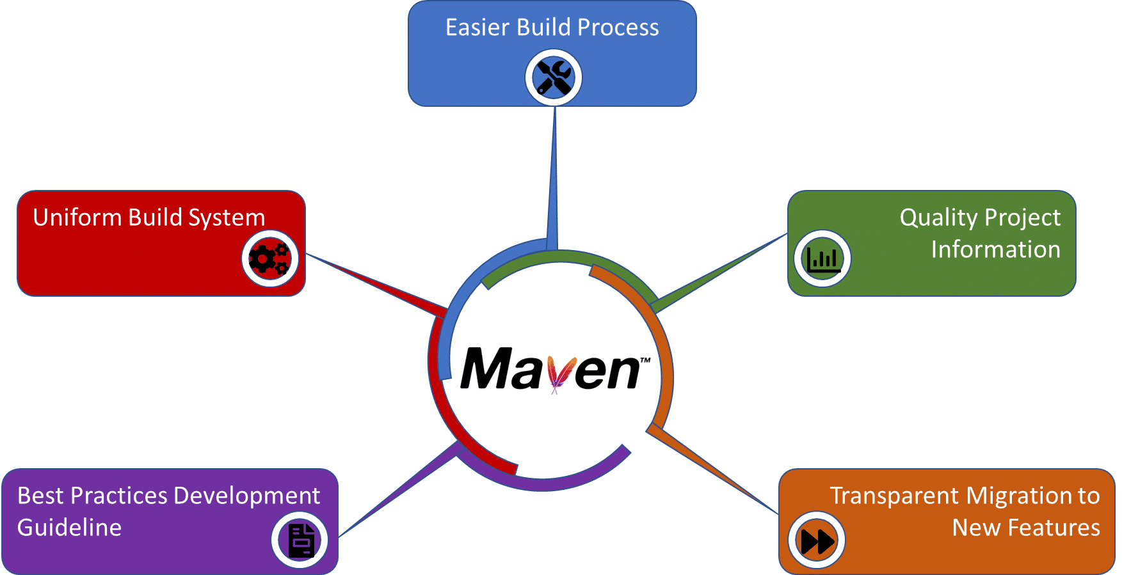

Slide 12

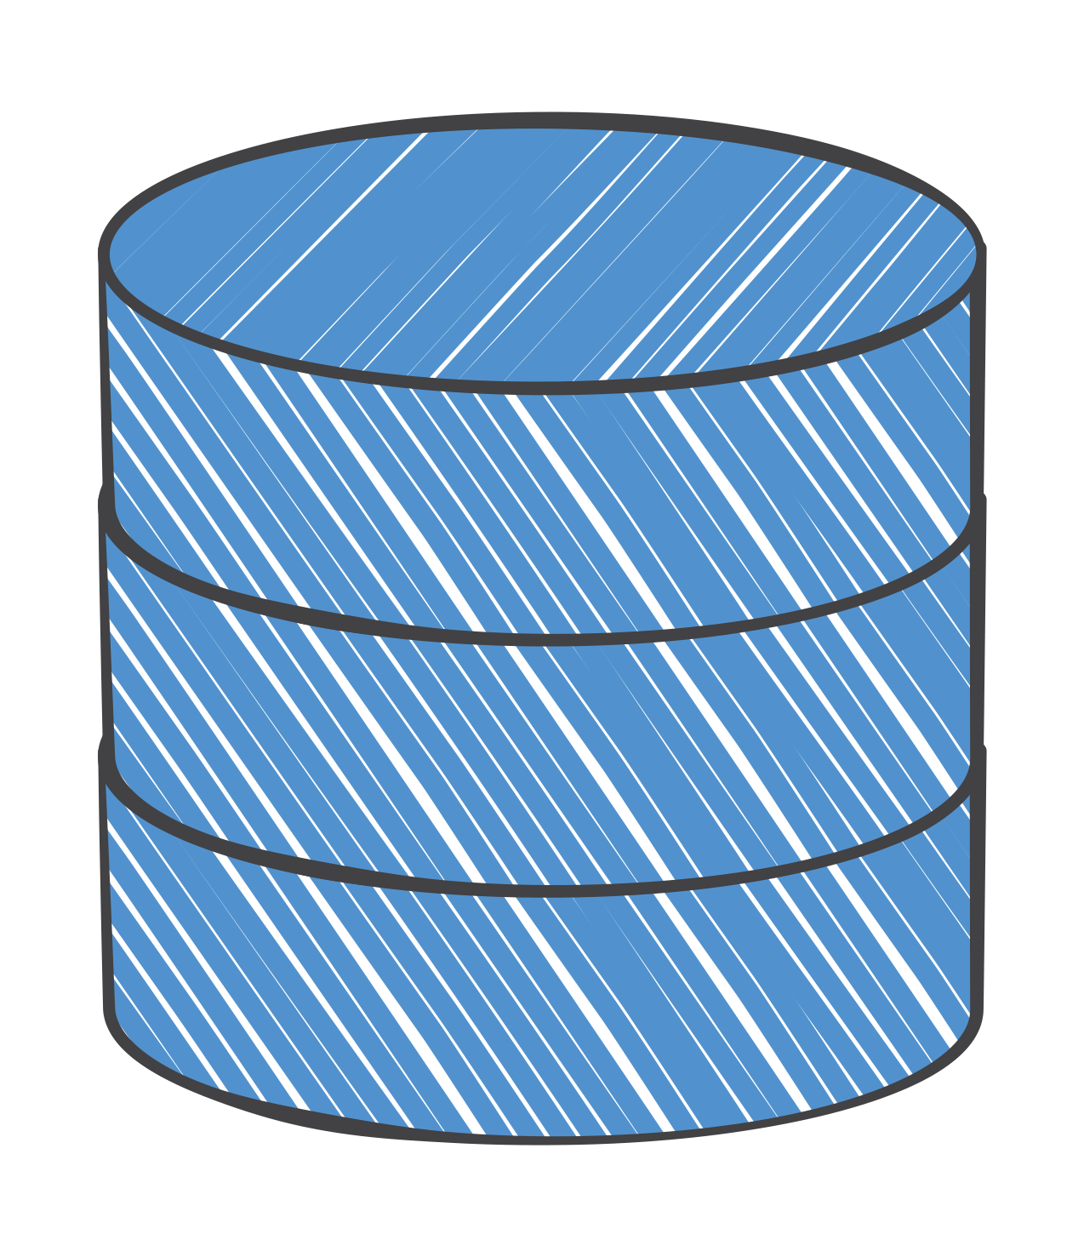
Local Repository
war plugin
Local Repository
Internet
jar plugin
junit.jar
mysql.jar
Local Repository
Maven Central Repository

Slide 13
Default Project Structure
└───maven-project
├───pom.xml
└───src
├───main
│ ├───java
│ ├───resources
│ ├───filters
│ └───webapp
├───test
├───java
├───resources
└───filters

Slide 14

Local Repository
war plugin
Local Repository
Internet
jar plugin
junit.jar
mysql.jar
Local Repository
Enterprise Repository
Maven Central Repository

Slide 15
Local Repository
war plugin
Local Repository
Internet
jar plugin
junit.jar
mysql.jar
Local Repository
Enterprise Repository
Maven Central Repository

Slide 16
Maven Setup

Slide 17
Java project
Create a project
mvn archetype:generate -DgroupId=com.valaxy -DartifactId=helloworld -DarchetypeArtifactId=maven-archetype-quickstart -DinteractiveMode=false
2. Compile java application
mvn install
3. Run the application
java -cp target/helloworld-1.0-SNAPSHOT.jar com.valaxy.App

Slide 18
webapp project
Create a project
mvn archetype:generate -DgroupId=com.valaxy.webapp -DartifactId=webapp-project -DarchetypeArtifactId=maven-archetype-webapp -DinteractiveMode=false
2. Compile webapp application
mvn deploy

Slide 19
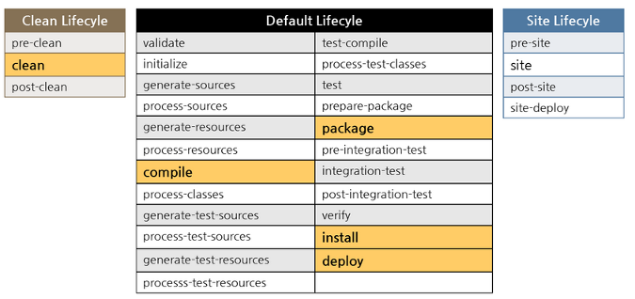

Slide 20



Questions
facebook.com/groups/valaxytechnologies
youtube.com/c/valaxytechnologies

