Slide 1

Static Code
Analyses

Slide 2
What is testing
Testing is a process, to evaluate the functionality of a software application with an intent to find whether the developed software met the specified requirements or not and to identify the defects to ensure that the product is defect-free in order to produce the quality product.

Slide 3
Testing types and methods
Testing Types:
Manual
Automation
Testing Methods:
Static ( On code)
Dynamic (On Application)

Slide 4
Reasons to use Static code analysis
Find errors earlier in development
Detects over complexity in the code
Find Security Errors
Enforces Best Coding Practices
Automated & Integrates in Jenkins
Can create project specific rules

Slide 5



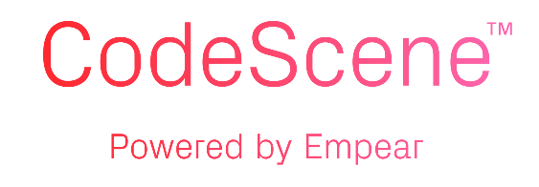

Static code analysis tools

Slide 6
What is SonarQube
Its an open source static testing analysis software. It is used by developers to manage source code quality and consistency. Some code quality check are
Potential bugs
Code duplication
Lake of test coverage
Excess complexity

Slide 7











Why SonarQube
Its supports 27 Languages

Slide 8
Components of SonarQube
SonarQuber Server
Web Interface
Database
Rules
SonarScanner
SourceCode

Slide 9
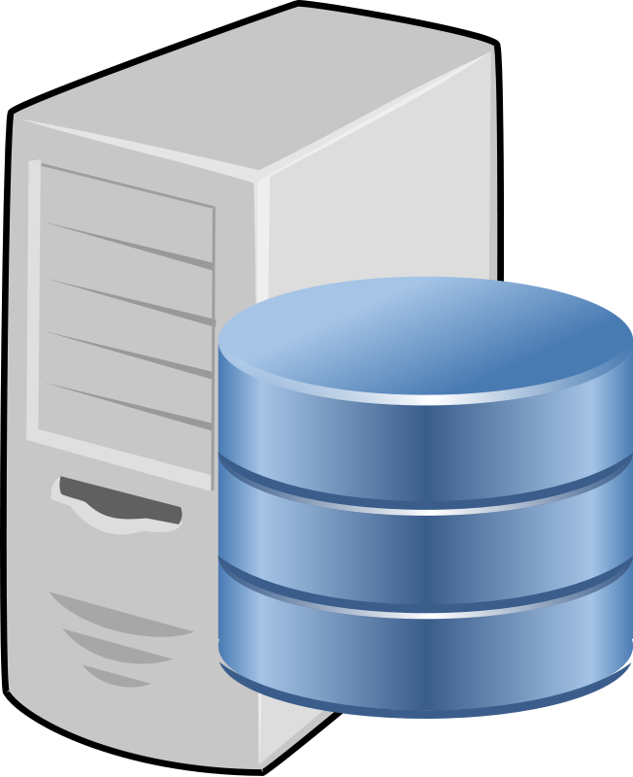


How SonarQube Works !!
Rules
SONAR SCANNER
Result
Developer
SonarQube Server

Slide 10
Components of SonarQube
SonarQuber Server
Web Interface
Database
Rules
SonarScanner
SourceCode

