Slide 1

Project Description
1.Find out user’s engagement and interaction with our product( software and mobile application to drive business insight for marketing product & development team
2.Find the success of the app by measuring user engagement and improve the experience altogether while helping the business grow.
BY – SURENDRA UPADHYAY

Slide 2
APPROACH
1.DOWNLOAD DATABASE FILE
2.USE MYSQL TO CREATE TABLE AND INPUT VALUES
3. CREATE TABLES
4. GEATHERED THE INSGIHT OF THE DATABASE
5. WRITE THE QUERIES TO FIND THE QUSTION’S ANSWER
6. ANALYSIS THE INFORMATION AND MAKE DECISION
7. DECISION MAKING

Slide 3

Tech_Stack_Used
MySQL Workbench 8.0 CE
MS EXCEL 2019
TABLEAU PUBLIC 2022.2
MS WORD
PAINT APPLICATION

Slide 4
INSIGHTS
TOTAL_USERS = 100
PICTURES_UPLOADED = 257
TOTAL_LIKES ON PHOTOS= 8782
NUMBER OF TAGS_ID = 21
MAXIMUM TIME TAG USED = SMILE(59 TIMES)

Slide 5
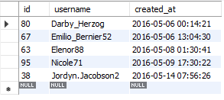


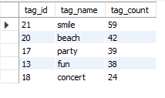
INSIGHTS
1.Find the 5 oldest users of the Instagram from the database provided
2.Find the number of users who have never posted a single photo on Instagram
3.Identify the winner of the contest and provide their details to the team(Top-3)
4.Identify and suggest the top 5 most commonly used hashtags on the platform

Slide 6

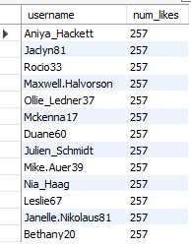

INSIGHTS
5.Provide data on users (bots) who have liked every single photo on the site
6.Provide how many times does average user posts on Instagram.
7.What day of the week do most users register on?

Slide 7
RESULTS
AD CAMPAGINE SHOULD BE ON SUNDAY AND THURESDAY
MAKE MORE SMILE RELATED AND POSITIVE VIBES TAGS
SEND PROMOTIONAL EMAIL FOR 1 ST PHOTO POST ON INSTA ,WHO NEVER ADDED ANY POST YET.
LAUNCH MORE CAMPAIGNS FOR MORE USERS ACTIVATION.
REWARDS OLDEST USERS FOR THERE ACTIVITIES.
WORK ON MORE PERSONLIZED AND INTRACTIVE FEATURE.

Slide 8

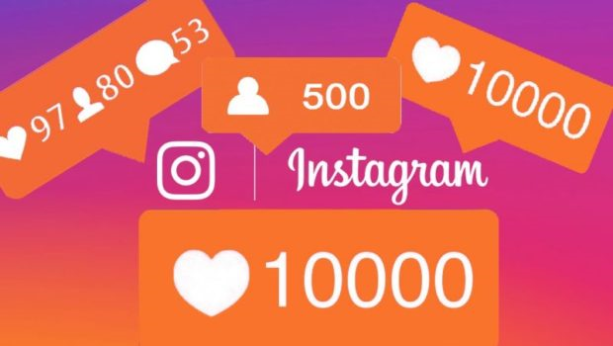
THE END

