Slide 1

MARCOM Valuation
Surendra Potupureddy

Slide 2

AGENDA
Business Objective & Budget Strategy
Financial Implications of Marcom
Seasonal Strategy
Marcom Vehicle & ROI

Slide 3
Business Objective & Budget Strategy
JOANN is the nation’s leading fabric and craft specialty retailer. Our retail stores and website feature a variety of competitively priced merchandise used in sewing, crafting and home decorating projects.
Our corporate strategy is to improve revenue from our current customers by identifying which customers to target with appropriate channels & discounts rates across different categories
Need to devise a model to estimate Marcom vehicles that drive most revenue and allocate budgets according to it

Slide 4
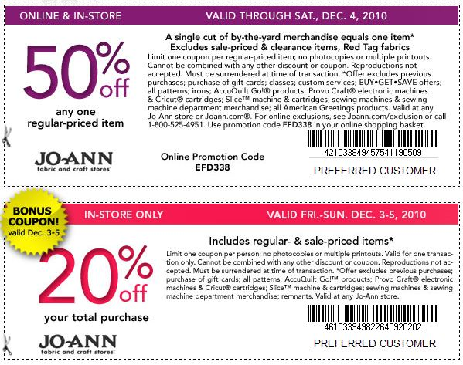



Marcom Vehicle: Introduction
SMS
Direct Mail
E- Mail
Coupon Types

Slide 5
Marcom Vehicle: Model Estimates
Variable | Parameter | Mean | $ Value | % Value
net_price | 71,632 | 3.85 | $275,424 | 58%
dm_cnt | 1.22 | 70,468 | $85,802 | 18%
email_cnt | -0.02 | 794,890 | -$17,026 | -4%
sms_cnt | 0.52 | 66,616 | $34,595 | 7%
adv_NPI | 0.03 | 435,048 | $11,770 | 2%
adv_SPC | 0.00 | 935,179 | $1,527 | 0%
unadv | 0.04 | 1,351,893 | $57,760 | 12%
q2 | -21,090 | 0.222 | -$4,687 | -1%
q3 | 28,512 | 0.222 | $6,336 | 1%
q4 | 190,027 | 0.222 | $42,186 | 9%
ThreeDaySale | 0.2857 | 6339.82 | $1,811 | 0%
Columbus_day | 0.42 | 11,357 | $4,785 | 1%
 |  | EST=> | $500,284
NET SALES |  | ACT=> | $477,592
 |  |  | 104.75%
Out of Marcom Vehicles, Direct Mail generates the highest revenue where as SMS has the highest ROI. It is obvious to investment in Direct Mail as per the percentages derived but sending Controlled SMS might result in highest revenue because of its high ROI. A strategy can be implemented and tested to derive best marketing spend.

Slide 6
Actual Vs Estimated

Slide 7
Marcom Vehicle & ROI: Direct Mail
Net Revenue generated through Direct Mail: $85,802
Marketing Spend on Direct Mail: $31,711
ROI = (85,802- 31,711)/ 31,711 = 170%!
Direct Mail’s contribution to Net Revenue peaks in the fourth week after mailing, and becomes less effective throughout week 5
Direct Mail
Direct Mail’s contribution to Net Revenue peaks in the second week after mailing, and becomes less effective throughout w

Slide 8
Marcom Vehicle & ROI: Direct Mail
Net Revenue generated through Direct Mail: -$17,026
Marketing Spend on Direct Mail: $17,488
ROI is negative in Email Marketing
Email’s contribution to Net Revenue peaks in the first week and quickly declines through week 3
Strategy: Controlled mailing should be used for this Channel.
Direct Mail’s contribution to Net Revenue peaks in the second week after mailing, and becomes less effective throughout w

Slide 9
Marcom Vehicle & ROI: Direct Mail
Net Revenue generated through SMS: $34,595
Marketing Spend on Direct Mail: $7,661
ROI = (34,595-7,661)/ 7,661 = 350%!
SMS’s contribution to Net Revenue peaks in the first week it is sent, and rapidly declines until week4
Conclusion: Heavy Investment on SMS as it has highest ROIDirect Mail’s contribution to Net Revenue peaks in the second week after mailing, and becomes less effective throughout w

Slide 10
Elasticity
Elasticity of Marcom vehicles :
Direct Mail : The Elasticity of 0.18 explains that a 10% increase the average Direct Mail send, the revenue generated increases by 1.8%
E-Mail: The Elasticity of 0.03 explains that a 10% increase the average SMS send the revenue generated decreases by 0.3%
Strategy: Controlled mailing should be used for this Channel
SMS : The Elasticity of 0.07 explains that a 10% increase the average SMS send the revenue generated increases by 0.7%
Conclusion: Heavy Investment on SMS as it has highest ROIil’s contribution to Net Revenue peaks in the second
Channel | Elasticity
Direct Mail | 0.18
E Mail | 0.03
SMS | 0.07

Slide 11
Seasonal Strategy

Slide 12
Seasonal Strategy
Even though the direct mail spend in Q1 is low, it has the second highest revenue.
Q2 has the lowest revenue generated but the marketing spend for direct mail and email is high in Q2. We can reduce the spend on Email as it has a negative ROI and allocate that budget towards SMS.
Q4 has the highest generated revenue but the least Marketing spend on SMS. As the ROI of SMS is higher than the other a robust linear model has to be built to determine the best ways to use Direct Mail and SMS channels.

