Slide 1





N.B.K.R INSTITUTE OF SCIENCE AND TECHNOLOGY
PARKING LOT
MANAGEMENT
BATCH-09

Slide 2

PRESENTATION BY
CH.SURENDRA(24KB1A0588)
CH.PAVAN KUMAR(24KB1A05B3)
D.LAKSHMI NARASIMHA(24KB1A05C8)
U.LOKESH(24KB1A05LU)

Slide 3


BORCELLE CAR DEALER
INTRODUCTION
STEP 1: ENTER THE VEHICAL NUMBER
STEP 2:CHECK AVALABILITY
STEP 3:ASSIGNE SLOT
STEP 4:LOG ENTER TIME
BORCELLE CAR DEALER

Slide 4

CONTENT
*SYSTEM CHECKS CURRENT LOT OCCUPANCY
*DISPLAY AVAILABLE SLOTS IN REAL TIME
*ALERT IF FULL CAPACITY IS REACHED

Slide 5

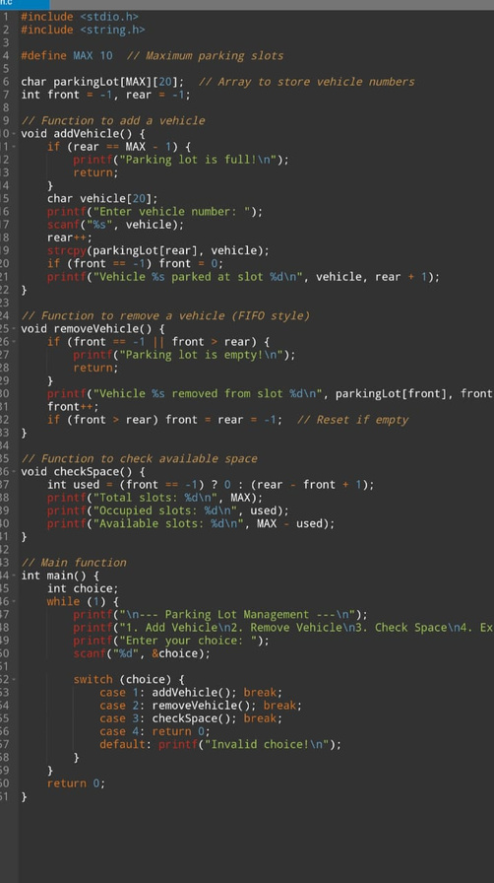
SAMPLE CODE
BORCELLE CAR DEALER

Slide 6

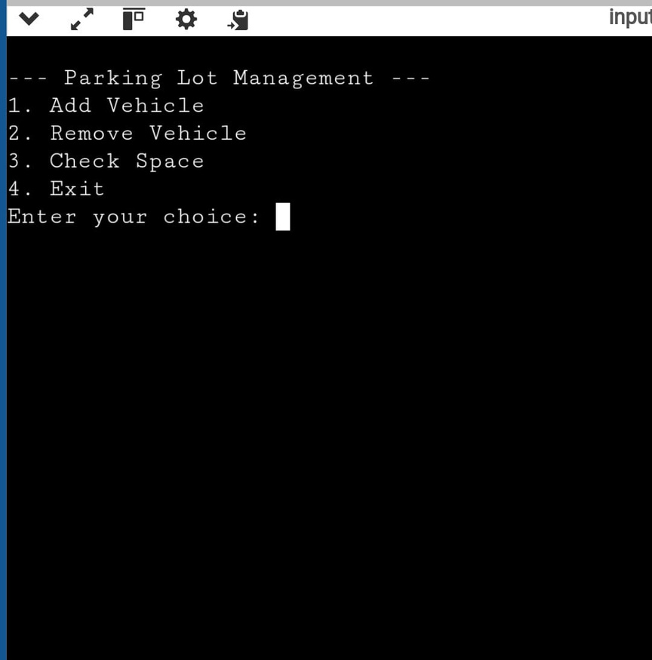
SAMPLE OUTPUT

Slide 7

CODE LINK
HTTPS://ONLINEGDB.COM/LQ87SRMJ0

Slide 8
THANK YOU

