Slide 1


Project: E-recruitment using ML
Client Mentor: Mr. Surendra Dattatrey
Mentor: Prof. S M Bendre
Core Team:
Vikash S Negi - 11810048,
Devender Bansal - 11810089,
Atul Sharma - 11810126,
Sandeep Kumar Singh - 11810014

Slide 2
Agenda
Executive Summary (Extract)
Project Motivation
Business Problem
Data Requirements & Data Collections
Data Preparation
Modeling and Evaluation
Conclusion
Demo
Limitation and Future Work

Slide 3
Executive Summary (Extract)
An organizations most important assets is it Talent. Right Talent is a competitive advantage for any Company.
A McKinsey study shows a Right Talent is 400% more productive than an average Hire.
However hiring right talent entails many challenges including
Hire Time
Hiring Cost
Biases of Recruitment team
Through this project, we have leveraged text analytics & Machine learning techniques to build a Generalized Automated Model
Shortlist resumes
Rank Resumes
Our Approach
Exploration
what common features are important for hiring department for evaluating a resume
How that information is written in a Resume
We explored
Through discussion with HR recruiter
Through EDA on set of resumes provided by Client
Built Generic Segments
Through employing ML & Text Analytic Techniques on the provided resumes
Supervised Training Models
Extract Required Features
Extracting Features from different segments
Comparing it with JD
Build Selection Model using a Supervised Classifier
Our Goal
Build a Generic model so that it can be applied to any Job posting
Build a modular framework, so that individual models can be improved upon, continuously

Slide 4
Project Motivation
One of the biggest challenges facing HR professionals today is finding the best talent to hire. This task has proven burdensome in the past, in part due to inefficient manual tasks that plague the recruiting process .In fact, per research conducted by LinkedIn 46% of recruiters and hiring managers have identified "finding the right candidate" as the biggest hurdle in hiring today. Also surveys show that hiring time might vary from 30 days to many months basis industry
To tackle these challenges, new technology companies are rapidly emerging in the HR tech ecosystem with robust solutions that use Big Data, predictive analytics, and AI to automate and improve everything in the recruitment process from job advertising and resume screening to applicant engagement, scheduling, and recruiting by text. These new tools offer us ways to help overcome the limitations and biases inherent in recruiting with automated processes that are hyper-responsive to market data, complex metrics, and even budget constraints. Hence this project is to find out on very first problem, where we would like to find out a solution to match job requisition with candidate’s resume.
Project Implications from industry perspective?
As we know, screening the resume is most time taking exercise in recruitment process across industry as it takes up to 23 hours for one hire approximately. In a real-life example when for a job opening receives 400 profiles (Avg basis) out of which 80% to 90% out of them are not eligible for the job, one can imagine why most talent acquisition leaders are still find hard to recruit the right candidate from a large applicant pool. Through this project we will try to cater an industry wide problem using robust automated system to provide the top candidate for a job from the applicant pool.

Slide 5
Project: Business Problem Statement
Business Context
Bringing the right people on board is a major part of long-term business success. Employees are any company’s most important asset. However, finding right talent through existing manual and keyword matching techniques are a big pain for recruiters. It involves too much effort, waste of valuable which in turn leads to in-optimal hiring.
As the outcome of the project, we want to automate the process of shortlisting of resumes.
This has potential to help an organization to
Reduce Hiring Time
Reduce Cost
Reduce\Remove Recruiter Biases
Area of impact
Faster hiring will reduce mean vacancy duration for any role.HR department & Hiring Managers will be the area of Impact.
Along with the Internal HR & recruitment departments. This project can be further developed in providing commercial Automated E-Recruitment as a service by various Job consulting firms as well as Online job portals
Project: Situation Analysis
Current Situation: - The resumes/Profiles have been screened manually with respect to the job description which is really a cumbersome job.
Proposed Approach: - A machine learning recommender program will be built to provide top profiles based on the job description passed to the program
Desired Situation:- An Automated engine which goes beyond keyword search and help match the right set of resumes for a given Job description.

Slide 6
Background Study Required
We divided our background study into two parts: Domain Knowledge & Execution
Domain Knowledge is the key aspect of this project. We spend number of hours discussing with our HR partner on how the recruitment process works, what are the different ATS tools are available, how the current screening process is executed, what is the average time to complete one job posting, and many other relevant information is captured.
Reading different types of formats: This become a challenge since resume never follow a similar structure and is different from each other, while sharing common few heading/segments it can be vary from text to image. We put our sincere efforts read through and find patterns for input format. We excluded info-graphic & image-based resume for this project.
Resume Analyzing Process: Selecting parsing methodology, for segments extraction is required a lot of pre-reads on text analytics. Going through concepts on NLP approach, Machine learning approach was required.
EDA with available set of resumes: We undertook the EDA process with the set of resumes shared with us. Using Various text extraction and text analytic techniques, following questions were answered
What are the most common headings used in Resume?
What percentage of resumes has minimal one Table structure?
What are the Unique words which are used in specific section of a resume?
What are the common ways of mentioning total experience in Resumes?
What are the unique words used in Education section of a Resume?
The above Background Study helped us to identify important Features to be extracted and we finalized 5 Features to be extracted is as follow
Total Experience
Relevant Experience
Skill Level
Education level
College Tier Level

Slide 7
Data Requirements & Data Collections
Data Availability
Data is provided by client, as requested. We have received the data in form of resumes/profiles well within the first 4 weeks.
The data is limited, as we only received 80 resumes to work on this project from the client along with 4 JD’s to work with. More profiles might help us in training the model
The resumes were masked for the PII information. Hence, we did not work on creating any feature pertaining the personal information.

Slide 8
Project Framework/Architecture
Input: Resume
Standardization: HTML Conversion
Reverse Engineer HTML Code
Segmentation:
Identify & Segment
Education Qualifications
NER
Train the System
Technical Skills
Syntax Analysis
Classify Segments
Life
Achievements
Parts of speech tagging
Evaluation through Decision Tree
Personal Information
Data process
Discard Data
Relevant Experience
Dictionary Based Search
Segmentation
Extracting Features
Evaluate & Train

Slide 9
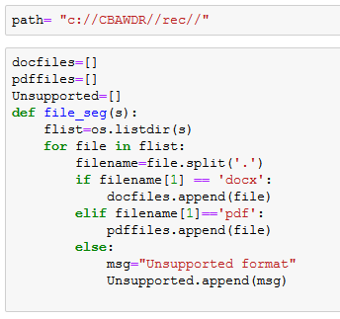
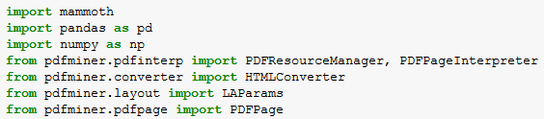
Step by Step: Process flow
Import file (Reading/Managing Input Data):
We decided to build our model on Word doc (Docx) and Acrobat (Pdf) format. As these are two widely used resume formats, we are excluding info-graphic and image-based resume.
We started with Segregating the set of .pdf & .docx resumes into two different lists. This was done so that we can use different libraries as needed for processing in subsequent steps
Technique & Codes (Sample Snippet Code)
Technique & Codes
Important Packages

Slide 10
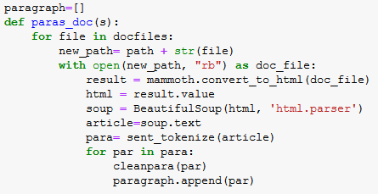
Step by Step: Process flow
Import file
HTML
As a second step, we have converted the input resumes into HTML file. As during our EDA, we found out that many resumes had tables.
Converting to HTML helped us to extract the table content without too much of complexity
The HTML format also gave us the flexibility to use HTML tags while extracting text.
We also could use an important library Beautiful Soup in Python for extracting text once format was converted to HTML
Technique & Codes
Important Packages
We have spent lot of men hours finding the best suited libraries for our requirement. We decided on mammoth for docx to HTML conversion & pdfminer.six for converting .pdf to HTML owing to simplicity and non- availability of single library to work on both

Slide 11

Step by Step: Process flow
Import file
HTML
Text Extraction
In this step, we started extracting the text from the converted HTML formats. The Text extraction was a regular process and it was undertaken for various purposes
EDA process – We used The Text Extraction at EDA phase using the Beautiful Python library and using HTML tags
Building corpus for labeling the paragraphs in the next phase
Extracting Text from unlabeled Resume
Extracting Text from Job Description
Technique & Codes
The Soup. Text technique along with Sentence Tokenization was employed to get the output as paragraphs.
Technique & Codes
Important Packages

Slide 12
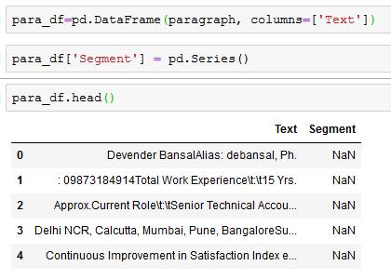

Step by Step: Process flow
Import file
HTML
Text Extraction
Corpus for Training
In this step, we created text corpus for training. We employed the aforementioned Text Extraction technique on a set of 48 Resumes. The output of the resumes was a list of 550+ paragraphs.
This is further be used for segmenting the unlabeled resume. Since, we faced challenge in segmenting the data into required segments through any method.
Sample Output
Important Packages
We used NLTK package for sentence tokenization while Pandas was used for creating Data Frames
Notes:
Beautiful soup, NLTK, Tokenization

Slide 13
Step by Step: Process flow
Import file
HTML
Text Extraction
Corpus for Training
Labeling
Manual
K-Mean Clustering (Proposed)
In the Next step, we decided to Label the extracted paragraphs from 48 resumes.
This was needed to build a supervised model for paragraph Classification. A Supervised Paragraph model would help us to classify the text of a resume and JD into predefined segments.
To Label data, we had two options
Manual Labeling
Employing Clustering Techniques like K-Means
Considering the low number of resumes and total of only 550+ paragraphs to be labeled. We went ahead did the manual labeling.
However, considering our project is open for improvements. It is strongly recommended to increase the number of resumes and employ Clustering technique to label the Paragraphs
Technique & Codes
Manual Labeling
K-Mean (Proposed)
Notes:
1. Manual Labelling 2. K-Means clustering . Scikit learn Supervised learning

Slide 14
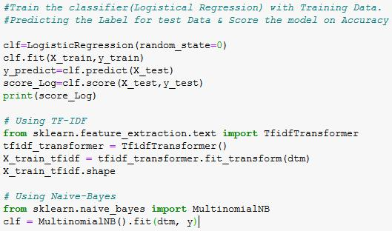

Step by Step: Process flow
Import file
HTML
Text Extraction
Corpus for Training
Model: Supervised
Segmentation
Labeling
Manual
K-Mean Clustering
In this Step we built a Text Classifier from the training Data. We first converted the paragraphs into vectors. And then trained using Logistic Regression Classifier.
We test with other classifiers including Linear SVC and multinomial Naïve Bayes. However, as we received better accuracy on the validation set. We went ahead with Count Vectorizer and Logistical Classifier.
As this is the training model and we require the same vectorizer to be fit while prediction for new resume. This Vectorizer was saved for non- label paragraphs
Technique & Codes
Important Packages

Slide 15
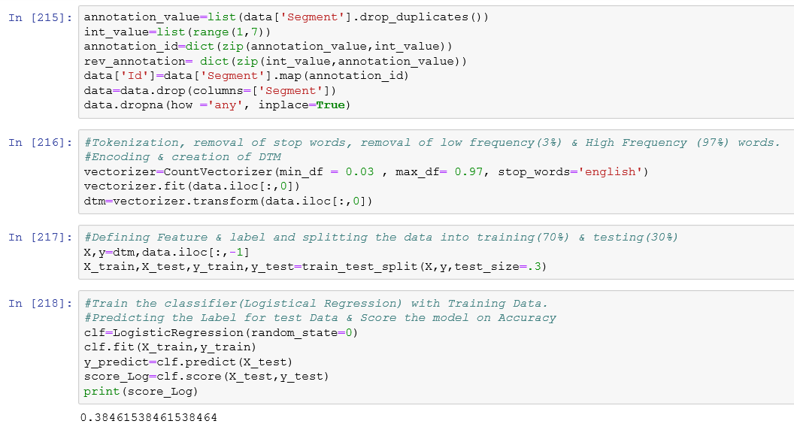
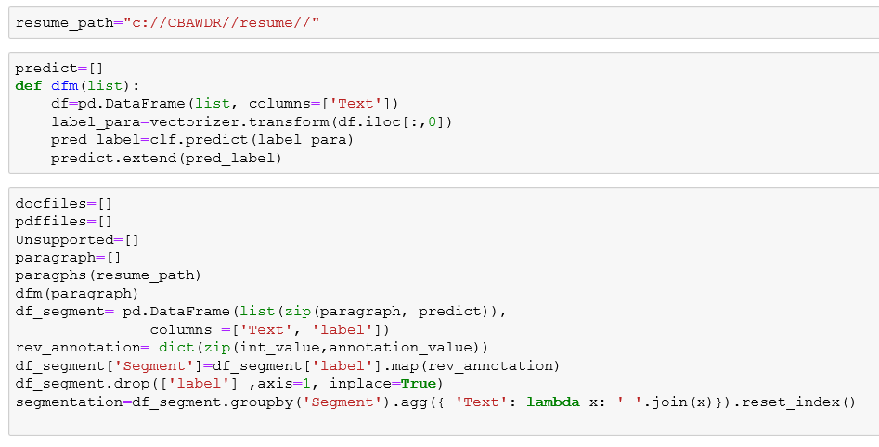
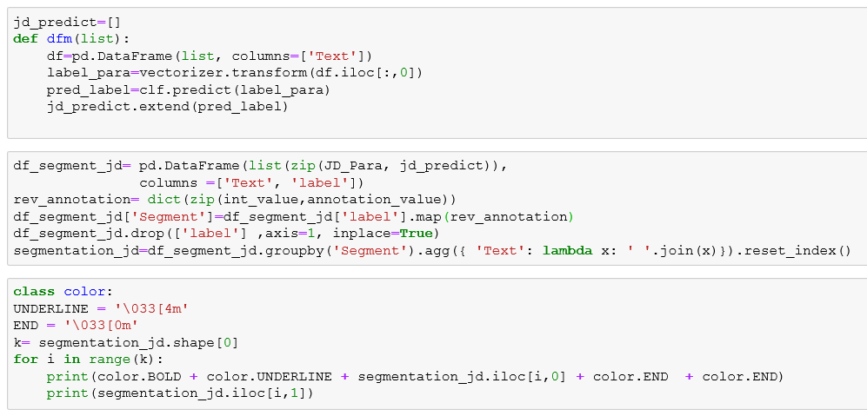
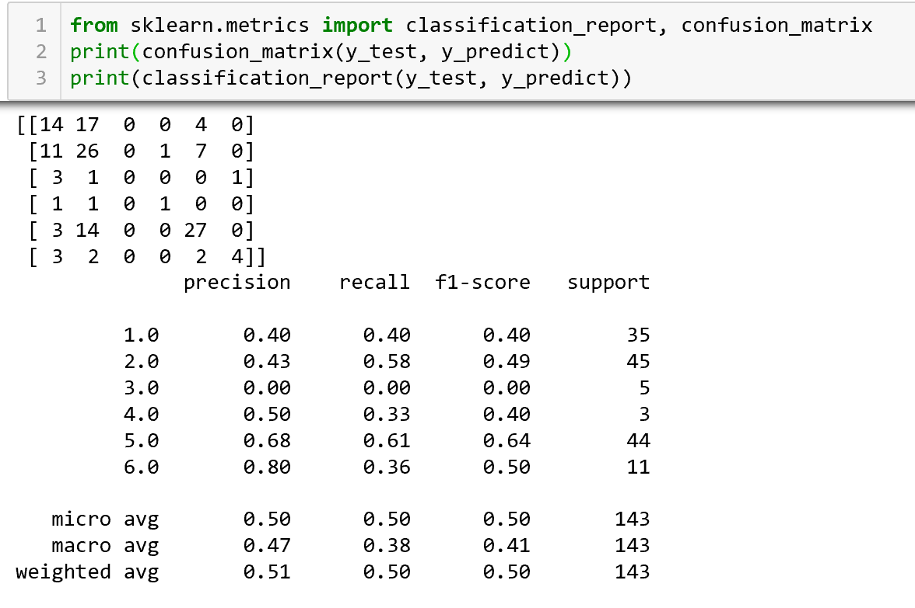
Insert Supervised Model
Insert Prediction Code
Confusion Matrix
{'Experience_Skills': 1, 'Skills': 2,
'Personal Details': 3, 'Education': 4,
'Other': 5,
'Experience': 6}

Slide 16
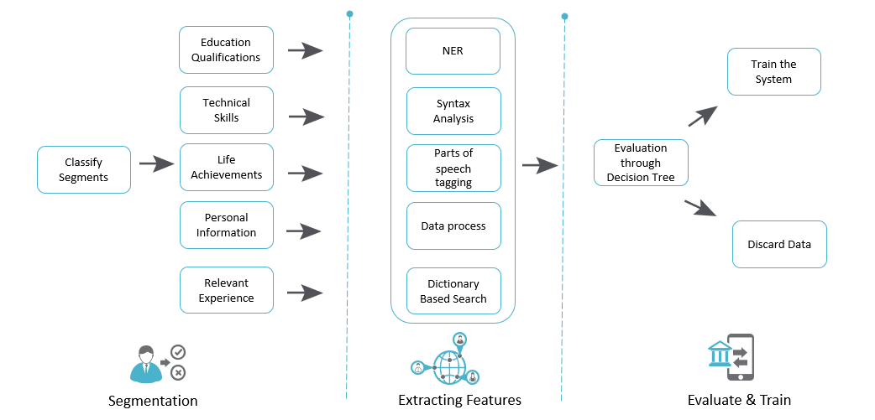
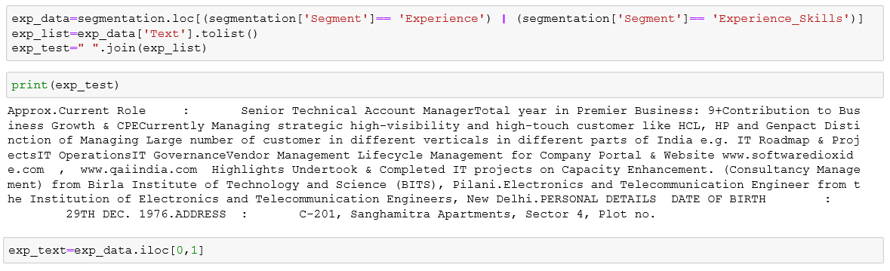
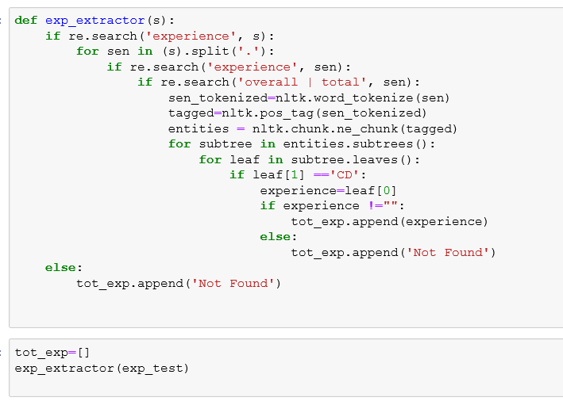
Post Segmentation Phases
Experience
No of Years of Total Experience
We used the regex, post- tagging and Entity extraction to find the total or overall experience of a resume. The codes is as below
After Segmentation, we have output for a resume neatly converted into different paras for respective segments.
We then built below individual functions to be applied on different sector to extract the pre-decided six features

Slide 17
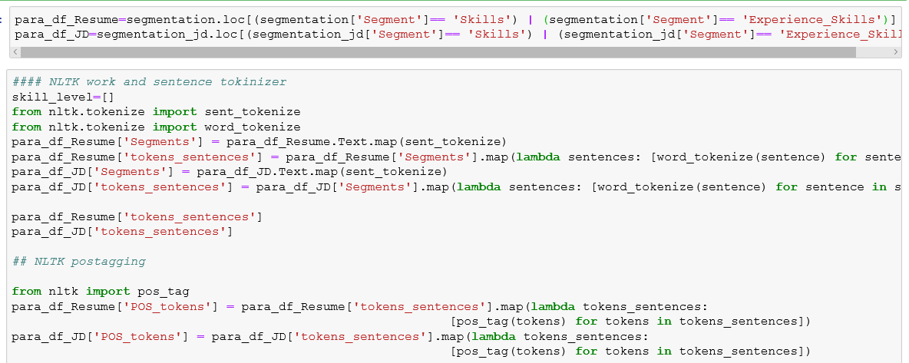
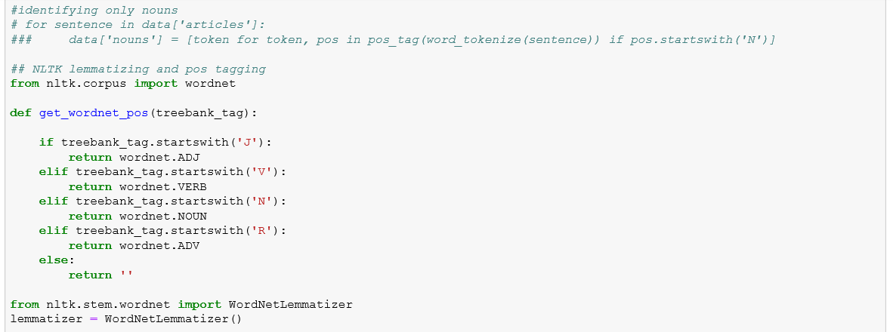
Relevant Experience
We used unique Keyword matching techniques between the Skill section of Given JD with the Experience section of the Resume. It helps us to provide a matching score basis the similarity.
We employed Tokenization, Pos tagging, Lemmatization & similarity algorithms to understand the similarity score.
Output of this function is list of one relevance value for every parsed resume as either High, Moderate or Low
Skills Feature
We used unique Keyword matching techniques between the Skill section of Given JD with the Skill section of the Resume. It helps us to provide a matching score basis the similarity.
We employed Tokenization, Pos tagging, Lemmatization & similarity algorithms to understand the similarity score.

Slide 18
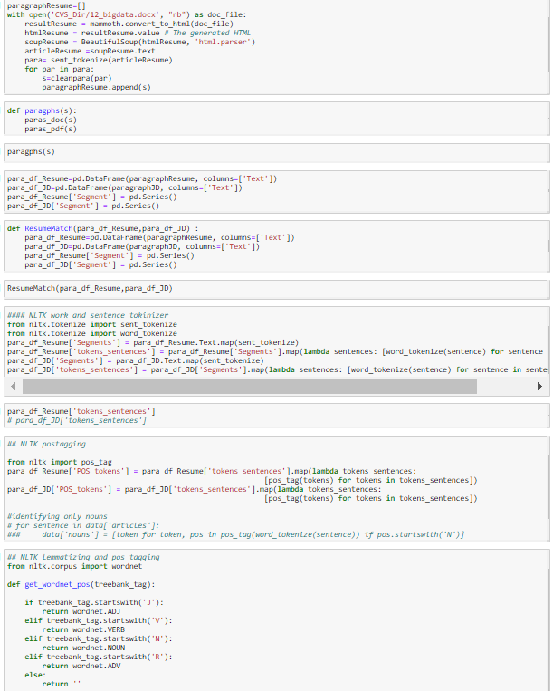
Education
Degree Level
We created function using tokenization, pos tagging and List comparisons to match keywords to find Degree Level of a Resume.
Output of this function is list of one-degree value for every parsed resume as either Masters, Bachelor or other
College Tier
During our Domain discussion with HR team, we found the Tier of the College of a candidate is an important feature while providing weightage. We created function using tokenization, pos tagging and matched the extracted college information with a predefined College Tier Lists.
Output of this function is list of one Tier value for every parsed resume as either Tier 1, Tier 2 or other.

Slide 19
Rating Methodology using supervised learning
Education Qualifications
Technical Skills
Import file:
New Resume
HTML
Text Extraction
Supervised Model
Individual Segment Scoring
Relevant Experience
Score EQ
Life
Achievements
Score TS
Final Ranking through scoring
Scoring Process
Score RE
Education Qualifications
Score LA
Technical Skills
Import file:
JD
HTML
Text Extraction
Supervised Model
Relevant Experience
Life
Achievements
Notes:
Note:
EQ: Education Qualification
TS: Technical Skills
RE: Relevant Experience
LA: Life Achievements

Slide 20
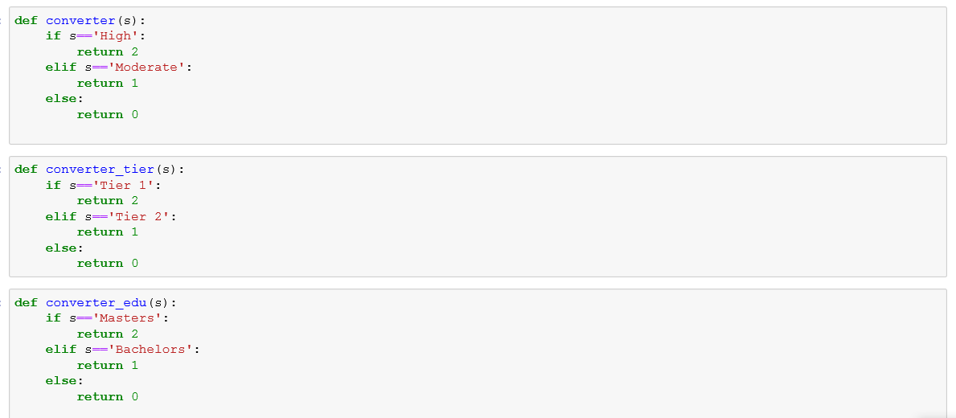
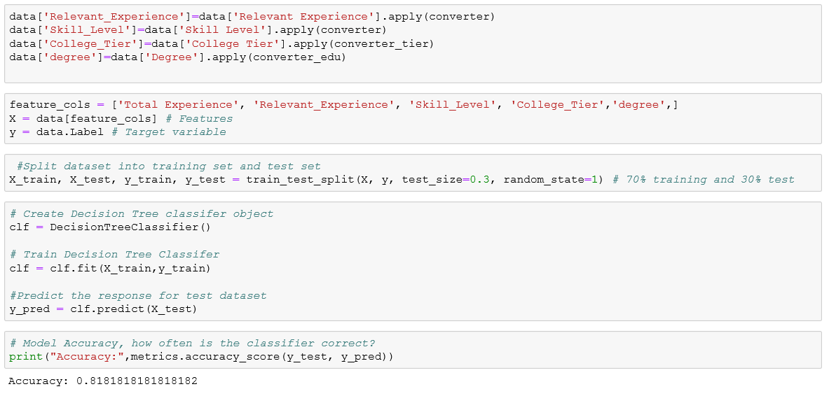
Once the five features with its value are extracted, we convert all the list into data frame.
Supervised model to classify a Resume
Last Stage of framework is to build a Supervised model and then use this model to predict whether a resume is Accepted or Rejected.
We used decision Tree Classifier to build our Model. For training purposes, 36 of the resumes out of 48 of total resumes were labeled manually as Accepted or Rejected.
Code for Supervised Model

Slide 21
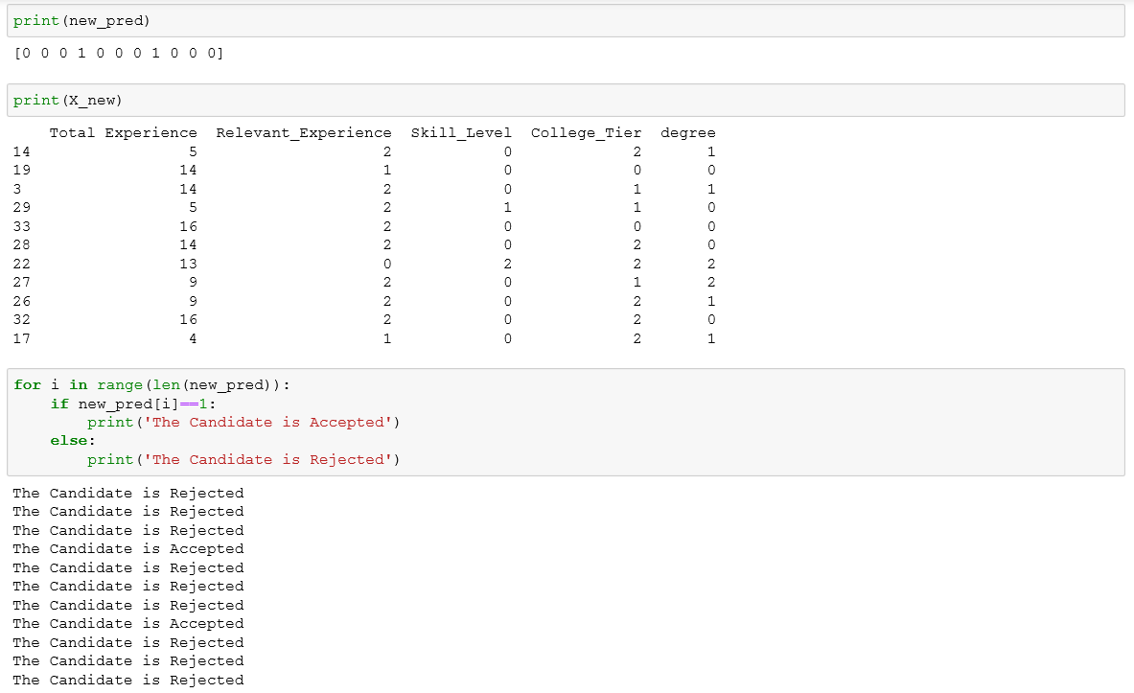
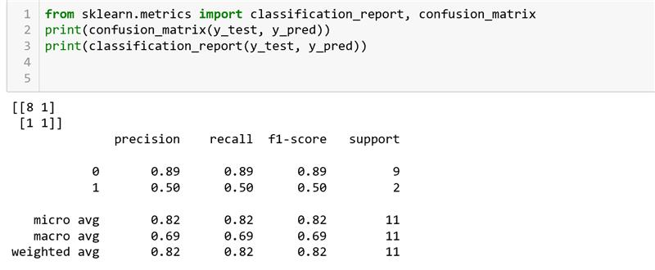
Code for Fitting the model
Output

Slide 22
Operationalization
Segmentation Supervised Model- Improvement
Input: Training Corpus
Improved supervised Model
Resume Label:- Manual or K-means (Proposed)
Input: Labelled Resume (for a position)
Trained Classier Model
Final Selection
Classified Trained Model
Input: Unlabeled Resumes
Decision

Slide 23
Conclusion/Recommendations
Process Impact: - A manual process of screening a candidate through 100s of resume would be automated which will be very efficient and less time consuming. We have started with structuring the framework and because we had very few resumes to train on, accuracy will be low at start but while more and more data will be fed, accuracy could be improved.
Cost Impact: - We four people have spent almost 3 months in defining the problem, creating a framework, deciding to go with and model training. If there is a team of 4 people in house working on same project, most probably they can achieve more efficiency and in house people would have access to real data. Initially it can be costly but once team is well trained and start working on various Text analytics projects, this project will a starting point and it will help company in long term. So, I would say this project can incur some cost but completely justified.
People need to open to change and adopt screening process through computers. It will still need manual intervention for some time until model start providing accuracy beyond threshold but until then, a feedback loop needs to be created at organization which will input the data back to system and model for training.
This is a machine learning model which need data and feedback loop for better accuracy and prediction. It is an iterative process where results are fed back with responses and based on that model is calibrated. Initially frequent calibrations would be needed and with course of time, this frequency can be quarterly or biannually.
Notes:
Note:
EQ: Education Qualification
TS: Technical Skills
RE: Relevant Experience
LA: Life Achievements

Slide 24
Limitations & Further Work
Limitations
Due to GDPR, resume was masked, limiting on the sharing the information
Due to time constraints we limited our scope and only word doc and Pdf as an input format is considered for this project (exclude Image based resume).
Further Work
This model has been created on limited set of data so more data will be needed. Further, based on results feedback loop need to be created for proper calibration of model and to improve the accuracy.
More personalization can be achieved

Slide 25
Q&A
Notes:
Insert

Slide 26
Thank you!!

