Slide 1

CS253: Software Operations
&
Development
Course project- SmartTutor
Prepared by- Group 16
Instructor- Indranil Saha
Software version- SmarTutor 0.1

Slide 2
Group- 16 Software Avengers
Team Members-
Sonu Kumar 211052 sonuk21@iitk.ac.in
Saurav Kumar 210950 sauravk21@iitk.ac.in
Surendra 211083 surendrak21@iitk.ac.in
Sarthak Paswan 220976 sarthakp22@iitk.ac.in
Yash Gothwal 211189 yashg21@iitk.ac.in
Ritesh Kantule 210488 kantulerr21@iitk.ac.in
Rishit Bhutra 220832 rishitb21@iitk.ac.in
Krishna Chandu 210857 pkrishna22@iitk.ac.in
Ch Hemanth 210277 chandaka21@iitk.ac.in
Project Mentor - Sumit Chaduhry
Course Instructor- Indranil Saha

Slide 3
Contents-
Introduction
Need for this Software (Potential users)
Key Design and Implementation Decisions
Demonstration of Software
Future development plan
Lessons Learnt
Q/A

Slide 4
Introduction
Our tool, SmartTutor, is intended to make the process of academic pre-registration more efficient.
It is designed to address the challenges that our IITK community faces each semester, i.e. during pre-registration. As students, we confront numerous challenges such as deciding which courses to add or drop, time management issues, and scheduling conflicts.
But why SmarTutor?
1. You can view what courses will be offered in each department.
2. Course Content and its Instructor
3. Add/Drop of Courses
4. Resolve timetable clashes
5. Discussion forum for each course

Slide 5
Potential users
1. Developers: Those in charge of coding and implementing SmarTutor.
2. Project Managers: Those responsible for calculating function requirements and overseeing project development and progress.
3. Users: The system's users fall into two basic categories:
Students: Those who can log in and use the product.
Department Mentors: Those who can log in, access, and edit courses as needed.
4. Testers: Individuals -who can validate the system during testing to ensure that it is complete and consistent.

Slide 6
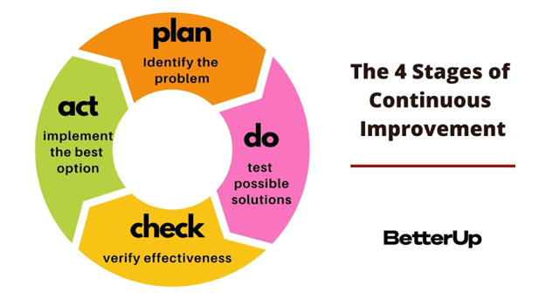
Key Design and Implementation Decisions
For designing purposes, we took the help of our TA and instructor. We had a lot of meetings before finalizing it.
For implementation. We had a lot of Confusions about the databasing part, should we go for MongoDB or MySQL
Gradually, we divided the whole work among ourselves. Some did the Frontend part, some did the backend part, and a few worked on the database part.

Slide 7


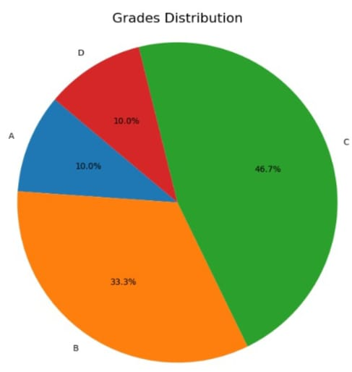
Future Plans Notifications and alert system Development for forums of courses Development for courses reviews

Slide 8
Future Plans
We have more ideas in our mind which we want to add to our product like-
Inclusion of Smart AI chatbot
A separate hangout and forum tab for each course
Taking Feedback/Review of each course at the end of the semester
notification System for course announcements, new forums, and many more
Your Suggestions Please!

Slide 9
Demonstration of Software
Let’s have a look at the Woking model of our project
WEB-
https://github.com/sauravkr21/CS253

Slide 10
Lessons Learnt
1. Planning is important but continuous improvement is also necessary.
2. For continuous improvement, debugging, and testing once a part of the project is completed.
3. Any changes made in the codebook should be backed with logic
importance of Teamwork, professionalism and most importantly learning from mistakes.

Slide 11
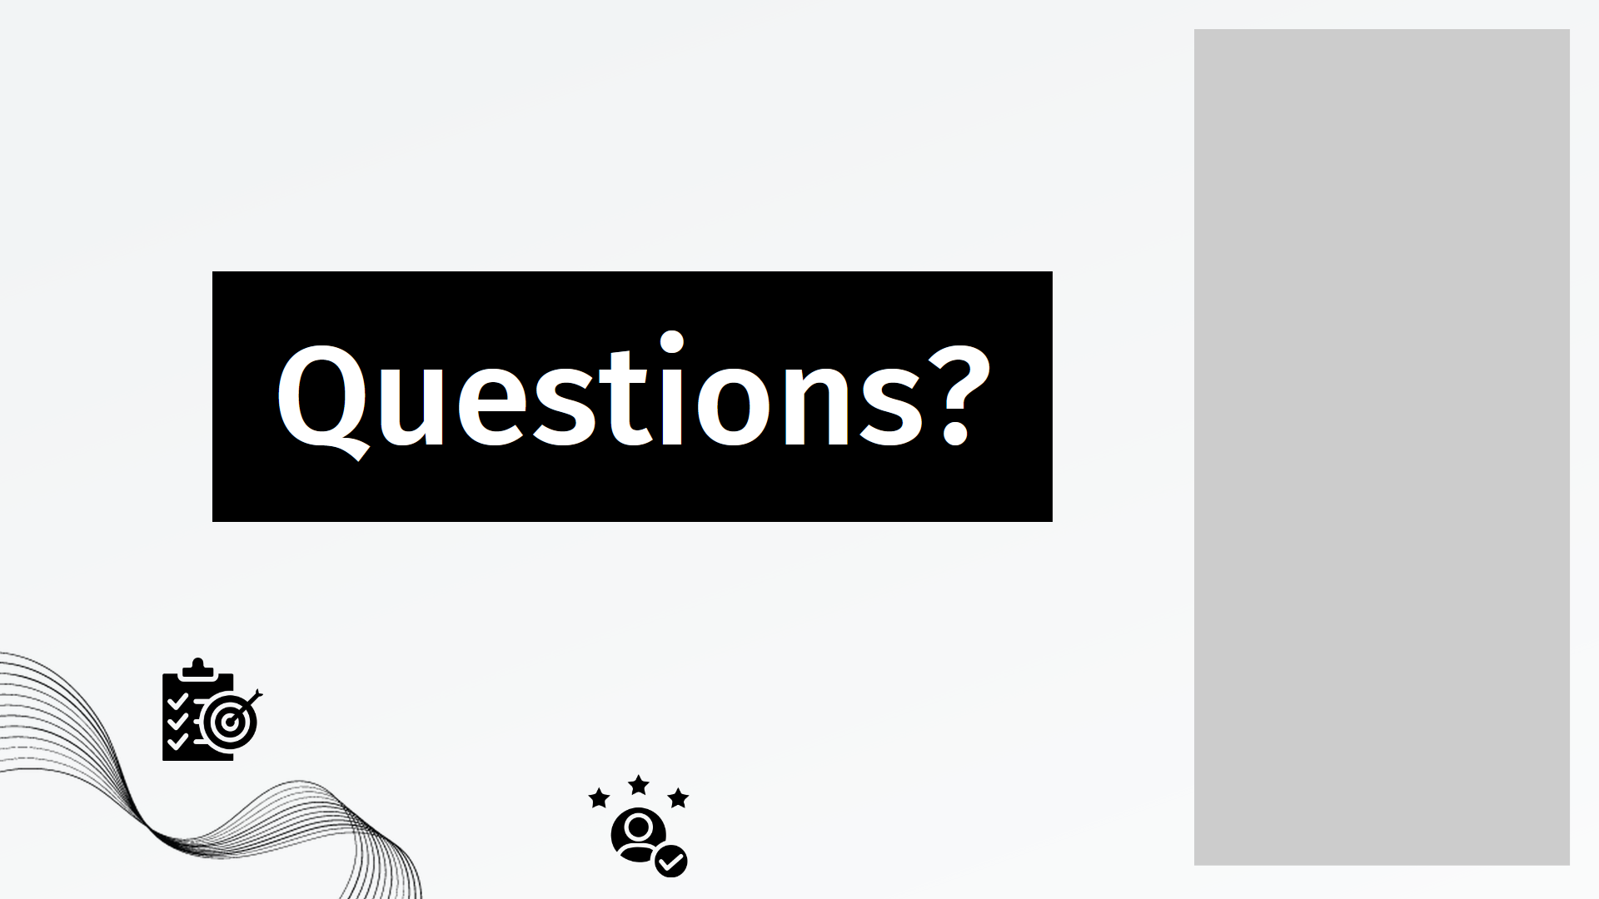

Slide 12


