Slide 1
Reliability

Slide 2
Database Reliability
Reliability in Database Systems refers to the ability of the database to operate continuously and recover from failures without data loss or corruption.
Reliability in the context of DDBS refers to the system's ability to continue functioning correctly despite failures of components like:
Sites (nodes/servers),
Communication links,
Transactions,
Storage media
Goal: To ensure correctness, consistency, and availability of data even in the presence of faults.

Slide 3
Types of Failures
In databases, a failure refers to any event that prevents a database from operating correctly or causes loss of data integrity, availability, or consistency. Failures can disrupt transactions, corrupt data, or even crash the system.
1. Transaction Failure
Occurs when a specific transaction cannot complete successfully.
Causes:
Logical errors (e.g., division by zero)
System-enforced constraints (e.g., unique constraint violation)
Deadlocks
Example: A banking transaction tries to withdraw more money than the account balance allows. The system aborts the transaction due to an insufficient balance.

Slide 4
Types of Failures
2. System (or System Crash) Failure
Occurs when the system (e.g., operating system or database server) crashes during transaction execution.
Causes:
Hardware failure (e.g., CPU, RAM)
Power outage
Software bugs
Example: While updating several rows in a table, the power goes out. The system crashes and all uncommitted transactions are lost unless properly recovered.

Slide 5
Types of Failures
3. Media (or Disk) Failure
Involves physical damage or corruption of storage devices where the database resides.
Causes:
Hard disk crash
File system corruption
Natural disasters
Example: The disk containing the database files becomes unreadable due to hardware failure. All data on the disk is potentially lost unless backups are available.

Slide 6
Types of Failures
4. Application Failure
The failure occurs in the application logic that interacts with the database.
Causes:
Programming bugs
Wrong SQL commands
Input validation issues
Example: An application mistakenly deletes customer records instead of updating them due to a coding error.

Slide 7
Types of Failures
5. Network Failure
The database cannot be accessed due to issues in network connectivity.
Causes:
Network outage
Router/switch failure
DNS resolution failure
Example: A distributed database system loses connection between nodes due to a router issue, resulting in a delay or failure in transaction replication.

Slide 8
Types of Failures
6. Concurrency Failure
Occurs when multiple transactions interfere with each other, violating isolation rules.
Causes:
Lost updates
Dirty reads
Uncommitted data access
Example: Two users simultaneously update the same bank account balance without proper isolation, causing incorrect final values.

Slide 9
Measures of Reliability
Uptime = Time when the system was working fine
Failures = How many times it stopped working
Mean Time Between Failures (MTBF)
The average operational time between two successive failures.
It tells “How long a database system or server works properly before it fails again”
Higher MTBF = more reliable system.
You are using a database server that sometimes crashes (stops working). You fix it each time and bring it back up.
Now you want to measure how often it crashes. That’s where MTBF helps.
MTBF = Total Uptime / Number of Failures

Slide 10
Measures of Reliability
📘 Example : Database Server
You have a SQL Server that runs 24/7 (24 hours a day, 7 days a week).
Over 60 days, you keep track and find:
The server ran fine for a total of 1,200 hours
It crashed 4 times
Now, using the formula:
ini
MTBF = 1,200 hours / 4 = 300 hours
So, the server runs smoothly for about 300 hours before it fails again.

Slide 11
Measures of Reliability
Downtime = Total time the database was not working
Failures = How many times the database failed
MTTR stands for Mean Time To Repair.
When your database crashes or goes down, MTTR measures the average time it takes your team to bring it back up and running.
It tells “How long it takes (on average) to fix a database system or component after it fails.”
MTTR = Total Downtime / Number of Failures
This includes:
Finding the issue
Diagnosing the problem
Fixing or restarting the system
Getting everything back to normal

Slide 12
Example
Local Database Server
Let’s say:
A SQL Server fails 3 times in one month
The first repair took 1 hour
The second took 2 hours
The third took 1.5 hours
➡️ Total repair time = 1 + 2 + 1.5 = 4.5 hours ➡️ Number of failures = 3
ini
MTTR = 4.5 hours / 3 = 1.5 hours
✅ So, it takes 1.5 hours on average to fix your database when it goes down.

Slide 13
Measures of Reliability: Availability
How much time a database system is up and running (available) and ready to use compared to the total time we expect it to work.
Imagine you have a database that should ideally work 24 hours a day, every day. But sometimes it crashes or goes offline for some time.
Availability measures: What percentage of time was the database actually working?
Availability=Uptime/(Downtime+Uptime)​×100% Where:
Uptime = Time the database was working fine
Downtime = Time the database was not working (failed or under maintenance)

Slide 14
Example
Example: Availability of a Database Server
Suppose in a month (30 days):
Total time = 30 days × 24 hours = 720 hours
The database was down (not working) for 5 hours due to failures or maintenance.
So, uptime = 720 - 5 = 715 hours
Now calculate availability:
Availability=715715+5×100=715720×100≈99.31%\text{Availability} = \frac{715}{715 + 5} \times 100 = \frac{715}{720} \times 100 \approx 99.31\%Availability=715+5715​×100=720715​×100≈99.31% ✅ This means your database was available 99.31% of the time during that month.

Slide 15
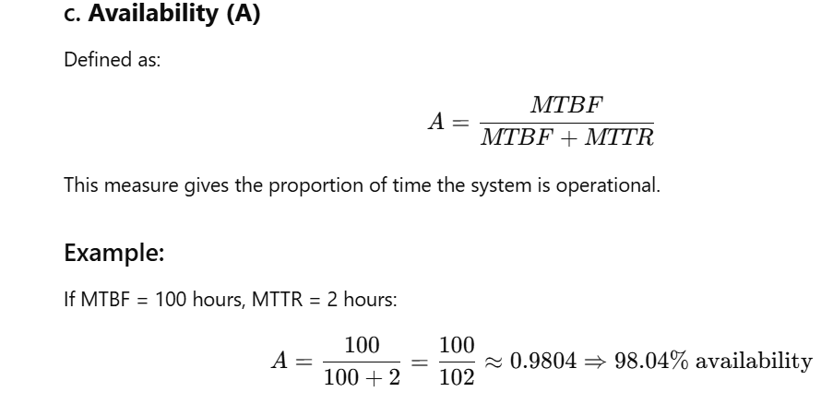

Slide 16
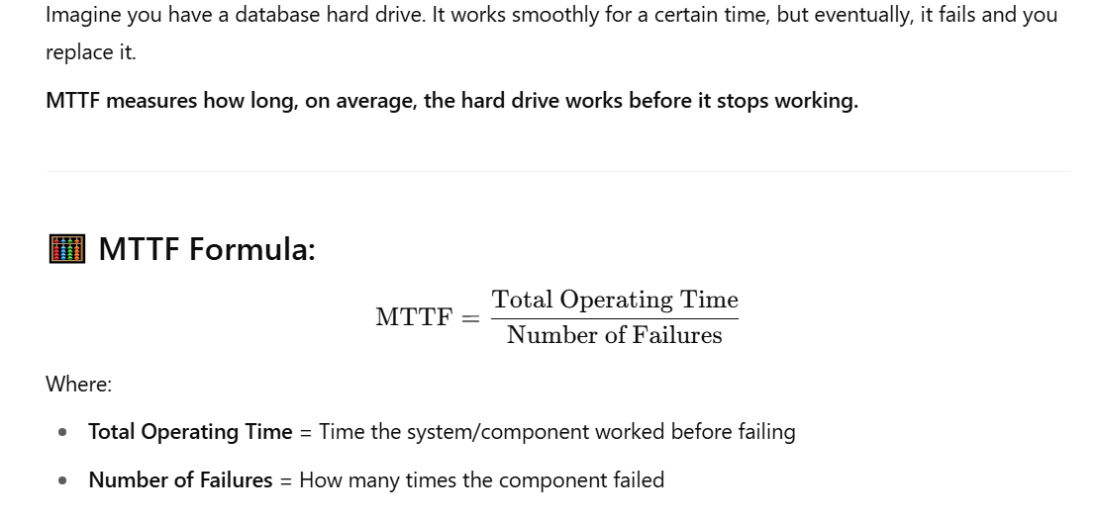

Slide 17
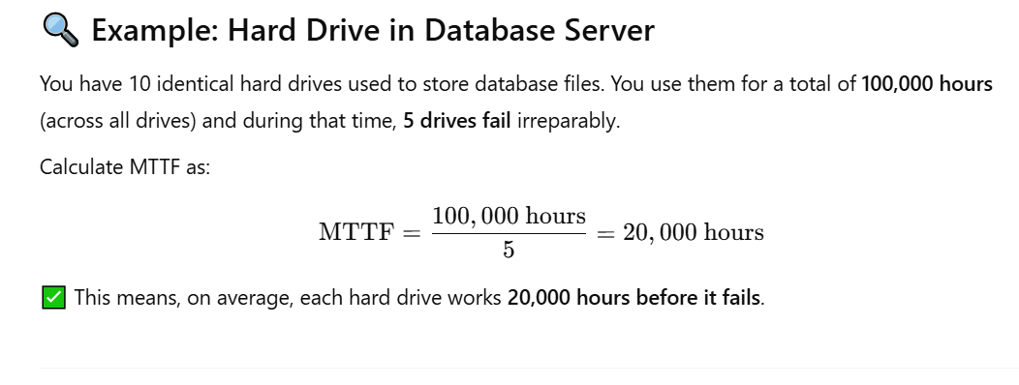

Slide 18
Key Aspects of Database Reliability
Data Integrity Ensures that the data is accurate and consistent throughout its life cycle.
Atomicity (A in ACID) A transaction is all-or-nothing. If one part fails, the whole transaction fails, and the database is unchanged.
Durability (D in ACID) Once a transaction is committed, it remains so—even in case of a crash.
Recovery Mechanisms Systems should be able to recover data to a consistent state after a crash using backup logs or recovery algorithms.
Fault Tolerance The ability of the system to continue working in the presence of faults (hardware/software).
Backups and Replication Regular backups and replicas of the data help in restoring lost data and increasing reliability.

Slide 19
Example: Bank Transaction
Scenario: Transferring $100 from Alice’s account to Bob’s.
Steps:
Check Alice’s balance.
Deduct $100 from Alice.
Add $100 to Bob.
Commit transaction.
What if a crash happens after Step 2?
Without reliability: $100 is deducted from Alice but not added to Bob → Data inconsistency.
With reliability:
The database rolls back the transaction.
Alice’s account still shows the original amount.
No loss, consistency maintained.

Slide 20
Reliability Measures
Measure | Description | Example
MTTF (Mean Time to Failure) | Avg. time the system operates before a failure. | If DB server works for 10,000 hrs before crash, MTTF = 10,000 hrs
MTTR (Mean Time to Repair) | Avg. time to recover from failure. | 1 hour to recover DB after crash
Availability | % of time DB is operational. | Availability = MTTF / (MTTF + MTTR)
Redundancy | Storing duplicate data/components. | Replicated DB in multiple data centers
Durability | Ability to save committed transactions even after crash. | Using Write-Ahead Logging (WAL) in PostgreSQL
These are metrics and practices to assess and enhance reliability:

Slide 21
Fault Tolerances
The ability of a database system to keep working correctly even when some parts fail.
A fault-tolerant database doesn’t crash or lose data just because of a hardware failure, software bug, or network problem.
Imagine your database server has a problem like:
Hard drive failure
Power outage
Network disconnection
Software crash
A fault-tolerant database system can handle these problems without stopping or losing important data.

Slide 22
Why is Fault Tolerance Important?
Keeps data safe and available 24/7
Prevents data loss or corruption
Avoids downtime for users and applications
Supports business needs that require high reliability

Slide 23
How Fault Tolerance is Achieved in Databases?
Replication: Copies of the data are stored on multiple servers.
If one server fails, others still have the data.
Example: MySQL Master-Slave replication
Failover Systems: Automatic switching to a backup database server when the main one fails.
Example: PostgreSQL with Patroni or AWS RDS Multi-AZ failover
RAID (Redundant Array of Independent Disks): Uses multiple hard drives to store data redundantly.
If one disk fails, data is still safe on others.
Example: RAID 1 (mirroring) or RAID 5 (striping with parity)
Transaction Logs and Backup: Keeps a log of all changes and frequent backups.
If failure happens, data can be recovered from logs or backups.
Error Detection and Correction: Database systems detect corrupt data or errors and correct them automatically.

Slide 24
Example 1: Replication Fault Tolerance
You run an e-commerce website with a primary database server and two replica servers.
Suddenly, the primary server crashes.
Traffic automatically switches to one of the replicas.
Users keep shopping without interruption.
When the primary is fixed, data syncs back to it.

Slide 25
Handling failures in databases
Transaction Atomicity and Logging (Write-Ahead Logging - WAL)
What is it?
Every transaction is atomic: it either completes fully or not at all.
Changes are first written to a log file before updating the database (Write-Ahead Logging).
The log helps the database know what to undo or redo after a failure.
Example:
Suppose a bank transfer moves $100 from account A to account B.
The system writes to a log: “Debit $100 from A” and “Credit $100 to B” before actually updating balances.
If the system crashes midway, on restart it uses the log to roll back incomplete changes or complete partial updates.

Slide 26
Handling failures in databases
Recovery Techniques: Rollback and Rollforward
What are they?
Rollback: Undo incomplete transactions to keep the database consistent.
Rollforward: Redo committed transactions using logs after a crash.
Example:
Crash happens while a transaction is halfway through.
Database reads the logs on restart.
For unfinished transactions, it rolls back (undoes partial changes).
For completed ones, it rolls forward (applies any missing changes from logs).

Slide 27
Handling failures in databases
Transaction Atomicity and Logging (Write-Ahead Logging - WAL)
What is it?
Every transaction is atomic: it either completes fully or not at all.
Changes are first written to a log file before updating the database (Write-Ahead Logging).
The log helps the database know what to undo or redo after a failure.
Example:
Suppose a bank transfer moves $100 from account A to account B.
The system writes to a log: “Debit $100 from A” and “Credit $100 to B” before actually updating balances.
If the system crashes midway, on restart it uses the log to roll back incomplete changes or complete partial updates.

Slide 28
Handling failures in databases
Transaction Atomicity and Logging (Write-Ahead Logging - WAL)
What is it?
Every transaction is atomic: it either completes fully or not at all.
Changes are first written to a log file before updating the database (Write-Ahead Logging).
The log helps the database know what to undo or redo after a failure.
Example:
Suppose a bank transfer moves $100 from account A to account B.
The system writes to a log: “Debit $100 from A” and “Credit $100 to B” before actually updating balances.
If the system crashes midway, on restart it uses the log to roll back incomplete changes or complete partial updates.

Slide 29
Example of Rollforward:
Consider the same banking system:
The database checkpoints at 1:00 PM.
Between 1:00 PM and 1:30 PM, several transactions commit but are still in memory (not saved on disk).
At 1:30 PM, system crashes.
During recovery:
The system starts from the 1:00 PM checkpoint.
It looks at the log and rolls forward by reapplying all committed transaction changes that happened between 1:00 PM and 1:30 PM.
The database is restored to the exact state before the crash.

Slide 30
3. Backup and Restore
What is it?
Periodic backups of the entire database are taken.
If major failure happens (e.g., disk crash), the database can be restored from backup.
Example:
A disk failure causes data loss.
Database admin restores the database from the latest backup.
Transaction logs after the backup are applied to catch up with recent changes.

Slide 31
4. Replication and Failover
What is it?
Data is replicated to multiple servers.
If the main server fails, the system fails over to a backup server without downtime.
Example:
You have a primary database server and a secondary replica.
Primary server crashes.
The system automatically switches to the replica, which continues serving requests.
When the primary is fixed, it resyncs with the replica.

Slide 32
5. Concurrency Control and Deadlock Handling
What is it?
Manages multiple transactions running simultaneously without conflicts.
Detects and resolves deadlocks (when two transactions wait on each other).
Example:
Two transactions try to update the same data.
Database uses locking mechanisms to serialize access.
If deadlock detected, one transaction is rolled back to free resources.

Slide 33
Local Reliability Protocols
In a distributed database system, a local reliability protocol is a method used at each individual site (node) to ensure transaction reliability and correctness locally, before coordinating with other sites.
Why Local Reliability Protocols?
Each site in a distributed system manages its own local transactions.
To maintain atomicity and durability, local sites need to commit or abort transactions properly.
Local protocols guarantee that transactions behave reliably locally, so global distributed protocols (like Two-Phase Commit) can build on them.
Main Points About Local Reliability Protocols:
They ensure that transactions at a single site commit or abort reliably.
They often use logging (Write-Ahead Logging) and locking.
They form the foundation for distributed commit protocols.

Slide 34
Types of Local Reliability Protocols
1. Write-Ahead Logging Protocol (WAL)
Before a transaction modifies the database, it writes the intended changes to a log.
In case of a crash, the system can use the log to redo committed transactions or undo incomplete ones.
Ensures atomicity and durability at the local site.
Example:
A local transaction wants to update a customer’s balance.
Before changing the data on disk, it writes the update details to the log.
If the system crashes after logging but before writing the data, recovery uses the log to complete the update.

Slide 35
How WAL works?
Let's say we have a transaction T1 that updates the balance of an account.
Step 1: Transaction Begins
Transaction T1 starts.
Lock is acquired on the account record.
Step 2: Log the "Before" and "After" State
Before updating the data, the system writes a log entry like:
sql
<T1, START> <T1, AccountID=101, OldBalance=1000, NewBalance=1200>
This ensures that if the system crashes, it can undo or redo this change.
Step 3: Write Data to Database
Now the new balance (1200) is written to the actual database.

Slide 36
How WAL works?
Step 4: Write Commit Record to Log
After successfully writing to the database, the system logs:
sql
<T1, COMMIT>
Only now is the transaction considered complete.
Step 5: Release Locks
Locks on the data are released.
Transaction ends.

Slide 37
🔁 Recovery Process Using WAL
If a crash happens before or after a commit, WAL helps:
💡 If COMMIT record exists:
Use the log to REDO the transaction changes, ensuring durability.
💡 If COMMIT record doesn't exist:
Use the log to UNDO partial changes using the "old values" from the log.

Slide 38
Step | Log Entry | Explanation
Begin T1 | <T1, START> | Transaction started
Before update | <T1, AccountID=101, Old=1000, New=1200> | Log both old and new values
Update DB | (Writes 1200 in DB) | Change made to the database
Commit | <T1, COMMIT> | Transaction safely committed
Example: WAL in Action
Suppose:
Account ID: 101
Original Balance: 1000
T1 wants to update balance to 1200
Logging Steps:

Slide 39
🧯 In Case of Crash
Crash After Step 2 (before commit):
Recovery checks for <T1, COMMIT> → Not found.
Uses Old=1000 → UNDO the change.
Crash After Step 4:
<T1, COMMIT> found.
Uses New=1200 → REDO the change to ensure it's not lost.

Slide 40
Types of Local Reliability Protocols
2. Lock-Based Protocol
Locks are used to control concurrent access to data items.
Local transactions acquire locks to avoid conflicts.
The protocol ensures serializability (correctness in concurrent transactions).
Example:
Transaction T1 locks record R for update.
Another transaction T2 must wait until T1 releases the lock.
If T1 aborts, it releases the lock without committing changes.

Slide 41
Types of Local Reliability Protocols
The Local Commit Protocol is the procedure a single site (node) in a distributed database uses to safely commit or abort its part of a distributed transaction.
Since a distributed transaction involves multiple sites, each site must ensure that its local operations are either fully committed or fully aborted, even in the face of failures.

Slide 42
How local commit protocol works?
Step 1: Receive "Prepare" Request
The global coordinator sends a "prepare" message asking Site S if it can commit.
Site S checks if it can commit all local operations:
Ensures all updates are logged.
Acquires all necessary locks.
No conflicts or errors.
Step 2: Write "Prepare" Log Entry
Site S writes a "prepare" record to its local log.
This indicates Site S is ready to commit but not yet committed.
Step 3: Send "Vote Commit" or "Vote Abort"
If everything is okay, Site S sends "vote commit" to the coordinator.
Otherwise, it sends "vote abort".

Slide 43
How local commit protocol works?
Step 4: Receive Final Decision
The coordinator sends a "commit" or "abort" message based on votes from all participants.
Step 5: Commit or Abort Locally
If commit:
Site S writes a "commit" record to the log.
Applies all changes permanently.
Releases locks.
If abort:
Site S writes an "abort" record.
Undoes all changes.
Releases locks.
Step 6: Acknowledge
Site S acknowledges completion to the coordinator

Slide 44
How local commit protocol works?
Suppose a distributed transaction updates customer accounts in two sites, Site A and Site B.
The coordinator sends "prepare" to Site A and Site B.
Site A checks its local changes, writes "prepare" log entry, and votes commit.
Site B detects a conflict, writes "abort" log entry, and votes abort.
Coordinator receives votes: one commit, one abort → decides to abort globally.
Coordinator sends "abort" to both sites.
Site A and Site B write "abort" records, rollback local changes, and release locks.
Transaction is aborted at all sites, ensuring atomicity.

Slide 45
Distributed reliability protocols
Distributed Reliability Protocols are essential in Distributed Database Systems (DDBS) to ensure data consistency, atomicity, and system reliability in the presence of failures like site crashes, network issues, or transaction aborts.
🔐 What Are Distributed Reliability Protocols?
Distributed reliability protocols are mechanisms that:
Ensure all-or-nothing execution of distributed transactions.
Handle failures gracefully (site, communication, transaction).
Guarantee atomicity and consistency across multiple nodes.

Slide 46
Two-Phase Commit (2PC)
Ensures that all participating sites in a distributed transaction either all commit or all abort, even in case of failure.
🧩 Working Steps of 2PC
🌐 Participants:
Coordinator: Manages the transaction (e.g., Site A)
Cohorts/Participants: Other sites involved in the transaction (e.g., Site B, C)
📌 Phase 1: Prepare Phase
Coordinator sends a PREPARE message to all participants.
Each participant:
Writes transaction to log.
If successful, replies VOTE COMMIT.
Otherwise, replies VOTE ABORT.

Slide 47
Two-Phase Commit (2PC)
📌 Phase 2: Commit/Abort Phase
Coordinator:
If all votes = COMMIT, sends GLOBAL COMMIT to all.
If any vote = ABORT, sends GLOBAL ABORT.
Each participant:
Performs the commit or abort action.
Acknowledges to coordinator.
🧪 Example of 2PC
Transaction: Transfer $100 from Site A to Site B and Site C
Coordinator (Site A) sends PREPARE
Sites B and C respond with VOTE COMMIT
Coordinator sends GLOBAL COMMIT
All sites commit the transaction
✅ Ensures atomicity even if a participant crashes after preparing but before committing (due to logs).
🚫 Limitation:
Blocking Problem: If the coordinator crashes after participants vote "commit" but before global decision, participants wait indefinitely.

Slide 48
Three-Phase Commit (3PC)
Improves upon 2PC by preventing blocking even if the coordinator crashes.
🧩 Working Steps of 3PC
📌 Phase 1: CanCommit
Coordinator asks: "Can you commit?" → CAN COMMIT
Participants reply YES (if ready) or NO
📌 Phase 2: PreCommit
If all say YES, Coordinator sends PRE-COMMIT
Participants prepare but do not yet commit, and acknowledge
📌 Phase 3: DoCommit
Coordinator sends DO COMMIT
Participants commit and reply with ACK

Slide 49
Three-Phase Commit (3PC)
🧪 Example:
Site A asks Sites B and C: CanCommit?
Both say YES
Site A sends PreCommit
Sites prepare and acknowledge
Site A sends DoCommit
All commit
✅ No blocking — each participant can decide based on PRE-COMMIT if coordinator crashes.
Drawback:
More communication overhead (adds 1 more phase)
Still assumes reliable communication and no message loss

Slide 50
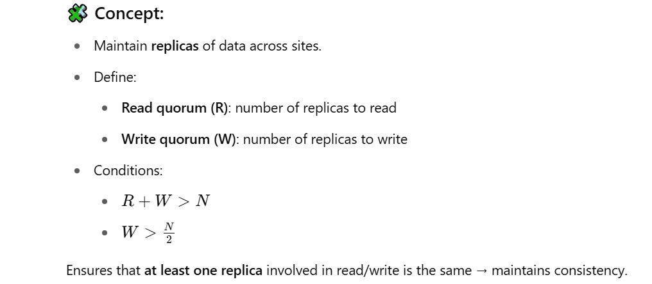
Quorum-Based Protocols
Used for replication control to ensure consistency in a distributed database.

Slide 51
Example
🧪 Example:
N = 5 replicas
R = 2, W = 4
→ Any write is to 4 sites, any read is from 2 → overlap guaranteed.

Slide 52
Voting Protocols
Used to decide whether an action (e.g., commit or abort) can proceed based on vote counts.
🧩 Steps:
Each site maintains a vote (say weight = 1).
Coordinator collects votes.
If majority of votes agree, action proceeds.
🧪 Example:
Total votes = 5
Minimum votes needed to commit = 3
Sites A, B, C vote commit → action proceeds.

Slide 53
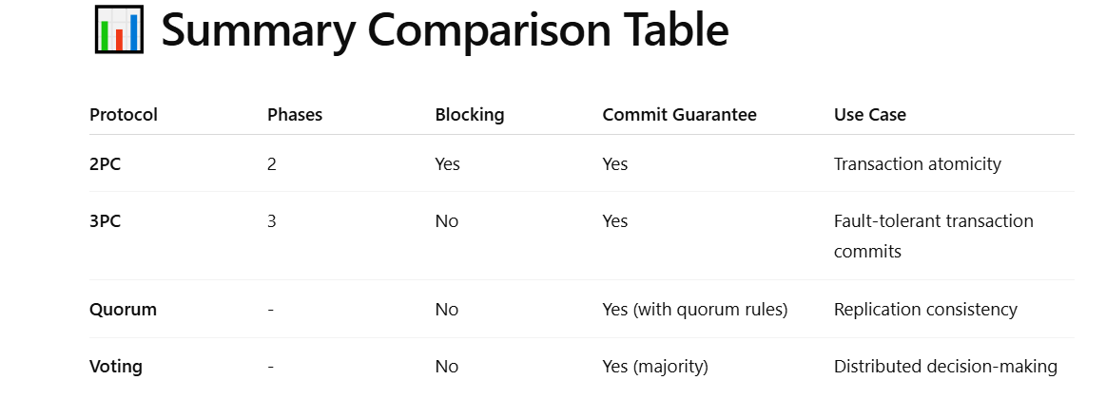

Slide 54
Site Failure
In a distributed database, data is stored across multiple sites (nodes/servers). A site failure refers to the complete crash or unavailability of one of these sites due to reasons like:
Hardware failure
Software crash
Power outage
Network isolation
A site failure implies that the entire DBMS and associated processes on that site are non-functional until recovery.

Slide 55
🧩 Characteristics of Site Failures
Non-responsive site: Cannot participate in transaction processing.
All data at that site is unavailable during failure.
Local transactions (originating from the failed site) are aborted.
Global transactions involving the failed site may be blocked or delayed depending on the protocol (e.g., 2PC).
Recovery is necessary before the site can resume operations.

Slide 56
🧪 Example of Site Failure
Scenario:
Suppose a distributed database has 3 sites:
Site A: Transaction coordinator
Site B: Holds customer data
Site C: Holds order data
Transaction T1:
Reads customer data from Site B
Inserts new order into Site C
If Site C fails during T1 (say, before order is inserted):
Transaction cannot complete.
Site A (coordinator) waits for Site C to respond (in 2PC).
If timeout exceeds, Site A may abort T1 and rollback changes at Site B.
Once Site C recovers, logs are used to replay or undo changes.

Slide 57
🔁 Recovery from Site Failure
When the failed site is back:
Restart the DBMS
Check logs for transactions that were:
Prepared but not committed → consult coordinator
Not started → safe to ignore
Committed → redo
Aborted → undo
Rejoin distributed transaction coordination

Slide 58
🔐 Handling Site Failures
🔸 Techniques:
Strategy | Description
Logging | Maintain logs of operations for redo/undo after failure.
Checkpointing | Periodically save DB state to reduce recovery time.
2PC/3PC Protocols | Used to handle commit/abort across multiple sites.
Replication | Maintain copies of data across multiple sites to tolerate site failure.

Slide 59
Network partitioning
Network partitioning is a type of failure in distributed systems where the network is split into disconnected partitions, and nodes in one partition cannot communicate with those in another.
📌 Example:
Assume a distributed database with 5 sites:
Site A, B, C (Partition 1)
Site D, E (Partition 2)
Due to network failure, A–B–C cannot communicate with D–E. Each partition thinks the other is down or unreachable.

Slide 60
🚨 Causes of Network Partitioning
Router failures
Link failures
Switch misconfiguration
Regional network outage (e.g., ISP issue)

Slide 61
⚠️ Impacts of Network Partitioning
Effect | Description
Inconsistent views | Sites may have different views of the system state
Uncertain transaction status | Coordinators may not reach participants
Risk of data inconsistency | Replicated data may diverge
Unavailability of majority | Commit protocols like 2PC may block

