Slide 1
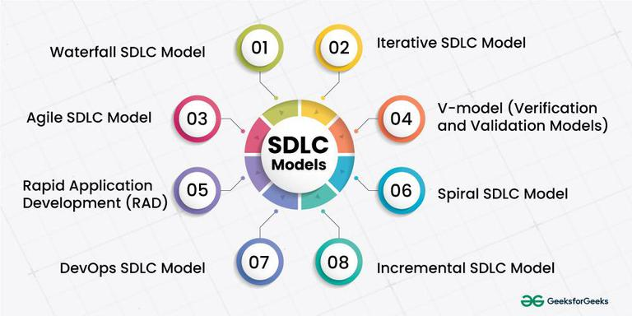
SDLC

Slide 2
SDLC
The Software Development Life Cycle (SDLC) is a framework that defines the process of software development in stages. It helps ensure that the software is developed systematically, with proper planning, execution, testing, and maintenance.
SDLC Phases generally include:
Requirement Gathering & Analysis: Understanding and documenting the client’s needs.
System Design: Architecting the software based on requirements.
Implementation: Writing the actual code for the system.
Testing: Verifying the system works as expected.
Deployment: Making the system live and available to users.
Maintenance: Ongoing support and improvements.

Slide 3
Types
Types of SDLC Models
Waterfall Model
V-Model (V-Shaped)
Spiral Model
Prototyping Model
Incremental Model
Agile Model
RAD
Iterative

Slide 4
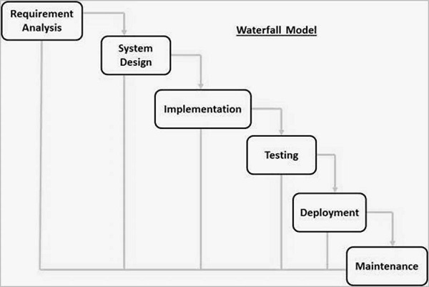
Waterfall

Slide 5
Waterfall
Phases of Waterfall SDLC Models
Requirements: The first phase involves gathering requirements from stakeholders and analyzing them to understand the scope and objectives of the project.
Design: Once the requirements are understood, the design phase begins. This involves creating a detailed design document that outlines the software architecture, user interface, and system components.
Development: The Development phase includes implementation involves coding the software based on the design specifications. This phase also includes unit testing to ensure that each component of the software is working as expected.
Testing: In the testing phase, the software is tested as a whole to ensure that it meets the requirements and is free from defects.
Deployment: Once the software has been tested and approved, it is deployed to the production environment.
Maintenance: The final phase of the Waterfall Model is maintenance, which involves fixing any issues that arise after the software has been deployed and ensuring that it continues to meet the requirements over time.

Slide 6
Waterfall - Pros
Simple and Easy to Understand:
The Waterfall model is easy to understand because it follows a linear and sequential approach. Each phase has clear deliverables and timelines.
Clear and Structured Process:
The model’s sequential nature provides a well-structured path from requirements gathering to maintenance. Each phase has a specific deliverable, making progress easy to track.
Well-Defined Documentation:
Waterfall emphasizes detailed documentation at every phase (e.g., requirement specification, design documents, etc.). This makes the process well-documented and transparent.
Easy to Manage:
Since the project follows a well-defined structure, it’s easier to manage from a project management perspective. Deadlines and milestones are clear.
Clear Requirements from the Start:
Requirements are gathered in full at the beginning of the project, minimizing the chance of scope creep during the later stages.
Stable Requirements:
The model works well for projects where requirements are stable and unlikely to change throughout the development process.

Slide 7
Waterfall - Cons
Inflexible to Changes:
Waterfall is rigid and does not handle changes well once the project is underway. Any change in requirements during later stages (especially during coding or testing) is expensive and difficult to implement.
Late Testing:
Testing happens only after the coding phase, which means that defects are identified late in the process, making them harder and more costly to fix.
No Working Software until Late:
The first working version of the software is not available until the end of the development phase. This can lead to situations where stakeholders may not fully understand the product until it's mostly complete, leading to potential misalignments with expectations.
Assumes Requirements are Well-Understood:
Waterfall assumes that the requirements are fully understood at the start of the project. This can be problematic if requirements are incomplete or ambiguous.
High Risk of Rework:
If requirements are misinterpreted or evolve during the project, large parts of the system might need to be redone, leading to delays and increased costs.
Not Suitable for Complex or Large Projects:
For large-scale projects or projects with uncertain requirements, Waterfall can become unwieldy, as it does not allow for flexibility and adaptation in later stages.

Slide 8
Waterfall – when to use?
Projects with Well-Defined Requirements:
If the requirements are clear and unlikely to change, the Waterfall model is a good fit. This is common in industries with regulatory or compliance standards where specifications are rigid (e.g., healthcare, aerospace, or government projects).
Smaller Projects or Simple Systems:
Waterfall is well-suited for small to medium-sized projects where the scope is clear and predictable. There is less complexity, so managing the project through sequential phases is easier.
Tightly Controlled and Predictable Projects:
When the project scope, timeline, and resources are very controlled and predictable, Waterfall can be an effective approach to ensure that everything is completed on schedule and within budget.
Projects with Minimal Risk or Uncertainty:
For projects where the risk of changes in requirements or unexpected technical challenges is low, Waterfall can work well. It’s ideal for projects where the technology and business requirements are stable and unlikely to change.
Regulatory or Compliance-driven Projects:
Projects that need to follow strict regulations or standards (e.g., software in medical or financial sectors) can benefit from Waterfall because of its heavy documentation and clear traceability.
Well-Documented or Fixed-Scope Projects:
When the requirements and expectations are explicitly defined and fixed, and there is a need for thorough documentation at every step, Waterfall’s emphasis on documentation can be advantageous.

Slide 9
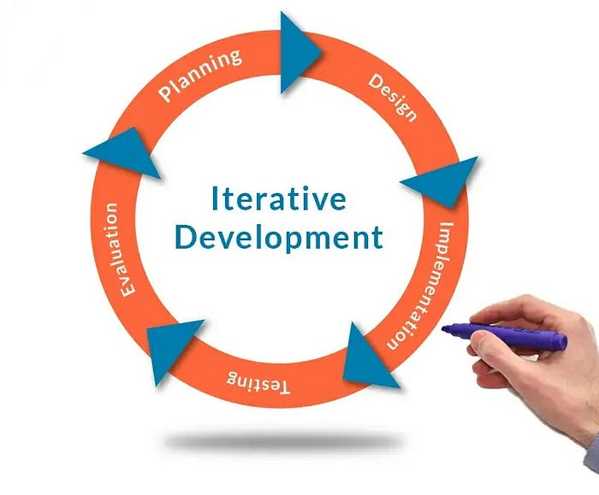
Iterative

Slide 10
Iterative
Iterative SDLC is a software development methodology where the system is developed and refined in repeated cycles (iterations) rather than building it all at once.
The main idea: Start with a simple version, then gradually improve it through multiple iterations until the final system meets all requirements.
Each iteration is like a mini-project, including planning, design, coding, and testing.
Key Principle: “Develop, test, get feedback, refine, repeat.”
Difference from Waterfall:
Waterfall: Linear, one phase after another.
Iterative: Cyclical, each cycle produces a better version of the software.

Slide 11
Iterative
The development process is divided into multiple iterations, and each iteration follows a mini-SDLC cycle.
Step-by-Step Process
Initial Planning & Requirements
Identify basic requirements
High-level design is prepared
Iteration Development Each iteration includes:
Requirement refinement
Design
Implementation
Testing
Evaluation
Users and stakeholders review the working version
Feedback is collected
Next Iteration
Improvements, new features, and fixes are added
Process repeats until the system is complete

Slide 12
Iterative - Pros
Flexibility: Easy to adapt to changing requirements during development.
Early Deliverables: Provides early versions of working software for stakeholder feedback.
Continuous Improvement: Iterative cycles allow for ongoing refinement of features.
Risk Reduction: Risks are identified early, reducing the chances of major project failure.
Frequent Testing: Continuous testing ensures higher-quality software.
User Involvement: Frequent feedback from users ensures the product meets their needs.

Slide 13
Iterative - Cons
Initial Planning Needs: Core requirements must still be defined initially, which can be challenging.
Complex Management: Managing multiple iterations and changes can be difficult.
Rework: Frequent changes based on feedback may lead to rework and delays.
Scope Creep: Ongoing feedback may lead to uncontrolled scope expansion.
Integration Challenges: Integrating new features after each iteration can become complex.
Documentation Issues: Can result in incomplete documentation due to rapid development cycles.

Slide 14
Iterative – When to Use?
Iterative development is ideal when:
Requirements are partially known or expected to change over time.
Feedback is essential for improving the system gradually.
The project is medium to large, but delivering small increments is possible.
You want to reduce risk by testing features early.
Not ideal when:
Requirements are completely fixed and known.
The project has strict deadlines for the full system release.

Slide 15
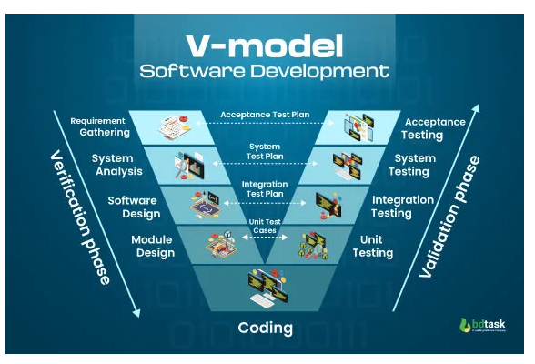
V-Shaped

Slide 16
V-Shaped
The V-Shaped Model (also called the Verification & Validation Model) is a software development life cycle model where each development phase has a corresponding testing phase.
Its name comes from the V-shape diagram:
Left side of V → Development phases
Right side of V → Corresponding testing/validation phases
Emphasis: Testing is planned in parallel with development rather than at the end.
Key Principle: “For every development activity, there is a corresponding testing activity.”
It is essentially an extension of the Waterfall model, but with a strong focus on verification and validation.

Slide 17
V-Shaped
An extension of the Waterfall model where testing is emphasized at each stage, directly correlating development and testing phases.
Pros:
Strong focus on verification and validation.
Each development phase has a corresponding testing phase, ensuring quality.
Clear and structured approach.
Cons:
Like Waterfall, it is rigid and difficult to accommodate changes once development has begun.
High risk if requirements are misunderstood early on.
When to use:
Projects with well-defined requirements and where validation at each stage is critical.
Projects that require rigorous testing and quality assurance (e.g., medical software, aerospace).

Slide 18
V-Shaped – When to use?
V-Shaped SDLC is ideal when:
Requirements are well-defined and stable from the start.
High reliability is required (e.g., medical, defense, avionics).
Projects are small to medium-sized, not huge enterprise systems.
There is enough time for thorough testing.
Not ideal when:
Requirements are uncertain or evolving.
Changes are frequent during development.
Rapid delivery is needed.

Slide 19
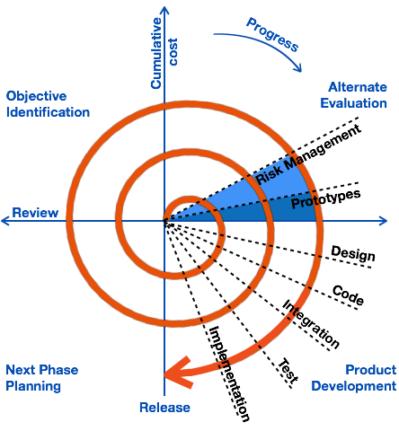
Spiral

Slide 20
Spiral
The Spiral Model is a risk-driven software development lifecycle (SDLC) model that combines iterative development with elements of Waterfall and prototyping.
It was introduced by Barry Boehm in 1986.
The model emphasizes risk assessment at every stage.
Development proceeds in repeated loops (spirals), each representing a development phase.
Key Principle: “Develop software in iterative cycles while continuously analyzing and mitigating risks.”
Analogy: Imagine climbing a spiral staircase—you go around in loops, each time higher and closer to the final product, while checking for obstacles (risks) before moving up.

Slide 21
Spiral
Each spiral loop typically includes four quadrants:
Planning
Identify objectives, alternatives, and constraints.
Determine what to build in this iteration.
Risk Analysis
Analyze alternatives and identify risks.
Develop prototypes or simulations if risks are high.
Engineering (Development & Testing)
Design, code, and test the selected solution for this iteration.
Includes integration of new features with existing ones.
Evaluation / Customer Feedback
Stakeholders review the iteration.
Feedback informs the next spiral loop.
After completing one spiral, the project moves to the next spiral, refining and expanding the system until final deployment.

Slide 22
Spiral – when to use?
Spiral is ideal for projects:
High-risk or complex systems, where failure is costly.
Where requirements are unclear or likely to change.
Large-scale projects with longer timelines.
Projects where prototyping and user feedback are essential.
Not suitable when:
Project is small or simple.
Budget is tight, because risk analysis and iterative prototyping are costly.
Time constraints require a quick, linear delivery.

Slide 23
Spiral
Overview: A risk-driven model that combines elements of both design and prototyping. It focuses on iterative development and requires frequent risk assessment at each iteration.
Pros:
Flexible and iterative, which allows for changes as the project progresses.
Good for large and complex projects where risks need to be managed throughout.
Allows for frequent testing and validation.
Cons:
Can be expensive and time-consuming due to repeated iterations.
Requires highly skilled project managers to manage risks.
Difficult to estimate the timeline and cost upfront.
When to use:
Large, complex projects with uncertain requirements or high risk.
Projects that require frequent stakeholder feedback and iterative refinements.

Slide 24
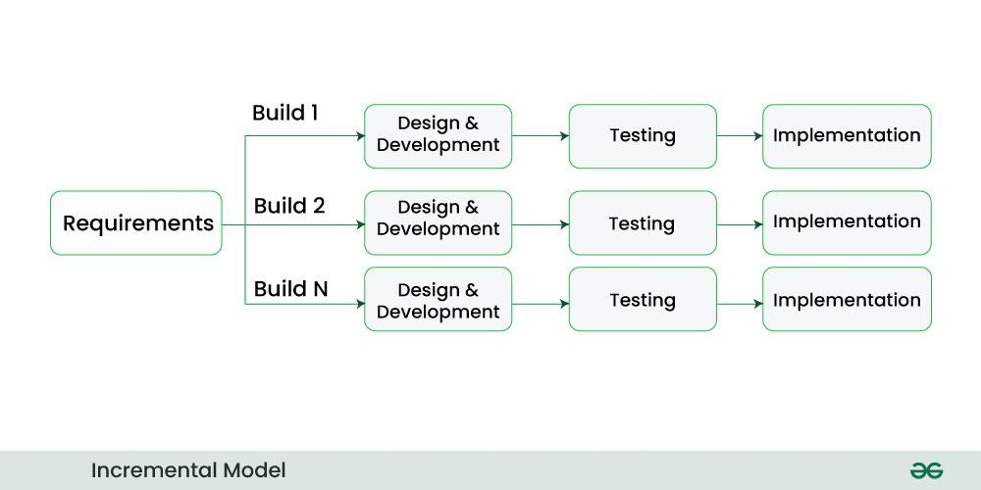
Incremental

Slide 25
Incremental
Incremental SDLC (Software Development Life Cycle) is a software development model where the system is designed, implemented, and tested in small, manageable modules or increments.
Each increment adds functionalities to the software.
The complete system evolves gradually rather than being built all at once.
It combines elements of waterfall and iterative development.
Think of it like building a house floor by floor instead of finishing the entire building at once.

Slide 26
Incremental
The workflow typically follows these steps:
Requirements Analysis
Identify core requirements for the first increment.
Complete requirements for the later increments are often analyzed progressively.
Design
Design the architecture for the current increment.
Ensure the design allows future increments to integrate smoothly.
Implementation (Coding)
Build the current increment/module.
Focus on delivering functional software for that specific part.
Testing
Test the increment individually.
Also integrate it with previously developed increments to ensure compatibility.
Deployment
Release the increment to users (optional for each stage, depending on project).
Gather user feedback.
Next Increment
Repeat the cycle for the next set of functionalities.
Continue until the full system is complete.

Slide 27
Incremental – when to use?
Incremental model is ideal when:
Requirements are partially known at the start.
The project is large and complex; delivering in increments allows early feedback.
Quick initial delivery is desired (early releases with basic features).
You want risk reduction by developing the software in smaller, testable parts.
User feedback is crucial to refine features in subsequent increments.
Not ideal when:
Requirements are completely unknown or highly unstable.
Small projects where overhead of incremental planning isn’t justified.

Slide 28
Incremental
The project is broken down into smaller, manageable components, and each part is developed and delivered incrementally.
Pros:
Delivers functional pieces of the system quickly, allowing early use.
Easier to manage than large-scale projects.
Allows for flexibility as changes can be made in each increment.
Cons:
May lead to integration issues between components if not properly managed.
The final product may lack a unified design.
Can result in less comprehensive documentation.
When to use:
Large projects that can be split into smaller components.
Projects where time-to-market is important and the system can be delivered in stages.
Systems that need frequent updates or feature additions.

Slide 29
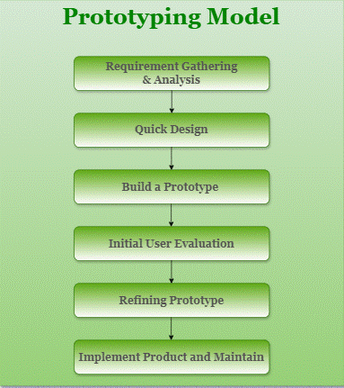
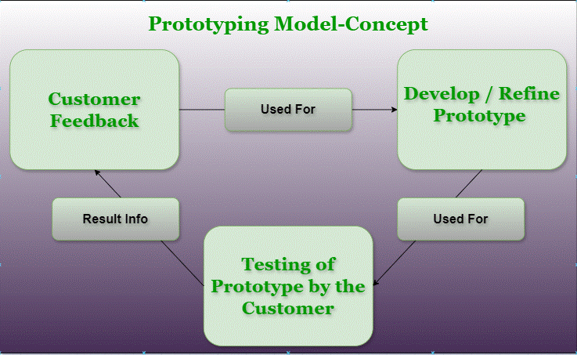
Prototying

Slide 30
Prototyping
Prototyping SDLC is a software development model in which a prototype (early working model) of the system is built to understand and clarify user requirements before developing the final system.
The prototype is not the final product
It helps users visualize the system
Requirements are refined through user feedback
Think of it like creating a sample or mock-up before manufacturing the real product.

Slide 31
Prototying
The model follows an iterative process:
Step-by-Step Process
Initial Requirements Gathering
Collect basic requirements (often incomplete or unclear)
Quick Design
Create a rough design (UI, inputs, outputs)
Build Prototype
Develop a simple, working model
Focus on user interaction, not full functionality
User Evaluation
Users test the prototype
Provide feedback and suggestions
Refinement
Modify the prototype based on feedback
Repeat steps 3–5 until requirements are clear
Final System Development
Once requirements are finalized, the real system is built using a suitable SDLC model (often Waterfall or Incremental)

Slide 32
Prototyping – when to use?
Best used when:
Requirements are unclear or incomplete
User interaction and UI are critical
System is customer-facing
Frequent user feedback is needed
New or complex technology is involved
Not suitable when:
Requirements are well-defined and stable
Project is small and simple
Time or budget is very limited

Slide 33
Prototyping - pros
Clear Requirements
Users understand what they want by seeing the prototype
Early User Involvement
Reduces misunderstanding between users and developers
Improved User Satisfaction
Final system closely matches user expectations
Early Error Detection
Design and requirement issues are found early
Better UI/UX Design
Especially useful for interactive applications

Slide 34
Prototyping - Cons
Increased Cost
Multiple iterations increase development cost
Time Consuming
Continuous feedback and refinement take time
Scope Creep
Users may keep requesting new features endlessly
Poor Documentation
Focus on prototype may reduce proper documentation
Unrealistic Expectations
Users may think the prototype is the final product

Slide 35
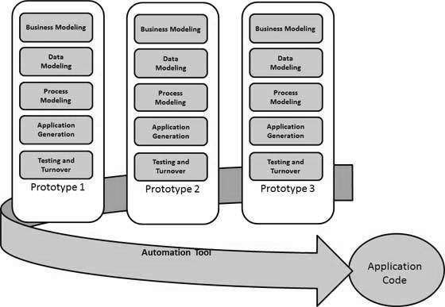
RAD

Slide 36
RAD
RAD (Rapid Application Development) is an SDLC model that focuses on fast development and quick delivery by using:
Prototyping
Reusable components
User feedback
Parallel development
Instead of long planning phases, RAD emphasizes working software in a short time.
RAD = Speed + User involvement + Prototypes

Slide 37
RAD
RAD divides development into short, time-boxed phases.
Main Phases of RAD
Requirements Planning
Business goals and high-level requirements are defined
Users, analysts, and developers work together
User Design
Prototypes are created quickly
Users review screens, workflows, and reports
Continuous feedback and refinement
Construction
Actual coding using reusable components
Multiple modules developed in parallel
Continuous testing and integration
Cutover
Final testing
Data conversion
Deployment and user training

Slide 38
RAD – when to use?
RAD is ideal in situations where:
Requirements are not fully clear at the beginning.
Rapid development is a priority.
User involvement is high and frequent feedback is possible.
The project is small to medium-sized, not huge enterprise systems.
The project can benefit from component reuse or prebuilt frameworks.
Not ideal when:
The project is very large and complex.
High security or safety requirements exist (e.g., aerospace, medical devices).
Users cannot actively participate during development.

Slide 39
RAD
The advantages of the RAD Model are as follows −
Changing requirements can be accommodated.
Progress can be measured.
Iteration time can be short with use of powerful RAD tools.
Productivity with fewer people in a short time.
Reduced development time.
Increases reusability of components.
Quick initial reviews occur.
Encourages customer feedback.
Integration from very beginning solves a lot of integration issues.
The disadvantages of the RAD Model are as follows −
Dependency on technically strong team members for identifying business requirements.
Only system that can be modularized can be built using RAD.
Requires highly skilled developers/designers.
High dependency on Modelling skills.
Inapplicable to cheaper projects as cost of Modelling and automated code generation is very high.
Management complexity is more.
Suitable for systems that are component based and scalable.
Requires user involvement throughout the life cycle.
Suitable for project requiring shorter development times.

Slide 40
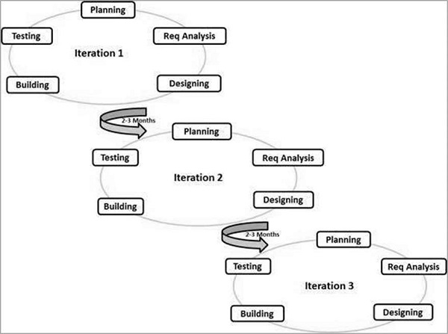
Agile

Slide 41
Agile
Agile SDLC is a software development approach that focuses on iterative development, customer collaboration, and quick delivery of working software. The project is divided into small time-boxed iterations called sprints (usually 1–4 weeks).
Agile follows the Agile Manifesto, which values:
Individuals and interactions over processes and tools
Working software over documentation
Customer collaboration over contract negotiation
Responding to change over following a plan

Slide 42
How to Choose an SDLC Model
Project Requirements:
Clear and Stable Requirements: Use Waterfall or V-Model when requirements are well-defined and unlikely to change.
Evolving or Unclear Requirements: Use Agile or Iterative models when requirements are likely to change.
Project Size and Complexity:
Small and Simple Projects: Use Waterfall or RAD for straightforward projects with limited scope.
Large and Complex Projects: Use Agile, Spiral, or DevOps for projects requiring flexibility and scalability.
Team Expertise:
Experienced Teams: Use Agile or Scrum when teams are skilled in iterative development.
Less Experienced Teams: Use Waterfall or V-Model for teams needing clear guidance.
Client Involvement:
Frequent Client Feedback: Use Agile, Scrum, or RAD when regular client interaction is required.
Minimal Client Involvement: Use Waterfall or V-Model when client input is limited to initial stages.
Time and Budget Constraints:
Fixed Time and Budget: Use Waterfall or V-Model for strict schedules and budgets.
Flexible Time and Budget: Use Agile or Spiral when adjustments are feasible.
Risk Management:
High-Risk Projects: Use Spiral for projects with significant uncertainties.
Low-Risk Projects: Use Waterfall for projects with minimal risks

